Slide 1


AWS Lambda
2019.01.06
$©$ Phurunbit Tech Ltd. 2019

Slide 2
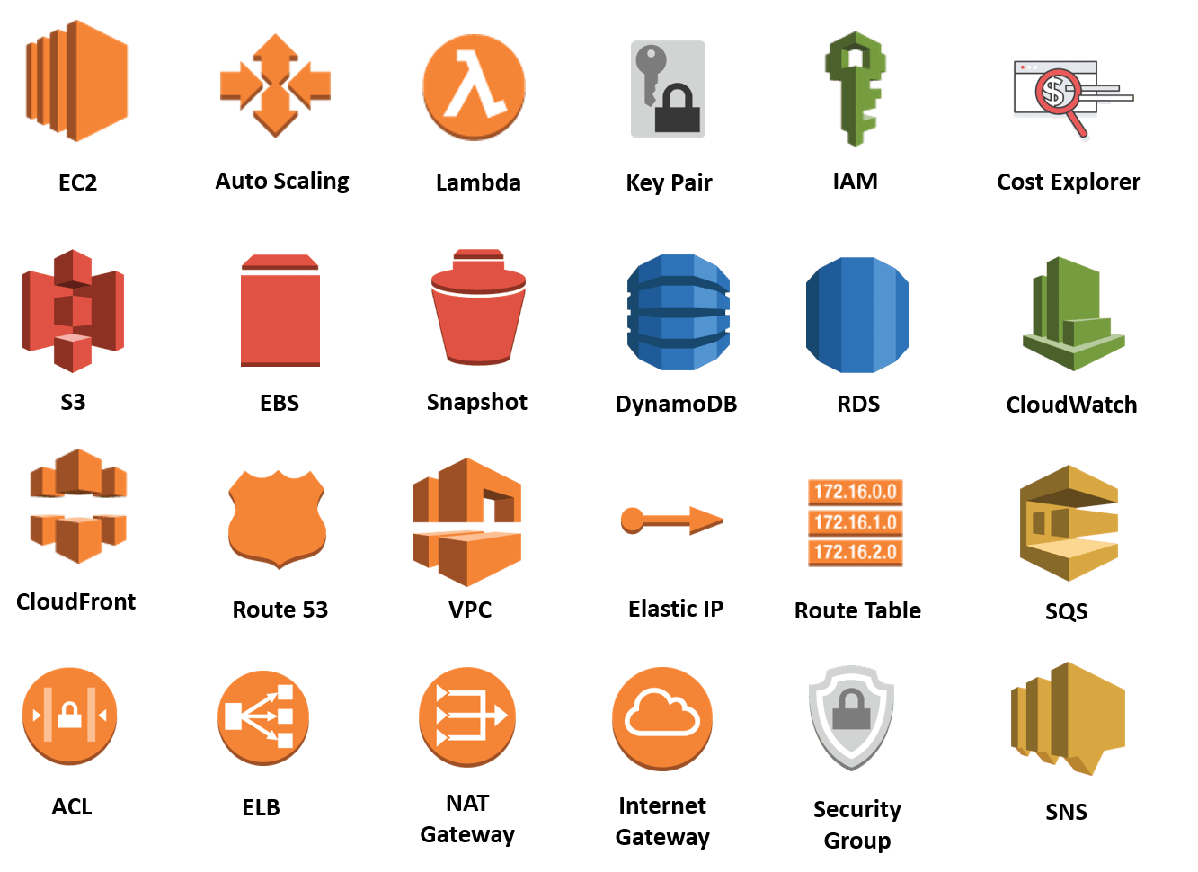

What is AWS?
Amazon Web Services (AWS)
is a subsidiary of Amazon.com that provides on-demand cloud computing platforms on a subscription basis.
$©$ Phurunbit Tech Ltd. 2019

Slide 3






















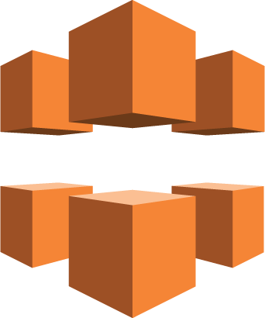











AWS Services
Application Services
Application Services
Mobile Services
Enterprise Applications
Amazon
SQS
Amazon
ElasticTranscoder
Amazon
SES
Amazon
CloudSearch
Amazon
Cognito
Amazon
Mobile Analytics
Amazon
SNS
Amazon
WorkDocs
Amazon
WorkMail
Deployment & Management
Administration & Security
Deployment & Management
Analytics
Amazon
Directory Service
Amazon
AWSIAM
Amazon
Trusted Advisor
Amazon
Config
Amazon
CloudTrail
Amazon
CloudWatch
Amazon
CloudFormation
Amazon
OpsWorks
Amazon
CodeDeploy
Amazon
Kinesis
Amazon
Data Pipeline
Amazon
EMR
Foundation Services
Compute
Storage & Content Delivery
Database
Networking
Amazon EC2
Amazon
Lambda
Amazon
CloudFront
Amazon
Glacier
Amazon
Storage Gateway
Amazon
Content Delivery
Amazon
Dynamo DB
Amazon
RDS
Amazon
Redshift
Amazon
Elastic Cache
Amazon
Route 53
Amazon
VPC
Amazon
RDS
$©$ Phurunbit Tech Ltd. 2019

Slide 4
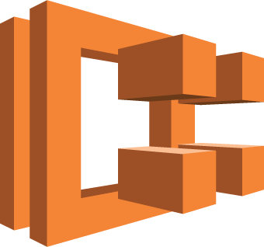
AWS compute offerings
Service | EC2 | ECS | Lambda
Unit of Scale | VM | Task | Function
Level of abstraction | Hardware | OS | Runtime
Use case | To configure servers, storage, network, os | To run servers, configure applications and control scaling | To run my code when it’s needed
$©$ Phurunbit Tech Ltd. 2019

Slide 5
AWS Lambda
What is AWS Lambda & Serverless?
$©$ Phurunbit Tech Ltd. 2019

Slide 6

AWS Lambda
AWS Lambda is a compute service that lets you run code without provisioning or managing servers.
With AWS Lambda, you can run code for virtually any type of application or backend service - all with zero administration.
Pay only for compute time, no charge for idle time.
$©$ Phurunbit Tech Ltd. 2019

Slide 7




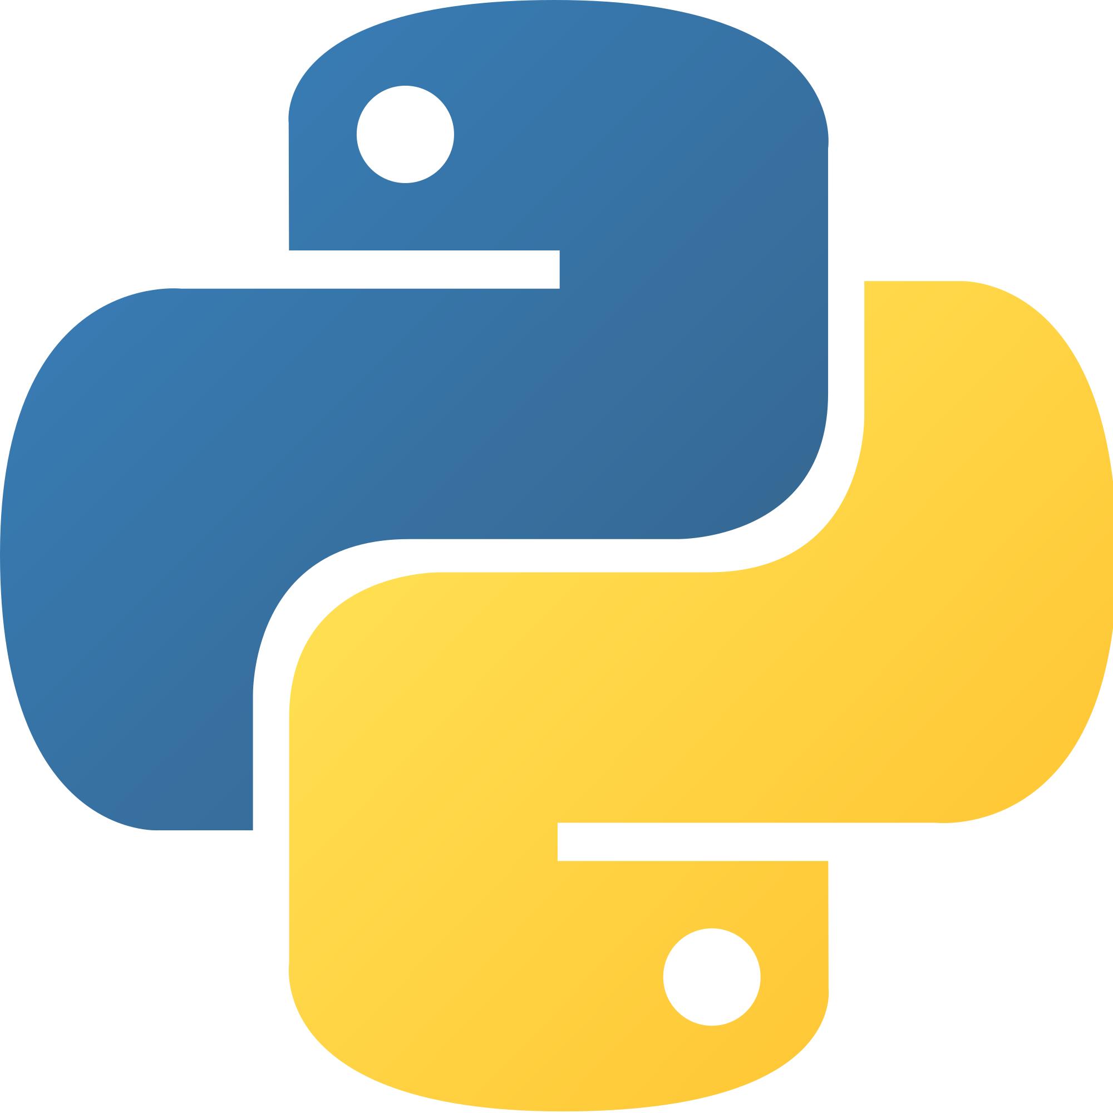

Supported Runtimes
Node.js 8.10
Node.js 6.10
Java 8
.Net Core 2.1
.Net Core 2.0
.Net Core 1.0
Go 1.x
Python 3.6
Python 3.7
Python 2.7
Ruby 2.5
$©$ Phurunbit Tech Ltd. 2019

Slide 8
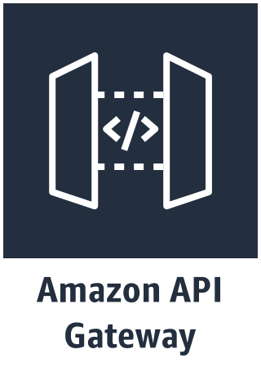
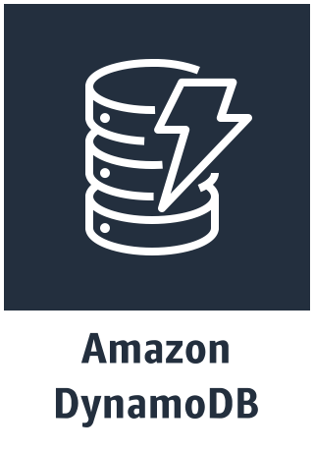


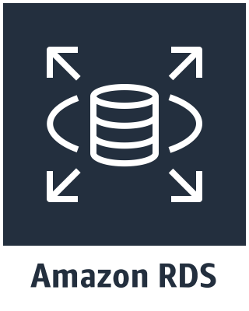
How it works?
Event Source
Function (Logic)
Services (States)
$©$ Phurunbit Tech Ltd. 2019

Slide 9



Event Sources that can trigger Lambda function
Data Stores
Endpoints
Amazon
Dynamo DB
Amazon
Aurora
Amazon
Content Delivery
Amazon
Cognito
Amazon
Kinesis
Amazon
API Gateway
Amazon
IoT
Repositories
Event / Message Services
Amazon
CloudFormation
Amazon
CloudTrail
Amazon
CloudWatch
Amazon
SQS
Amazon
SES
Amazon
SNS
Amazon
Step Functions
$©$ Phurunbit Tech Ltd. 2019

Slide 10
Limitations of Lambda
100 concurrent requests per function
1536 MB max memory per function
300 s max runtime
50 MB package size of function deployment
250 MB package size of dependencies
$©$ Phurunbit Tech Ltd. 2019

Slide 11
That’s all, Folks!
$©$ Phurunbit Tech Ltd. 2019

