Slide 1


Hyperledger
2019.02.10
$©$ Phurunbit Tech Ltd. 2019

Slide 2

Why Hyperledger? Problems with existing blockchains
Limited Throughput
Slow Transaction Confirmations
No confidentiality
Anonymous Processors
Too much effort to keep governance
Designed for cryptocurrency
Hard to customize and apply for B2B, B2C services
Duplicated efforts for common issues
$©$ Phurunbit Tech Ltd. 2019

Slide 3

What is Hyperledger
The Hyperledger is a project of a collaborative effort created to advance blockchain technology by identifying and addressing important features for a cross-industry open standard for distributed ledgers that can transform the way business transactions are conducted globally.
Modular
Open Source
Highly Secure
Interoperable
Cryptocurrency-agnostic
Complete with APIs
$©$ Phurunbit Tech Ltd. 2019

Slide 4
Comparison between Ethereum and Hyperledger
$©$ Phurunbit Tech Ltd. 2019

Slide 5
Ethereum vs. Hyperledger (Public and Private)
Ethereum is public permissionless network which anyone can access to read and write operations.
Hyperledger is a private network aimed at solving problems specific to the enterprise landscape. Only privileged entities and nodes can participate in its operations. To receive access, one must enroll and be granted permission from a trusted Membership Service Provider (MSP)
$©$ Phurunbit Tech Ltd. 2019

Slide 6
Ethereum vs. Hyperledger (Privacy in transactions)
In Ethereum, there are no means to issue a private transaction between members (except Quorum).
Hyperledger can have multiple ledger (channels). A channel can be available only to certain members. This is very important use case in enterprise integration scenarios, because it isn’t especially desirable to offer full transparency of internal business processes to the competitors.
$©$ Phurunbit Tech Ltd. 2019

Slide 7
Ethereum vs. Hyperledger (Consensus mechanism)
In Ethereum, it requires costly consensus algorithm like “Proof of Work” to validate transactions and secure the network. Before accepting a transaction from one node, every node must confirm it in the form of an incentive block.
Hyperledger by default doesn’t have consensus algorithm. However due to it’s pluggable feature, it is possible to apply other common algorithms.
$©$ Phurunbit Tech Ltd. 2019

Slide 8
Ethereum vs. Hyperledger (Cost of Execution)
In Ethereum, every transaction cost some gas, as a mean of reward for miners to compensate for computing powers to validate transactions.
Hyperledger doesn’t have notion of gas, Every participant knows all other participant of the network so it’s easy to detect malicious users and activities and revoke access if needed.
$©$ Phurunbit Tech Ltd. 2019

Slide 9
Ethereum vs. Hyperledger (Smart Contract)
In Ethereum, Solidity is used to write smart contracts. Solidity smart contract was designed in deterministic way.
Hyperledger calls smart contract as chaincode. Developers can write chaincodes in common programming languages like Golang or Node.js. With chaincode, developers can use non-deterministic functions while designing chaincode.
$©$ Phurunbit Tech Ltd. 2019

Slide 10
Ethereum vs. Hyperledger (Modularity)
In Ethereum, it doesn’t have notions of modularity.
Hyperledger is designed as modular and different components can be switch on and off.
$©$ Phurunbit Tech Ltd. 2019

Slide 11
Ethereum vs. Hyperledger (Transaction Flow)
In Ethereum, when a transaction happens it basically goes through two steps. The first transaction is added to ledger in some order and propagated to all peers. Then the transaction is executed by all peers to be sure all the peers ends up in the same state.
Hyperledger, client sends the transaction by choosing to endorse peers from those specified in the endorsing policy of channel. The first transaction gets executed using chaincode and validates signatures, then the transaction is sent to all peers in the channel.
$©$ Phurunbit Tech Ltd. 2019

Slide 12
Hyperledger Blockchain Frameworks
$©$ Phurunbit Tech Ltd. 2019

Slide 13
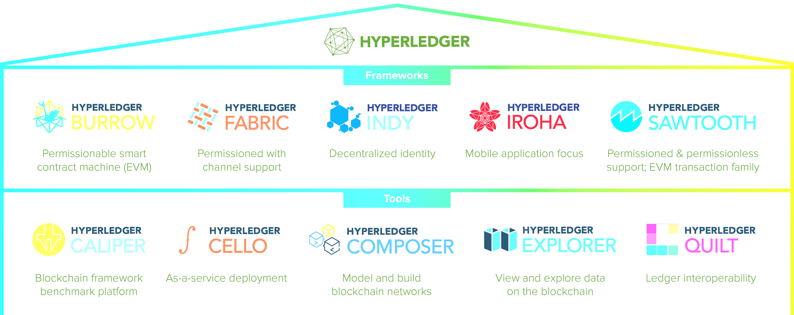
Hyperledger Greenhouse
$©$ Phurunbit Tech Ltd. 2019

Slide 14
Frameworks
Hyperledger Fabric
Blockchain implementation intended as foundation for developing applications or solutions with a modular architecture that allows components, such as consensus and membership services, to be plug-and-play.
Hyperledger Iroha
Distributed ledger project designed to be simple and easy to incorporate into infrastructural projects requiring distributed ledger technology.
Hyperledger Sawtooth
Platform for building, deploying and running distributed ledgers. Sawtooth aims to keep distributed and to make smart contracts safe for enterprise use.
Hyperledger Burrow
Permissioned Ethereum smart contract EVM implementation
$©$ Phurunbit Tech Ltd. 2019

Slide 15
Hyperledger Tools
Hyperledger Composer
A collaboration tool for building business networks, accelerating development and deployment of smart contracts.
Hyperledger Cello
Aims to bring the on-demand “as-a-service” deployment model to blockchain and reduce the effort required to create and manage a decentralized blockchain network.
Hyperledger Explorer
a tool to view, invoke, deploy or query blocks, transactions and associated data stored on the ledger.
$©$ Phurunbit Tech Ltd. 2019

Slide 16
Hyperledger Use Cases
$©$ Phurunbit Tech Ltd. 2019

Slide 17
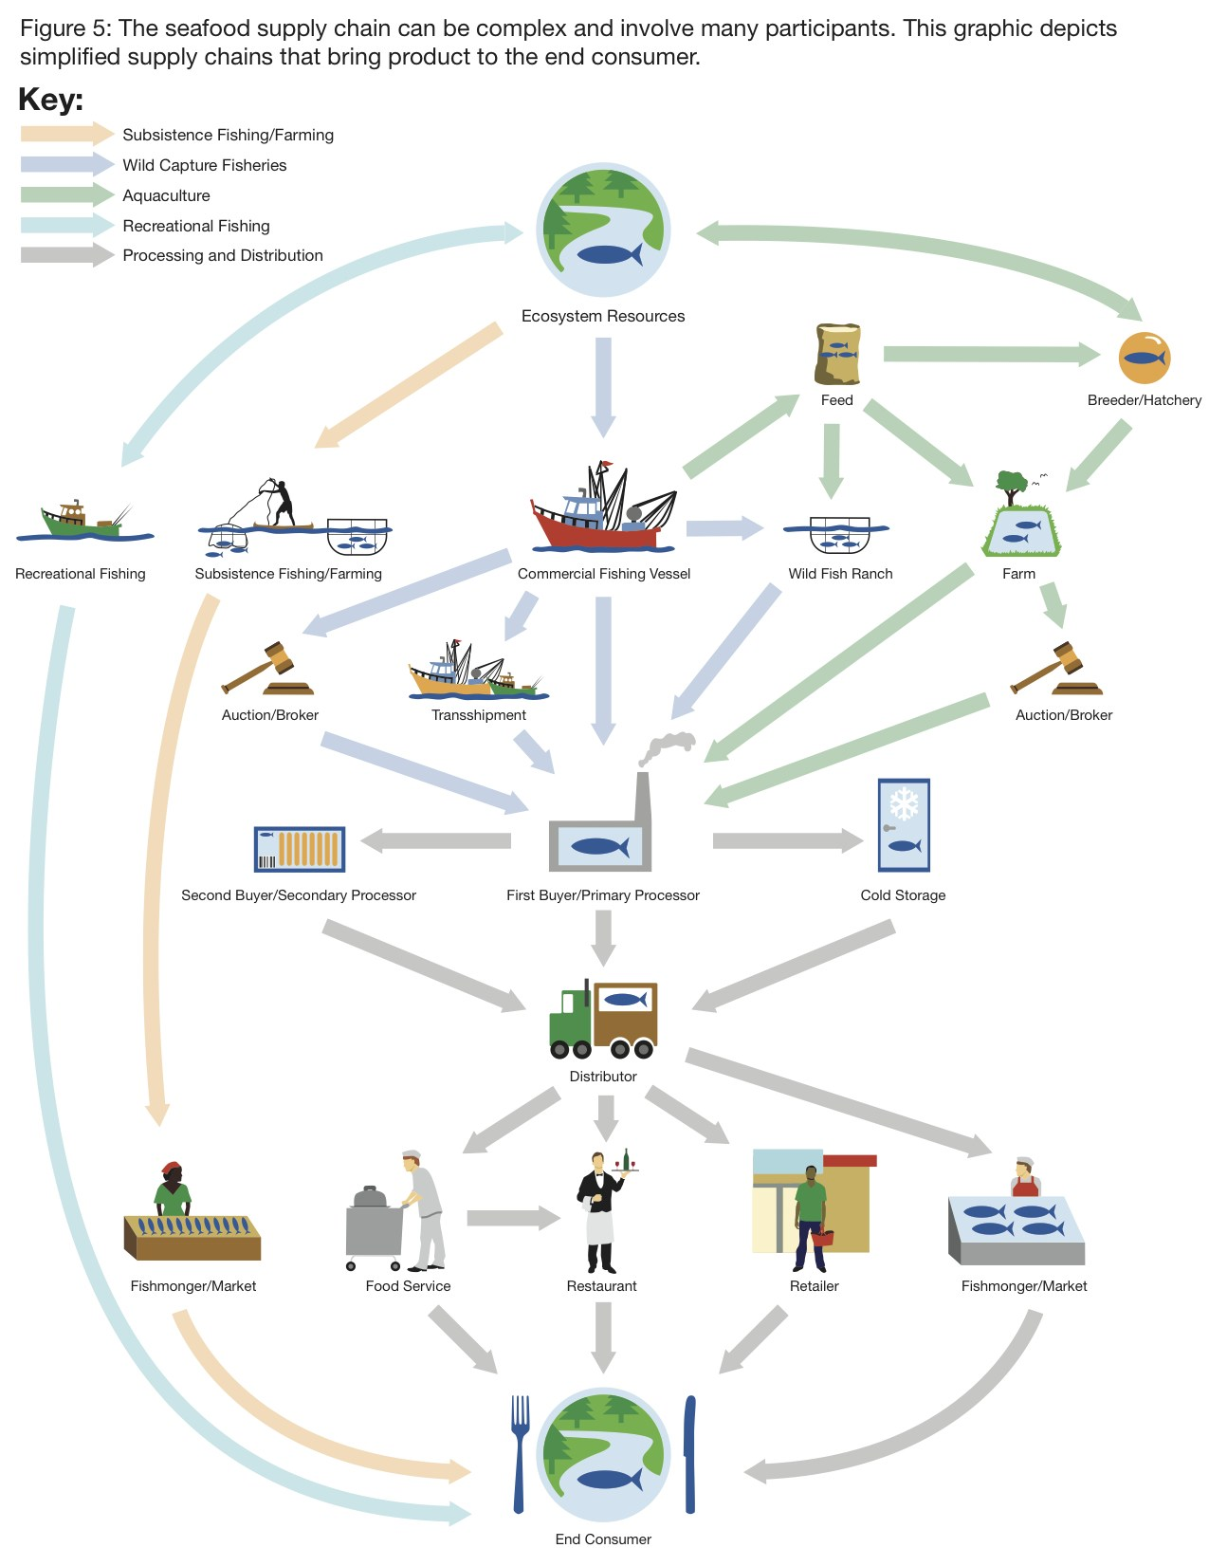
Supply Chain Management: Tracking Fish from Ocean to Table
Many different paths from Ocean to table
Lack of global authority to trace
Most existing processes are paper-based
$©$ Phurunbit Tech Ltd. 2019

Slide 18
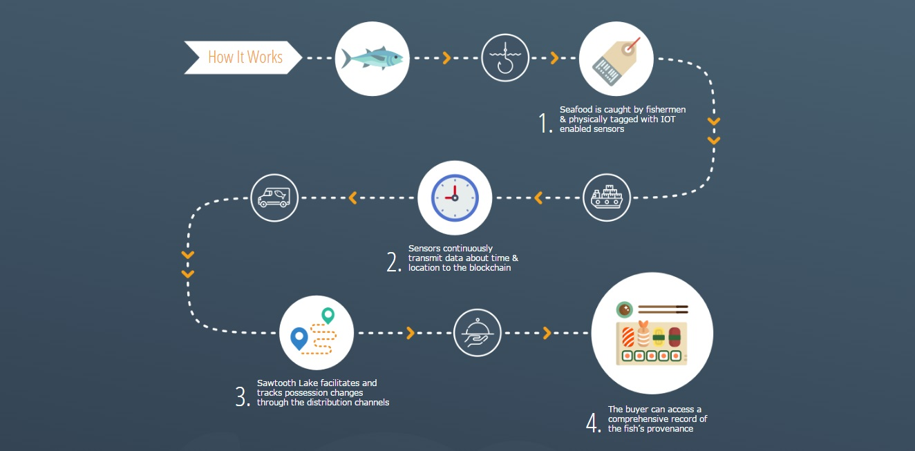
New approach using Hyperledger Sawtooth
$©$ Phurunbit Tech Ltd. 2019

Slide 19
That’s all, folks
Thank you!
$©$ Phurunbit Tech Ltd. 2019

