Slide 1
Redis
2019.02.24
$©$ Phurunbit Tech Ltd. 2019

Slide 2
Overview of this presentation
What is Redis?
Features of Redis
Data types of Redis
Exercise (1). Installation
Exercise (2). Strings
Exercise (3). Lists
Exercise (4). Sets
Exercise (5). Sorted Sets
Exercise (6). Hash
Exercise (7). PubSub
Use Cases
$©$ Phurunbit Tech Ltd. 2019

Slide 3
What is Redis?
Redis (Remote Dictionary Server) is a in-memory key-value database.
Can handle up to 2³² keys, A string value can be at max 512 Mbyte in length
Released in March 2009
$©$ Phurunbit Tech Ltd. 2019

Slide 4
Features of Redis
Speed: Redis loads whole dataset in memory.
Persistence: Asynchronously save data changes on disk using some conditions. Redis supports append-only file persistence mode.
Abstract data types: Lists, Sets, Sorted sets of strings (collections of non-repeating elements ordered by a floating-point number called score), Hashes
Supported Languages: Many languages; C/C++, C#, Go, Javascript, PHP, Ruby, Node, Python etc.
Platform-free: Works in most systems like Linux, MacOS, BSD and so on. Doesn’t provide official support for Windows
$©$ Phurunbit Tech Ltd. 2019

Slide 5
Data Types of Redis
Type | Keys | Values
String | page:index.html order_book_count | <html><head>[…]</head></html> 7464
Set | users_logged_in_today | {1, 2, 3, 4, 5, 6, …, 53245}
List | latest_order_ids | [201, 204, 456, 1120, …, 2530]
Hash | user:5b72f0a8a34a8611:session | time => 10927353 username => john
Sorted(scored) Set | coins_and_prices | BTC ~ 19452.3 ETH ~ 235.2 LTC ~ 65.8
$©$ Phurunbit Tech Ltd. 2019

Slide 6
Exercise 1. Installation
Install on Ubuntu
Install on MacOS
To check Redis server is running
$sudo apt-get update
$sudo apt-get install redis-server
$redis-server
$brew install redis
$redis-server
$redis-cli ping
$©$ Phurunbit Tech Ltd. 2019

Slide 7
Exercise 2. Strings
Example commands for string
> SET KEY VALUE
> GET KEY
> DEL KEY
> GETRANGE KEY 0 3
> MSET KEY1, VAL1, KEY2, VAL2
> MGET KEY1, KEY2
> INCR KEY
> DECR KEY
var order_object = {
type: “market”,
amount: 35.2,
currency: “btcusd”
};
// in Node.js
redisClient.set(”order_object”, JSON.stringify(order_object));
$©$ Phurunbit Tech Ltd. 2019

Slide 8
Excercise 2. Strings
$©$ Phurunbit Tech Ltd. 2019

Slide 9
Exercise 3. Lists
var currency_queue = [”btc”, “eth”, “ltc”, …];
LPUSH
RPUSH
a
b
c
d
e
f
LPOP
RPOP
$©$ Phurunbit Tech Ltd. 2019

Slide 10
Exercise 4. Sets
> SADD KEY VALUE1, VALUE2, VALUE3
> SMEMBERS KEY
a
b
c
d
$©$ Phurunbit Tech Ltd. 2019

Slide 11
Exercise 5. Sorted Sets
Example commands for sets
> ZADD KEY SCORE1 VALUE1 SCORE2 VALUE2 SCORE3 VALUE3
> ZRANGE KEY 0 -1
> ZRANGE KEY 0 -1 WITHSCORES
> ZCOUNT KEY –inf +inf
> ZSCORE KEY VALUE
> ZRANK KEY MEMBER
> ZREVRANGE KEY 0 -1 WITHSCORES
> ZINCRBY KEY 500 MEMBER
var book = {
orderbook: {
“3562.2”: 25,
“3673.7”: 92,
“3895.1”: 494
}
};
// node.js
redisClient.zadd(“book:btc:buy”, 25, “3562.2”, 92, “3673.7”, 494, “3895.1”);
$©$ Phurunbit Tech Ltd. 2019

Slide 12
Exercise 6. Hash
Example commands for hash
> HSET key field value
> HGET key
> HGET key field
> HMSET key field1 value1 field2 value2 …
> HGETALL key
> HDEL key field1 field2 …
> HKEYS key
> HVALS key
> HEXISTS key field
var orders[0] = {
“_id”: ObjectId(“2346kdsk234”),
“type”: “market”,
“symbol”: “btcusd”,
“amount”: 2.5235
};
// node.js
redisClient.hset(“order:2346kdsk234”, “type”, “market”);
redisClient.hset(“order:2346kdsk234”, “symbol”, “btcusd”);
redisClient.hset(“order:2346kdsk234”, “amount”, “2.5235”);
$©$ Phurunbit Tech Ltd. 2019

Slide 13
Exercise 7. PubSub
Example commands
> PUBLISH channel message
> SUBSCRIBE channel
> UNSUBSCRIBE channel
> PSUBSCRIBE channel_pattern
var order_object = {
userId: 58939,
type: “market”,
amount: 35.2,
currency: “btcusd”
};
// in Node.js
redisClient.publish(”CORE”, JSON.stringify(order_object));
// on the other side
redisClient.subscribe(“CORE”);
$©$ Phurunbit Tech Ltd. 2019

Slide 14
What is this Redis used for?
Session Cache
Full Page Cache (i.e.Margento)
Message Queue
Leaderboards/Counting
Pub/Sub real time data feed
$©$ Phurunbit Tech Ltd. 2019

Slide 15
Use case 1. Cache, Counting
API
session:63429 …
Redis
userId … expire …
Database
select user where..
$©$ Phurunbit Tech Ltd. 2019

Slide 16
Use case 2. Message Queue, Pub/Sub
Exchange backend
REST API
Redis
WORKERS
POST /create
PUB create newOrder
SUB commands
COMMAND channel
Order Filled
SUB marketData
PUB orderStatus
DATA channel
websocket
$©$ Phurunbit Tech Ltd. 2019

Slide 17
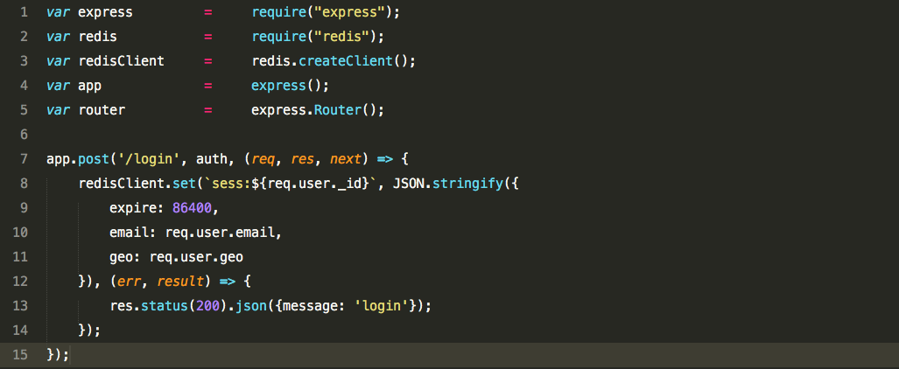
Example code in Node.js
Session Cache
Full Page Cache (i.e.Margento)
Message Queue
Leaderboards/Counting
Pub/Sub real time data feed
$©$ Phurunbit Tech Ltd. 2019

Slide 18
Example code in Laravel
Install predis package
composer require predis/predis
$©$ Phurunbit Tech Ltd. 2019

Slide 19
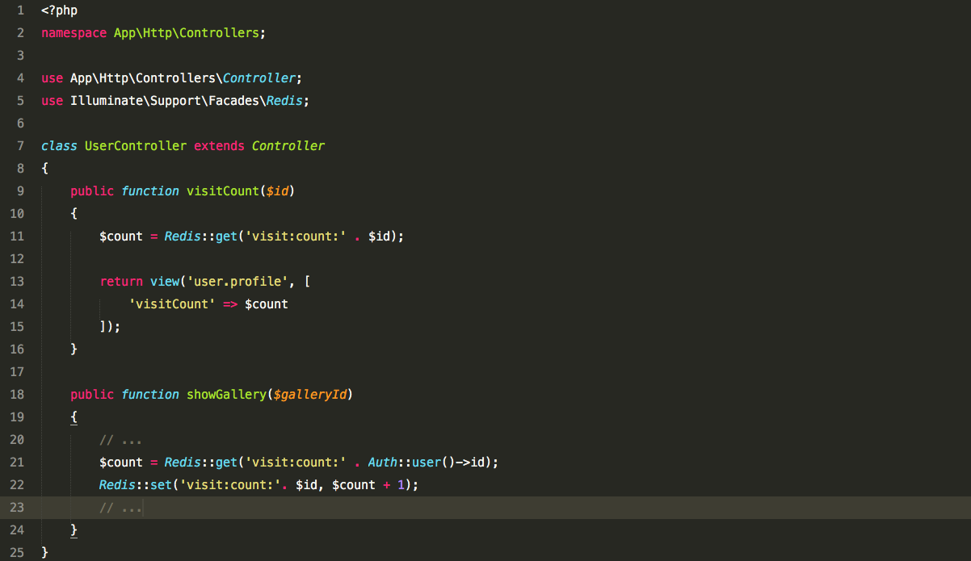
Example code in Laravel
$©$ Phurunbit Tech Ltd. 2019

Slide 20
That’s all, folks
Thank you!
$©$ Phurunbit Tech Ltd. 2019

