Slide 1
ELASTICSEARCH
2019.04.14

Slide 2
What is Elasticsearch?
? is a search engine based on the Lucene library
- Free and Open Source distributed inverted index
- Build on top of Apache Lucene
- Developed in Java, so inherently cross-plateform
- Released in Feb, 2010

Slide 3
Features
Easy to Scale (Distributed)
RESTful API
Build on top of Apache Lucene
Excellent Query DSL
Multi-tenancy
Advanced search features (Full Text)
Document Oriented
Per-operation Persistence

Slide 4
Easy to Scale (Distributed)
Start from small, but can grow with your business
Scalable horizontally out of the box. As you need more capacity, just add more nodes
RESTful API
API driven. Almost any action can be performed using a simple RESTful API using JSON over HTTP.

Slide 5
Built on top of Apache Lucene
Lucene is a high performance, full-featured Information Retrieval library, written in Java
Lucene is stable, proven technology, and continuously being added with more features and best practices

Slide 6
Excellent Query DSL
Exposes a very complex and capable query DSL(Domain Specific Language)
Caching and speed up common queries, or complex queries with parts that can be reused
Multi-tenancy
Can host multiple indexes on one node or cluster.
Can query multiple types and multiple indexes with one simple query

Slide 7
Document Oriented
Store complex real world entities as structured JSON documents
Per-operation Persistence
Puts your data safety first.
Document changes are recorded in transaction logs on multiple nodes in the cluster to minimize the chance of any data loss.

Slide 8
Basic Concepts
Cluster
consists of one or more nodes
Node
is a running instance of elasticsearch
Index
is like a ‘database’ in a relational database
Type
is like a ‘table’ in a relational database
Document
is like a row in a table in a relational database
Field
is similar to a column in a table in RDB

Slide 9
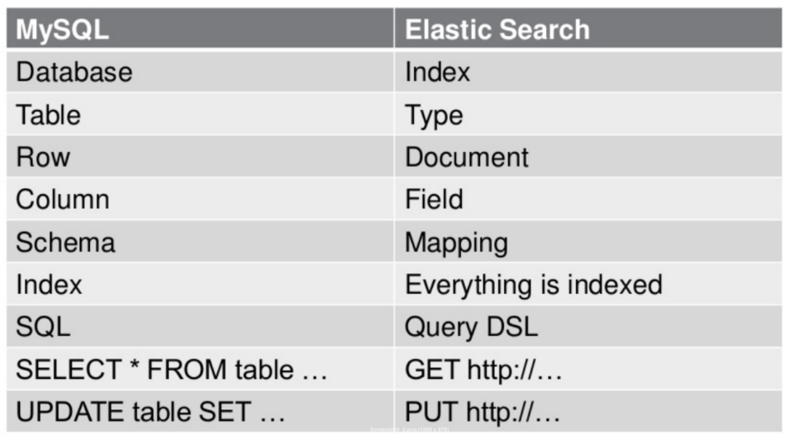

Slide 10
Differences with Relational DB
No SQL Database
No relations, No constraints, No joins
Easier to Scale

Slide 11
Insuitable Usecases of RDB
● Relevance based searching
● Searching when entered spelling of search term is wrong
● Full text search
● Synonym search
● Phonetic search

Slide 12
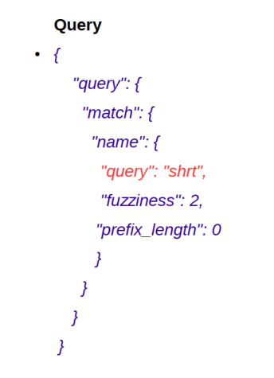
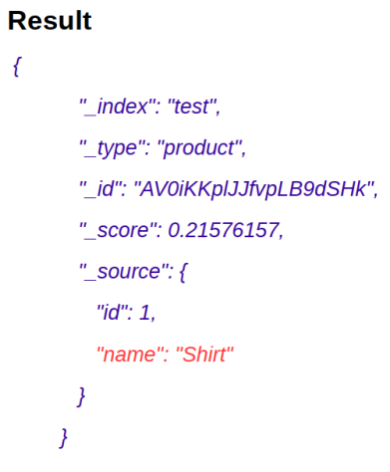
E.x. 1

Slide 13
E.x. 2
Searched “Top Doctor's College”, but documents contains “Top Medical Institutions”
'Smith', 'Smythe'

Slide 14
Installation
- Windows:
https://artifacts.elastic.co/downloads/elasticsearch/elasticsearch-7.0.0-windows-x86_64.zip
- Linux:
https://artifacts.elastic.co/downloads/elasticsearch/elasticsearch-7.0.0-linux-x86_64.tar.gz
- Full Installation
https://www.vultr.com/docs/how-to-install-and-configure-elastic-stack-elasticsearch-logstash-and-kibana-on-ubuntu-17-04

Slide 15
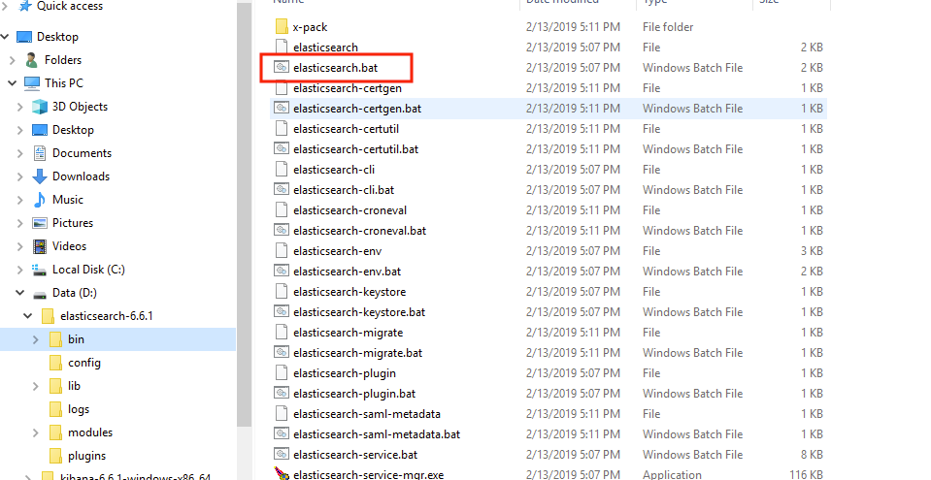
http://localhost:9200

Slide 16
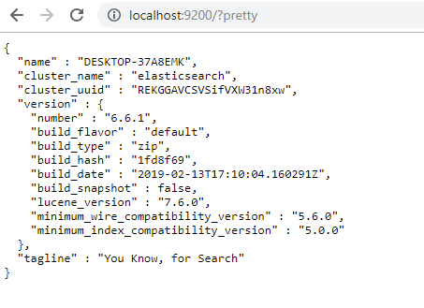
Are you alive “Elasticsaerch”?
http://localhost:9200/?pretty

Slide 17
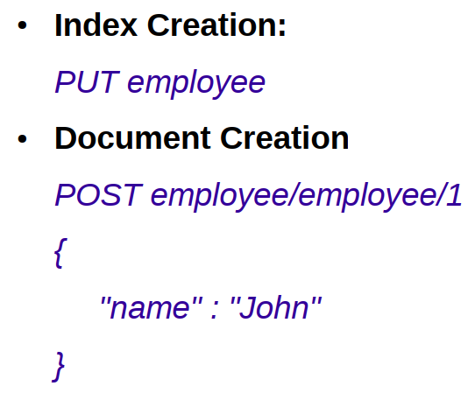
Create Index/Document
curl -X PUT "localhost:9200/index1"

Slide 18
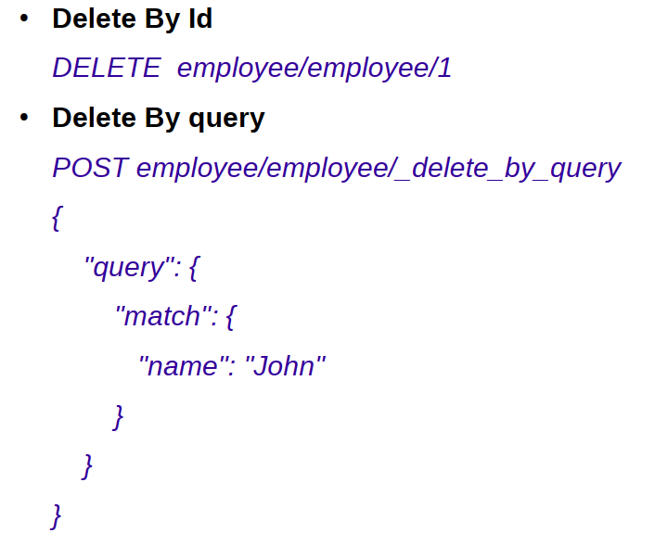
Delete Document

Slide 19
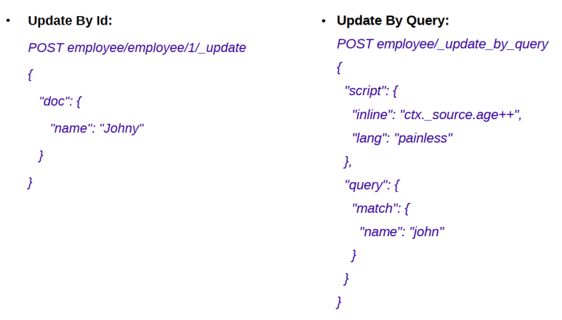
Update Document

Slide 20
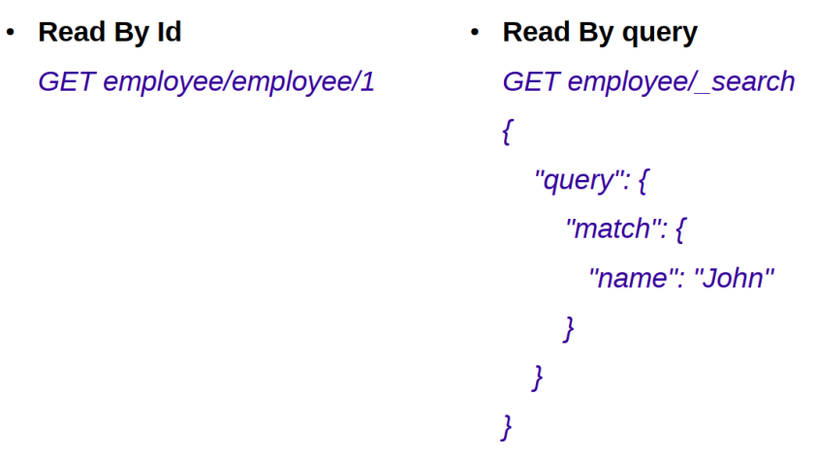
Search Document

Slide 21
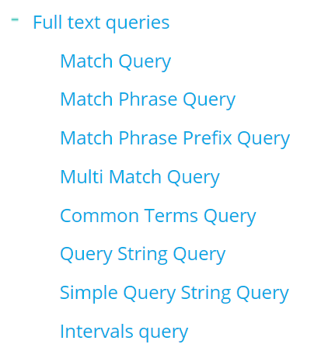
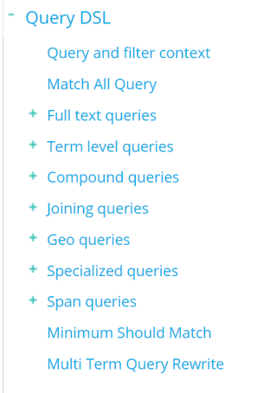
Query DSL

Slide 22
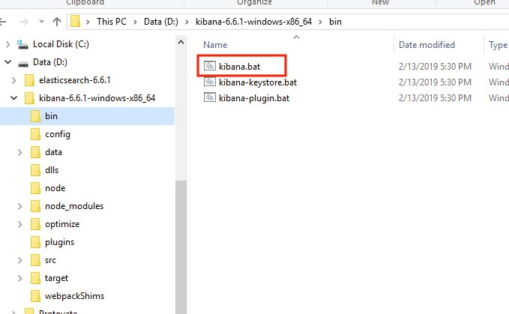
Kibana
? Open source data visualization plugin for ES
http://localhost:5601

Slide 23
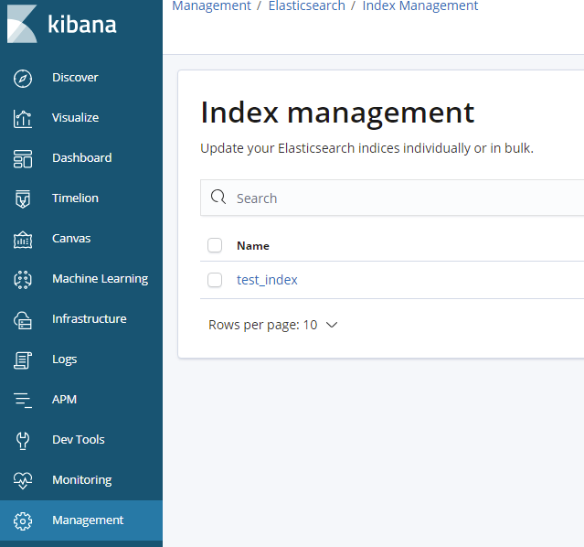
Kibana

Slide 24
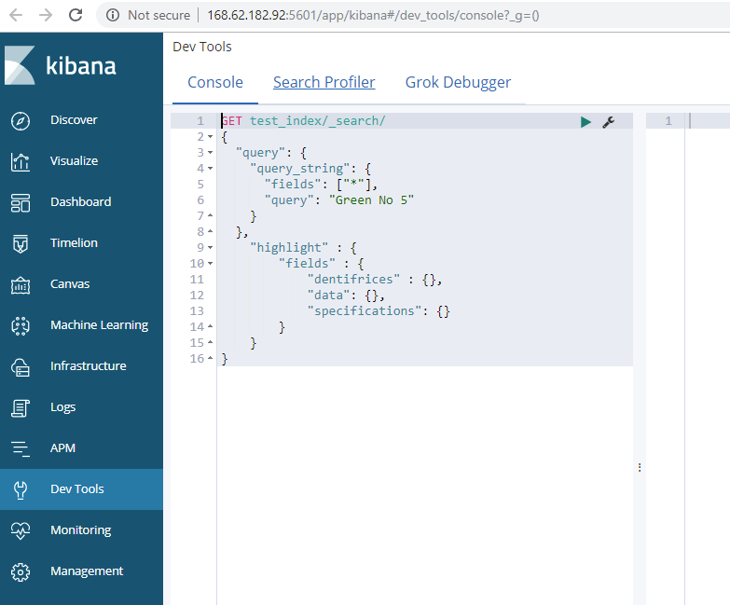
Kibana

Slide 25
THANKS!

