Slide 1
Introduction of Common Services
Git(Bitbucket, Github, Gitlab)
Connecting Server

Slide 2
About Git
?
Git (/ɡɪt/) is a version control system (VCS) for tracking changes in computer files and coordinating work on those files among multiple people. It is primarily used for source code management in software development, but it can be used to keep track of changes in any set of files.

Slide 3
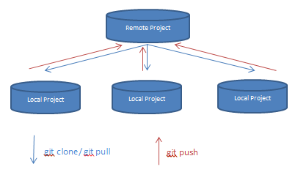
About Git
The necessary of using Git
Git allows a team of people to work together, all using the same files. And it helps the team cope with the confusion that tends to happen when multiple people are editing the same files.
Normally our clients are sharing their project
source codes via github, gitlab or bitbucket to
protect and update the source codes.
For example:
Client: Do you use github? If yes, please let me know your github username.
Freelancer: Sure, I have github account. Please invite me to your github project via my account. This is my github
ID(higherstar, https://github.com/higherstar). Or you can invite me my account email address.
( higherstar@outlook.com ).

Slide 4
About Git
3rd Party Services Based On Git
There are several 3rd party services which are based on Git.
GitHub(https://www.github.com)
GitLab(https://www.gitlab.com)
Bitbucket(https://bitbucket.com)

Slide 5
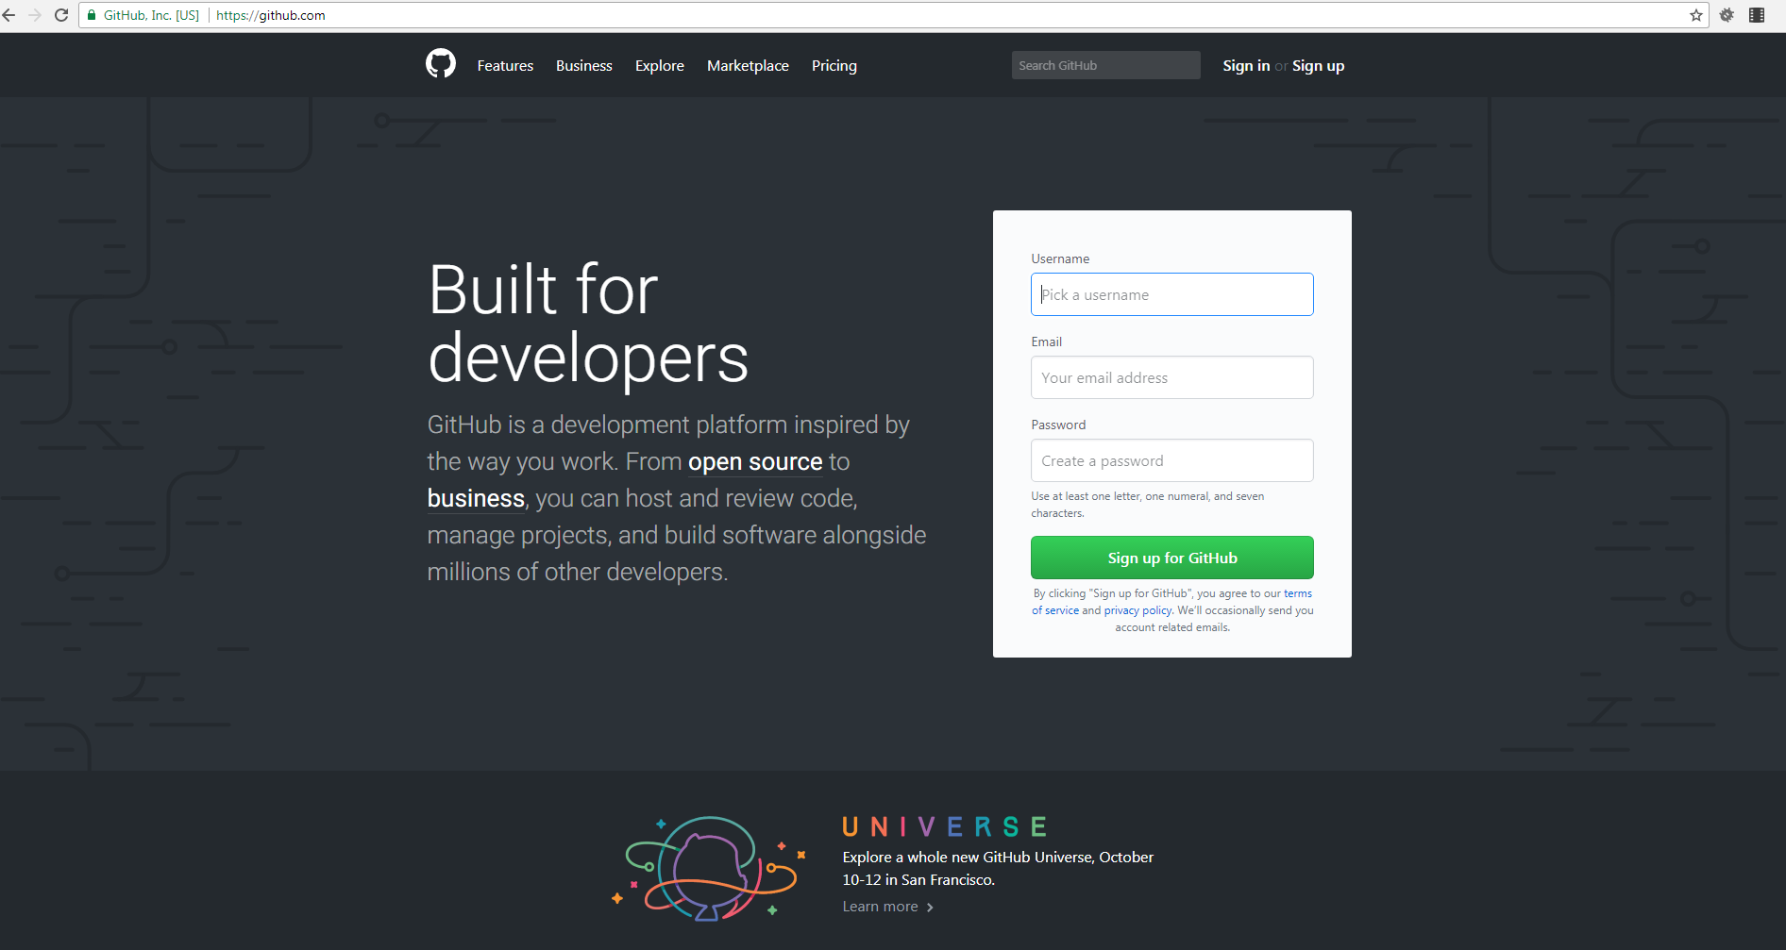
About Git
3rd Party Services Based On Git
1) Github
-url: https://github.com

Slide 6
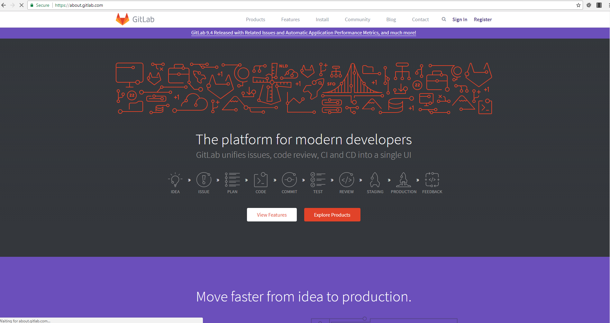
About Git
3rd Party Services Based On Git
2) GitLab
-url: https://gitlab.com

Slide 7
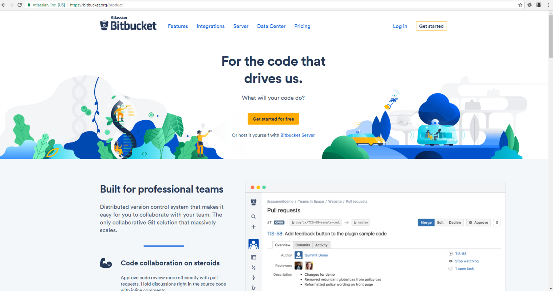
About Git
3rd Party Services Based On Git
3) Bitbucket
-url: https://bitbucket.com, https://gitbucket.org

Slide 8
About Git
2. Management of GIT repository
Create
Clone
Commit / Pull / Push

Slide 9
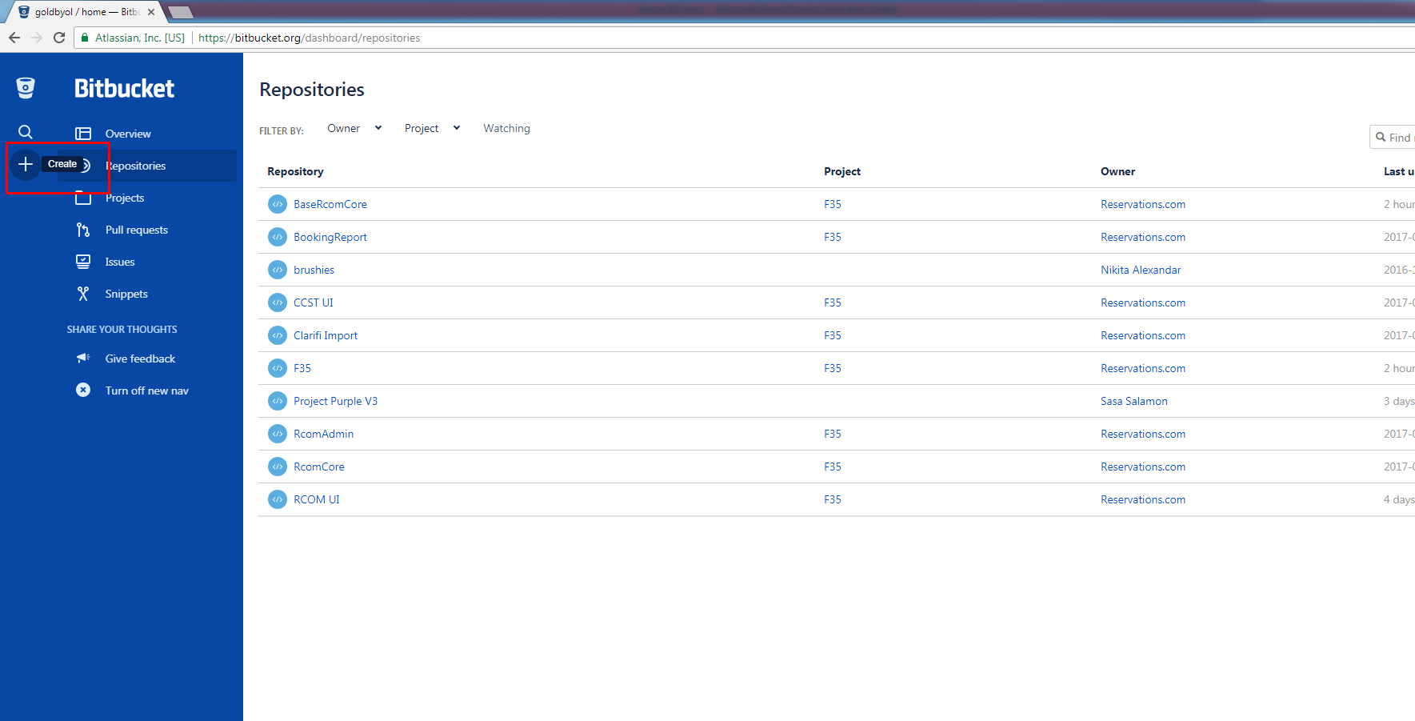
About Git
2. Management of GIT repository
1) Create
When you create new repository, you can setup the repository type as two choice, that is, one is public and another is private.
If it is public, everyone can access to this repository without any permission.
But if it is private, only someone who has write and read permission to this repository can access to the repository.
• Gitub can only create public repository with free account, in order to create private repository on
Github, then you will need to upgrade your account to paid account($9/month).
• Bitbucket and Gitlab can create both of public and private repository with free account as well.

Slide 10
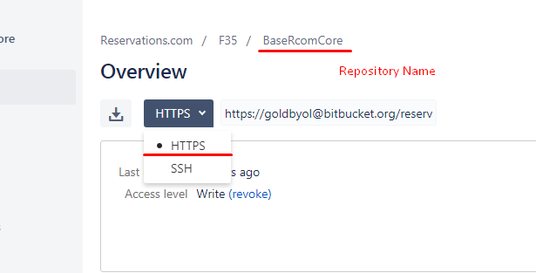
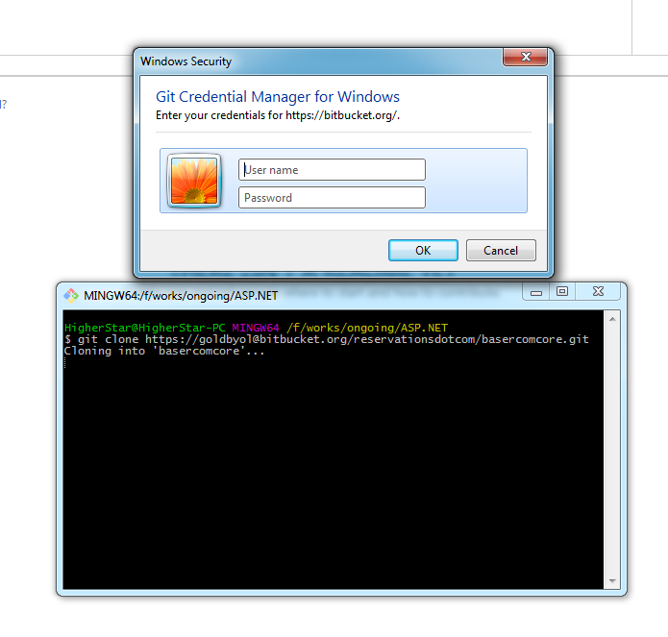
About Git
2. Management of GIT repository
2) Clone
-Using Https Link
While cloning, you will need to type your account credentials(if it is using bitbucket, then you will need to input bitbucket account credential) on the following confirm dialog.(You will see this confirm dialog when only using Https link of repo.)
In this case, you will need to copy the https link of the repository and then clone the repo with this link.(see below screenshot)

Slide 11
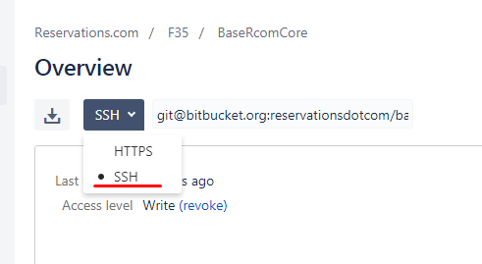
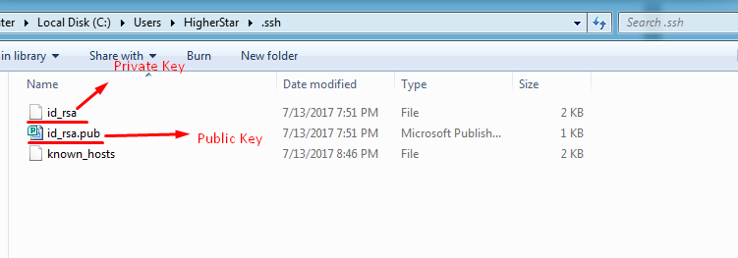
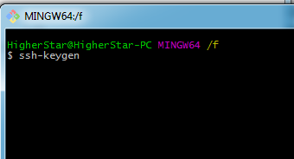
About Git
2. Management of GIT repository
-Using SSH Link
In this case, you will need to add your computer ssh public key on settings page.
If your computer does not have these key files set, then you can create this by using the following git command.
Then it will be generated under C:/>Users/<Account Name>/.ssh/

Slide 12
About Git
2. Management of GIT repository
The known_hosts file will include all server address to which you are going to try to access with this keys set.

Slide 13
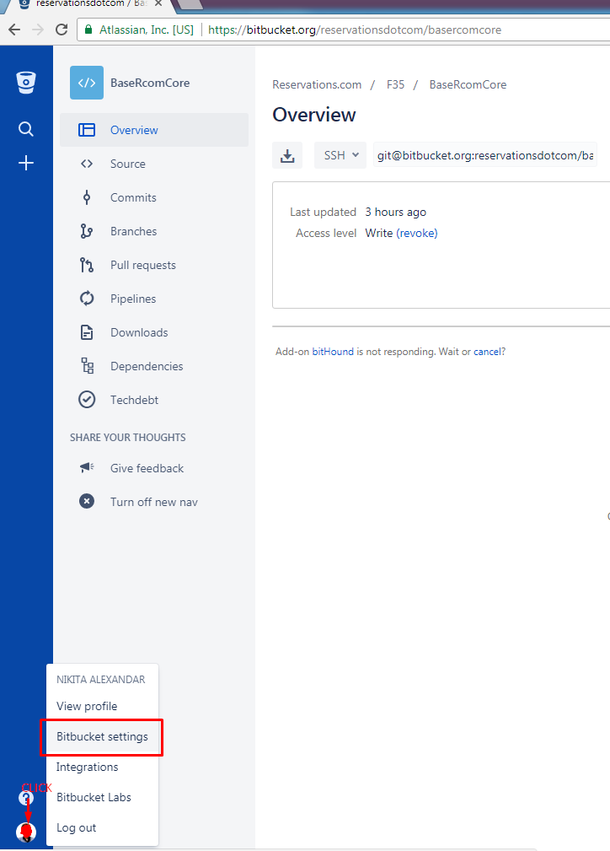
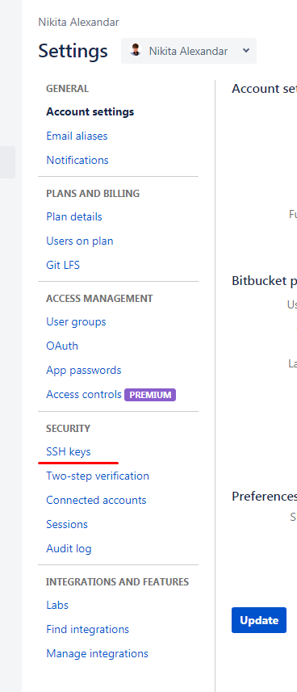
About Git
2. Management of GIT repository
After creating ssh key files set, you will need to add the public key content under the settings page.

Slide 14
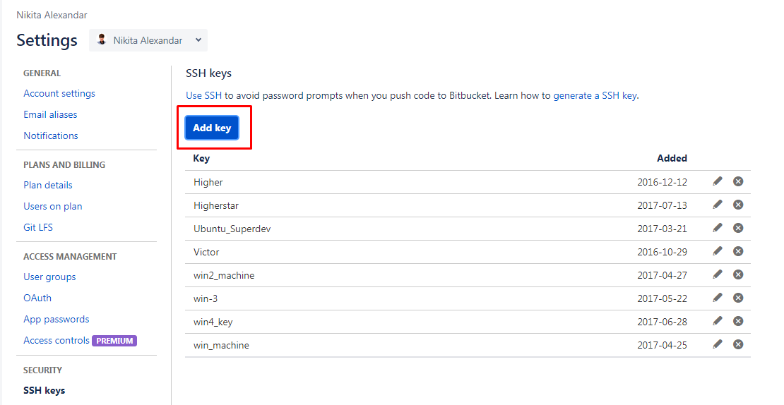
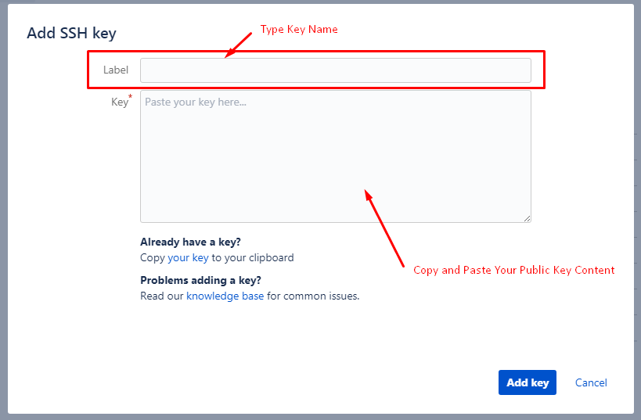
About Git
2. Management of GIT repository
As you can see from the above screen shot, you can add several keys under your account.
That is, it means you can work on several machines with one account.

Slide 15
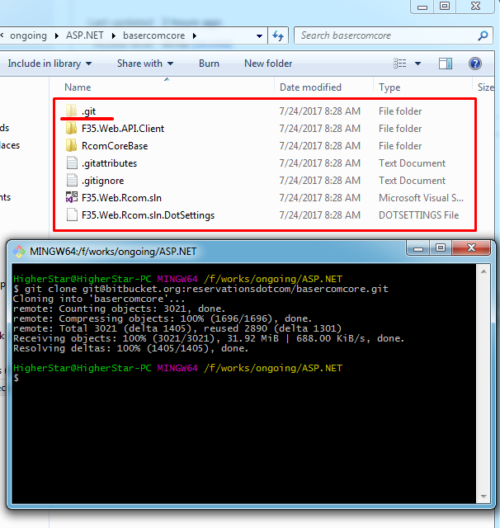
About Git
2. Management of GIT repository
So after adding your ssh public key under your account settings page, then you can clone any private repositories which you can access to using SSH links.

Slide 16
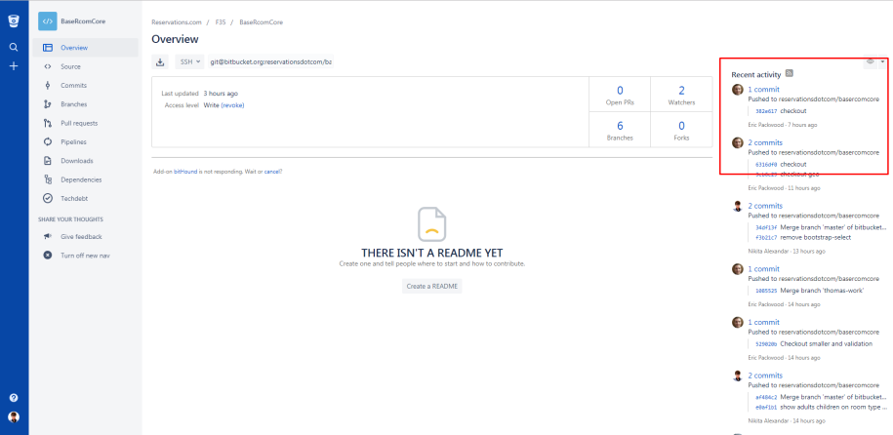
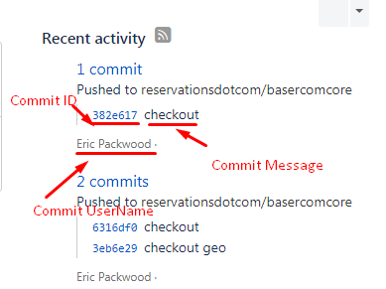
About Git
2. Management of GIT repository
2) Commit / Pull / Push
After you change something on local git repository, maybe you will want to update your current changes to remote git repository.
In this case, you will need to commit your changes to remote repository with commit message.

Slide 17
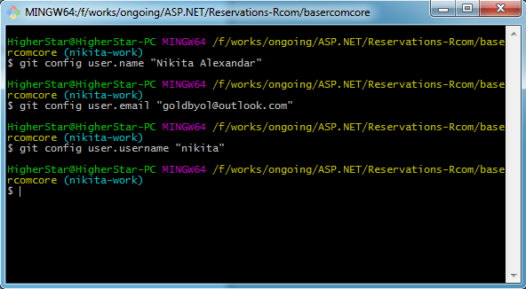
About Git
2. Management of GIT repository
In order to commit something
First of all, you need to config your information under the local git repository.
Go to local git repository root path and then config some information about you.

Slide 18
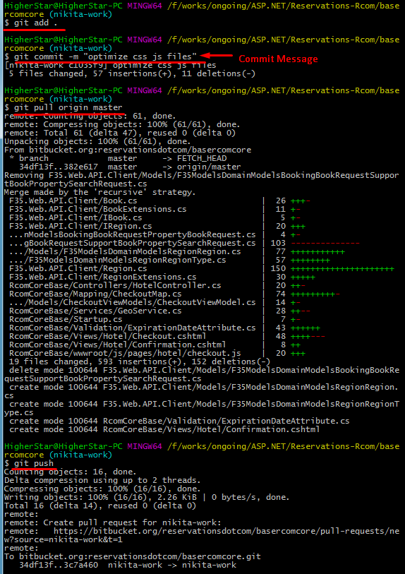
About Git
2. Management of GIT repository
In order to commit something
Second of all, you need to run the following git shell commands.
In order to get more detailed knowledge regarding git shell commands, please look at the git-tutorial.pdf file.

Slide 19
Connecting Server
In order to connect to server, there are two common ways, that is, one is to use SSH and another is to use FTP.
• Secure Shell (SSH) is a cryptographic network protocol for operating network services securely over an unsecured network.
• File Transfer Protocol (FTP) is a standard network protocol used for the transfer of computer files between a client and server on a computer network.
- The difference between when connecting by FTP and when connecting by SSH?
In a word, FTP only allows the control of files, while SSH allows a wide variety of applications.

Slide 20
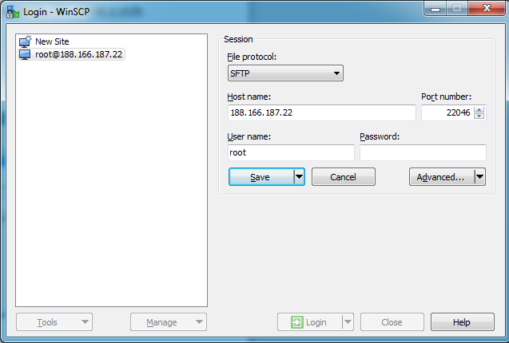
Connecting Server
Tools
1) WinScp
Normally we use WinSCP to connect server to control files of server.

Slide 21
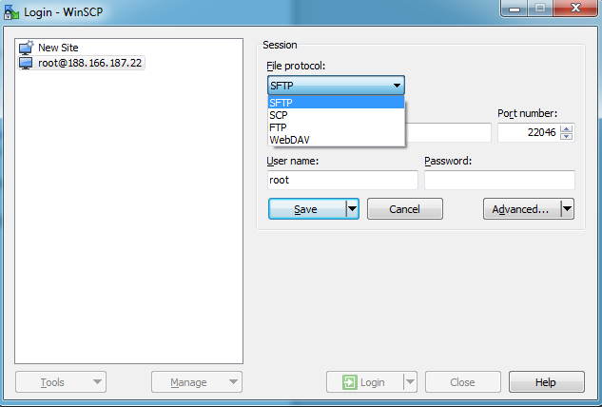
Connecting Server
Tools
In the case of using SSH, normally the default port number is 22 or 22046, and if it is using of FTP, then the default port number is 21.

Slide 22
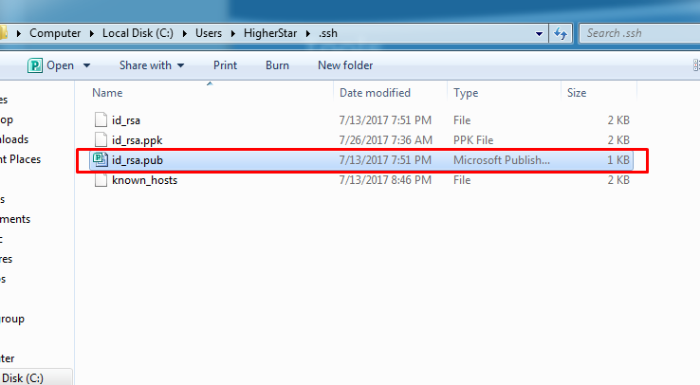
Connecting Server
Tools
Sometimes our clients provide me with SSH information to connect their servers without password.
In this case, they want me to provide them with my Public SSH key file.

Slide 23
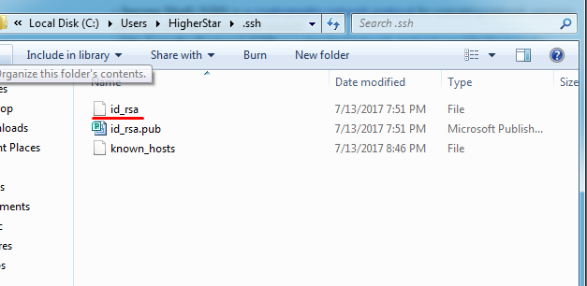
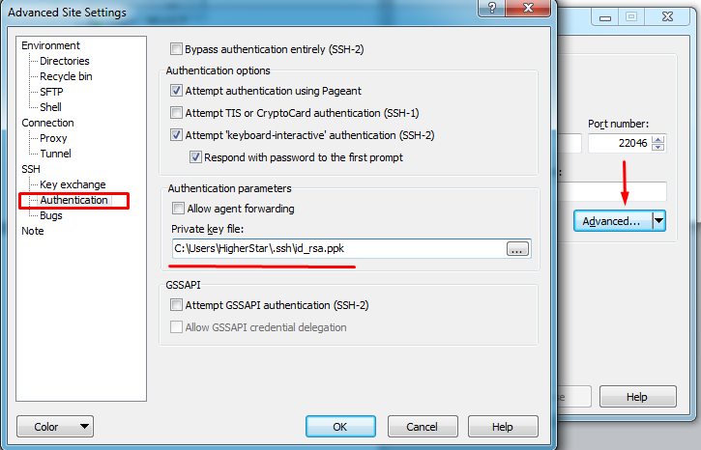
Connecting Server
Tools
Then they will set up my public SSH key file on their server to make me connect to the servers with this key.
At this time, we will need to use private key file to connect.

Slide 24
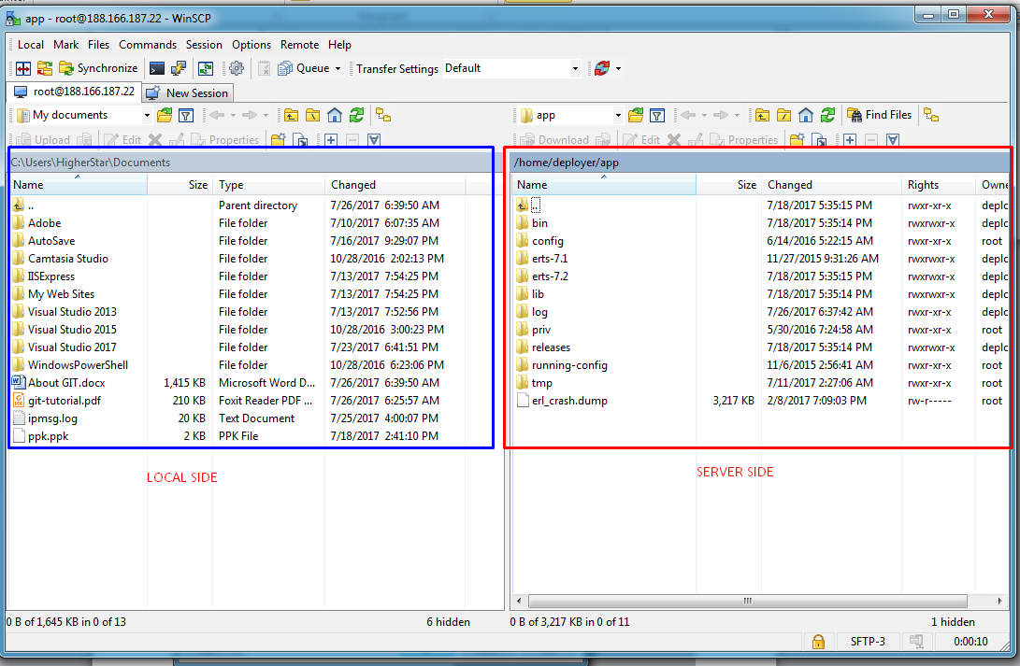
Connecting Server
Tools
After setting up the private key file on Advanced Settings, then Click the “Open” button to connect server.

Slide 25
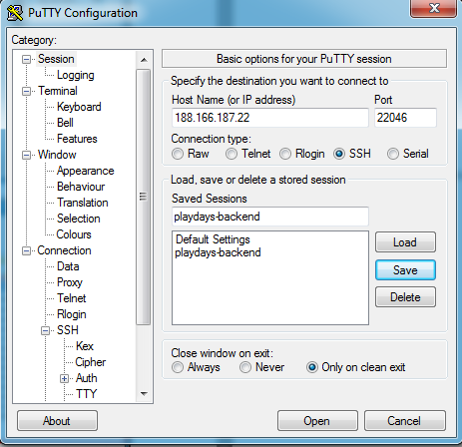
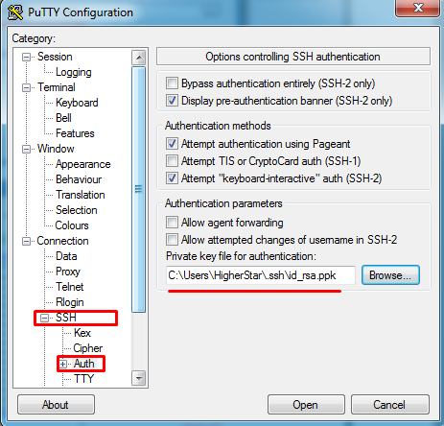
Connecting Server
Tools
2) Putty
Normally we use Putty to control server by using Shell Commands.
Setup SSH private key file to connect server without pwd.
And then click “Open” button to connect to server.

Slide 26
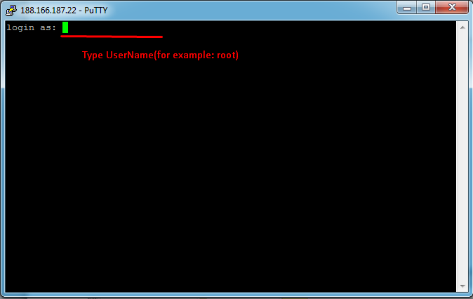
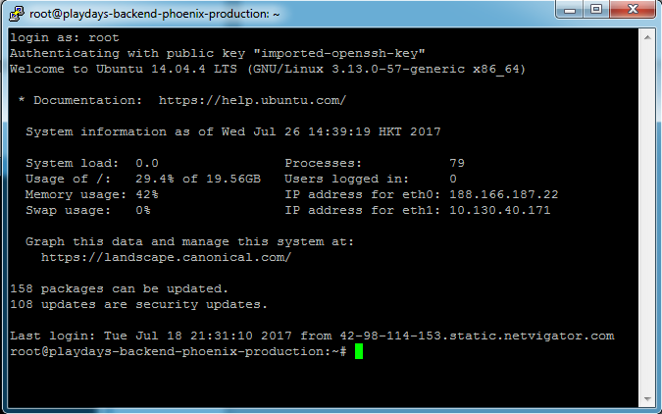
Connecting Server
Tools
After typing username, then Putty will authenticate you with public key which saved on server and private key which you just imported to putty.
If success, then you can see the welcome message like the following.
After successful login, you can manage server by using shell commands.

