Slide 1
( Lecture )
2019.04.21

Slide 2
Contents
What is AMP ?
How AMP works ?
AMP Projects
AMP Components
How to convert HTML to AMP

Slide 3
1. What is AMP
Accelerated Mobile Pages (AMP) is an open-source HTML framework that provides a straightforward way to create web
pages that are fast, smooth-loading and prioritize the user-experience.
AMP Project was announced by Google on October 7, 2015 following discussions with its partners in the European Digital News Initiative, and other news publishers and technology companies around the world, about improving the performance of the mobile web.

Slide 4
2. How does it work
AMP consists of AMP HTML, the AMP JS library, and the Google AMP Cache.
It actually consists of normal HTML with a few restrictions and added specialized tags and does not require a lot of additional work.
AMP JS works to make sure that the most important content is loaded quickly and clearly, while third party content such as ads are not at the forefront so that users will see their preferred content as soon as possible.
AMP has discovered that content that loads quickly leads to faster reading, and in turn that results in more consumption.

Slide 5
AMP JS
The AMP JS library implements all of AMP's best performance practices, manages resource loading and gives you the custom tags, all to ensure a fast rendering of your page.
Among the biggest optimizations is the fact that it makes everything that comes from external resources asynchronous, so nothing in the page can block anything from rendering.
Other performance techniques include the sandboxing of all iframes, the pre-calculation of the layout of every element on page before resources are loaded and the disabling of slow CSS selectors.

Slide 6
AMP Cache
The Google AMP Cache is a proxy-based content delivery network for delivering all valid AMP documents.
It fetches AMP HTML pages, caches them, and improves page performance automatically.
When using the Google AMP Cache, the document, all JS files and all images load from the same origin that is using HTTP 2.0 for maximum efficiency.

Slide 7
Key Features
Allow only asynchronous scripts
Size all resources statically
All CSS must be inline and size-bound
Minimize style recalculations
Only run GPU-accelerated animations
Prioritize resource loading
Load pages in an instant

Slide 8
3. AMP Projects
AMP Projects
AMP Websites
AMP Stories
AMP Emails
AMP Ads

Slide 9
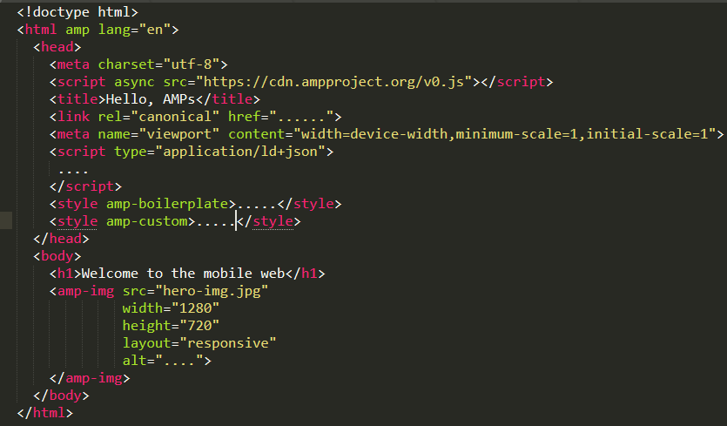
AMP WebSite Example

Slide 10
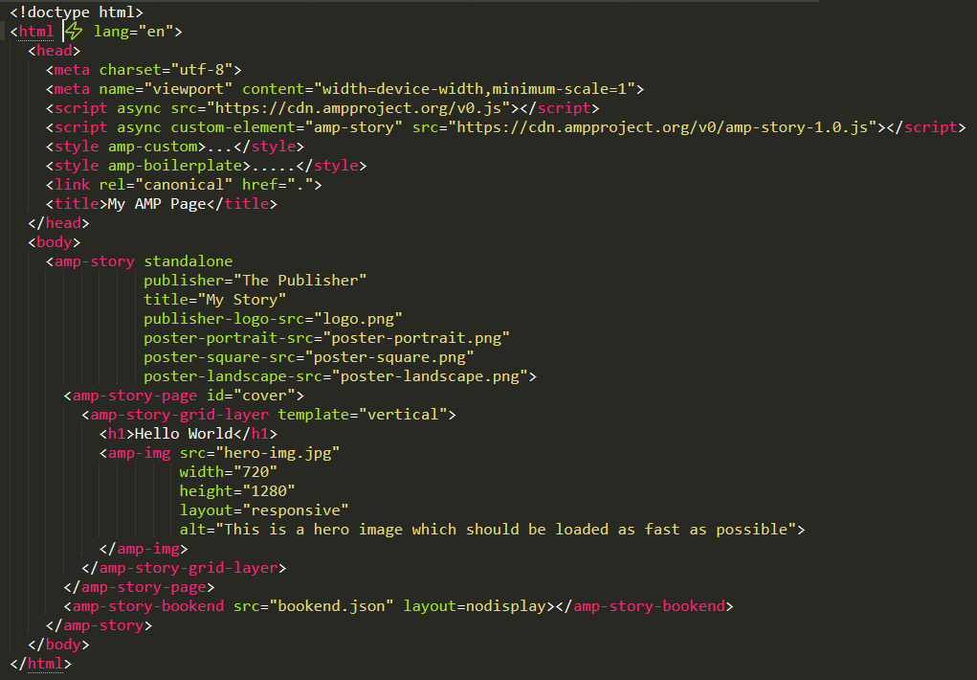
AMP Story Example

Slide 11
4. AMP Components
amp-3d-gltf
amp-access-laterpay
amp-access
amp-accordion
amp-ad
amp-addthis
amp-analytics
amp-anim
amp-app-banner
amp-audio
amp-bind
amp-bodymovin-animation
amp-brid-player
amp-brightcove
amp-call-tracking
amp-carousel
amp-dailymotion
amp-date-countdown
amp-date-display
amp-date-picker
amp-dynamic-css-classes
amp-experiment
amp-facebook-comments
amp-facebook-like
amp-facebook-page
amp-facebook
amp-fit-text
amp-font
amp-form
amp-fx-collection
amp-fx-flying-carpet
amp-geo
amp-gfycat
amp-gist
amp-google-document-embed
amp-google-vrview-image
amp-hulu
amp-iframe
amp-ima-video
amp-image-lightbox
amp-image-slider
amp-img
amp-inputmask
amp-instagram
amp-install-serviceworker
amp-jwplayer
amp-kaltura-player
amp-lightbox-gallery
… … …

Slide 12
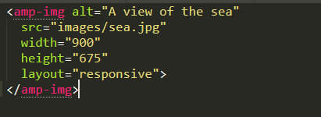
AMP Component Examples
- <amp-img>
Supported Layouts: ================
fill, fixed, fixed-height, flex-item, intrinsic, responsive

Slide 13
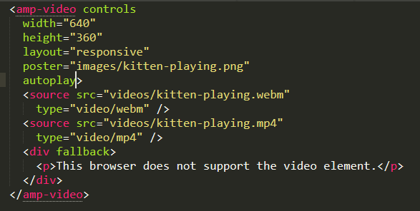
- <amp-video>
Poster: The image for the frame to be displayed before video playback has started.
By default, the first frame is displayed.
Other Attributes: control, loop, crossorigin, muted, artist, album

Slide 14
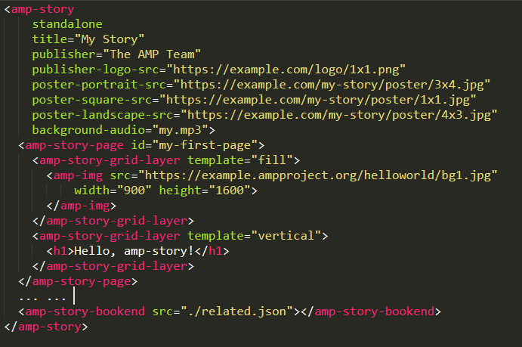
- <amp-story>

Slide 15
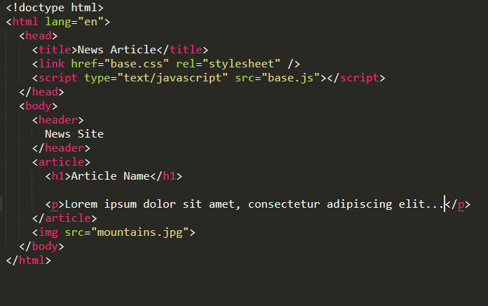
5. How to convert HTML to AMP

Slide 16
Thank you

