Slide 1
Email Marketing Automation with Sendgrid
2019-06-23

Slide 2
What is Sendgrid Automation?
SendGrid Automation offers intuitive workflows that leverage automation triggers you already have in place, empowering you to set up automated, recurring emails or drip series in the time it takes to develop your usual 1-to-many emails.

Slide 3
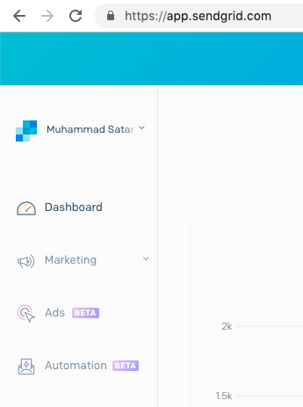
New Marketing Campaigns is currently in closed beta.
During beta, only approved participants have access to the product. Functionality and performance may be imperfect, and we reserve the right to change functionality at any time without warning.

Slide 4
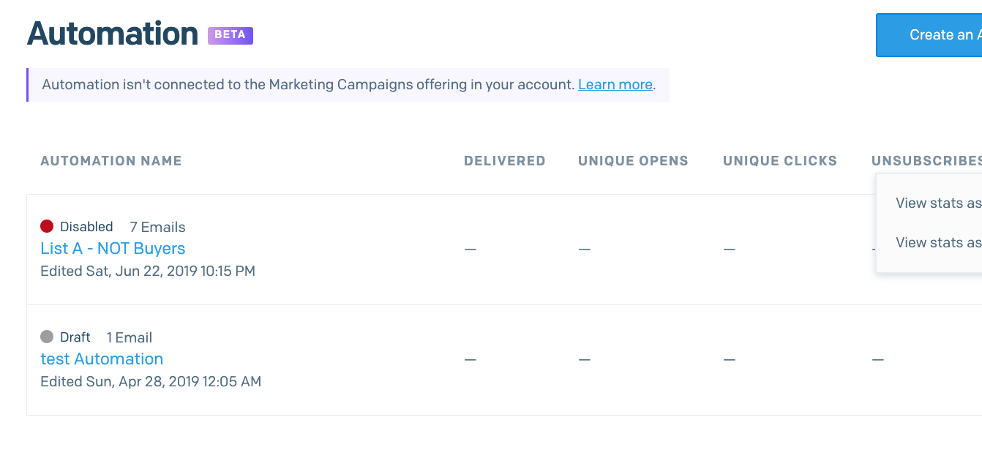
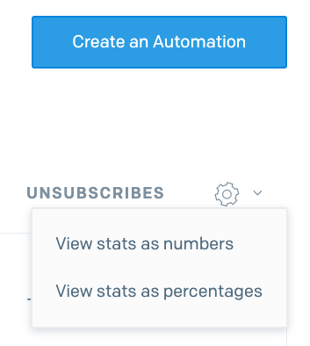

Slide 5
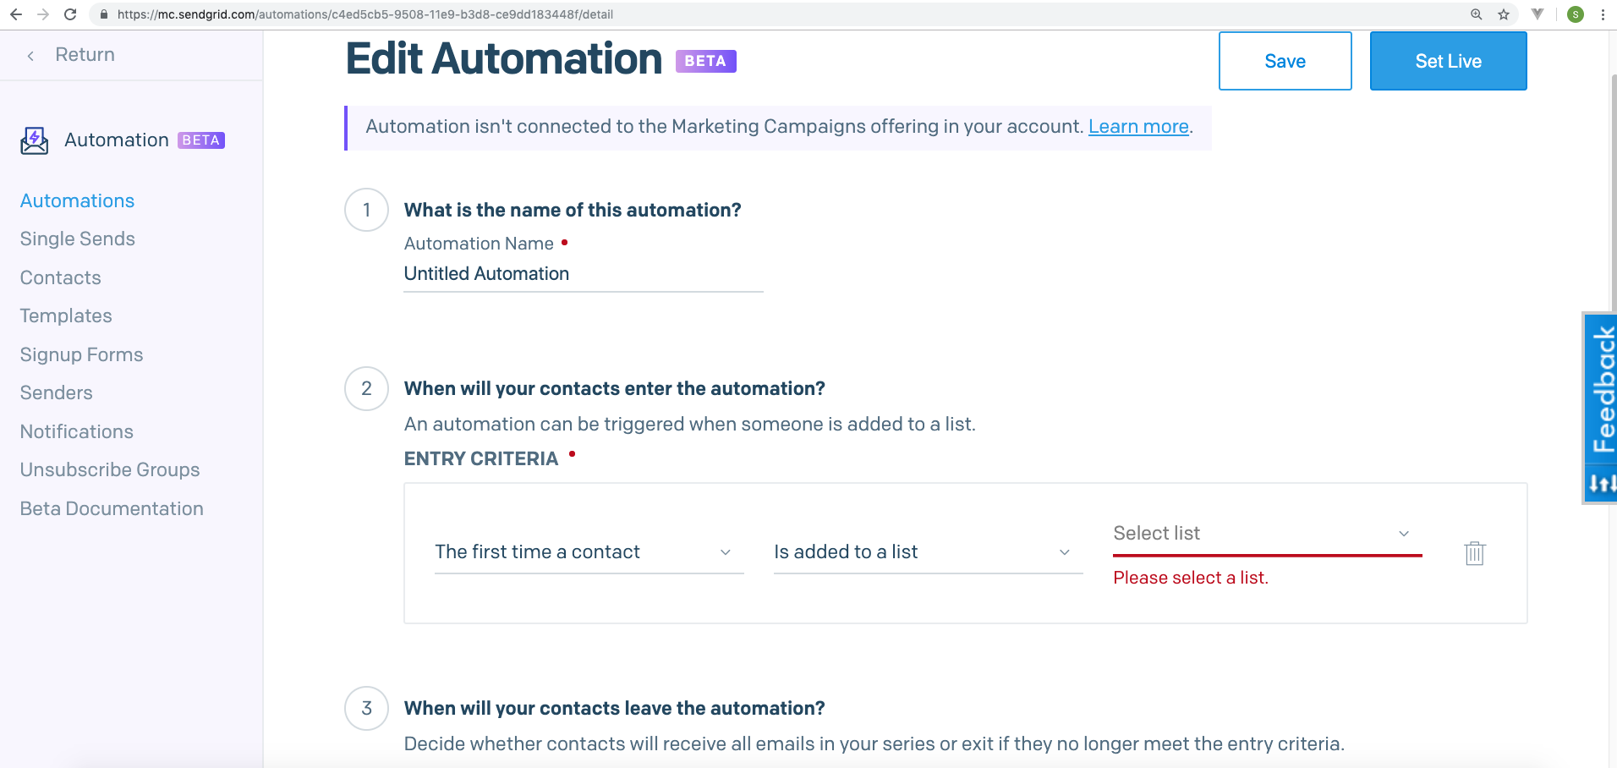

Slide 6
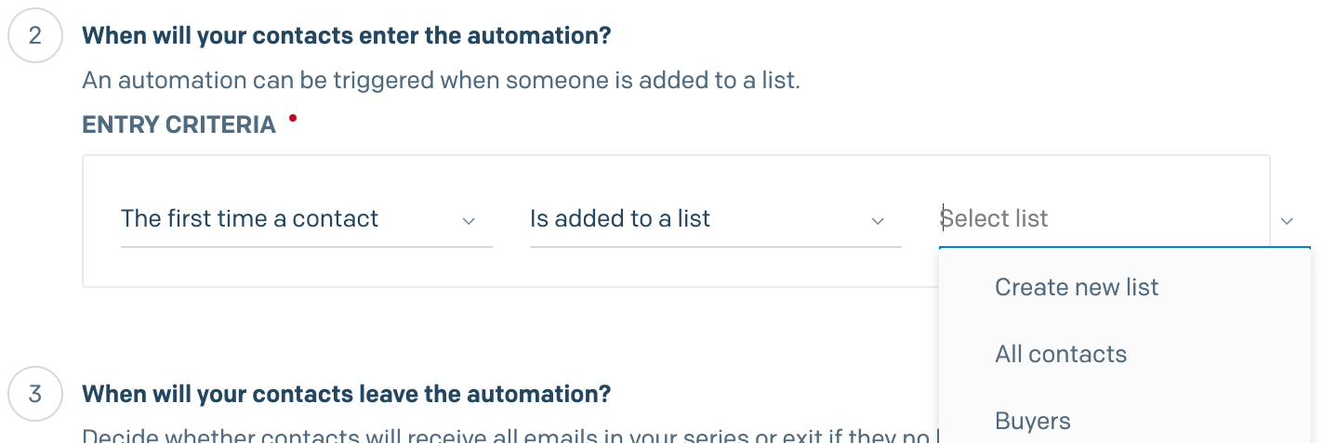

Slide 7
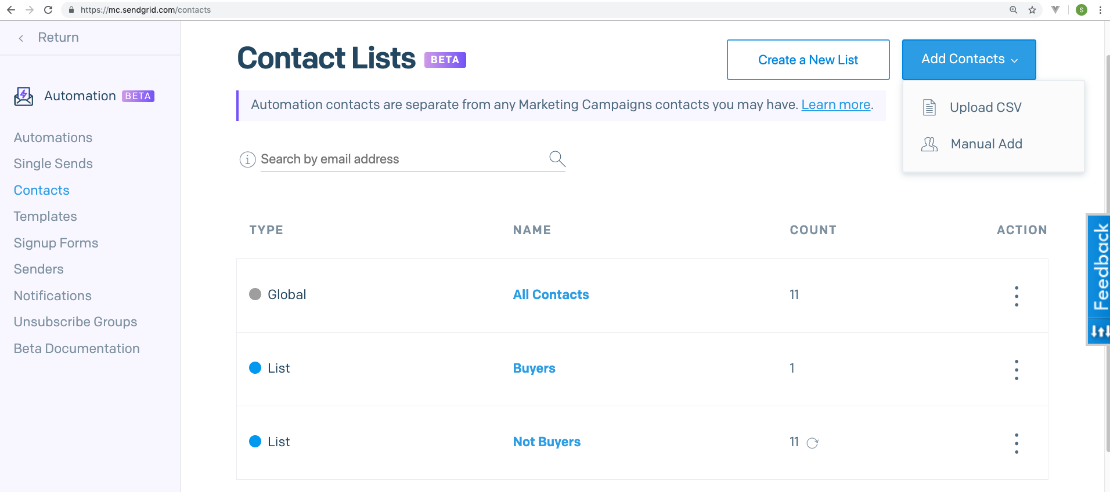
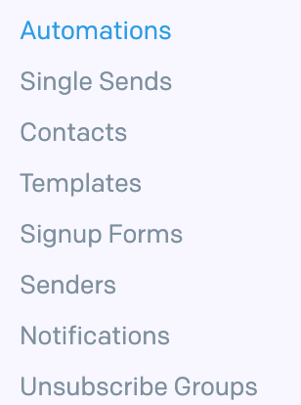

Slide 8
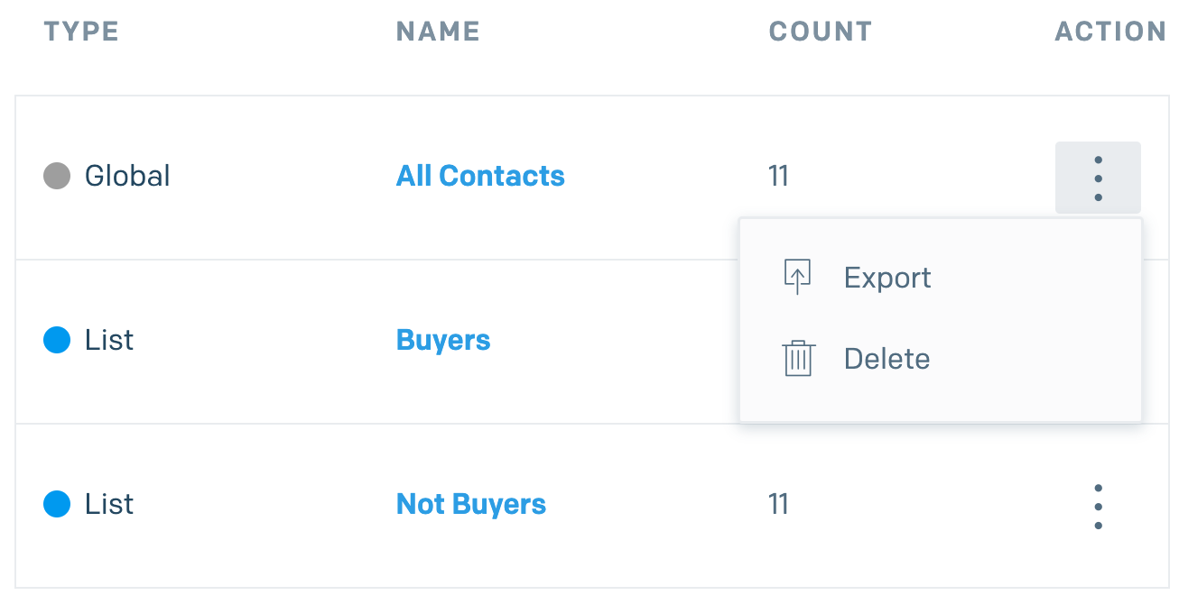

Slide 9
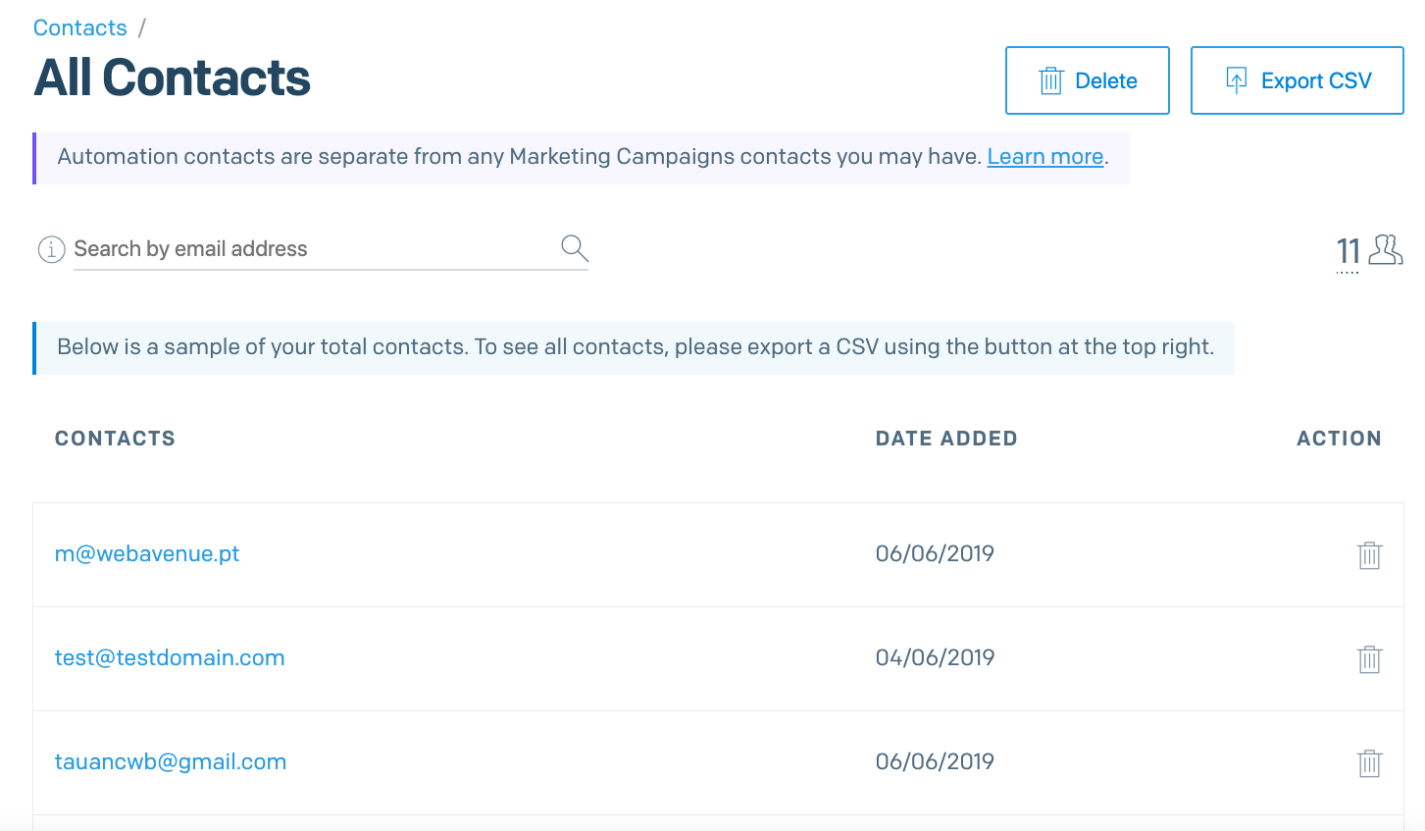

Slide 10
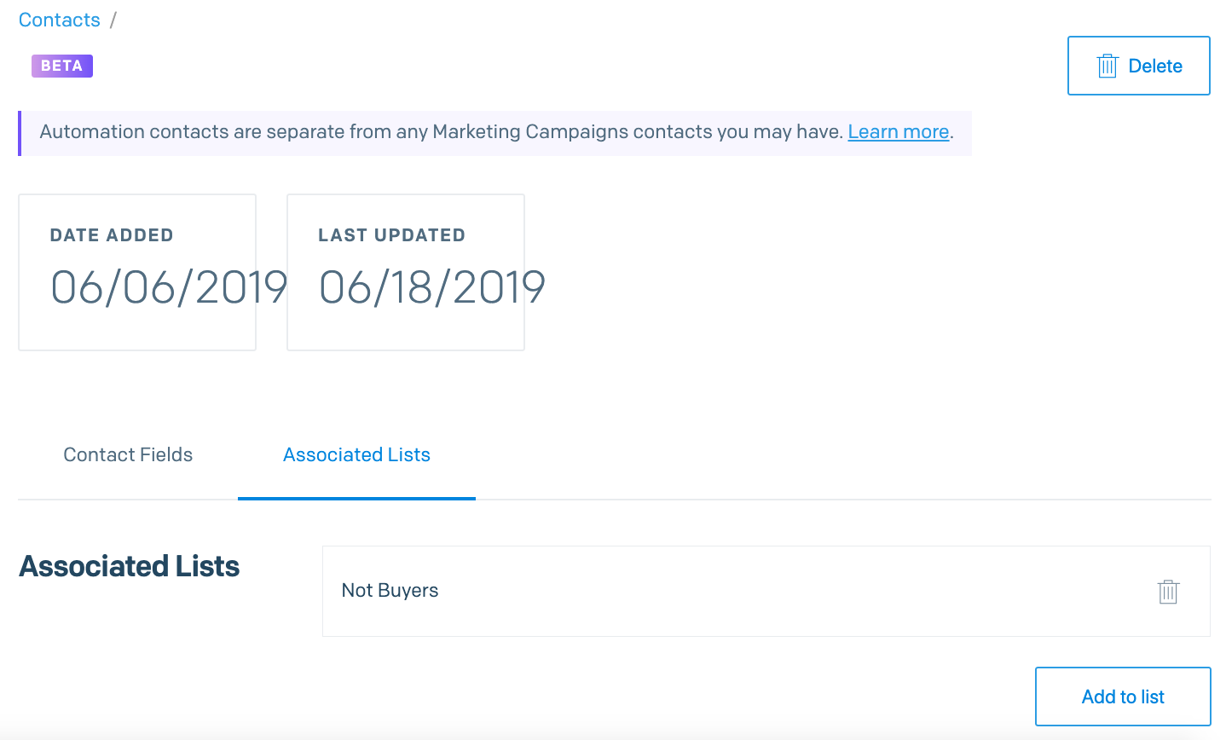
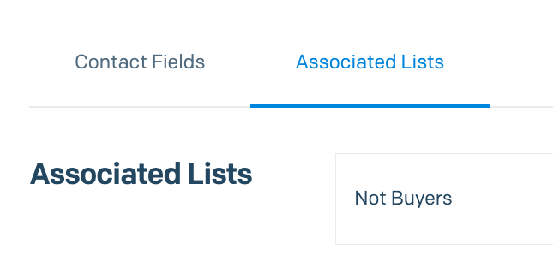

Slide 11
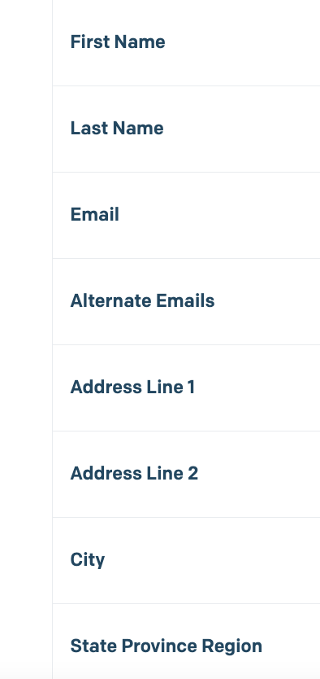
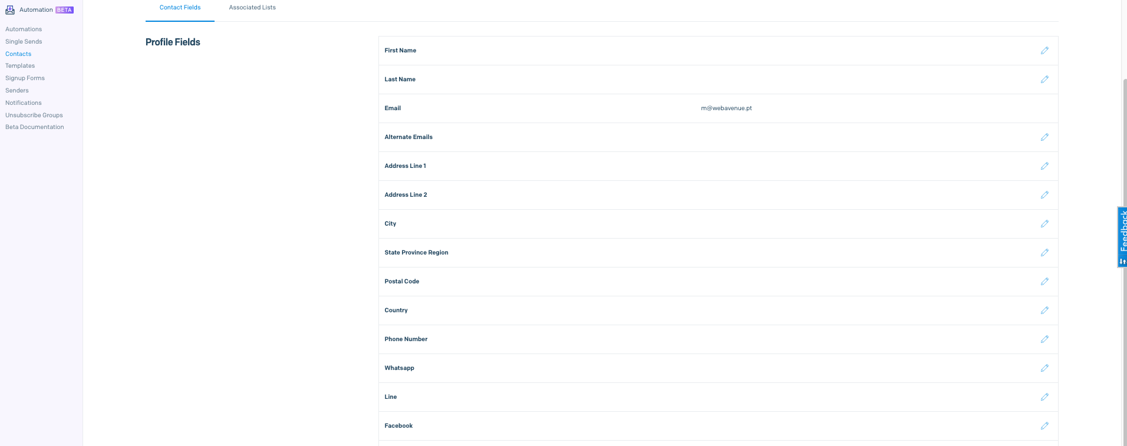
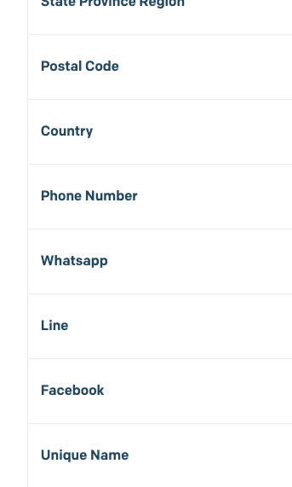

Slide 13
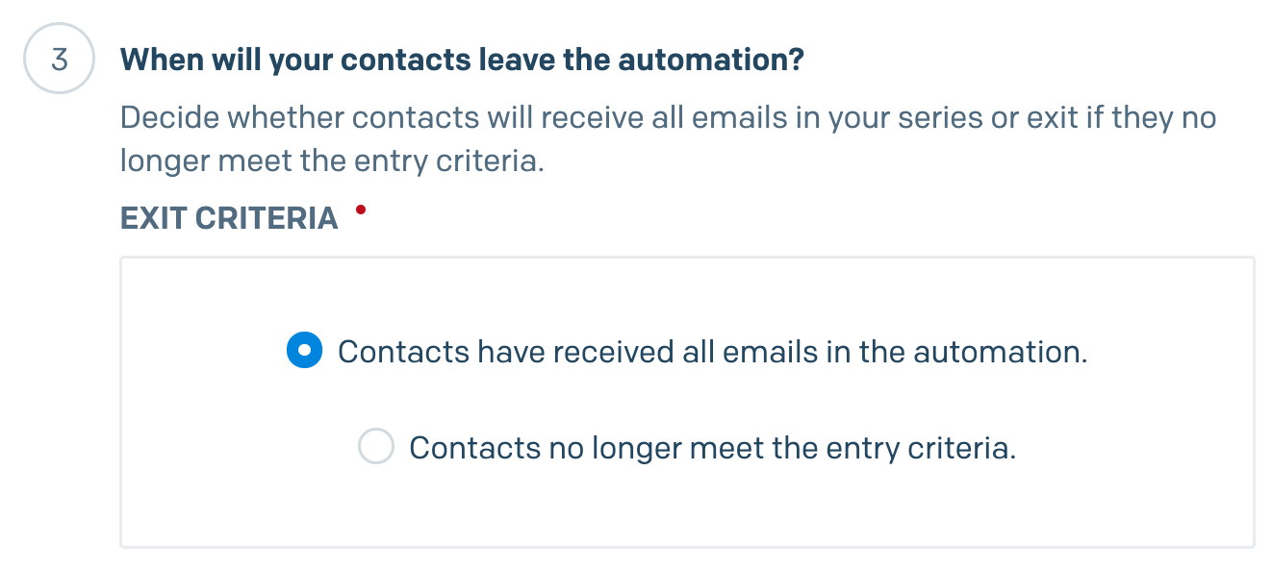

Slide 14
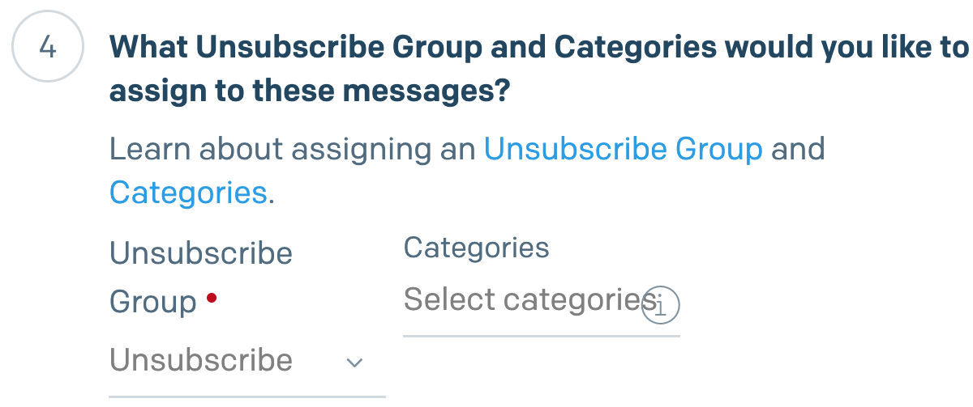

Slide 17
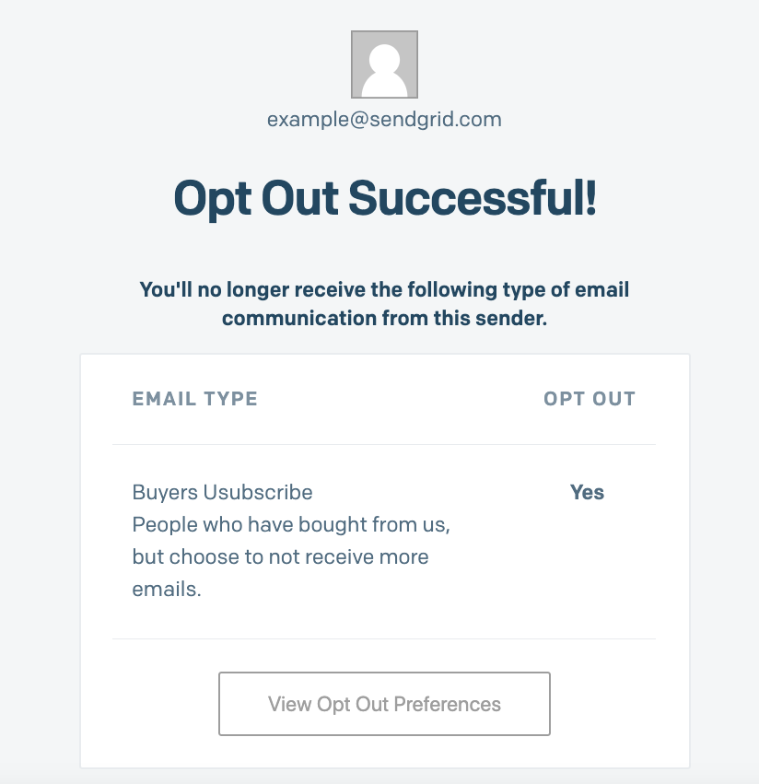

Slide 19
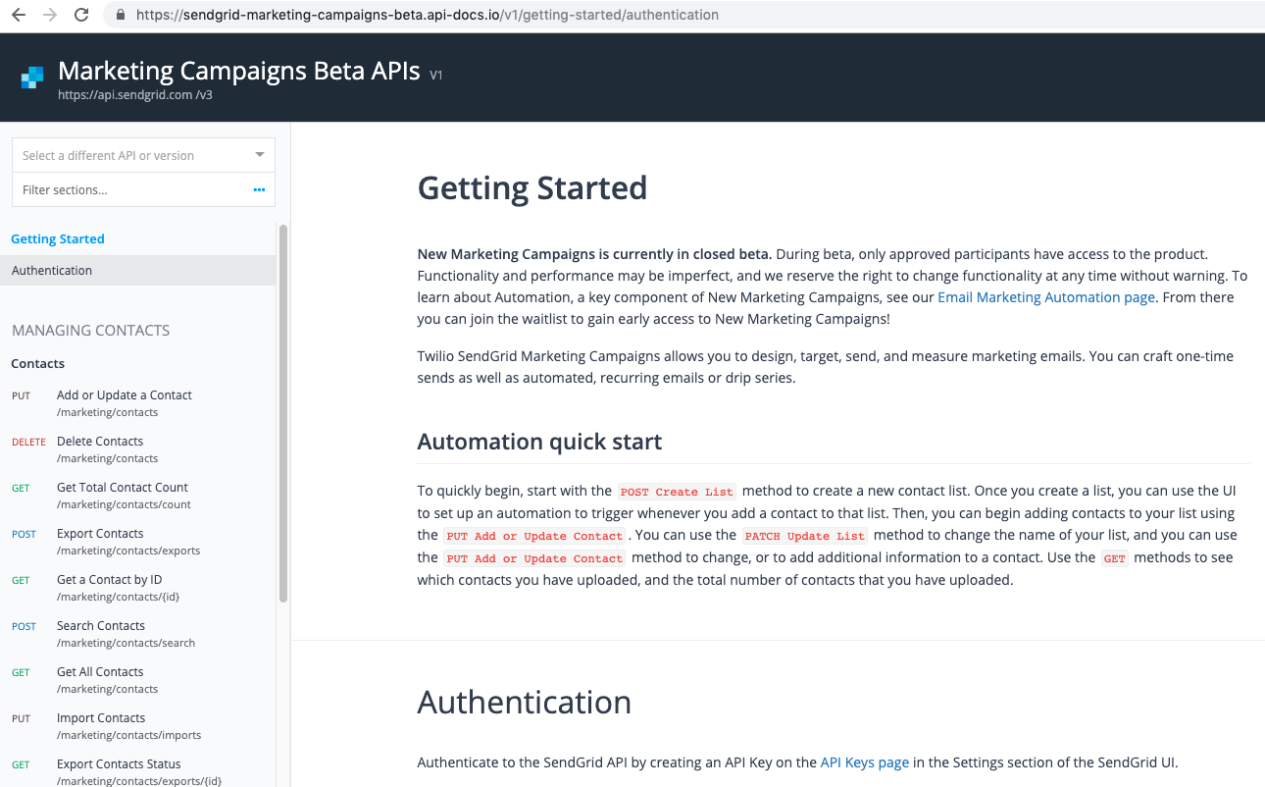
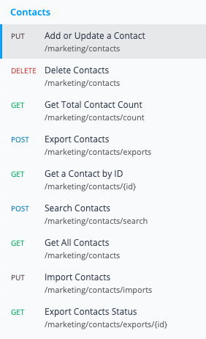
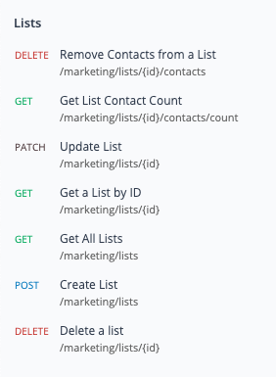

Slide 20
Known API Issues
This API is not currently supported in any of the SendGrid Libraries.
The URL to call the API is not the final URL and will be changed.
Error messages are not always informative - 404s often mean that there is an invalid value (email or ID).
The GET Count methods can be delayed in having the updated contact counts.
In PUT Add or Update a Contact, the email field is case sensitive. If you add an email with capital letters, and then you are using GET All Contacts and filtering by email, you have to use the same case.

Slide 21
Thank you.

