Slide 1
HyperText Transfer Protocol (HTTP)
2019. 05. 18

Slide 2
SUMMARY
HTTP Conception
OSI Model
How HTTP Works
Request and Response
Session and Cookie

Slide 3
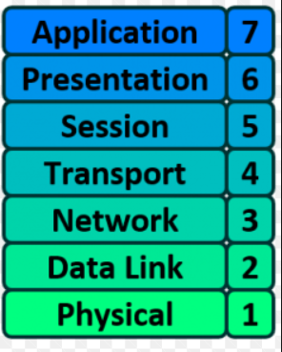
HTTP CONCEPTION
Protocol: A standard procedure for defining and regulating communication.
ex: TCP, UDP, HTTP, SMTP.
HTTP: Protocol for transferring data between server and client like plaintext, hypertext, image, videos and sounds.
HTTP is the foundation of data communication for the WWW (World Wide Web).

Slide 4
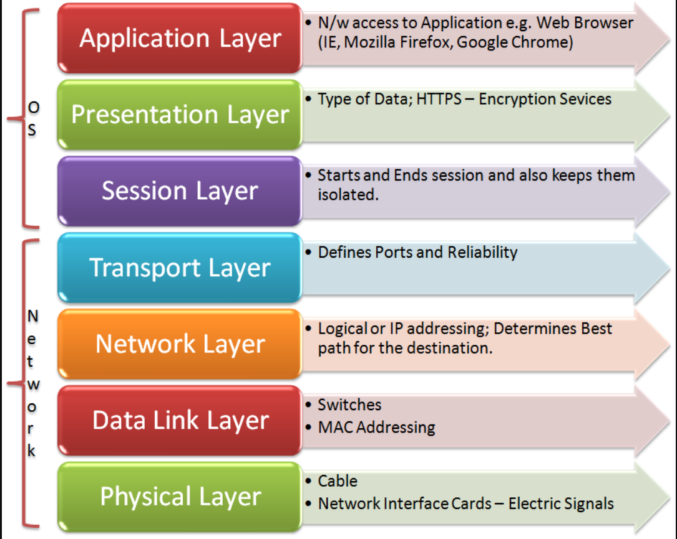
OSI Model

Slide 5
TERMINOLOGY
Internet Protocol address (IP address) is a numerical label assigned to each device
Transmission Control Protocol (TCP) is a protocol to ensure reliable, ordered, error-checked delivery of a stream of octets.
Port Number : A port number is a 16 bit number which when associated with IP address, completes the destination address for a communications session.

Slide 6
HOW HTTP WORKS
HTTP is implemented with client and server program, executing on different end systems, talk to each other by exchanging HTTP messages.
The HTTP client first initiates a TCP connection with the server. Once the connection is established, the browser and the server processes access TCP through their socket interfaces.

Slide 7
HOW HTTP WORKS

Slide 8
HOW HTTP WORKS

Slide 9
HOW HTTP WORKS

Slide 10
HOW HTTP WORKS

Slide 11
HTTP REQUEST MESSAGE

Slide 12
HTTP RESPONSE MESSAGE

Slide 13
STATUS CODES AND PHRASES

Slide 14
HTTP: A STATELESS PROTOCOL
Web application servers are generally "stateless":
Each HTTP request is independent; server can't tell if 2 requests came from the same browser or user.
Web server applications maintain no information in memory from request to request

Slide 15
COOKIES
A cookie is a small piece of text stored on a user's computer by their browser. Common uses: authentication, storing site preferences, shopping cart items, and server session identification.
Each cookie is just a name-value pair
Cookies can only store 4KB of data

Slide 16
ARE ALL COOKIES SAME?
Session Cookies: These are temporary cookie files, which are erased when you close your browser. When you restart your browser and go back to the site that created the cookie, the website will not recognize you.
Persistent cookies: these remain on your hard drive until you erase them or they expire.

Slide 17
SESSION
A session can be defined as a server-side storage of information that is desired to persist throughout the user's interaction with the web site.
Cookie is passed to the web server every time the browser makes an HTTP request and used by the server to implement Session

Slide 18
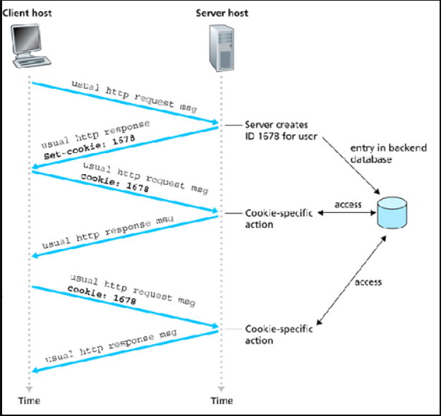
COOKIE & SESSION STEPS

Slide 19
THANK YOU

