Slide 1
Envoyer
2019-07-28 RIC

Slide 2
Heroic Features
GitHub / Bitbucket Integration
GitLab Self-Hosted Integration
Seamless Deployment Rollbacks
Deploy To Multiple Servers

Slide 3
Heroic Features
Application Health Checks
Integrated Chat Notifications
Deploy Any PHP Project
Unlimited Team Members

Slide 4
Integrations

Slide 5
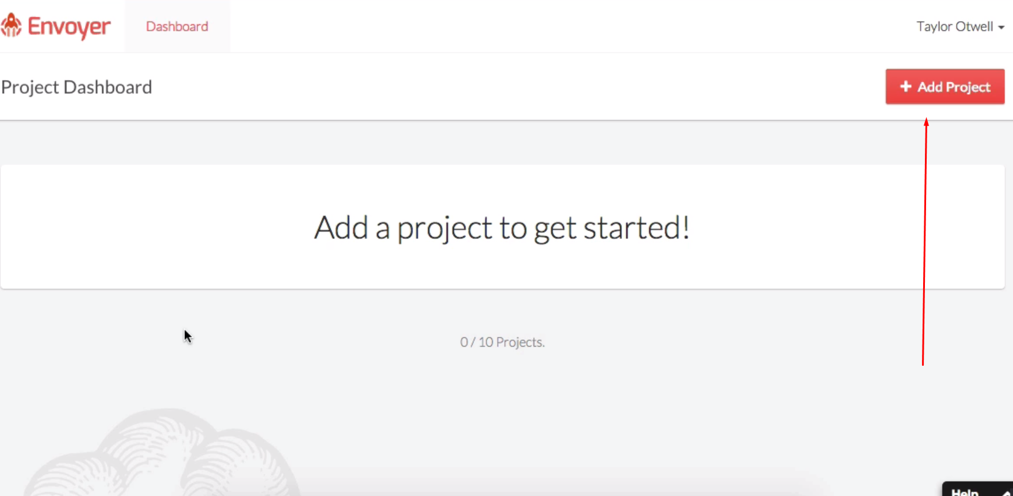

Slide 6
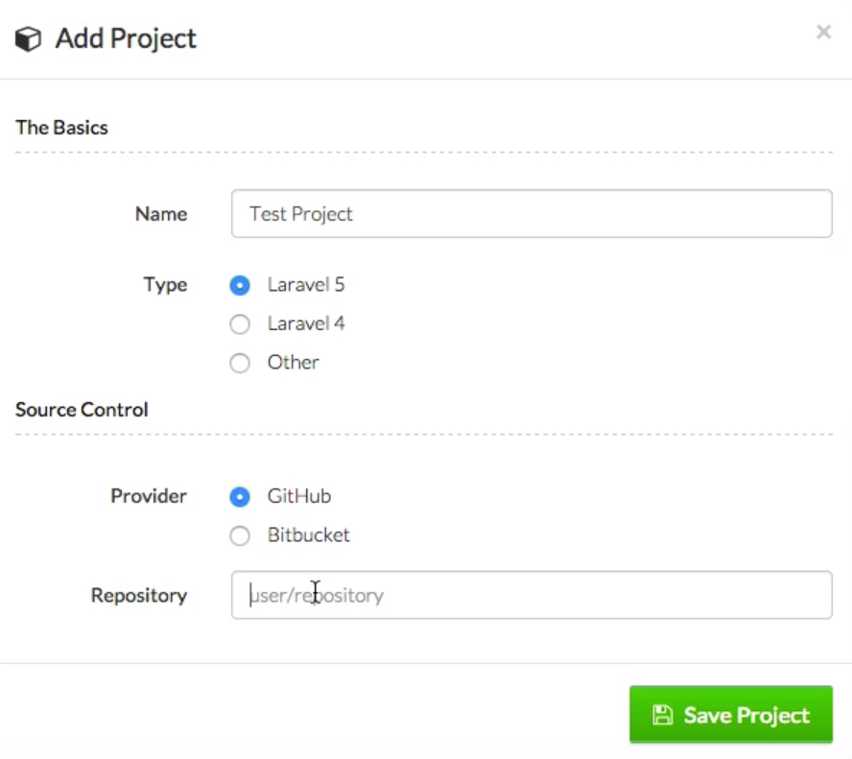

Slide 8
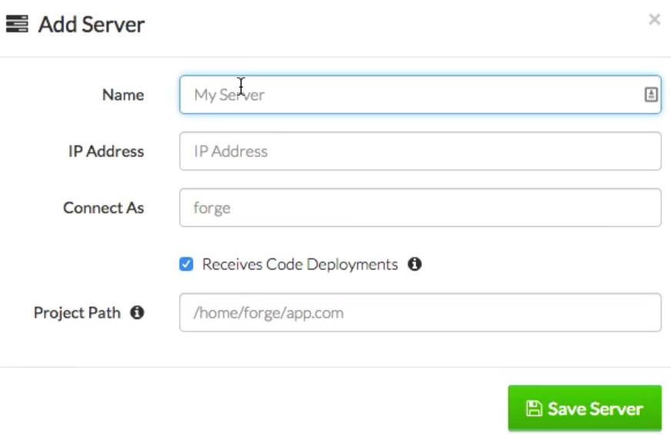

Slide 9
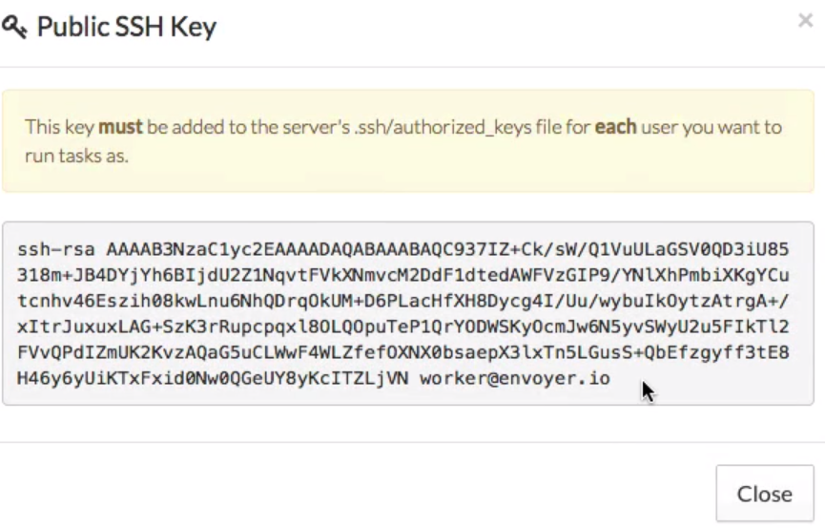

Slide 10
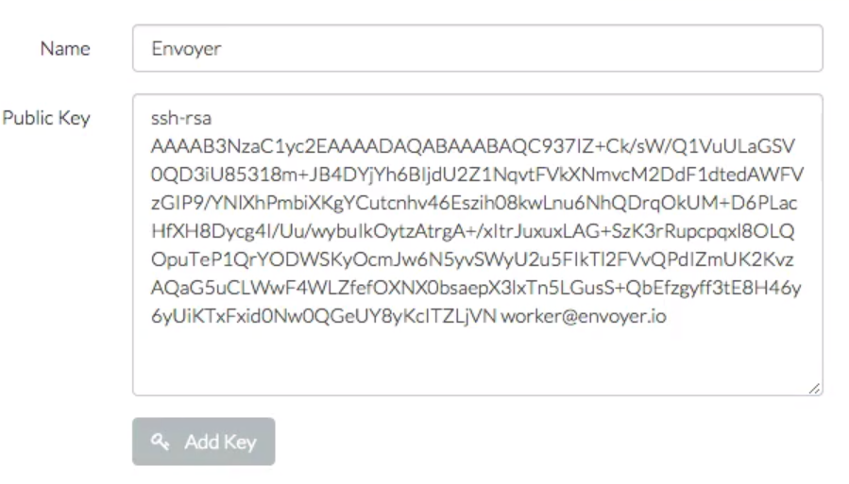

Slide 11
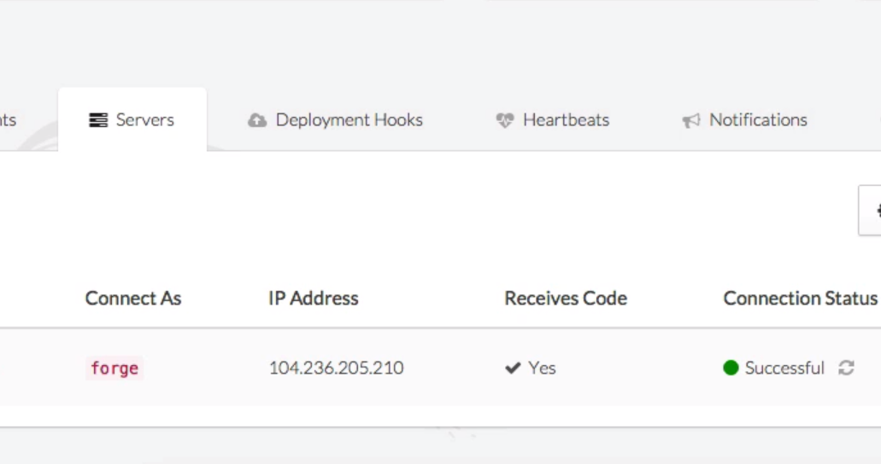

Slide 12
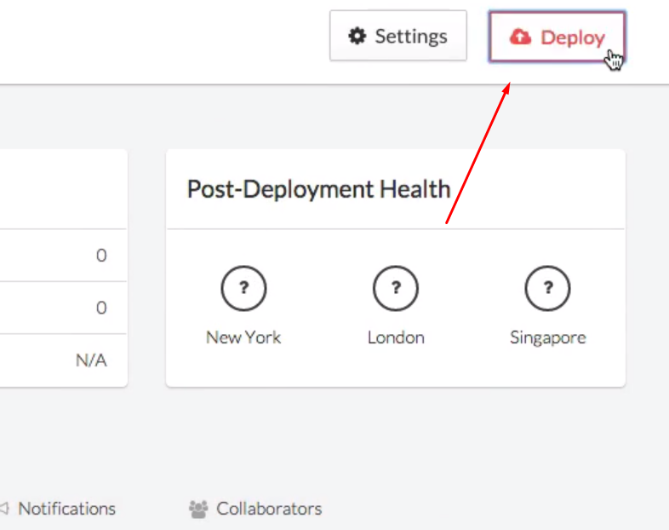

Slide 13
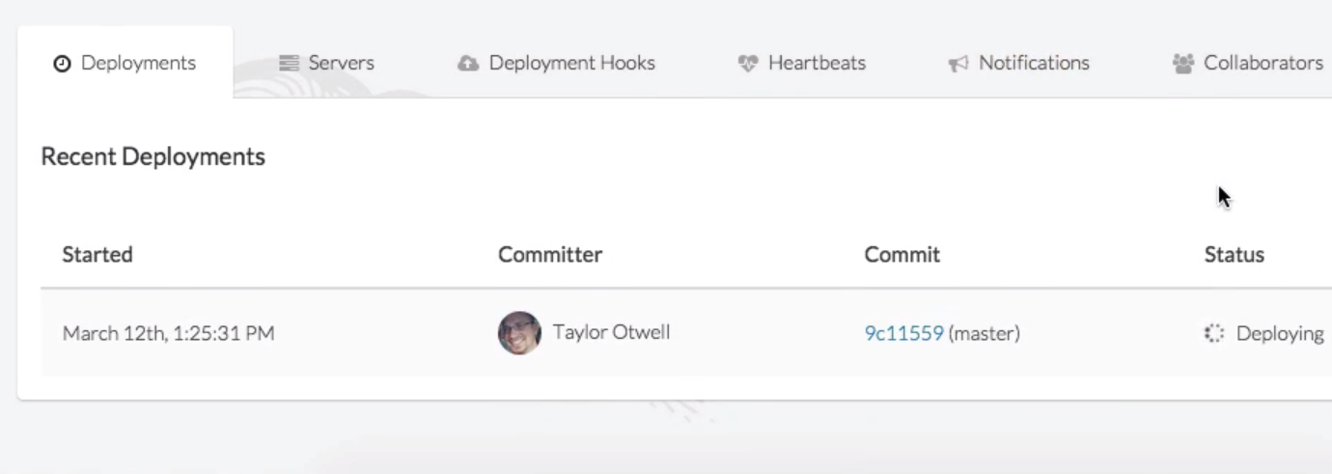

Slide 14
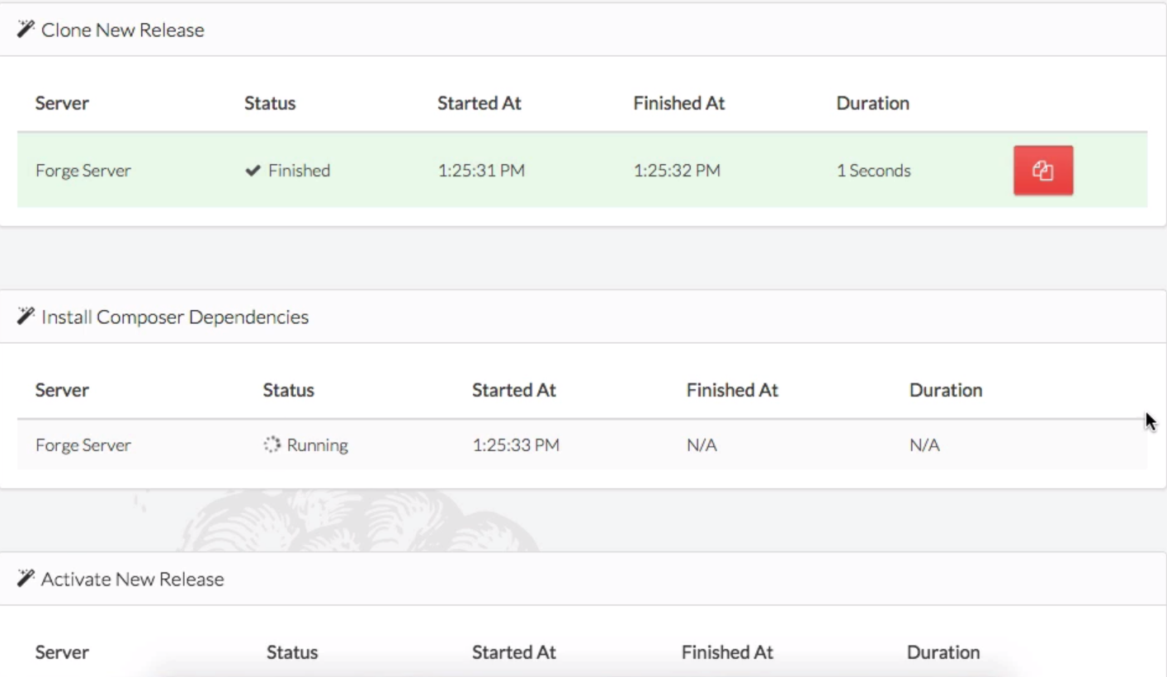

Slide 15
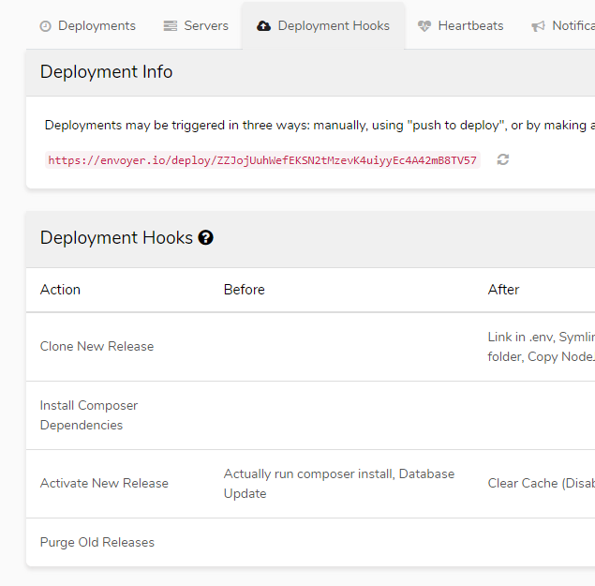

Slide 16
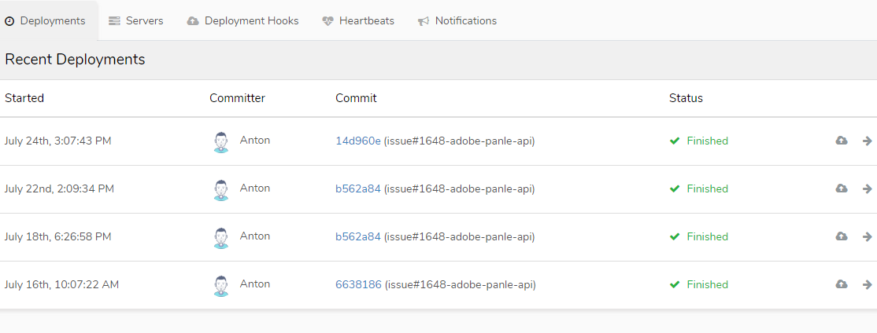

Slide 17
Thanks!

