Slide 1
GatsbyJS
@Phurunbit Tech Inc, 2019

Slide 2
01
02
03
What is Gatsby?
Why Gatsby?
How Gatsby Works
TABLE OF CONTENTS
04
05
06
Gatsby Features
How To Use Gatsby
Gatsby Example
Building blazing fast, modern apps and websites with React
Gatsby is a modern web framework for blazing fast websites
Pull data from anywhere
One page summary of how to install Gatsby
Using CLI

Slide 3
01
What is Gatsby?
Building blazing fast, modern apps and websites with React

Slide 4
Gatsby
Gatsby is a free and open source framework based on React that helps developers build blazing fast websites and apps.

Slide 5
OUR STORY
Was born in May 2015 as a simple way to build a website with React.
In early 2018, Gatsby Inc to help website development teams build CMS-powered websites with modern tooling.

Slide 6
02
Why Gatsby
Modern web framework for blazing fast websites

Slide 7
Why Gatsby?
Digital experiences on the edge
Blazing fast websites
Today’s consumers want to visit websites, not physical locations. Move at their speed — create their digital experiences with Gatsby.
Turn content-driven websites into lightning-fast edge apps that skyrocket engagement. Security and speed live on the edge, with Gatsby.
Gatsby’s edge architecture delivers website performance by default.
With Gatsby, 200ms is the new 2s. Near-instantaneous navigation means users stay engaged with
your content, rather than bouncing while they wait for it to load.

Slide 8
WHAT SETS US APART?
START QUICKLY
DELIGHT DEVELOPERS
ENSURE SAFETY
EXCEED EXPECTATIONS

Slide 9
03
How Gatsby Works
Pull data from anywhere

Slide 10
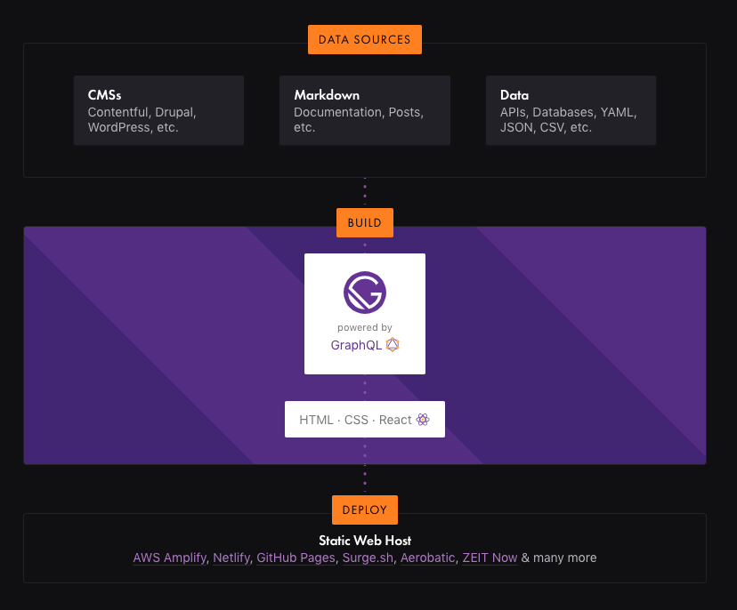
How Gatsby
works

Slide 11
04
Gatsby Features
One page summary of how to install Gatsby

Slide 12
Features
Modern web tech without the headache
Enjoy the power of the latest web technologies – React.js , Webpack , modern JavaScript and CSS and more — all set up and waiting for you to start building.
Bring your own data
Gatsby’s rich data plugin ecosystem lets you build sites with the data you want — from one or many sources: Pull data from headless CMSs, SaaS services, APIs, databases, your file system, and more directly into your pages using GraphQL .

Slide 13
Features
Scale to the entire internet
Gatsby.js is Internet Scale. Forget complicated deploys with databases and servers and their expensive, time-consuming setup costs, maintenance, and scaling fears.
Future-proof your website
Do not build a website with last decade’s tech. The future of the web is mobile, JavaScript and APIs—the JAMstack. Every website is a web app and every web app is a website.

Slide 14
Features
Static Progressive Web Apps
Gatsby.js is a static PWA (Progressive Web App) generator. You get code and data splitting out-of-the-box. Gatsby loads only the critical HTML, CSS, data, and JavaScript so your site loads as fast as possible.
Speed past the competition
Gatsby.js builds the fastest possible website. Instead of waiting to generate pages when requested, pre-build pages and lift them into a global cloud of servers — ready to be delivered instantly to your users wherever they are.

Slide 15
05
How To Use Gatsby

Slide 16
Use the Gatsby CLI
Install the Gatsby CLI.
npm install -g gatsby-cli
gatsby new gatsby-site
Create a new site.
Start development server.
gatsby develop
gatsby serve
Serve the production

Slide 17
Gatsby Example
06
Using CLI

Slide 18
Example

Slide 19
THANKS

