Slide 1
NOW
World-Class Static Hosting
2019.12.1
https://zeit.co

Slide 2
- Conception & Features
- Installation & Deploy
- Now Configuration
- Serverless Function
Overview

Slide 3
ZEIT Now is a cloud platform for static sites and Serverless Functions. It enables developers to host websites and web services that deploy instantly, scale automatically, and requires no supervision, all with no configuration.
Conception

Slide 4
Features
- Now provides the framework to avoid re-writing and re-learning everything from scratch to take advantage of serverless today
- You can deploy popular client-side frameworks (like Next.js, React, Angular, Vue), Node.js or Go APIs with nearly zero configuration
- We integrate directly with Git to deploy upon every push

Slide 5
Installation

Slide 6
> npm i -g now
> now login
> npm init next-app my-next-project

Slide 7
Deploy

Slide 8
> cd my-next-project
> now
> now --prod

Slide 9
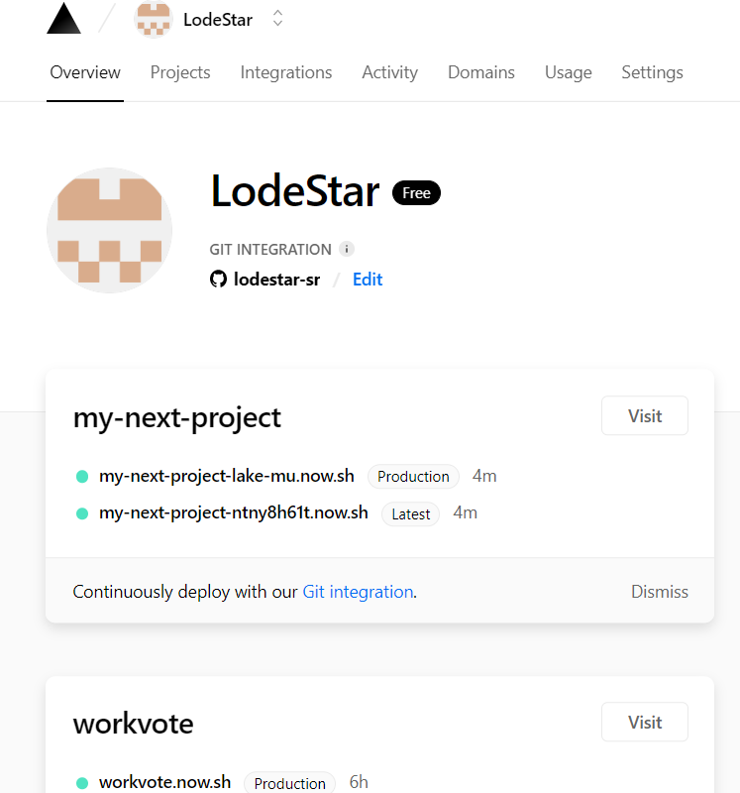
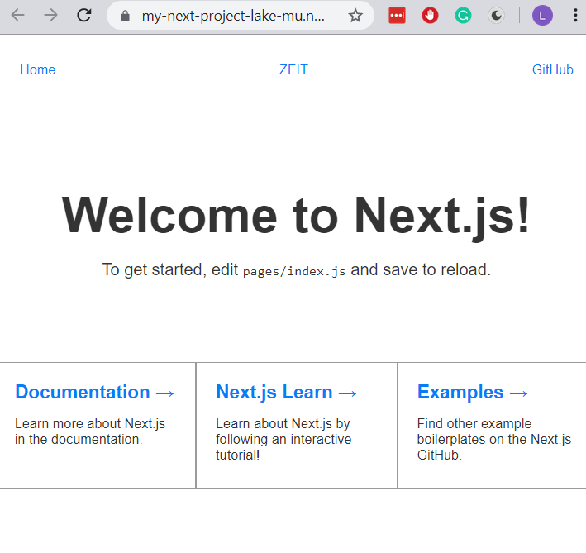

Slide 10
Custom Domain

Slide 11
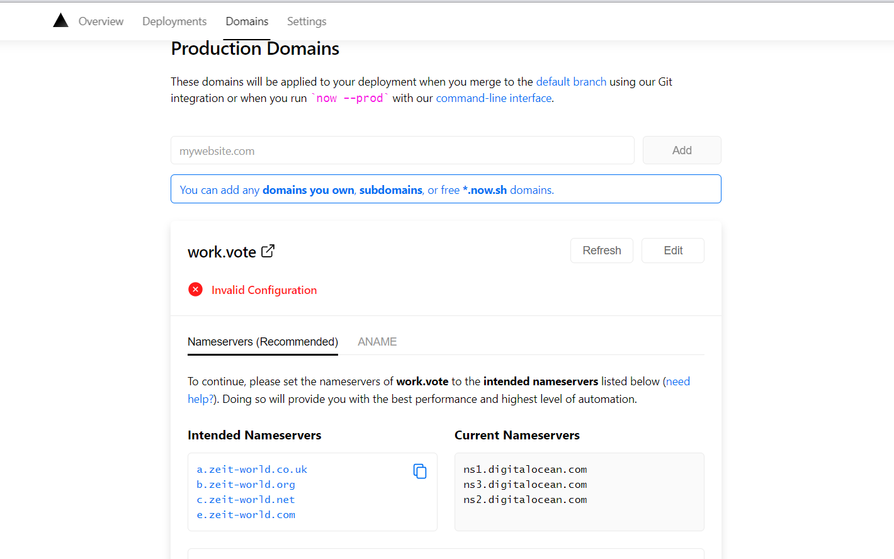

Slide 12
NOW Configuration

Slide 13
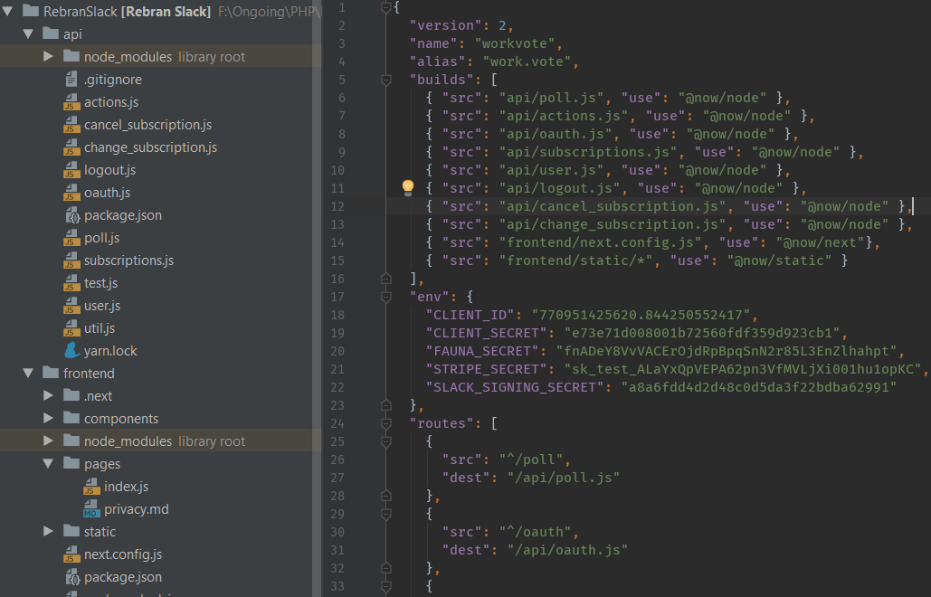

Slide 14
Serverless Functions
With ZEIT Now, you can deploy Serverless Functions with
- Node.js
- Go
- Python
You can use Serverless Functions to handle user authentication, form submission, database queries, custom slack commands, and more.

Slide 15
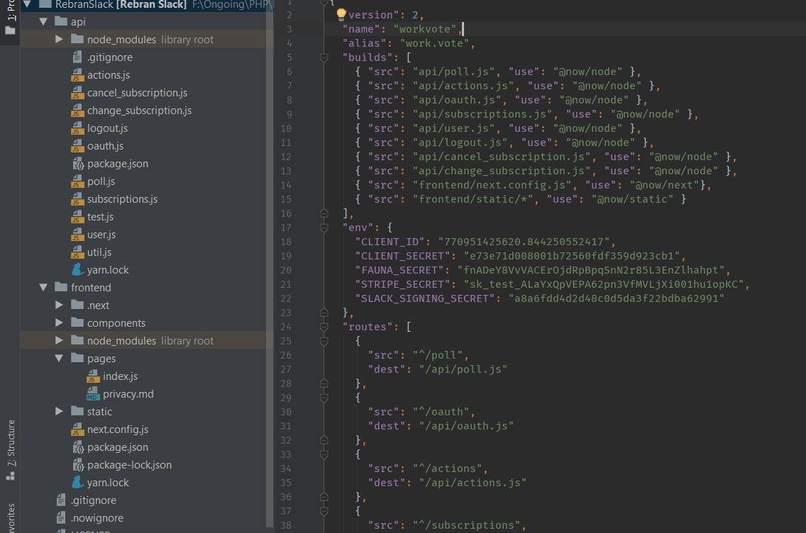

Slide 16
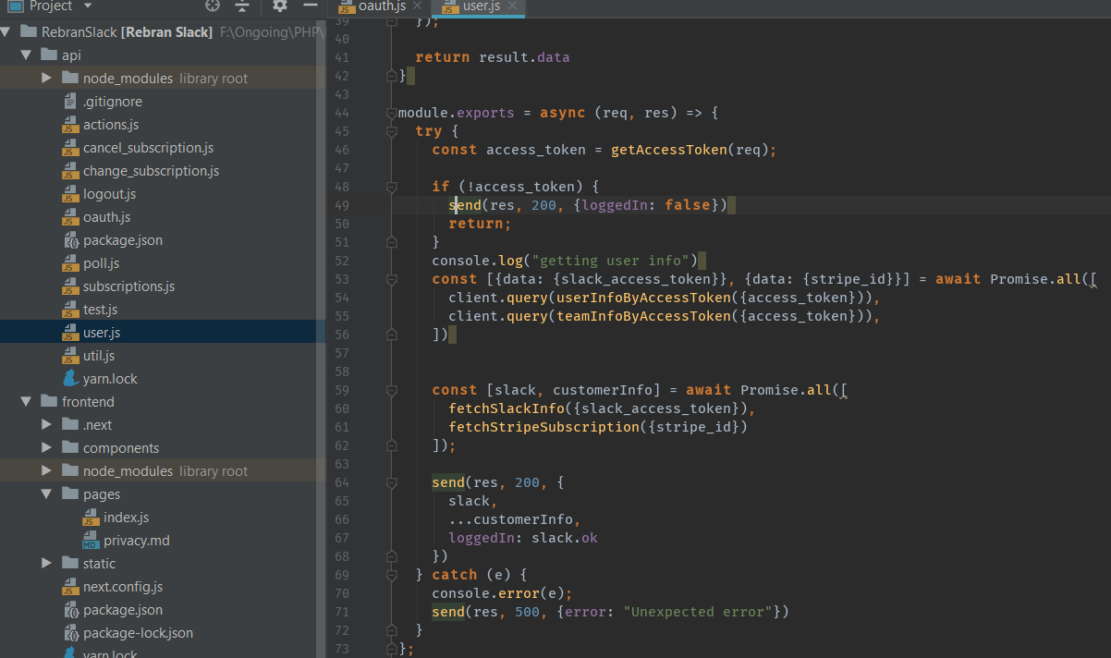

Slide 17
Thank You

