Slide 1
Stripe-SCA
(Strong Customer Authentication)
2019-09-15

Slide 2
Concept
Strong Customer Authentication (SCA), a rule in effect as of September 14, 2019, as part of PSD2 regulation in Europe, requires changes to how your European customers authenticate online payments.
Card payments require a different user experience, namely 3D Secure, in order to meet SCA requirements.
Transactions that don’t follow the new authentication guidelines may be declined by your customers’ banks.

Slide 3
Migrating existing payment
https://stripe.com/docs/payments/payment-intents/migration
Update your API version and your client library.
Migrate your existing Charges API integration on Web, iOS, and Android to use the Payment Intents API.
Migrate your integration that saves cards on Customer objects.
Test with regulatory test cards to ensure your upgraded integration handles authentication correctly.

Slide 4
Update your API version and your client library
While the Payment Intents API works on all API versions, we recommend that you upgrade to the latest API version. If you decide to use an API version older than 2019-02-11, note the following two changes as you go through the code examples:
requires_source has been renamed to requires_payment_method
requires_source_action has been renamed to requires_action
In addition, if you use one of our Client libraries, upgrade to the latest version of the library in order to use the Payment Intents API.

Slide 5
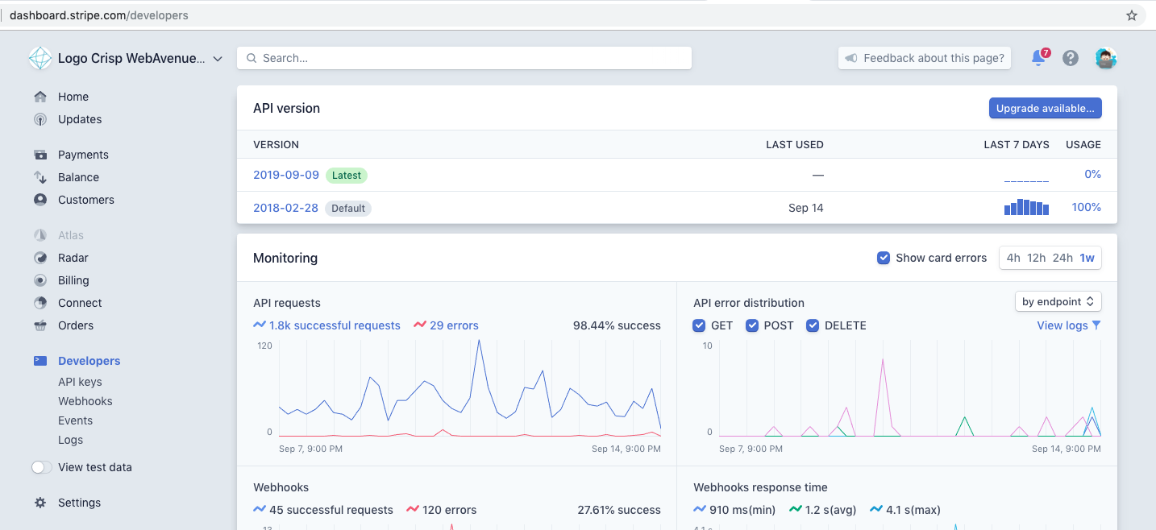
Update your API version and your client library

Slide 6
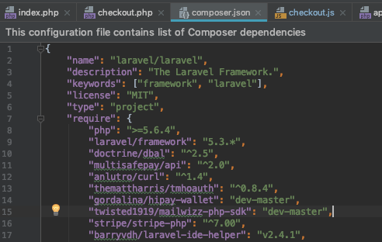
Update your API version and your client library

Slide 7
2. Migrate your existing Charges API integration on Web, iOS, and Android to use the Payment Intents API
Collect payment details on the client side
Attempt the payment on the server side
Handle the server response on the client side

Slide 8
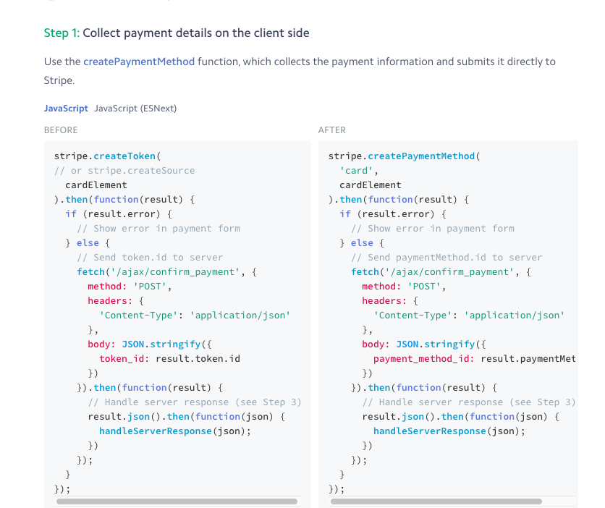
Collect payment details on the client side

Slide 9
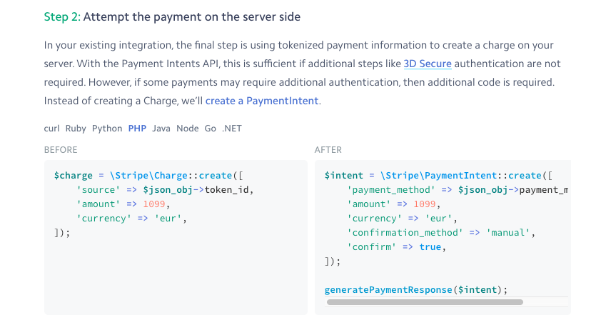
Attempt the payment on the server side

Slide 10
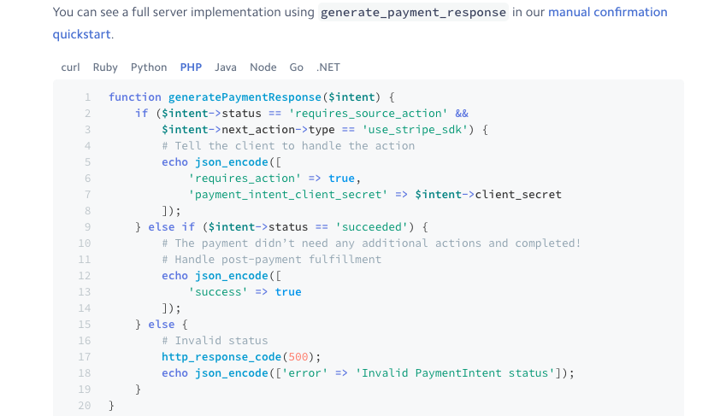
Attempt the payment on the server side

Slide 11
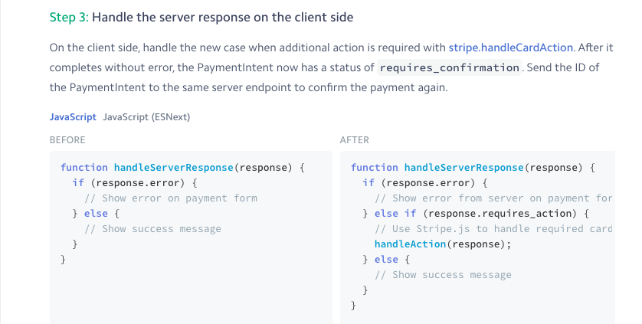
Handle the server response on the client side

Slide 12
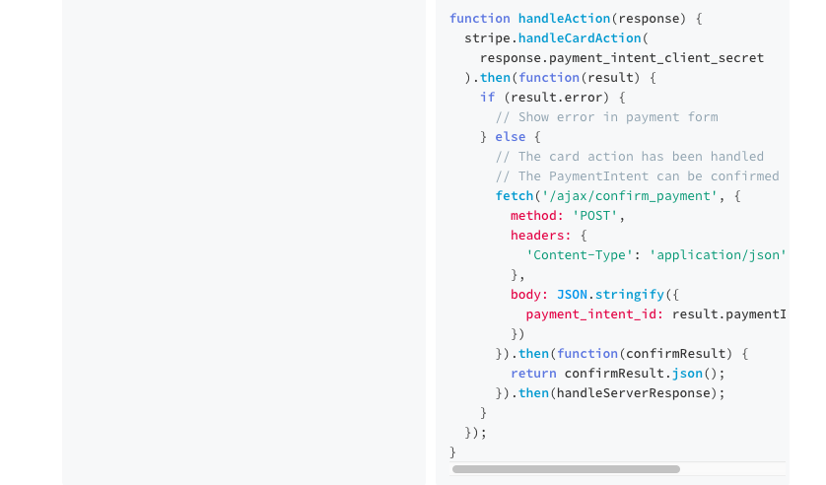
Handle the server response on the client side

Slide 13
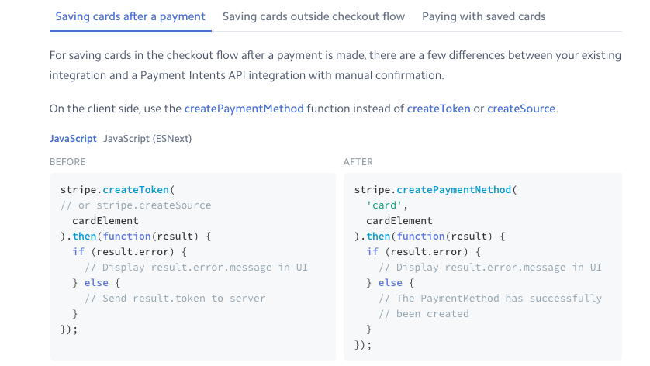
3. Migrate your integration that saves cards on Customer objects.

Slide 14
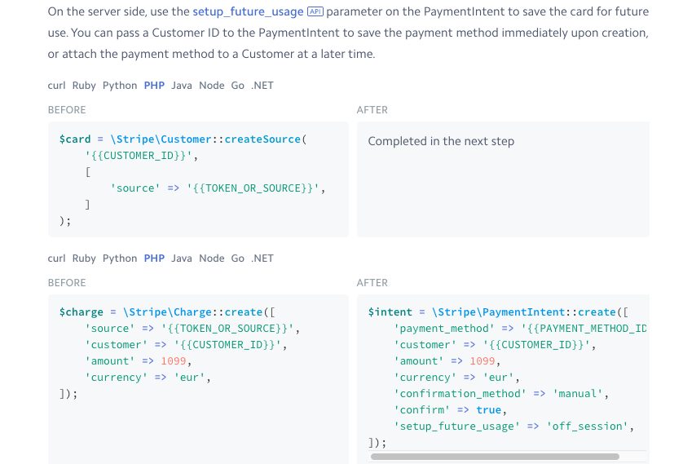
Migrate your integration that saves cards on Customer objects.

Slide 15
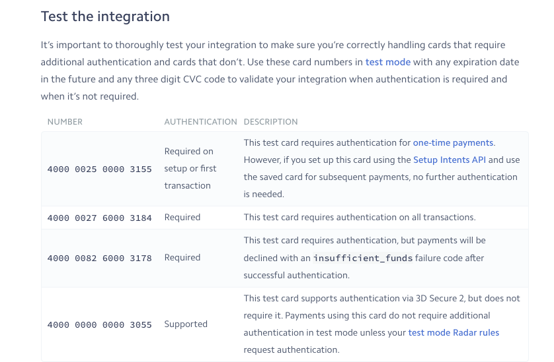
4. Test with regulatory test cards to ensure your upgraded integration handles authentication correctly.

Slide 16
Thank You

