Slide 1
Web Application Testing
2019-05-26 RIC

Slide 2
What is covered in this Lecture?
Why is test important?
What is type of test?
Examples

Slide 3
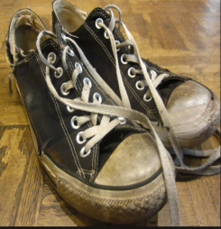
1. What is test importnat?

Slide 4
2. What is type of test?
Unit
Integration
End To End, Functional, Browser

Slide 5
2.1. Unit Testing
Individual and isolated parts work.
Class or complex algorithm
Isolated and independent
Fast (few seconds)

Slide 6
2.2. Integration Testing
That is to test how parts of system work together
Database, network and third-party
Not Isolated
Slower than unit testing

Slide 7
2.3. E2E Testing
That is to test whether the flow of application is performing as designed from start to finish
User’s behavior
Very slow

Slide 8
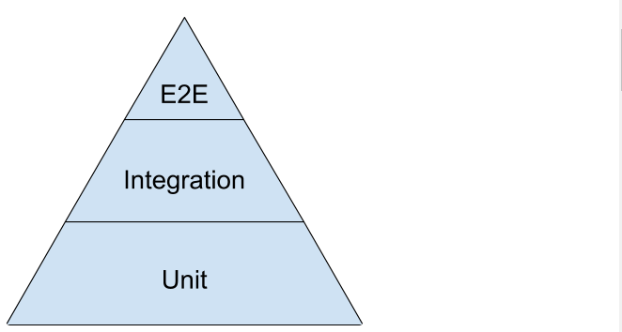
2. Balance between tests
10%
20%
70 %

Slide 9
3. Example (laravel dusk)
.php artisan dusk: install
.php artisan dusk
.php artisan dusk:make Browse
.php artisan dusk tests/Browser/Browse.php

Slide 10
3. Example (laravel dusk)
{root}/tests/Browser/Browse.php

Slide 11
3. Example (laravel dusk)
Functions
Asserts
.assertSee
.assertSeeIn
.assertDontSeeIn
.assertPathIs
.assertRouteIs
…
.visit
.waitForText
.type
.click
.loginAs
…

Slide 12
Thank You

