Slide 1
Expo
Open Source Framework
For Universal React Native Applications

Slide 2
Content
What is Expo?
2. Get Started
3. Expo Tools
4. Advantages and Disadvantages of Expo

Slide 3
What is Expo?
Expo is a framework and a platform for universal React applications.
It is a set of tools and services built around React Native and native platforms that help you develop, build, deploy, and quickly iterate on iOS, Android, and web apps from the same Javascript/TypeScript codebase.

Slide 4
2. Get Started
# Install the command line tools
npm install --global expo-cli
# Create a new project
expo init my-project
# Start the project
expo start
# Login with your expo account (https://expo.io)
expo login

Slide 5
# Build the project
expo build:ios
expo build:android
# Publish app to expo host
expo publish
(go to https://exp.host/@username/yourApp)
# Release channels
expo publish --release-channel <your-channel>
(go to https://exp.host/@username/yourApp?release-channel=<channel-name>)
...

Slide 6
3. Expo Tools
Expo Client
for Android and iOS
Expo Cli
Command line environment
Expo Snack
React Native in browser
Expo SDK
libraries

Slide 7
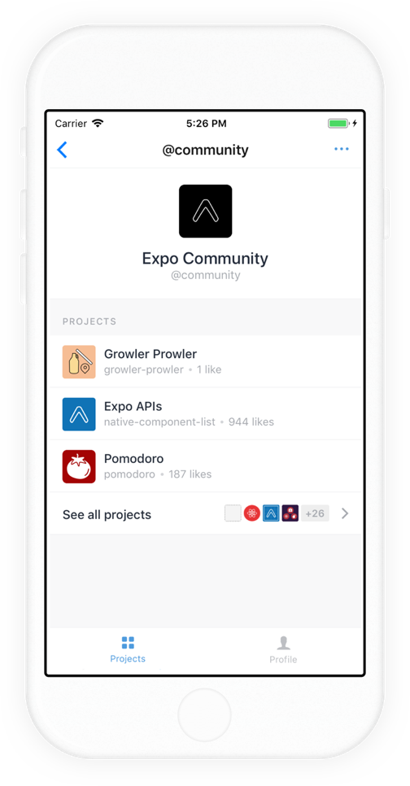
Expo Client
Run your projects before you deploy. Open projects by scanning QR codes. Install the Expo client app on your iOS or Android phone and connect to the same wireless network as your computer. Use the Expo app to scan the QR code from your terminal to open your project.

Slide 8
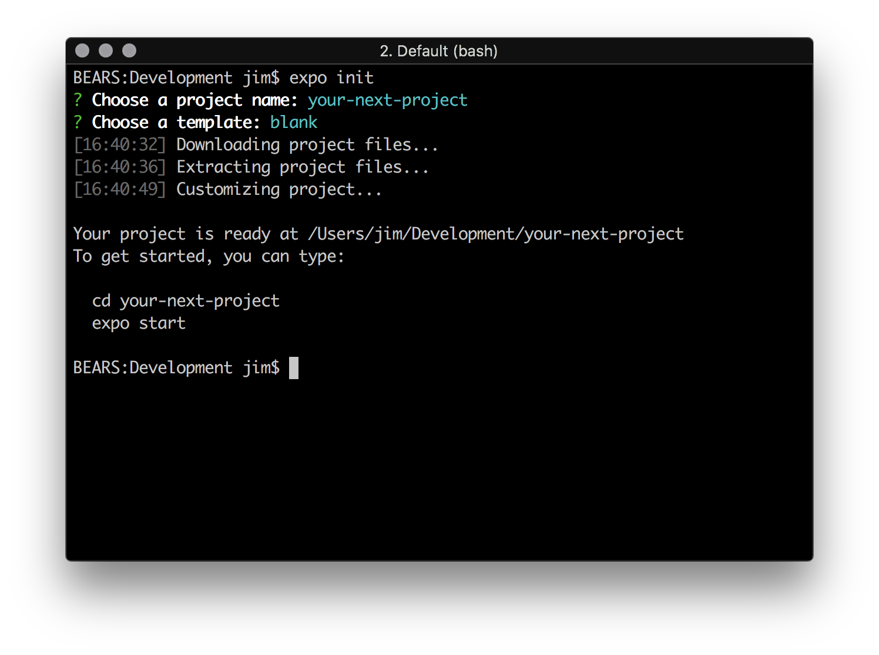
2) Expo CLI
Serve, share, build, and publish Expo projects. Assuming that you have Node 10 LTS or greater installed, you can use npm to install the Expo CLI command line utility: npm install -g expo-cli

Slide 9
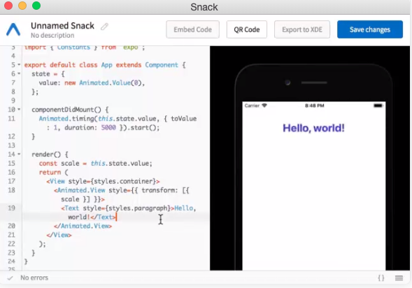
3) Expo Snack
Snack lets you to run complete React Native projects in the browser. No download required. https://snack.expo.io https://expo.io/snacks/@<user_name>/

Slide 10
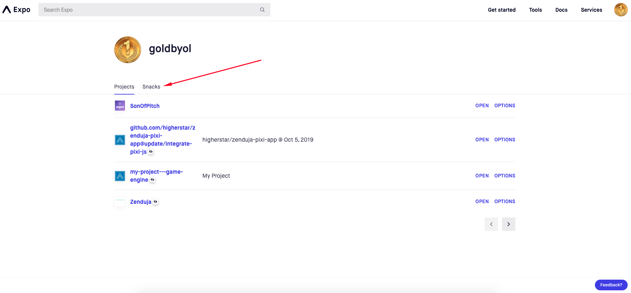

Slide 11
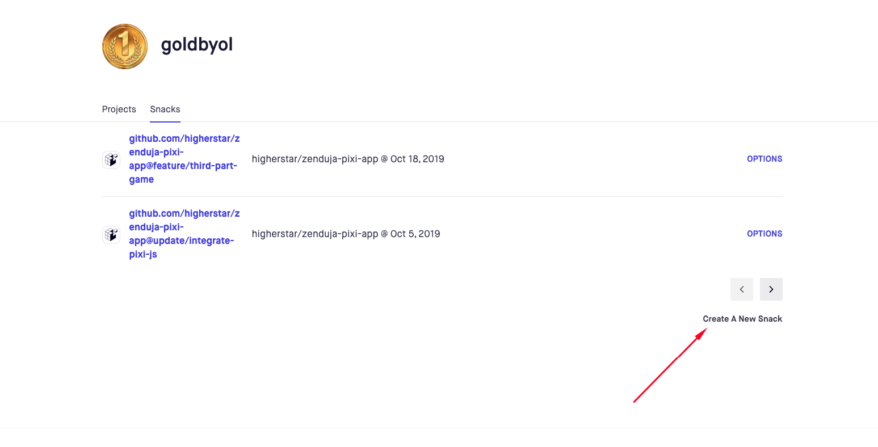

Slide 12
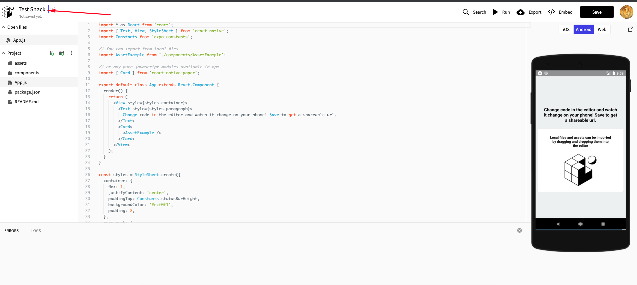

Slide 13
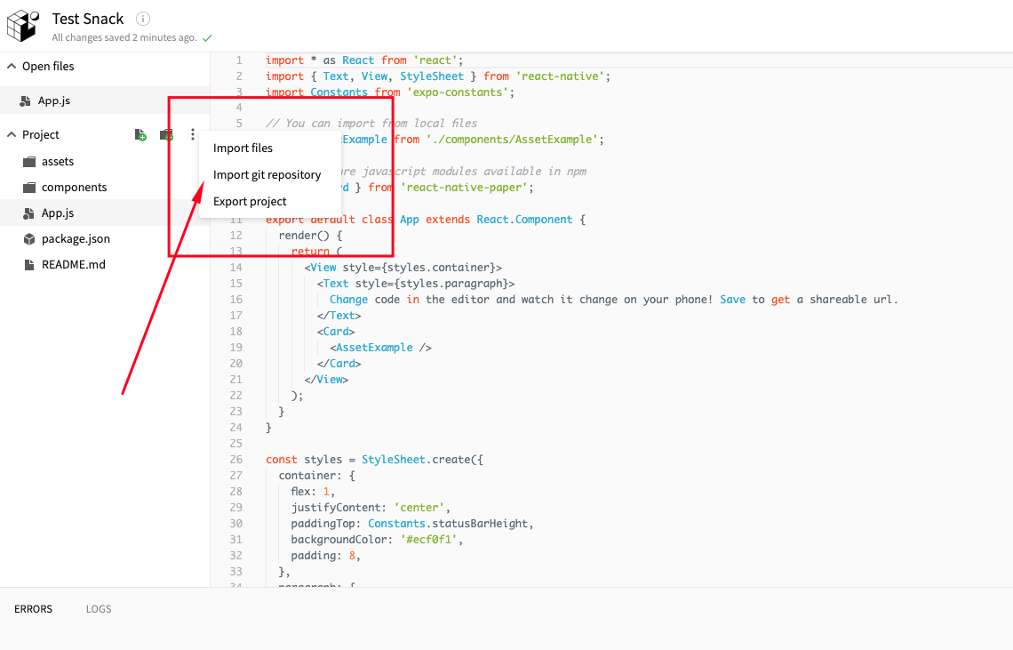

Slide 14
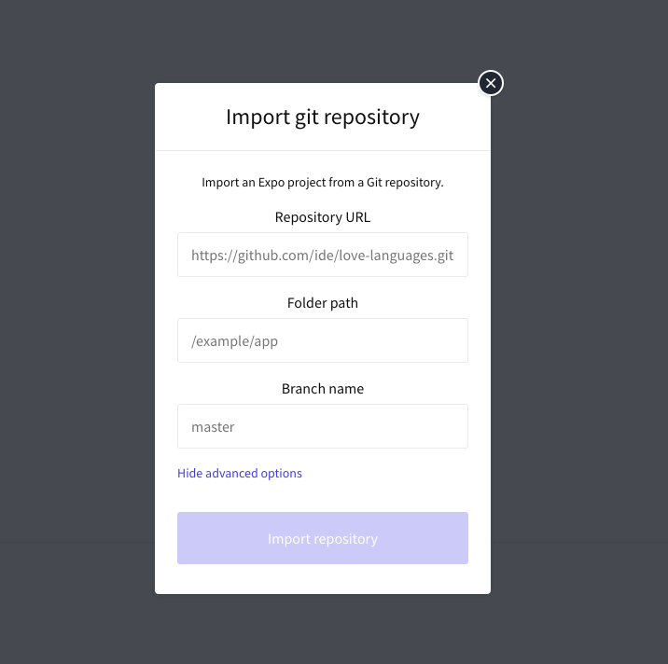

Slide 15
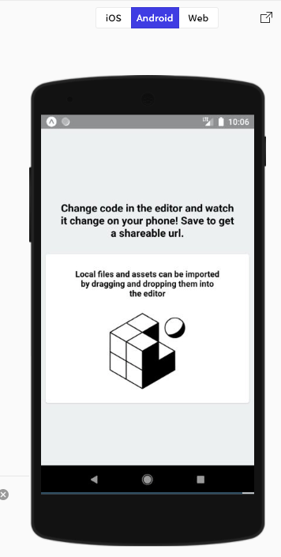
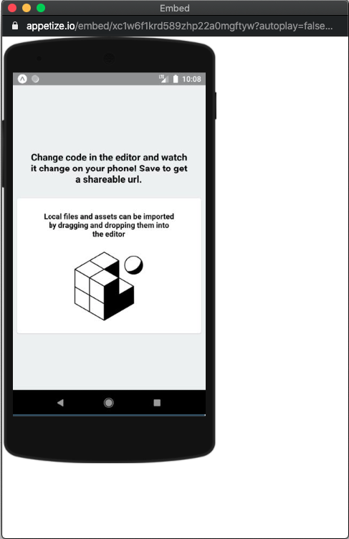

Slide 16
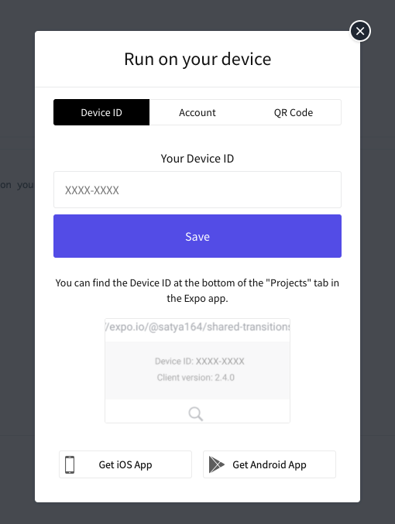
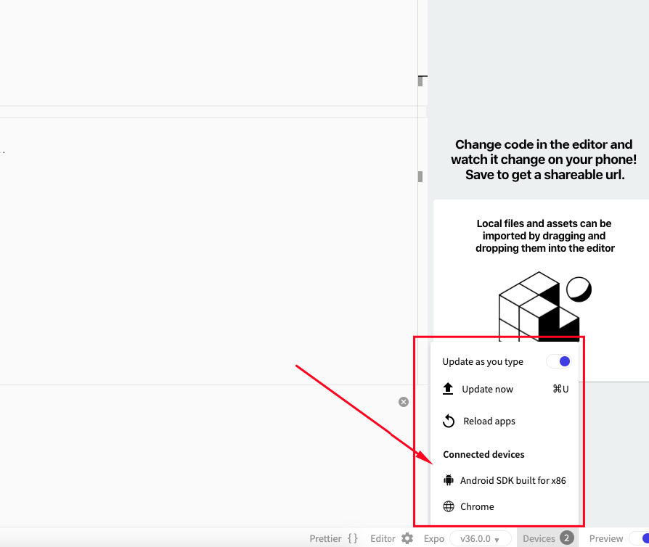

Slide 17
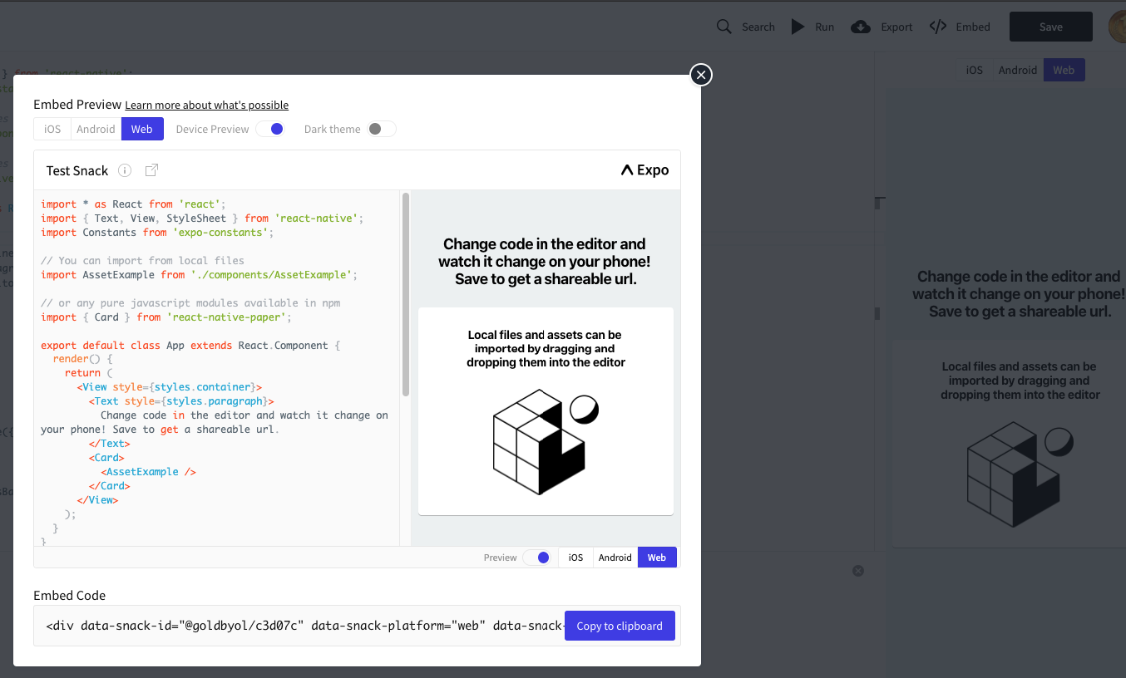

Slide 18
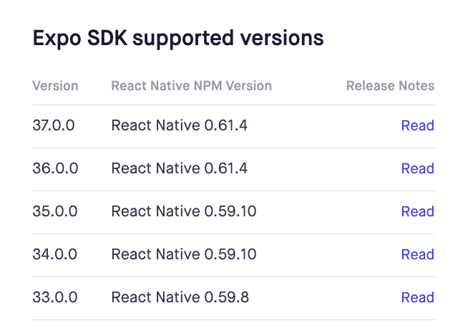
4) Expo SDk
Access native device APIs in your Expo project.

Slide 19
4. Advantages and Disadvantages of Expo
1) Advantages
Fast and simple project installation (in just several minutes)
A convenient utility Expo CLI that opens in a browser and helps to check the app status, devices it runs on, scan QR code or send the link via email to open the app in Expo client, switch the production / development mode and publish your app on Expo server.
Expo client is an app that is installed from Google Play and Apple Store on your phone. It allows opening projects during development without build via XCode or Android Studio. With Expo client, you can send your app to others for review, which is very useful when testing as you can see all changes in code in Expo client without creating apk or ipa files.

Slide 20
Expo SDK offers the collection of ready solutions, such as working with the device accelerometer, camera, notifications, geolocation, etc. You can see them in the section SDK API Reference. Expo team regularly updates SDK with new solutions.
Over the Air - very handy Expo feature for updating your app over the air without repeated deployment on Google Play or Apple Store. When users open your app, it will automatically update new changes in JavaScript code.
You can develop apps for ios without macOS with ios device and test them with Expo client
Automatic management of certificates and app signatures

Slide 21
2) Disadvantages
You can’t add native modules written in Objective-C, Swift, Java, Kotlin
You can’t use packages with native languages that require linking
The app has a big size as it is built with all Expo SDK solutions, even those you don’t use. An application with Hello World weighs 25 MB
Often everything works well in Expo client during testing, but certain problems may occur in a standalone app.

Slide 22
Thank you a lot

