Slide 1
How To Implement CI/CD In GitHub

Slide 2
The Problem
We use Github and every day we commit and push codes to github.
And we want to deliver codes to server via SSH at every commit of git.
In this case, how to implement that in Github?

Slide 3
Steps
Install Azure Pipeline Github App in your github organization account
Add configuration of Azure Pipeline on repository setting
Add ssh configuration in Pipeline
Add environment variables in Pipeline

Slide 4
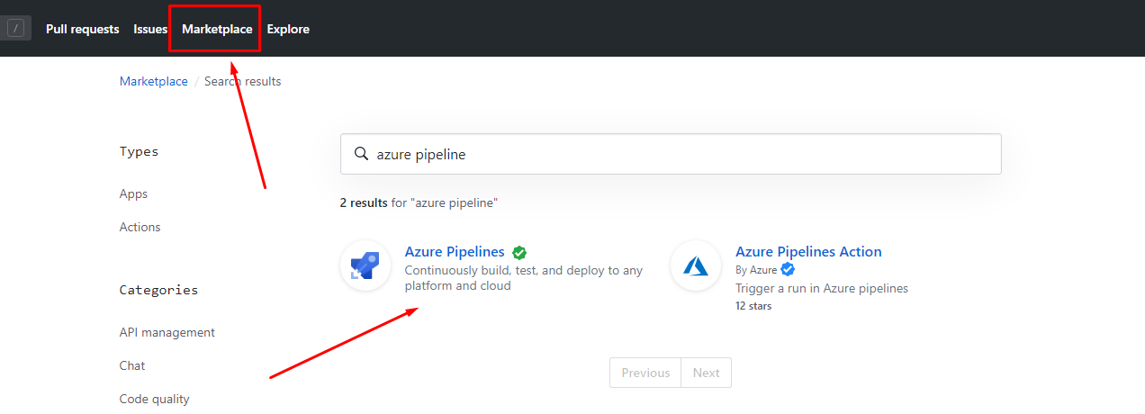
Install Azure Pipeline Github App in your github account

Slide 5
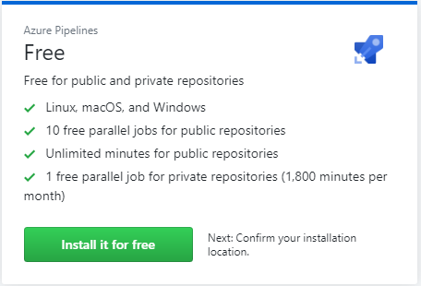

Slide 6
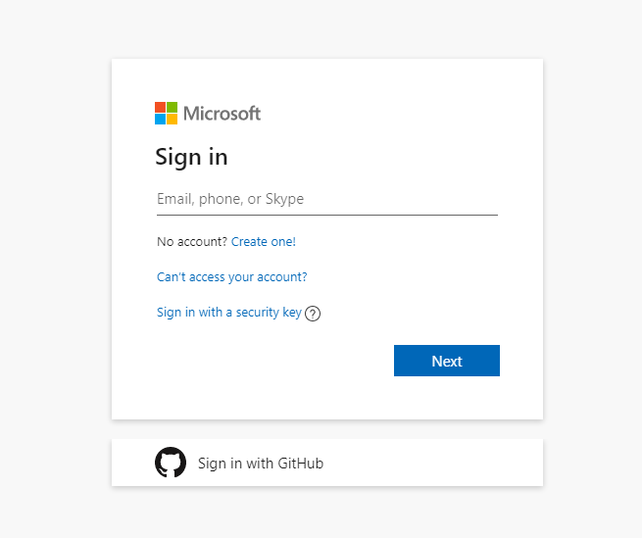

Slide 7
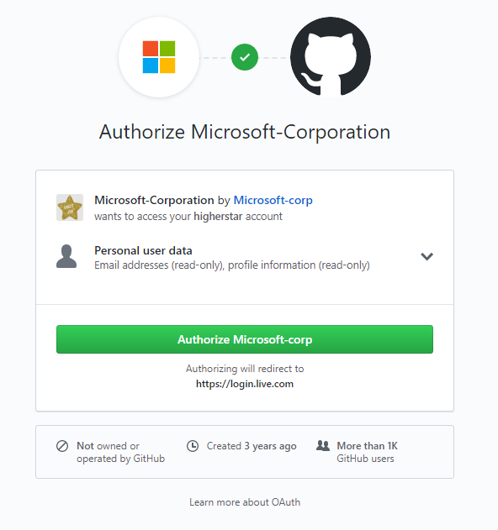

Slide 8
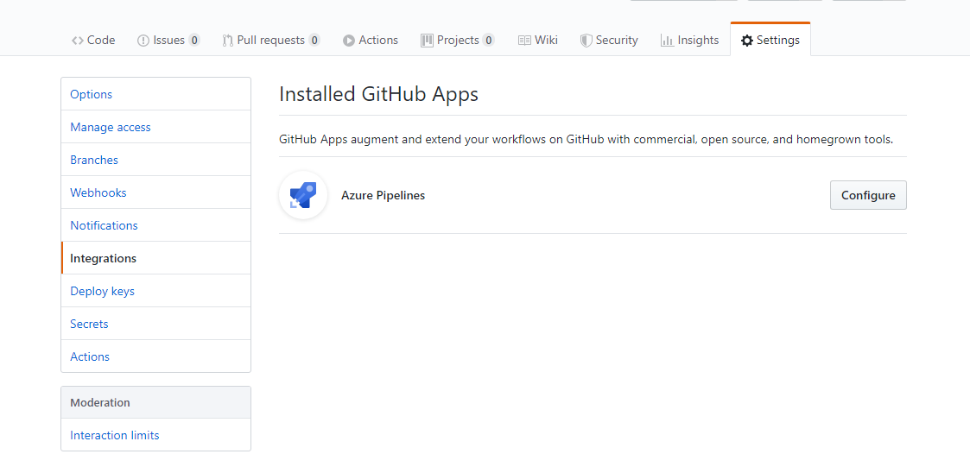
Add configuration of Azure Pipeline on repository setting

Slide 9
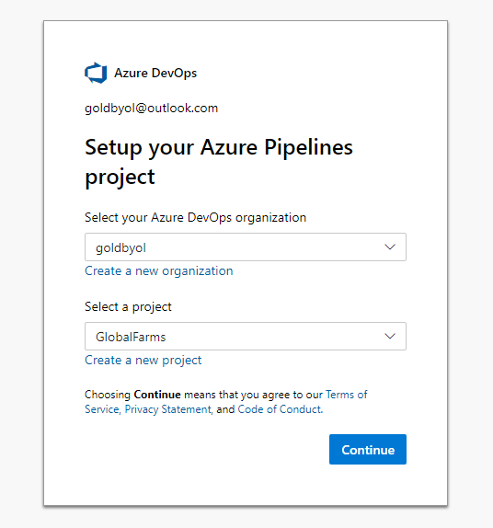

Slide 10
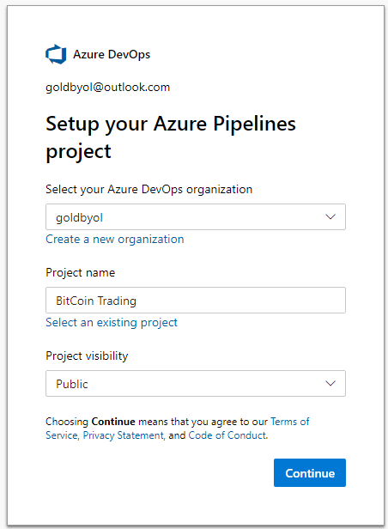
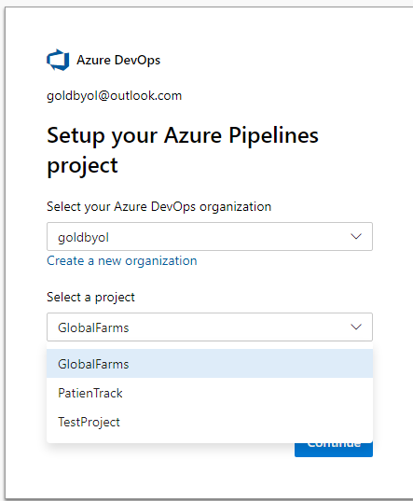

Slide 11
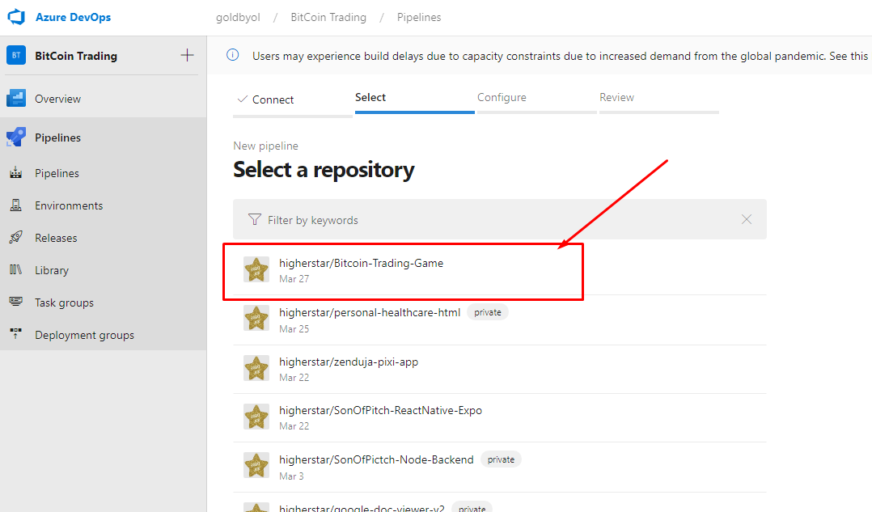

Slide 12
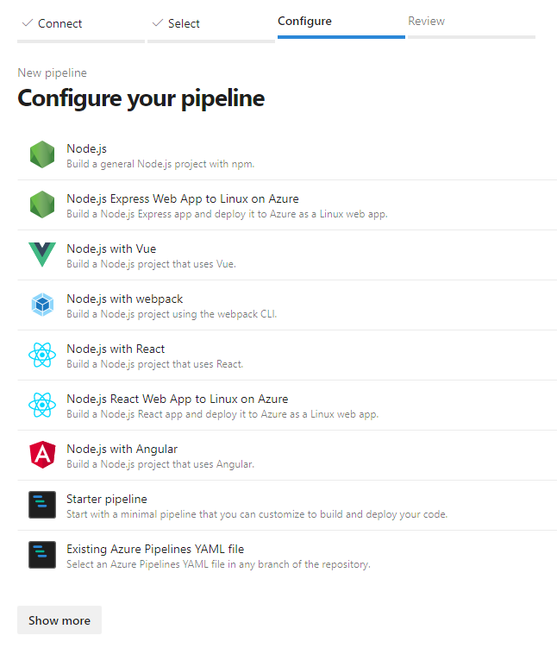

Slide 13
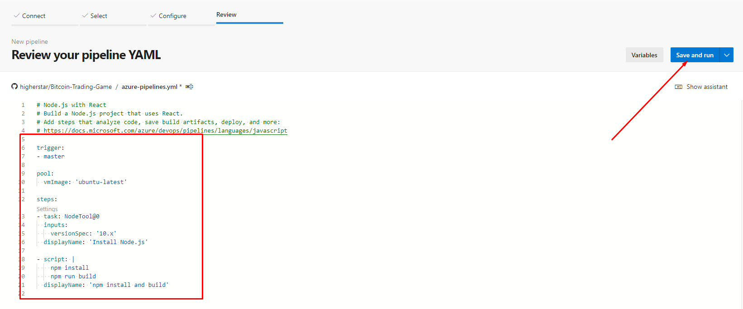

Slide 14
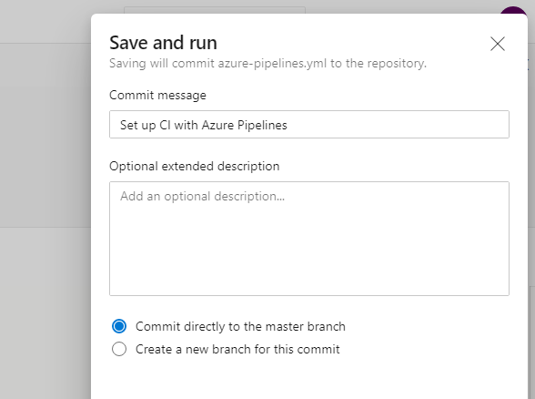

Slide 15
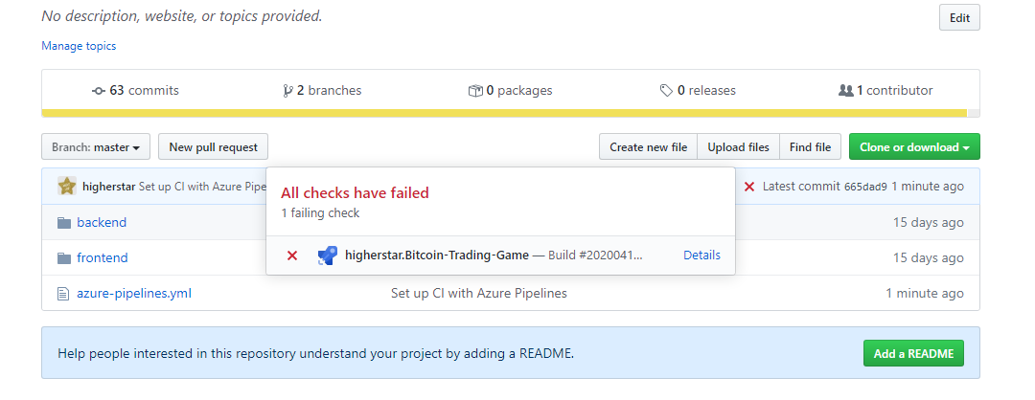

Slide 16
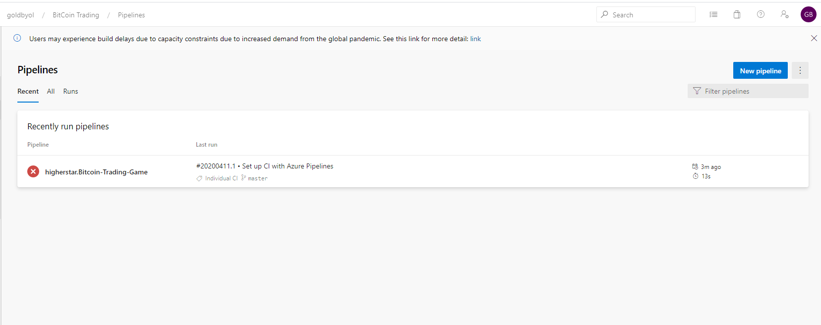

Slide 17
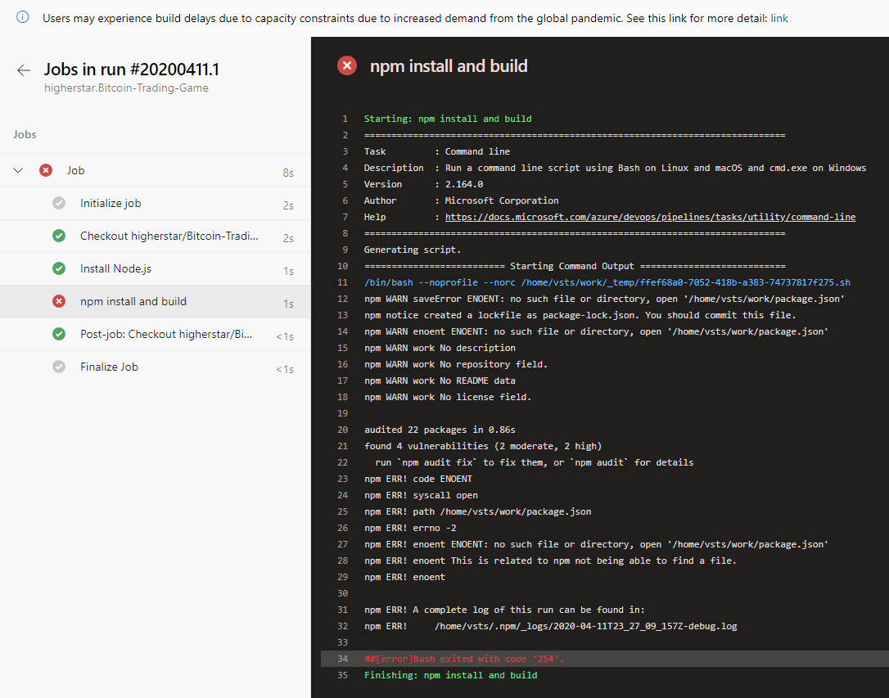

Slide 18
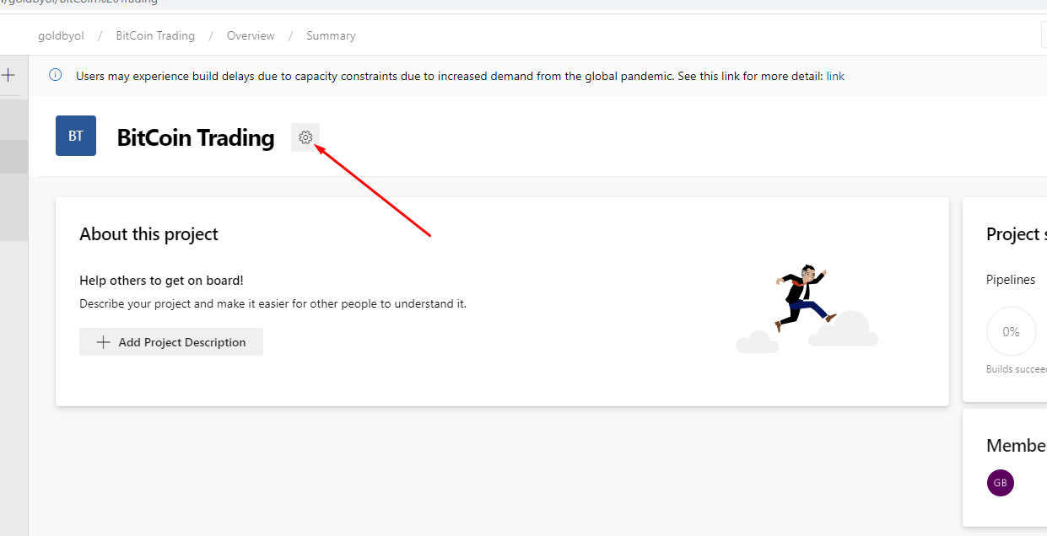
Add ssh configuration in Pipeline

Slide 20
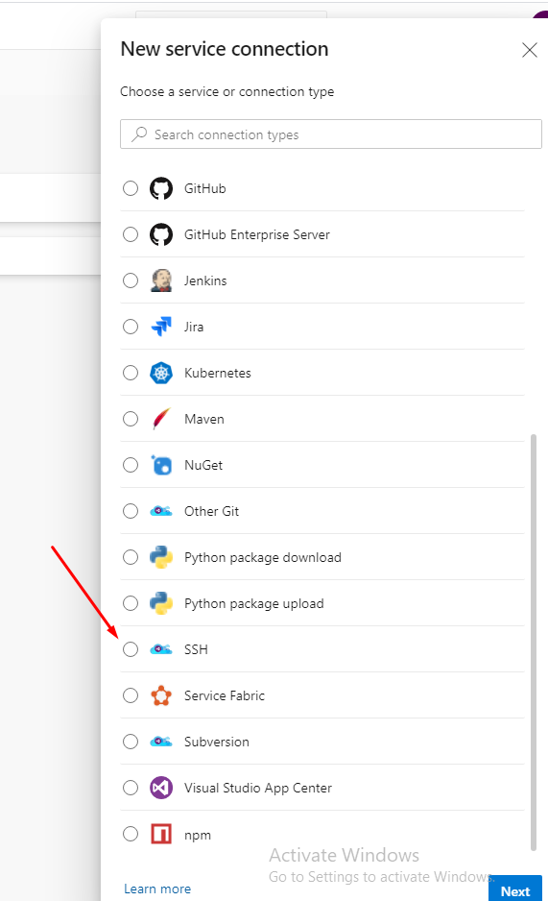
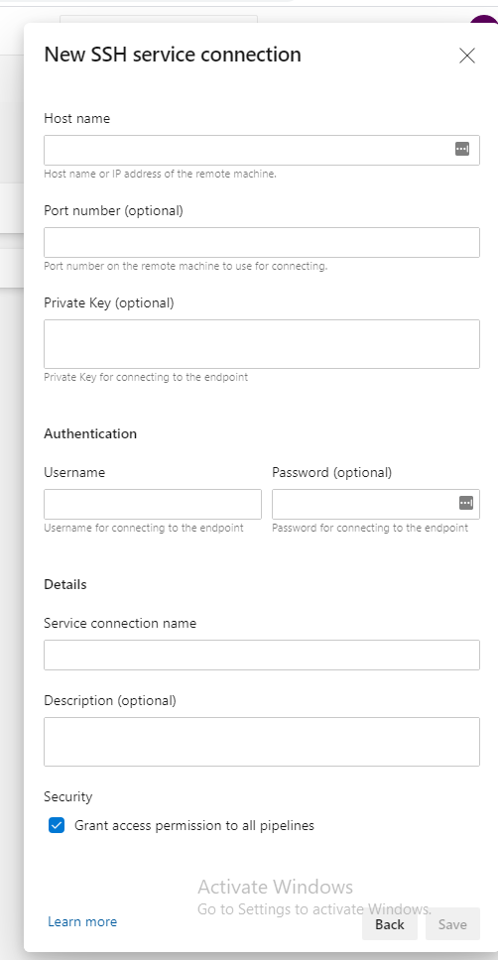
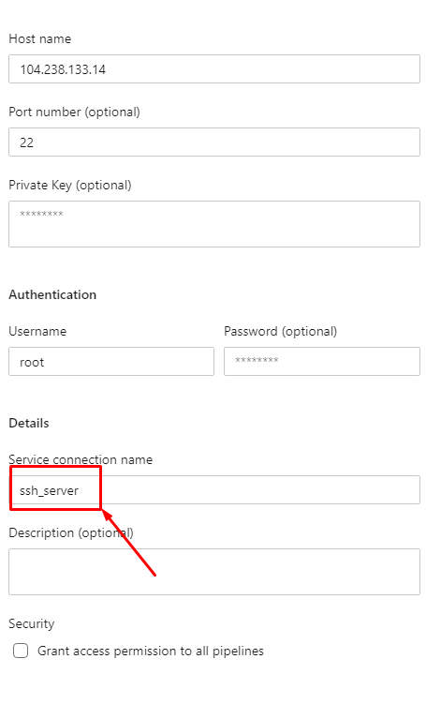

Slide 21
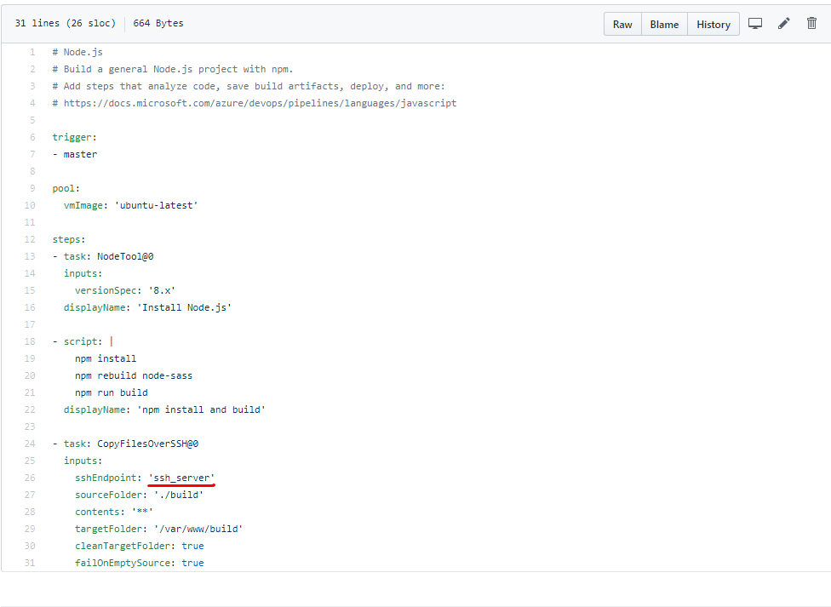

Slide 22
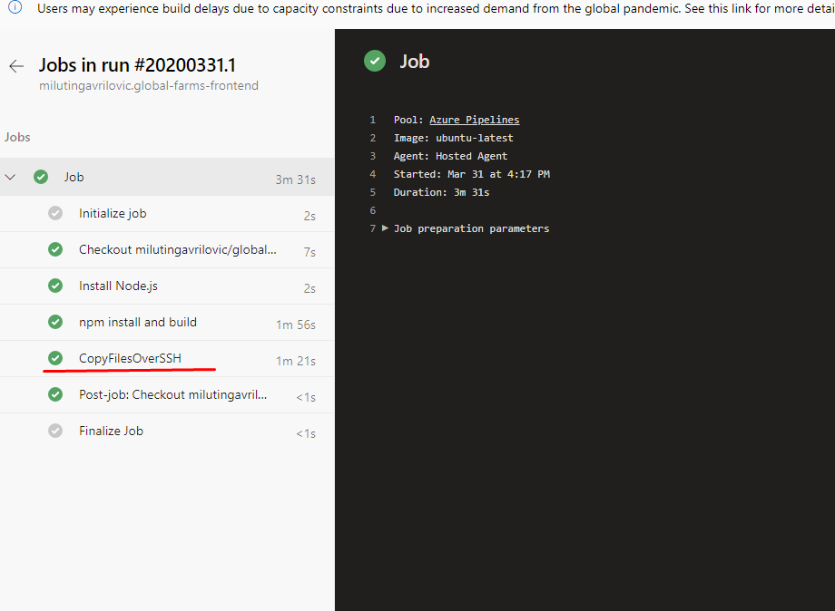

Slide 23
Add environment variables in Pipeline

Slide 24
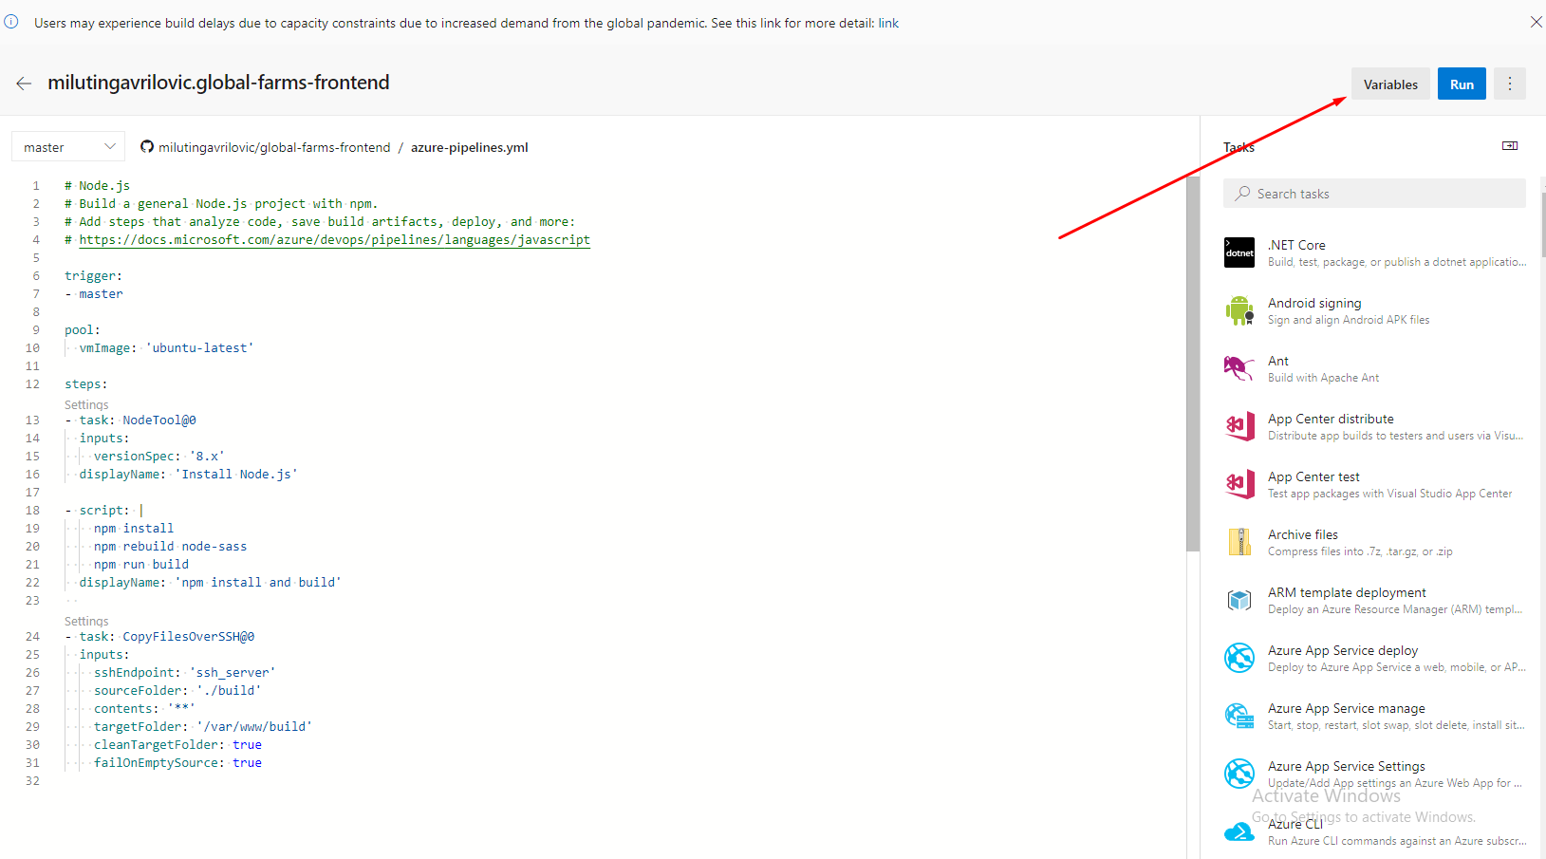

Slide 25
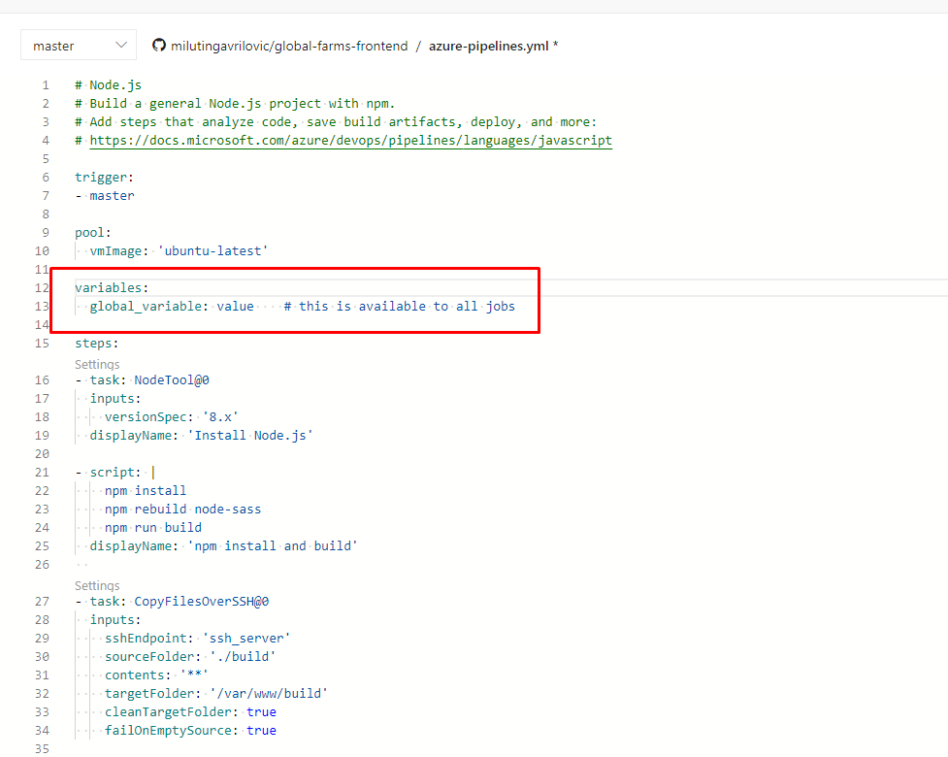

Slide 26
Thank you!

