Slide 1

Flutter Development
2020.05.03

Slide 2
Overview
1. Concept
2. Architecture
3. Development
4. Pros & Cons

Slide 3
1. Concept
Flutter is an Open-source UI Software Development Kit created by Google
First stable version, v1.0 was released on Dec 11, 2019

Slide 4
2. Architecture

Slide 5
2. Architecture
Dart Platform
Flutter Engine
Foundation Library
Design-specific Widgets

Slide 6
Dart
2. Architecture
? is a client-optimized programming language for apps on multiple platforms.
Object-oriented, class-based, garbage-collected language with C-style syntax
Released by Google on Nov 14, 2013

Slide 7
Flutter Engine
2. Architecture
Flutter's engine, written primarily in C++
- Animation and graphics,
- File and network I/O,
- Plugin architecture,
- Dart runtime and compile toolchain

Slide 8
3. Development

Slide 9
3. Development
1) Installation
- Download flutter SDK for your platform
- Install Android Studio with Android SDK
- Install Visual Studio
- Configure flutter path in SYS Environment
Check installation:
$ flutter doctor

Slide 10
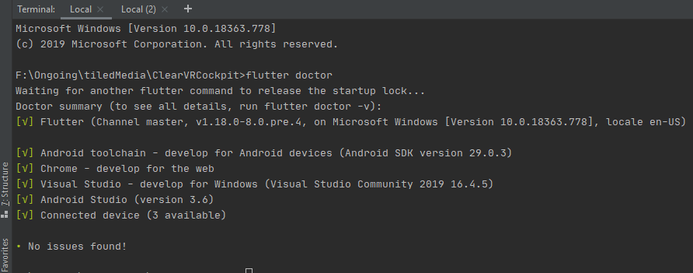
3. Development

Slide 11

3. Development
2) Create project
- Terminal

Slide 12
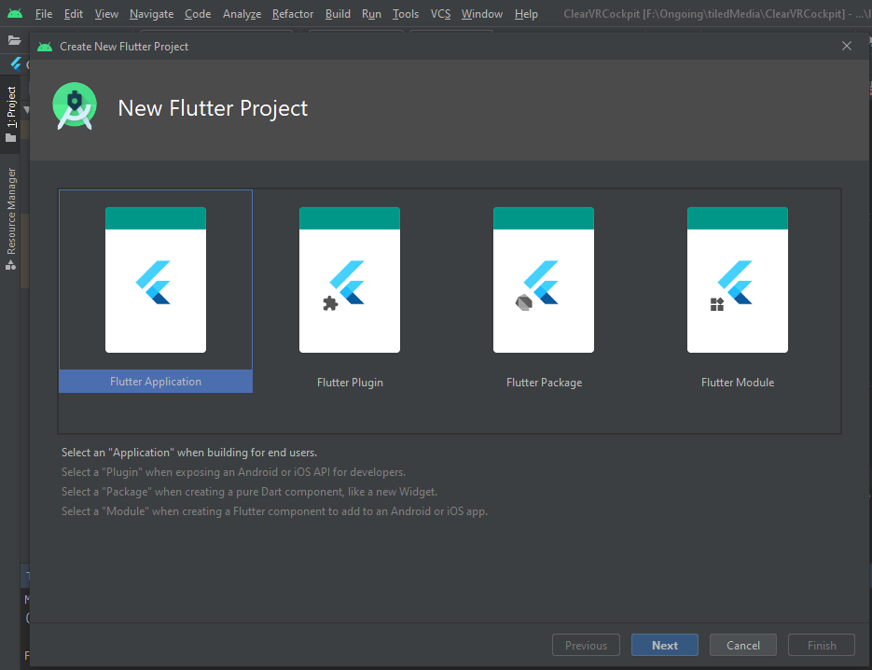
3. Development
- IDE

Slide 13
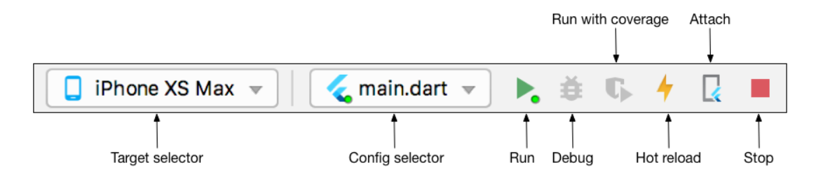

3. Development
3) Run & Debug
- IDE
- Terminal

Slide 14
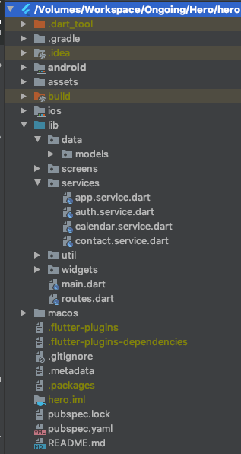
3. Development
4) Project Structure

Slide 15
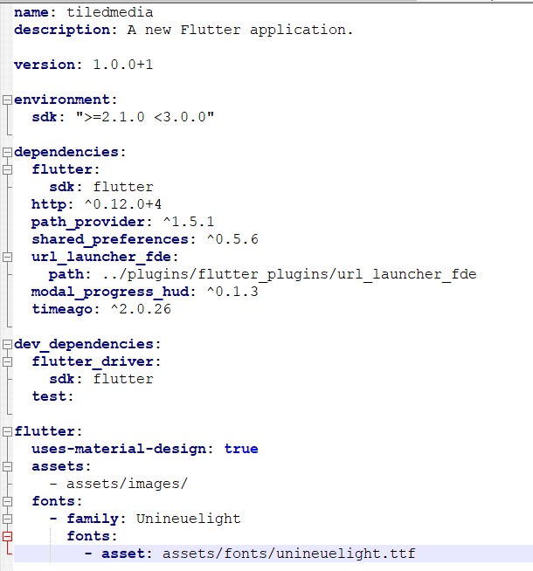
3. Development
5) pubspec.yaml

Slide 16
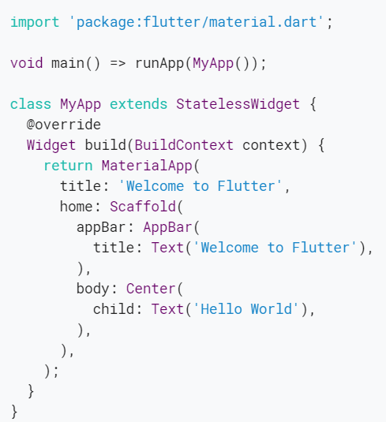
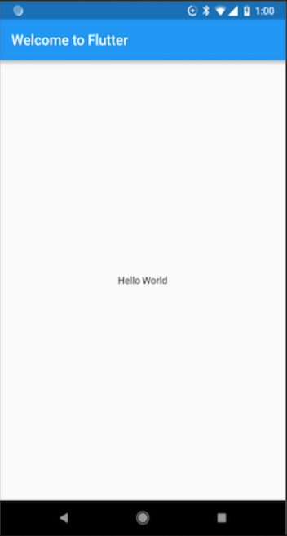
3. Development
lib/main.dart
6) Hello World

Slide 17
3. Development
7) UI Design Tricks
- StatefulWidget vs StatelessWidget
- Flutter Widget vs Web UI
- Main layout Widgets

Slide 18
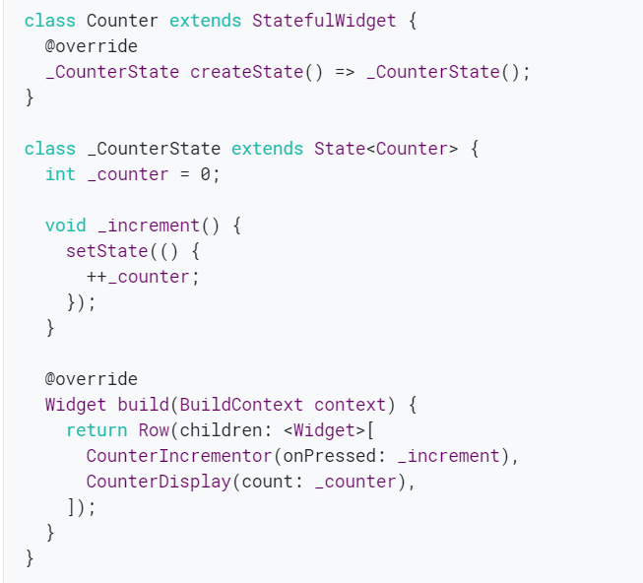
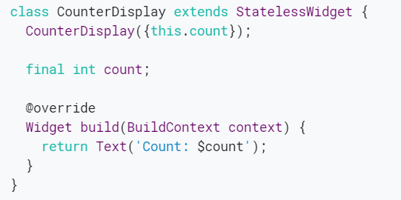
3. Development
- StatefulWidget vs StatelessWidget

Slide 19
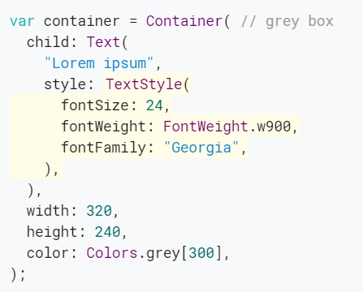
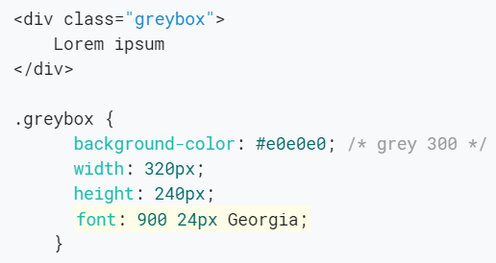
3. Development
- Flutter widget vs Web UI

Slide 20
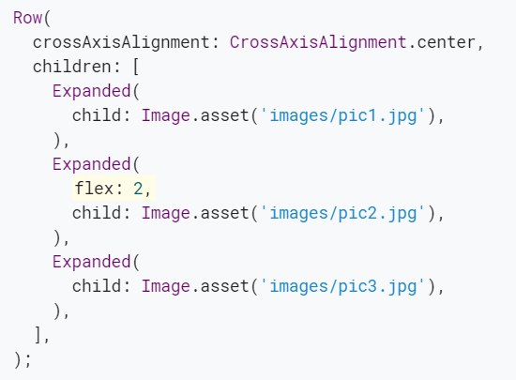
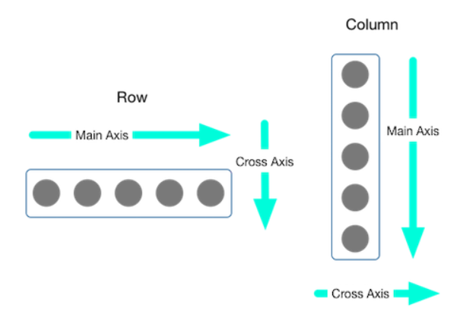

3. Development
- Main Layout Widgets

Slide 21
4. Pros and Cons

Slide 22
4. Pros & Cons
Pros
- Single code base, cross-platform support
- No compatibility issues
- Hot reload
- Great development environment
- Reactive framework, not need to update the UI content manually
- High performance
- Easy to learn for web developers

Slide 23
4. Pros & Cons
Cons
- User interface and logic is intermixed
- Need to learn new language (though it is easy to learn)
- Need to develop native features for every platforms
- Big size of application (Use built-in widgets)

Slide 24
Thank you

