Slide 1
Python/Django School
Django

Slide 2
01
What is Python and Django?
02
How to use Django?
TABLE OF CONTENTS
03
Deep & Advanced

Slide 3
01
What is Python and Django?

Slide 4
Python – What? Why?
The most popular programming language ever.

Slide 5
Interpreted, high-level, general-purpose
Core philosophy
Python!
- Beautiful is better than ugly.
- Explicit is better than implicit.
- Simple is better than complex.
- Complex is better than complicated.
- Readability counts.

Slide 6
Python is very easy to read.
Logical operator
Membership operator
# Logical operator examples
a = True
b = False
print(a and b) # False
print(a or b) # True
print(not b) # True
# Membership operators examples
list = [2,4,6,7,3,4]
print(5 in list) # False
cities = (“Amsterdam", “London")
print(“Berlin" not in cities) #True

Slide 7
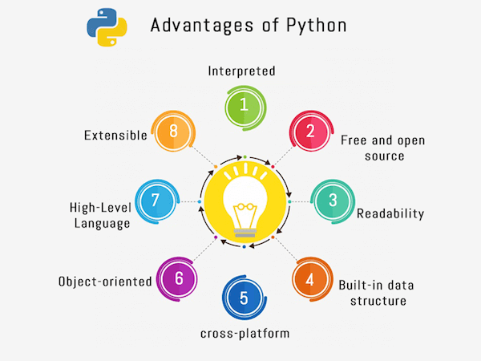

Slide 8
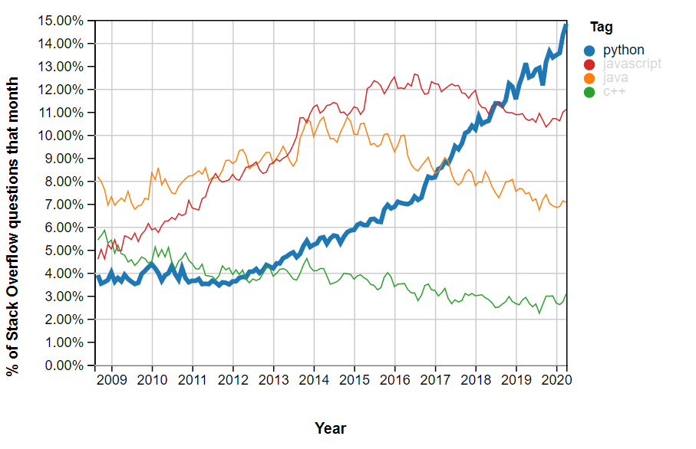

Slide 9
Caution: Python2 is not available now. Let’s use Python3

Slide 10
Django – What? Why?
“Django is a high-level Python Web framework that encourages rapid development and clean, pragmatic design. Built by experienced developers, it takes care of much of the hassle of Web development, so you can focus on writing your app without needing to reinvent the wheel. It's free and open source.”

Slide 11
To ease the creation of complex, database-driven websites.
Primary goal;
DRY!
The framework emphasizes reusability and "pluggability" of components, less code, low coupling, rapid development, and the principle of don't repeat yourself.

Slide 12
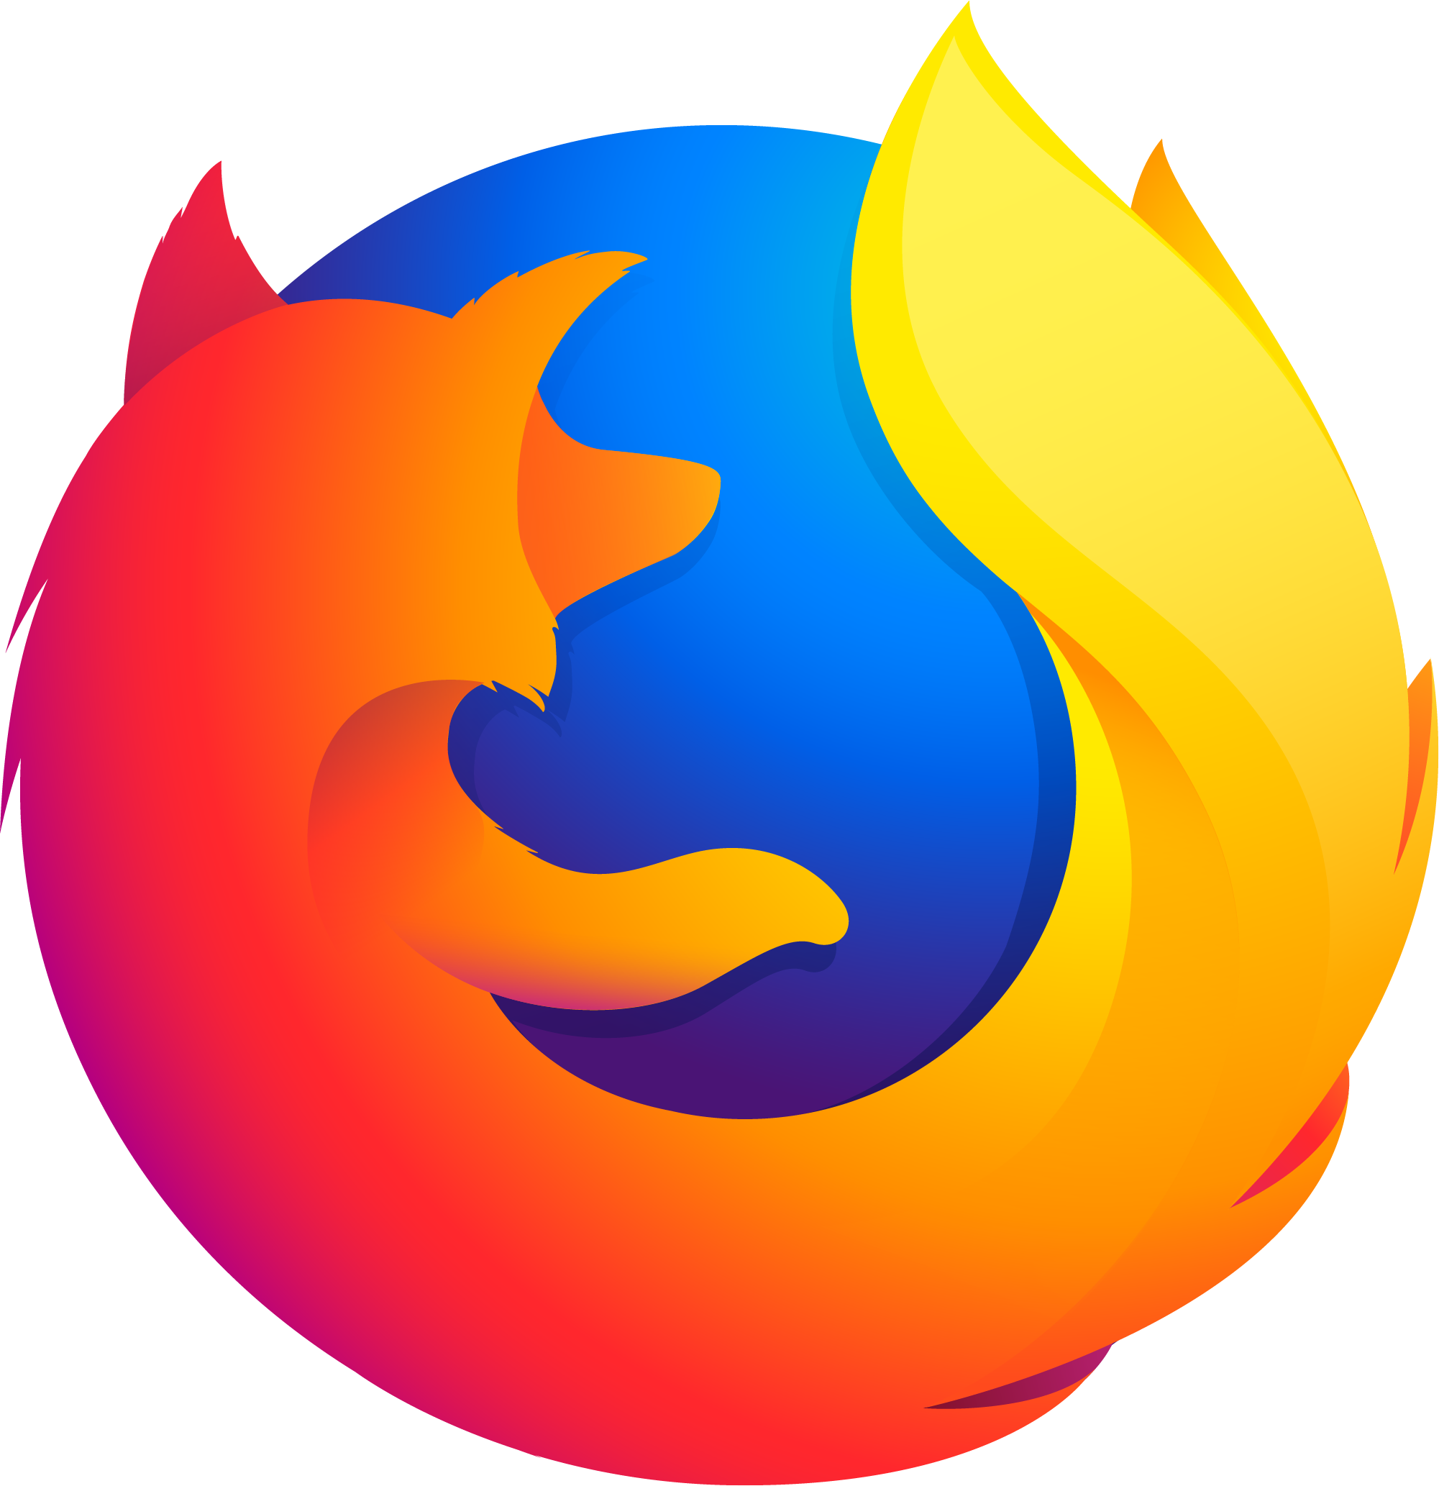
Sites built in Django
Pinterest, Instagram, Mozilla Support, Disqus, Bitbucket, and Nextdoor

Slide 13
02
How to use Django?

Slide 14
Environment Setup
Hi, Django
OS
MAC, Windows, Ubuntu
I am here!
IDE
VS Code, PyCharm

Slide 15
Environment Setup
Install Python 3
Install pip
$ sudo apt-get install python3
$ sudo apt-get install -y python3-pip
Install Virtualenv
Install django
$ pip install virtualenv
$ pip install django

Slide 16
Let’s get started. – Create Project
$ django-admin startproject mysite
First Project
mysite/
manage.py
mysite/
___init__.py
settings.py
urls.py
asgi.py
wsgi.py

Slide 17
Let’s get started. – Create App
$ python manage.py startapp polls
First App
polls/
__init__.py
admin.py
apps.py
migration/
___init__.py
models.py
tests.py
views.py

Slide 18
Let’s get started. – Create View & Router
polls/views.py
polls/urls.py
from django.http import HttpResponse
def index(request):
return HttpResponse("Hello")
from django.urls import path
from . import views
urlpatterns = [
path('', views.index, name='index'),
]

Slide 19
Let’s get started. – Create Router in Project
mysite/urls.py
from django.contrib import admin
from django.urls import include, path
urlpatterns = [
path('polls/', include('polls.urls')),
path('admin/', admin.site.urls),
]
Router

Slide 20
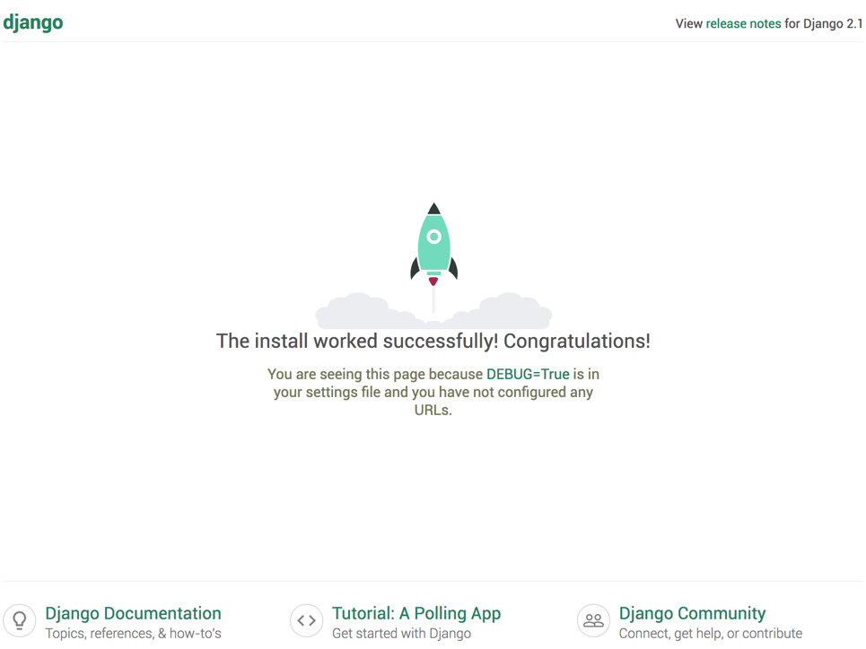
$ python manage.py runserver

Slide 21
03
Deep & Advanced

Slide 22
Database Management
Relational
Non-Relational
MySQL
PostgreSQL
SQLite
MongoDB

Slide 23
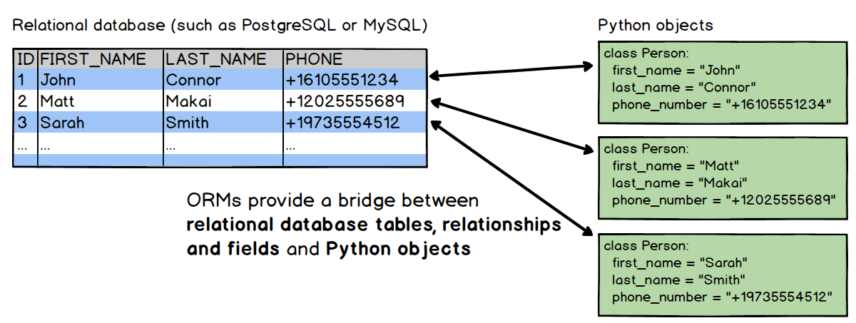
ORM – Is it better than SQL?
- Not suited for small-scale projects
- Speed
?

Slide 24
How to build model?
from django.db import models
# Create your models here.
# add this
class Todo(models.Model):
title = models.CharField(max_length=120)
description = models.TextField()
completed = models.BooleanField(default=False)
def _str_(self):
return self.title
ORM

Slide 25
No worry about Controller

Slide 26
Unit test for Django
import unittest
class TestStringMethods(unittest.TestCase):
def test_upper(self):
self.assertEqual('foo'.upper(), 'FOO')
def test_isupper(self):
self.assertTrue('FOO'.isupper())
self.assertFalse('Foo'.isupper())
def test_split(self):
s = 'hello world'
self.assertEqual(s.split(), ['hello', 'world'])
# check that s.split fails when the separator is not a string
with self.assertRaises(TypeError):
s.split(2)
if __name__ == '__main__':
unittest.main()Z
“unittest” for Unit Test

Slide 27
Files after create project
File Name | Description
manage.py | A command-line utility that allows you to interact with your Django project
__init__.py | An empty file that tells Python that the current directory should be considered as a Python package
settings.py | Consists of the settings for the current project
urls.py | Contains the URL’s for the current project
wsgi.py | This is an entry-point for the web servers to serve the project you have created
I am Simple.

Slide 28
Middlewares in Django
Middleware is a framework that is light and low-level plugin system for altering Django’s input and output globally. It is basically a framework of hooks into the request/ response processing of Django. Each component in middleware has some particular task.
For example, the AuthenticationMiddleware is used to associate users with requests using sessions.
Django provides many other middlewares such as cache middleware to enable site-wide cache, common middleware that performs many tasks such as forbidding access to user agents, URL rewriting, etc, GZip middleware which is used to compress the content for browsers, etc.

Slide 29
What is Django used for?
- Client relationship management (CRM) systems;
- Content management systems (CMS) for internal and commercial use;
- Communication platforms;
- Booking engines;
- Document administration platforms;
- Among other things, Django is great for:
- Algorithm-based generators;
- Emailing solutions;
- Verification systems;
- Filtering systems with dynamically changing rules and advanced parameters;
- Data analysis solutions and complicated calculations;
- Machine learning;
I like CMS and Algorithms

Slide 30
Advantages of Django framework
- Rich ecosystem
- Maturity
- Admin panel by default
- Good for SEO
- Libraries (Django REST framework, Django CMS, Django allauth)
- ORM
I am a Veteran

Slide 31
Disadvantages of Django
- Not suited for small-scale projects
- Speed
Big-scale projects only please.

Slide 32
THANKS!
I know Django
Does anyone have any questions?

