Slide 1
React Native Development
Here is where your presentation begins

Slide 2
Table of Content
1. What is React Native and How to Setup?
2. Working with React Native
3. React Native Navigation
4. Technical essentials in React Native
5. The most Common Types of APPS
6. React Native Pros and Cons

Slide 3
01
What is React Native? How to Setup?

Slide 4
What is React Native?
REACT
React Native was released in 2015 by Facebook. React Native uses JavaScript as a programming language for writing mobile apps.
React Native is a JavaScript framework for building cross platform IOS and Android mobile applications.
Like React, React Native was also built by a team over at Facebook and shares the component-based structure.
IOS
ANDROID

Slide 5
How to setup?
> npm install -g create-react-native-app
> create-react-native-app MyReactNative
> npm install -g react-native-cli
> npm start
> react native run-android
Install creact-react-native-app
Create-react-native-app myReactNative
JDK install..
Android Studio install, SDK install
Install react-native-cli
Start react-native

Slide 6
02
Working With React Native

Slide 7
React DOM
DOM
In React, the Virtual DOM acts as a layer between the developer’s description of how things ought to look and the work done to actually render your application onto the page.
Rather than directly render changes on the page, React computes the necessary changes in-memory and re-renders the minimal amount necessary.
DOM
DOM

Slide 8
Virtual DOM
State Change
Computer Diff
Render
Browser DOM

Slide 9
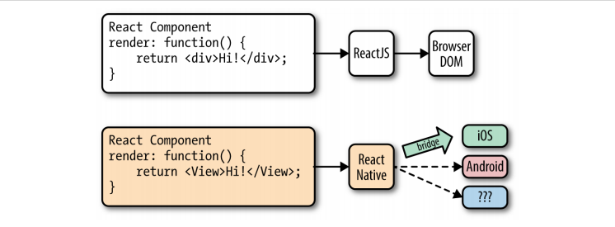
React Native Render
Instead of rendering to the browser’s DOM, React Native invokes Objective-C APIs to render to IOS components, or Java APIs to render to Android components.
This sets React Native apart from other cross-platform app development options, which often end up rendering web-based views.

Slide 10
Working with Views
When writing in React for the web, you render normal HTML elements (<div>, <p>, <a> , etc.). With React Native, all of these elements are replaced by platform specific React components.
The most basic is the cross-platform , a simple and flexible UI element that can be thought of as analogous to the <div>.
On IOS, for instance, the <View> component renders to a UIView, whereas on Android it renders to a View
import { DatePickerIOS } from "react-native";
<div>
<View>
< DatePickerIOS
date = { this.state.date }
mode = “time”
/>
<span>
<Text>
<li>
<FlatList>

Slide 11
React Native Style
Using Inline Style
Using StyleSheet.create
01
02
03
Styling with Object
const styles = StyleSheet.create({
button:
{
borderRadius: "8px",
background Color: "#99CCFF"
}
})
<Text style={[ styles.button, styles.accentText ]}>Style3</Text>
const italic = { fontStyle: "italic" };
const bold = { fontWeight: "bold" };
<Text style={bold} > Style2 </Text>

Slide 12
03
React Native Navigation

Slide 13
Screen Structure
Screen
StackNavigator
Screen
SwitchNavigator
StackNavigator
Screen
Screen
StackNavigator
Screen
Screen

Slide 14
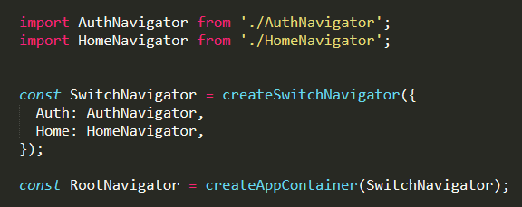
CreateSwitchNavigator
The purpose of SwitchNavigator is to only ever show one screen at a time. By default, it does not handle back actions and it resets routes to their default state when you switch away.

Slide 15
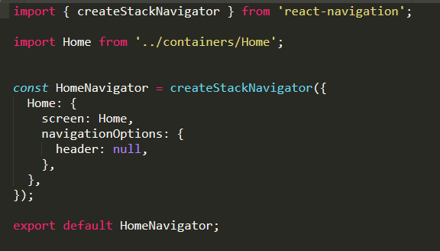
CreateStackNavigator
Provides a way for your app to transition between screens where each new screen is placed on top of a stack.
By default the stack navigator is configured to have the familiar iOS and Android look & feel: new screens slide in from the right on iOS, fade in from the bottom on Android. On iOS the stack navigator can also be configured to a modal style where screens slide in from the bottom

Slide 16
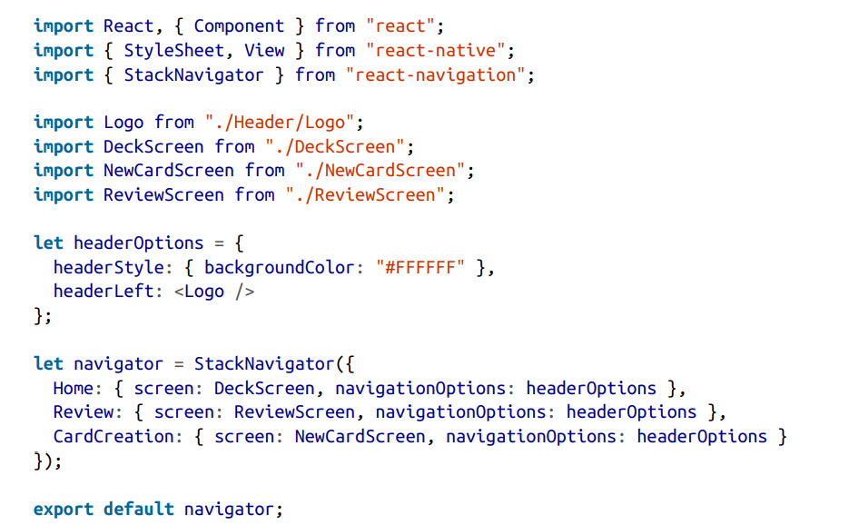
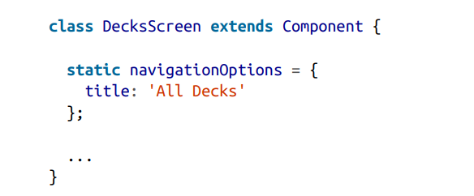
Switch Screen & Configuring the Header
The navigator will attempt to find the appropriately named screen to render.
this.props.navigation.navigate(“HomeScreen");
this.props.navigation.goBack();
We can also pass in navigationOptions to the StackNavigator in order to configure what gets rendered in the header.

Slide 17
04
Technical Essentials in React Native

Slide 18
Social Media integration
Google, Facebook, Instagram, Twitter, Youtube…
Map Integration
React Native Maps, Mapbox
Notification Management
Push Notification and Local Notification, Calendar, Alarm
Authentication
Host Platform APIs
User authentication with Firebase, Phone authentication service, OTP authentication
Saturn is composed mostly of hydrogen and helium

Slide 19
05
The most Common Types of APPS

Slide 20
User
P2P
Chatting
Group
Type
Location
Messaging
Voice & Video
Type
Dating
Global
APP
Local
Social Dating
APPS
Ecommerce
Word Press
Secret Dating
Shopify
Location Dating
Food Deliver
Tinder
Location Tracking
Bumble
Map
Happn
Speed, Acceleration
Template

Slide 21
06
React Native Pros and Cons

Slide 22
Pros
Cons
- Fast refresh = fast coding
- One codebase, 2 mobile platforms
- It uses a wildly popular language
- Developer freedom of choice
- Relative maturity
- An active – and vast – community
- Easy to learn for React developers
- Up to 50% less testing
- It isn’t really Native
- Fewer components out of box
- Developer freedom of choice
- Lots of abandoned packages
- Fragile UI
- Apps are bigger than native ones
- Easy to learn for React developers
- Up to 50% less testing

Slide 23
Thank you!

