Slide 1
Ruby On Rails
May 12, 2020

Slide 2
Overview
Concepts
Architecture
Development
Pros and Cons
Ruby On Rails with React

Slide 3
Concepts
Ruby is a dynamic, object-oriented language with a focus on simplicity and productivity. (Yukihiro Matsumoto)
Ruby on Rails, or Rails, is a server-side web application framework written in Ruby.
Ruby 1.0 1996, Rails First Released July 2004
Latest version — Ruby 2.7.1, Rails 6.0.3

Slide 4
Main Features
DYNAMIC
Dynamic programming language is a term used in computer science to describe a class of high-level programming languages which, at runtime, execute many common programming behaviors that static programming languages perform during compilation.
OBJECT-ORIENTED
Ruby is pure object-oriented language and everything appears to Ruby as an object
Even a class itself is an object that is an instance of the Class class
Ruby is based on the concept of “objects” , classes , attributes and methods.

Slide 5
General purpose
Ruby is a programming language designed to be used for writing software in a wide variety of application domains like:
• Server-Side(Ruby-on-Rails)
• Web Servers
• Common GUI Applications
• Low-Level systems
• Simulations
• 3D Modeling
• Robotics
• Web Applications Implemented in Rails

Slide 6
Ruby gems and RVM
RUBY GEMS
As most programming languages, Ruby offers a wide set of third-party libraries.
Most of them are released in the form of a gem.
RubyGems is a package manager for the Ruby programming language that provides a standard format for distributing Ruby programs and libraries
RUBY RVM (Ruby Version Manager)
RVM is a programmer’s helping hand for :
Production
Testing
Gem Management
Note : RVM is for Ruby applications, *not just for Rails*! Any Ruby based application will benefit from your use of RVM

Slide 7
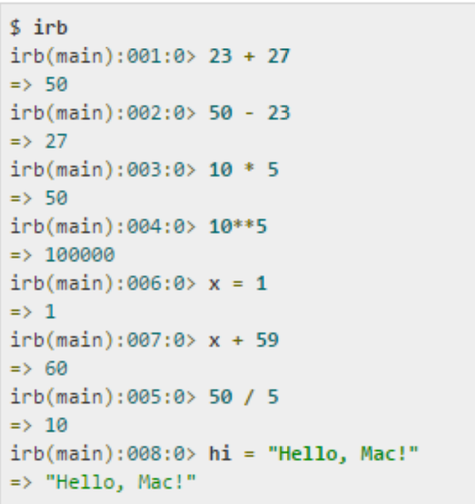
IRB
Interactive Ruby Shell (IRB or irb) is a REPL for programming in Ruby. The program is launched from a command line and allows the execution of Ruby commands with immediate response, experimenting in real-time.
irb is executed using the “irb” command.
Use “exit” to exit irb

Slide 8
Tools and General programming concepts
• Ruby files use the suffix .rb
• Comments start with #
• Multiple line comments use =begin , =end
• nil(null in other programming languages) means that the object is an instance of the Nil Class
• Blocks end using the “end” statement
• Variables dynamically change their type
For Ruby Developing recommend RubyMine (Developed by JetBrains)
VS Code

Slide 9
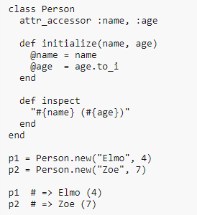
Naming
1. Local variables, method’s parameters and method names are written in lowercase
2. Constants are written in capital letters
3. Global variables are prefixed with the dollar sign ($)
4. Field names are prefixed with the “at” sign "@"
5. Class names are prefixed with the “double at” sign "@@"

Slide 10
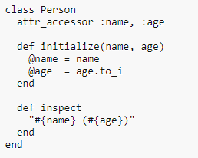
Classes and Objects
Class ClassName
attr_accessor :var1,:var2
<methods>
End
Constructors are named “initialize(param1,param2…)”
attr_accessor is used as getter,setter

Slide 11
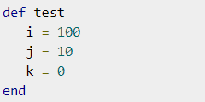
Methods
def method_name(param_1,param_2...)
<code>
<code>
<code>
end
• “return” is not necessary. The returned value is the latest changed variable
• Method block ends with “end”

Slide 12
String characteristics
• “\n” is used as line breaker
• If we want to use a variable name inside a string we just add #{variable_name}
• Alternatively, we can use the + operator in order to unite 2 or more strings
• Double quote vs Single quotes : Double quotes allow you to do string interpolation

Slide 13
Array
• Arrays, like variables, don’t need initialization
• temp = Array.new(10)
• puts temp.size or puts temp.length
• We can save variables of different type
• Values are saved as A = ['A','B','C'] or A[0] = 1 etc
SHORTCUT %w
%w is used in order to initialize arrays alternatively,
A = %w{ A B C }

Slide 14
Hashes (Collection of key-value pairs)
• To initialize Hashes we use curly braces instead of braces
• In order to initialize a map :
"key => value"
Note : keys are unique, values are not
• temp = Hash.new
temp[:key]
If key does not exist, nil is returned

Slide 15
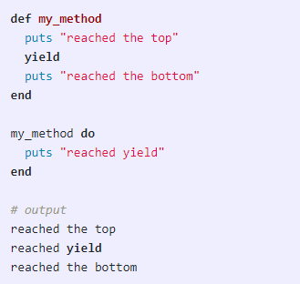
Code blocks
• We can call a method which has the same name but different body by using the yield command
• Any code surrounded by curly braces is a block
• The calling can include arguments called
Block arguments
{|arg1,arg2| code_including_args}

Slide 16
Why Ruby?
1. Ruby allows the programmer to do things fast (less code – but
takes time to learn).
2. Open-Source (Hundreds of resources – everything is free! –
gems usage)
3. Everything is free! Gems usage save time and money
4. Ruby On Rails (Rails conventions)

Slide 17
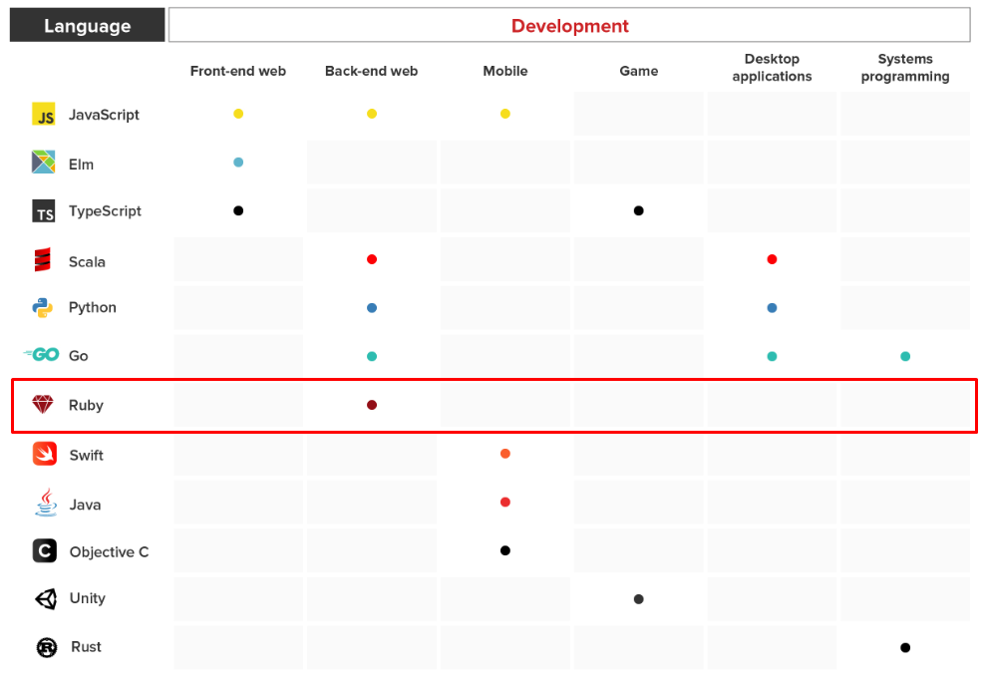
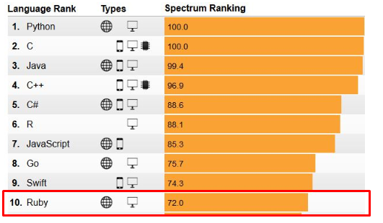
Position of Ruby

Slide 18
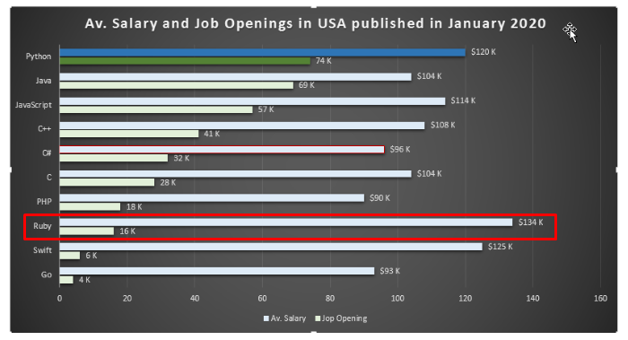
Ruby On Rails Jobs
Upwork 8~10 jobs/day
The highest salary
The less job posting

Slide 19
Architecture

Slide 20
Architecture Components
Ruby on Rails Server
Routes
Controllers
Models
Views
Assets

Slide 21
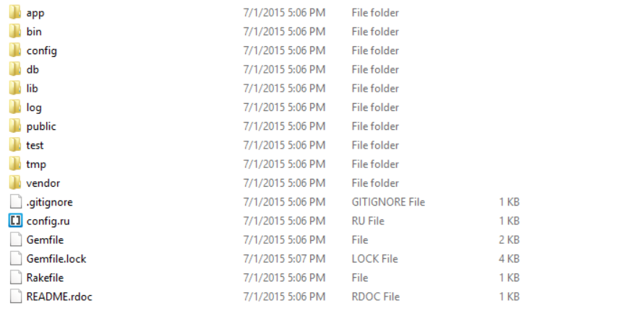
Directory structure

Slide 22
Routes configuration

Slide 23
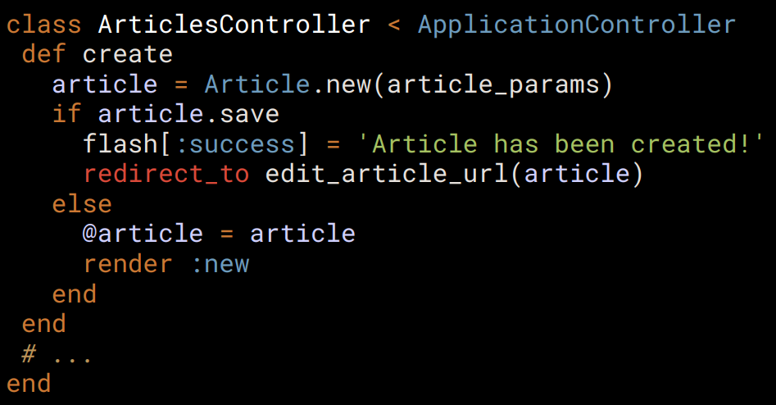
Controls and actions
● A Controller is an Object.
● An Action is a public method on this Controller.
● It takes the data of the HTTP request.
● It does the job requested.
● It prepares the data for the View.
● Asks view to build up the response.

Slide 24
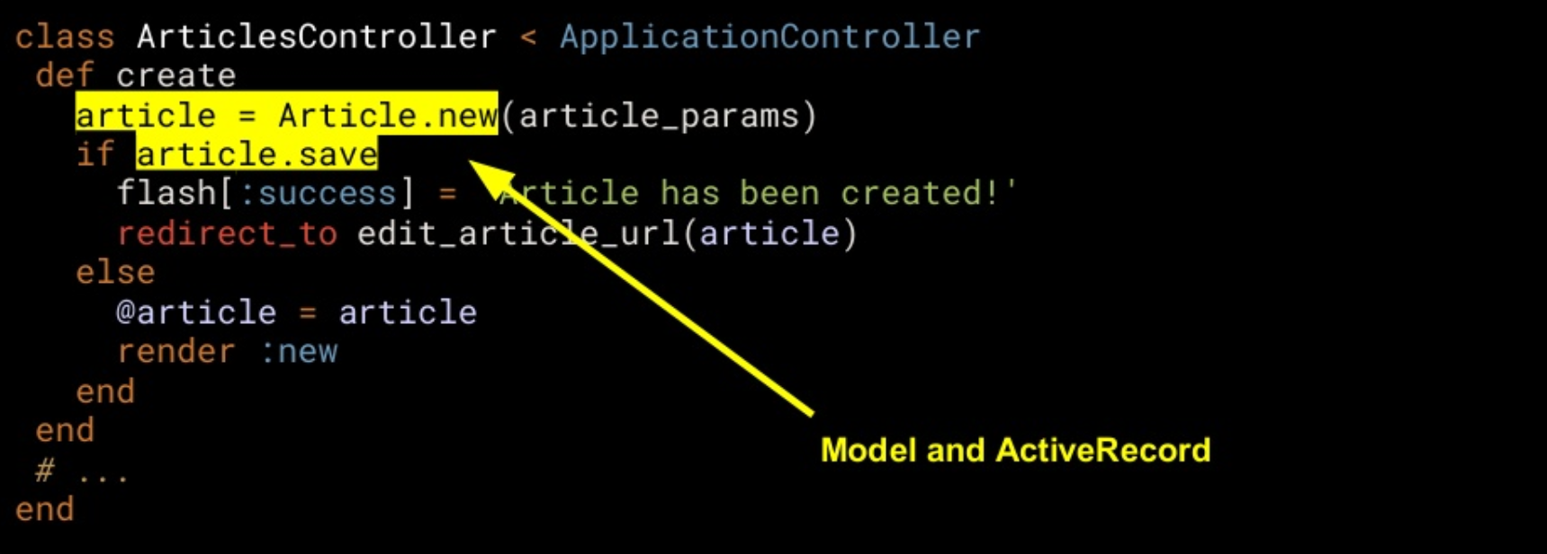
Controllers Example

Slide 25
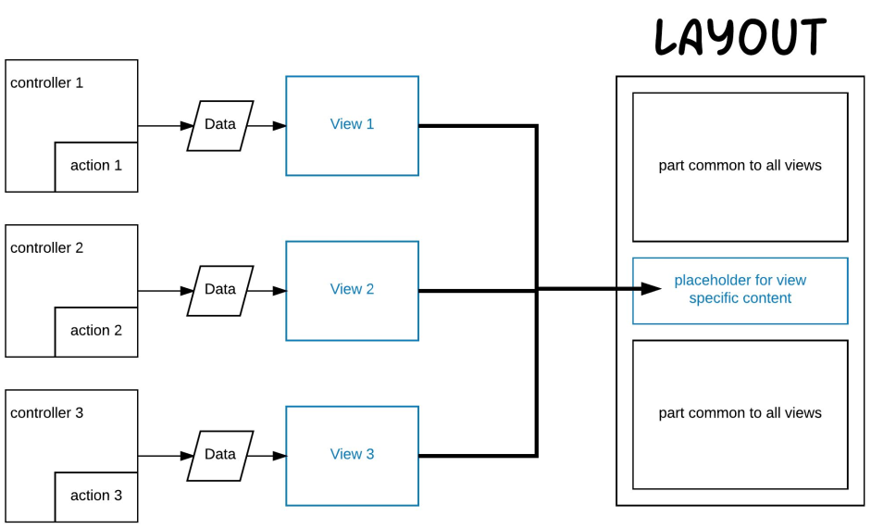
Layout and View

Slide 26
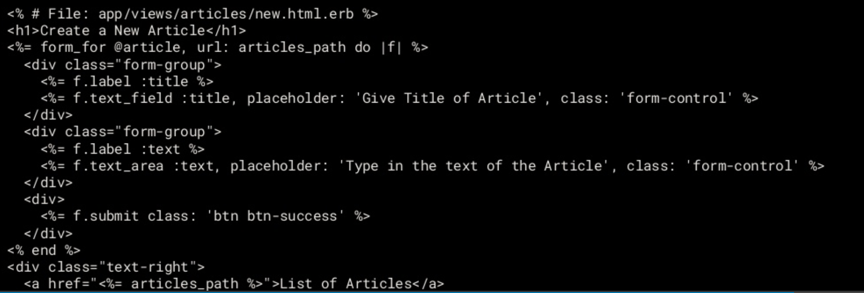
View Example

Slide 27
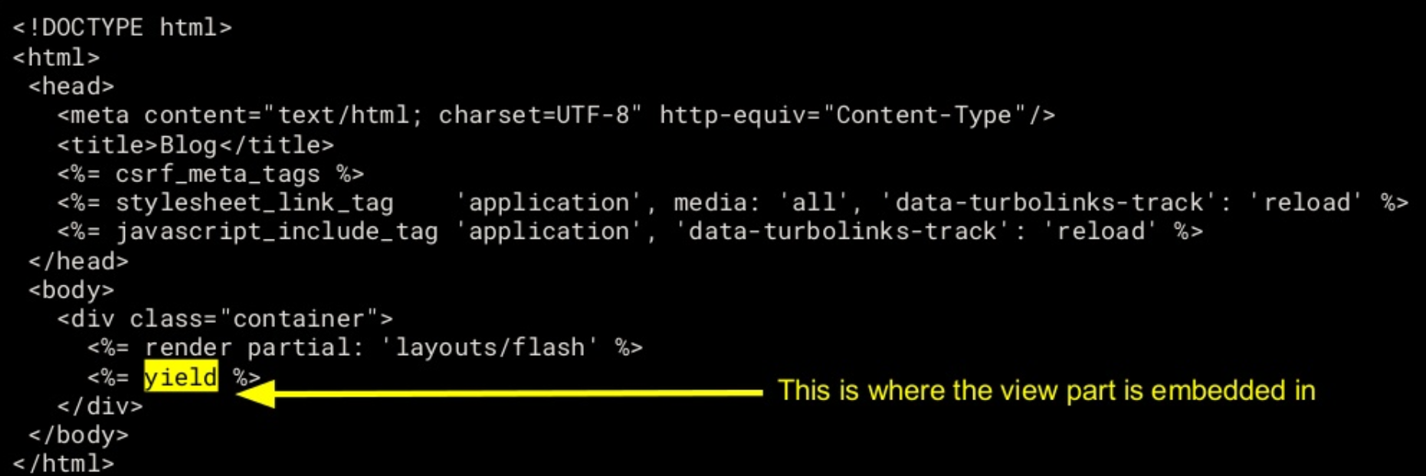
Layout Example

Slide 28
Development

Slide 29
Environment Setup
Linux
Install Prerequisite Dependencies
Install rbenv/rvm
Install Ruby
Install Rails
Windows
Cmder (console emulator)
Chocolatey
Installing Ruby and Rubocop
Installing Ruby on Rails

Slide 30
Ruby install on ubuntu
Install RVM (development version):
\curl -sSL https://get.rvm.io | bash
Install RVM stable with ruby:
\curl -sSL https://get.rvm.io | bash -s stable --ruby
Additionally with rails (poor man's railsinstaller):
\curl -sSL https://get.rvm.io | bash -s stable --rails
Installing rubies
$ rvm install 2.6.5
$ rvm use 2.1.1
$ ruby -v
ruby 2.1.1p76 (2014-02-24 revision 45161) [x86_64-darwin12.0]
$ which ruby
/Users/rys/.rvm/rubies/ruby-2.1.1/bin/ruby

Slide 31
Creating a New Rails Project
Database Install (MySQL)
2. Configure The Rails Application
rails new [application name] -d mysql
rails new my-app -d mysql
mysql -u root -p
nano config/database.yml
password: [MySQL password]
rake db:create
sudo apt-get update sudo apt-get install mysql-client libmysqlclient-dev
gem install mysql2

Slide 32
Why Back End with Ruby On Rails
Ruby is a very productive
Creative
Improved code quality
An interpreted scripting language
Speed / Fast Development
Efficiency
Great for startups
Scalability
Great for high-traffic sites
Easy to deployment

Slide 33
Pros and Cons
Consumes a lot of resources
Bad performance in some cases
Support for websockets
Not enough for more complex systems
Becomes more and more complex
Fast development
Many gems
Good hosting
Great community
Good marketing

Slide 34
Ruby On Rails with React

Slide 35
Why React with Ruby On Rails
Reduced server response time
Cut down Memory usage
Development speed, quality & business model
Low learning curve
6 well-known B2B companies globally are using React with Ruby on Rails
Klarx, Airbnb, Gusto, TaskRabbit, OpenDoor, Casper

Slide 36
Create Ruby On Rails with React
Installing Frontend Dependencies
React Router, for handling navigation in a React application.
Bootstrap, for styling your front-end components.
jQuery and Popper, for working with Bootstrap.
Setting Up the Homepage
rails g controller Homepage index
Configuring React as Rails Frontend
Webpacker gem
Javascript_pack_tag, stylesheet_pack_tag

Slide 37
~/rails_react_recipe/app/views/layouts/application.html.erb
<meta name="viewport" content="width=device-width, initial-scale=1, shrink-to-fit=no">
<%= javascript_pack_tag 'Index' %>

Slide 38
Thank you

