Slide 1
Apollo Graphql
2020-04-19

Slide 2
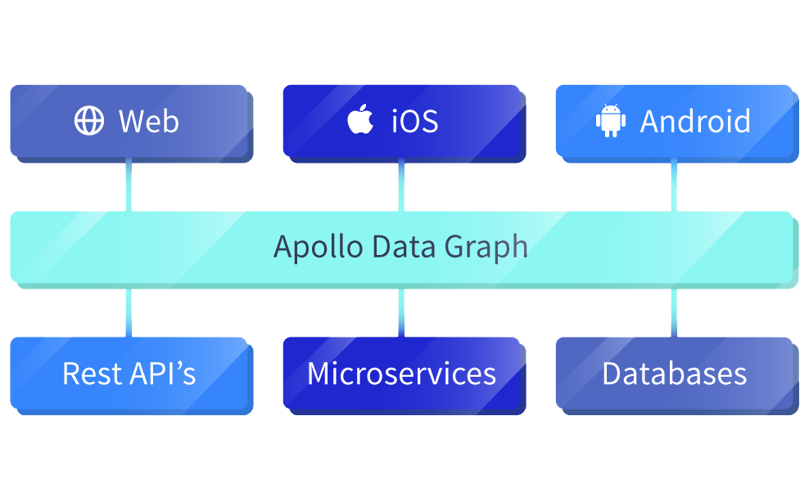
What is Apollo Graphql
Apollo is a platform for building a data graph, a communication layer that seamlessly connects your application clients (such as React and iOS apps) to your back-end services.

Slide 3
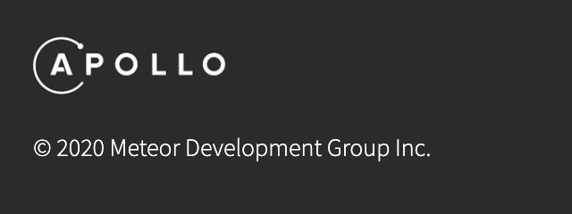
Who made Apollo?
From https://www.apollographql.com/

Slide 4
Why Meteor developers made Apollo?
Meteor is a full-stack web application framework written in JavaScript. By default, it gives developers a connection to a Mongo database.
Apollo was created by (former?) members of the Meteor development team.
The idea to build a GraphQL library (/libraries) came out of a desire among the Meteor community to hook the wonderful infrastructure of the Meteor stack into databases that were not called “MongoDB”.

Slide 5
A small personal anecdote
I used Meteor for nearly all of my development work with Meteor until I tried using Apollo. Many Meteor developers decided it was easier to use Apollo with React than with Meteor’s own templating engine (the one called Blaze), so I followed suit. At that point, I wasn’t using Meteor’s default data layer and I wasn’t using Blaze, so I stopped using Meteor all together! Apollo was intended to be the library which kept people who needed to use non-Mongo databases on the Meteor platform, but its release ultimately pushed me into the world of React with Webpack as a build-tool!

Slide 6
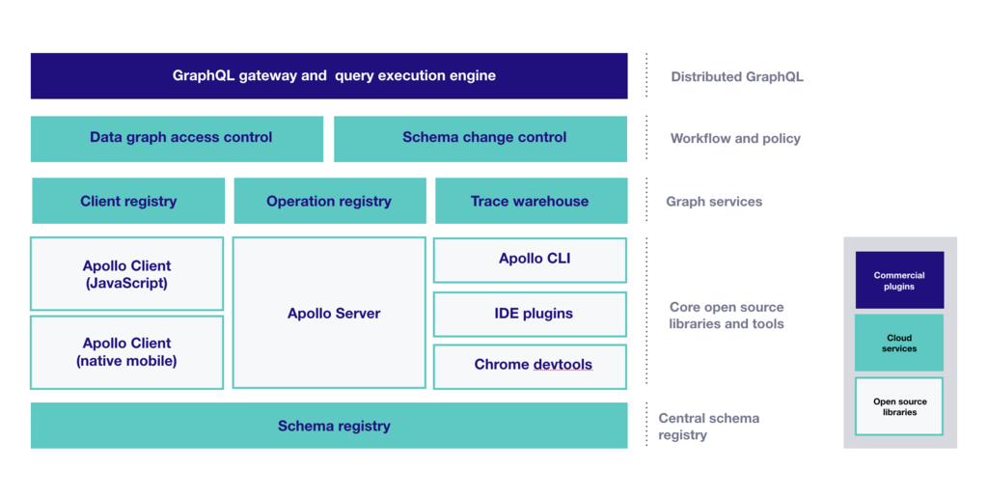
The Apollo GraphQL platform

Slide 7
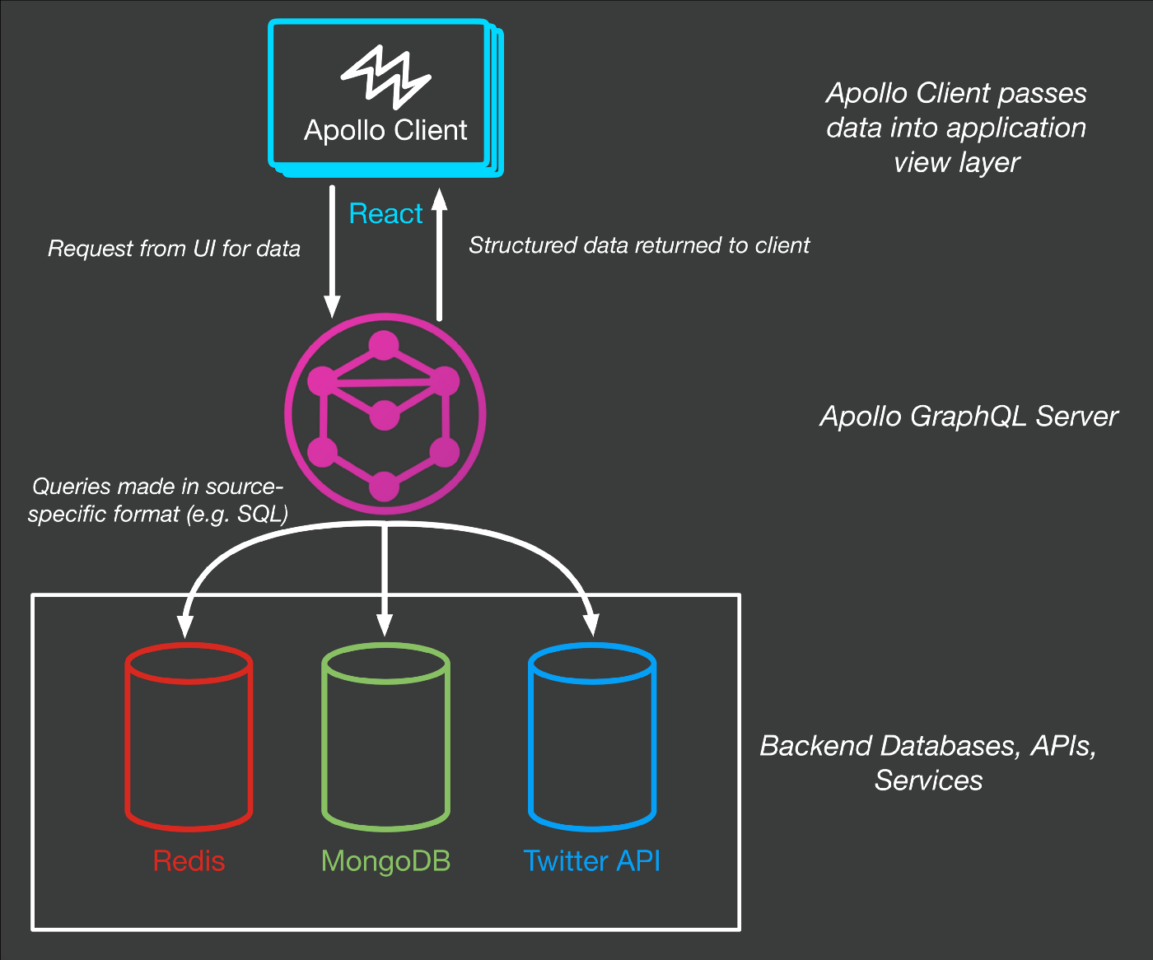
Client - Server
Layout

Slide 8
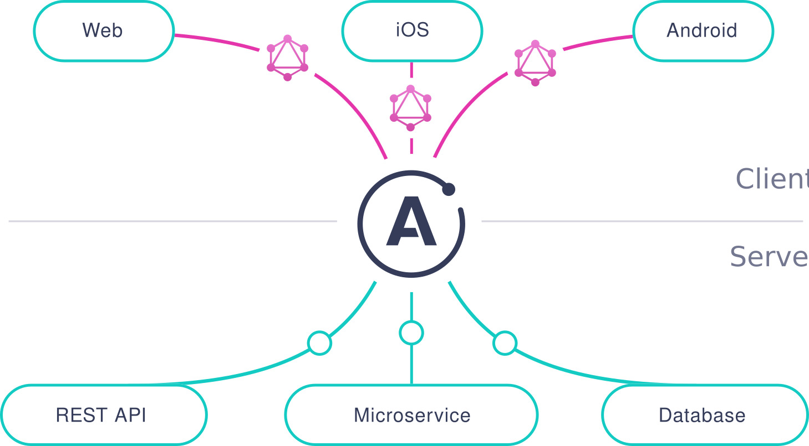
Apollo Server
Apollo Server is an open-source, spec-compliant GraphQL server that's compatible with any GraphQL client, including Apollo Client. It's the best way to build a production-ready, self-documenting GraphQL API that can use data from any source.

Slide 9
Step 1: Create a new project & install dependencies
mkdir graphql-server-example
cd graphql-server-example
npm init --yes
npm install apollo-server graphql
touch index.js
Applications that run Apollo Server require two top-level dependencies:
apollo-server is the core library for Apollo Server itself, which helps you define the shape of your data and how to fetch it.
graphql is the library used to build a GraphQL schema and execute queries against it.

Slide 10
Step 2: Define your GraphQL schema
const { gql } = require('apollo-server');
const typeDefs = gql`
type Book {
title: String
author: String
}
type Query {
books: [Book]
}`;
A schema is a collection of type definitions (hence "typeDefs") that together define the "shape" of queries that are executed against your data.
# Comments in GraphQL strings (such as this one) start with the hash (#) symbol.
# This "Book" type defines the queryable fields for every book in our data source.
# The "Query" type is special: it lists all of the available queries that clients can execute, along with the return type for each. In this case, the "books" query returns an array of zero or more Books (defined above).

Slide 11
Step 3: Define your data set
const books = [
{
title: 'Harry Potter and the Chamber of Secrets',
author: 'J.K. Rowling',
},
{
title: 'Jurassic Park',
author: 'Michael Crichton',
},];
Now that we've defined the structure of our data, we can define the data itself.
Apollo Server can fetch data from any source you connect to (including a database, a REST API, a static object storage service, or even another GraphQL server).
For the purposes of this tutorial, we'll just hardcode some example data.
This snippet defines a simple data set that clients can query.
Notice that the two objects in the array each match the structure of the Book type we defined in our schema.

Slide 12
Step 4: Define a resolver
const resolvers = {
Query: {
books: () => books,
},
};
We've defined our data set, but Apollo Server doesn't know that it should use that data set when it's executing a query.
To fix this, we create a resolver.
Resolvers define the technique for fetching the types defined in the schema.
Resolvers tell Apollo Server how to fetch the data associated with a particular type.
This resolver retrieves books from the "books" array above.
Because our Book array is hardcoded, the corresponding resolver is straightforward.

Slide 13
Step 5: Create an instance of ApolloServer
// The ApolloServer constructor requires two parameters: // your schema definition and your set of resolvers.
const { ApolloServer } = require('apollo-server');
const server = new ApolloServer({ typeDefs, resolvers });
// The `listen` method launches a web server.
server.listen().then(({ url }) => {
console.log(`🚀 Server ready at ${url}`);
});
We've defined our schema, data set, and resolver.
Now we just need to provide this information to Apollo Server when we initialize it.

Slide 14
Apollo Client
Apollo Client is a complete state management library for JavaScript apps. Simply write a GraphQL query, and Apollo Client will take care of requesting and caching your data, as well as updating your UI.

Slide 15
Community integrations
This lesson focuses on React, but Apollo Client supports many other platforms:
JavaScript
Angular
Vue
Meteor
Ember
Web Components
Apollo Elements
Native mobile
Native iOS with Swift
Native Android with Java

Slide 16
Step 1: Installation
npm install apollo-boost @apollo/react-hooks graphql
apollo-boost: Package containing everything you need to set up Apollo Client
@apollo/react-hooks: React hooks based view layer integration
graphql: Also parses your GraphQL queries

Slide 17
Step 2: Create a client
import ApolloClient from 'apollo-boost';
const client = new ApolloClient({
uri: process.env.REACT_APP_GRAPHQL_URI, // /graphql by default
credentials: 'include',
onError: ({ graphQLErrors, networkError }) => {
...
The only thing needed to get started is the endpoint for your GraphQL server.
If uri is not passed in directly, it defaults to the /graphql endpoint on the same host your app is served from.

Slide 18
Step 3: Connect your client to React
import React from 'react';
import { render } from 'react-dom';
import { ApolloProvider } from '@apollo/react-hooks';
import client from './graphql/apolloClient';
const App = () => (
<ApolloProvider client={client}>
<div>
<h2>My first Apollo app 🚀</h2>
</div>
</ApolloProvider>
);
render(<App />, document.getElementById('root'));

Slide 19
Step 4: Request data
import React from 'react';
import { useQuery } from '@apollo/react-hooks';
import { gql } from 'apollo-boost';
const EXCHANGE_RATES = gql`
{
rates(currency: "USD") {
currency
rate
}
}
`;
function ExchangeRates() {
const { loading, error, data } = useQuery(EXCHANGE_RATES);
if (loading) return <p>Loading...</p>;
if (error) return <p>Error :(</p>;
return data.rates.map(({ currency, rate }) => (
<div key={currency}>
<p>
{currency}: {rate}
</p>
</div>
));
}

Slide 20
External links
https://www.apollographql.com/docs/react/data/queries/#usequery-api
https://developer.mozilla.org/en-US/docs/Web/API/Request/credentials
https://www.apollographql.com/docs/react/integrations/integrations/#web-components
https://codesandbox.io/s/48p1r2roz4
https://blog.meteor.com/the-meteor-chef-an-introduction-to-apollo-b1904955289e

Slide 21
Thank you!

