Slide 1
Bugsnag
(2020-10-18)

Slide 2
Overview
What is Bugsnag ?
What is the feature ?
How to use ?
Example

Slide 3
What is bugsnag ?
Bugsnag is a service which is providing error monitoring for applications

Slide 4
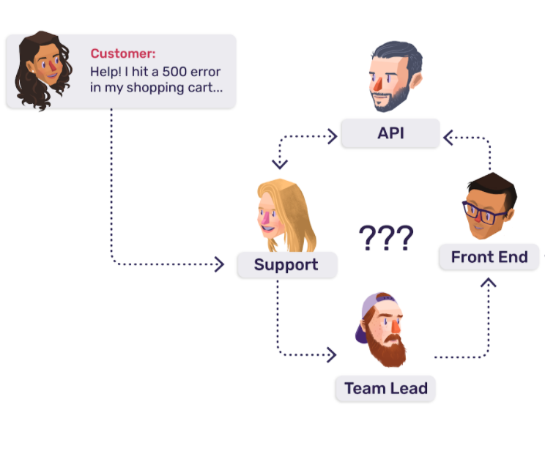
Why is error monitoring needed?

Slide 5
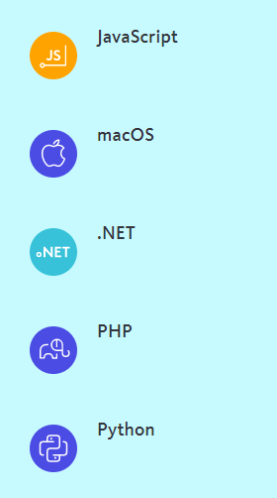
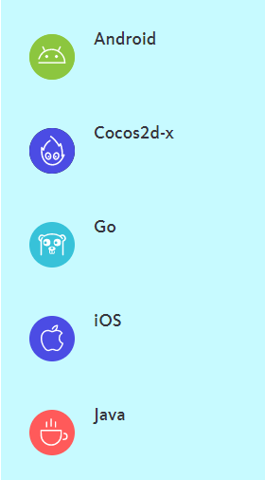
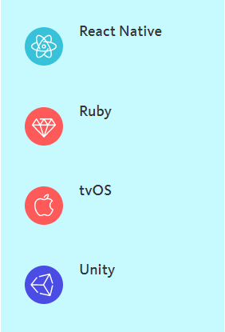
What is the feature?
Red
Is the color of blood, and because of this it has historically been associated with sacrifice, danger and courage.

Slide 6
How to use?

Slide 7
Installation (Laravel)
1. Add bugsnag/bugsnag-laravel to your composer.json
2. Register bugsnag service provider before your AppServiceProvider::class in config/app.php
3. Configure your Bugsnag API Key in your .env file
$ composer require "bugsnag/bugsnag-laravel:^2.0"
'providers' => [
// ... Bugsnag\BugsnagLaravel\BugsnagServiceProvider::class,
// ...
],
BUGSNAG_API_KEY=your-api-key-here

Slide 8
Installation(Laravel)
4. set up a bugsnag logging channel and add it to your logging stack in config/logging.php
5. Reporting handled exceptions can be accomplished as follows
'channels' => [
'stack' => [
'driver' => 'stack',
'channels' => ['single', 'bugsnag'],
],
'bugsnag' => [
'driver' => 'bugsnag',
],
],
try {
// Some potentially crashy code
} catch (Exception $ex) {
Bugsnag::notifyException($ex);
}

Slide 9
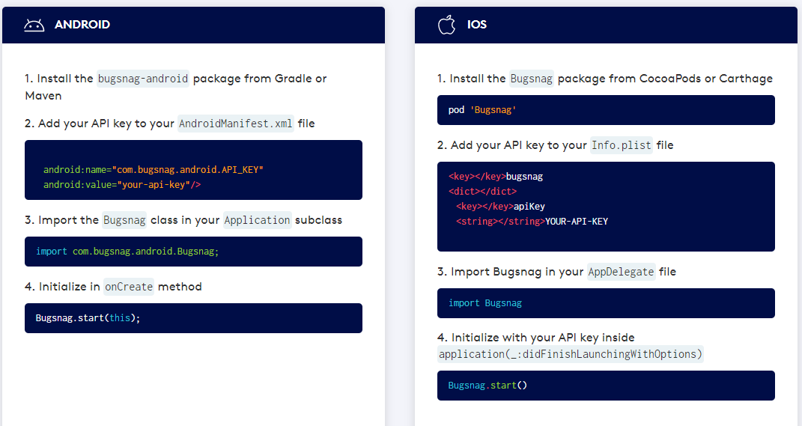
Installation (Mobile)

Slide 10
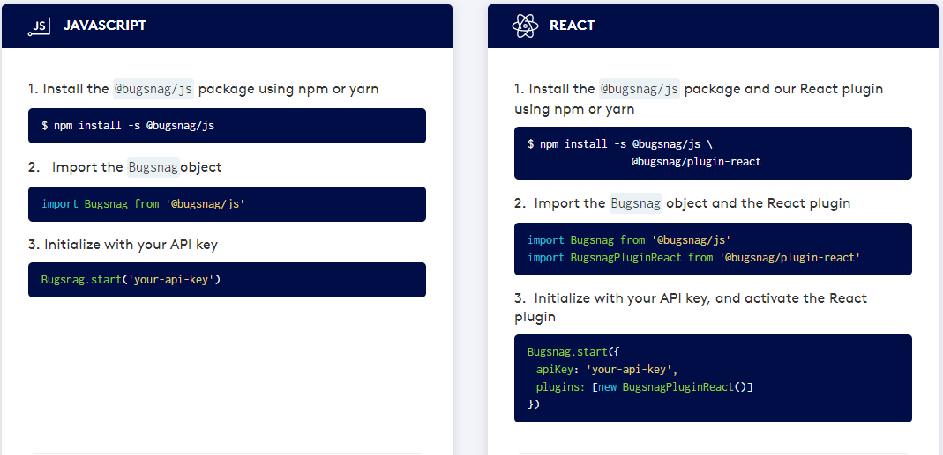
Installation (Browser)

Slide 11
Installation (Server)

Slide 12
Example
use Bugsnag\BugsnagLaravel\Facades\Bugsnag;
use RuntimeException;
Bugsnag::notifyException(new RuntimeException("Test error"));

Slide 13
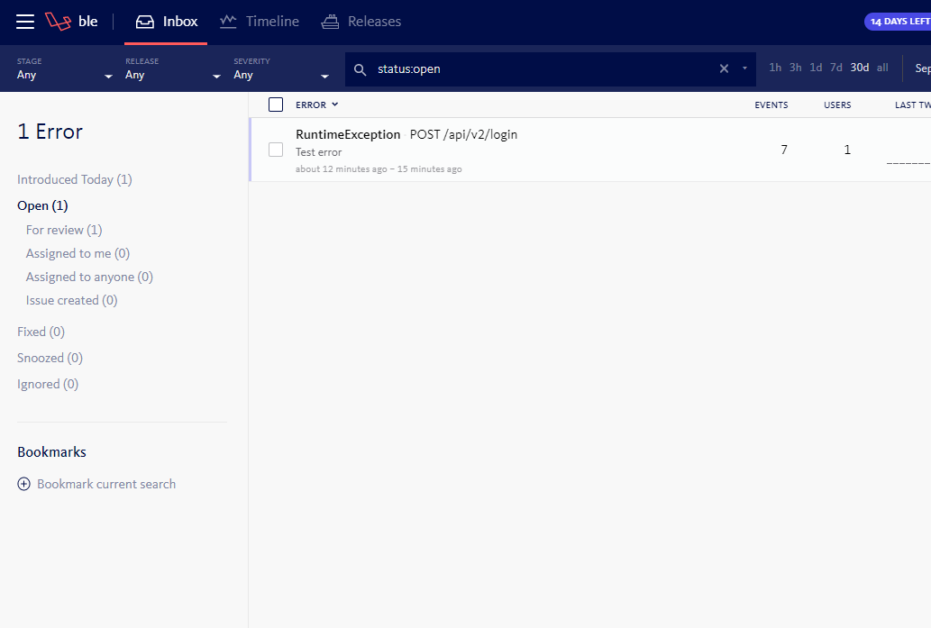
Example

Slide 14
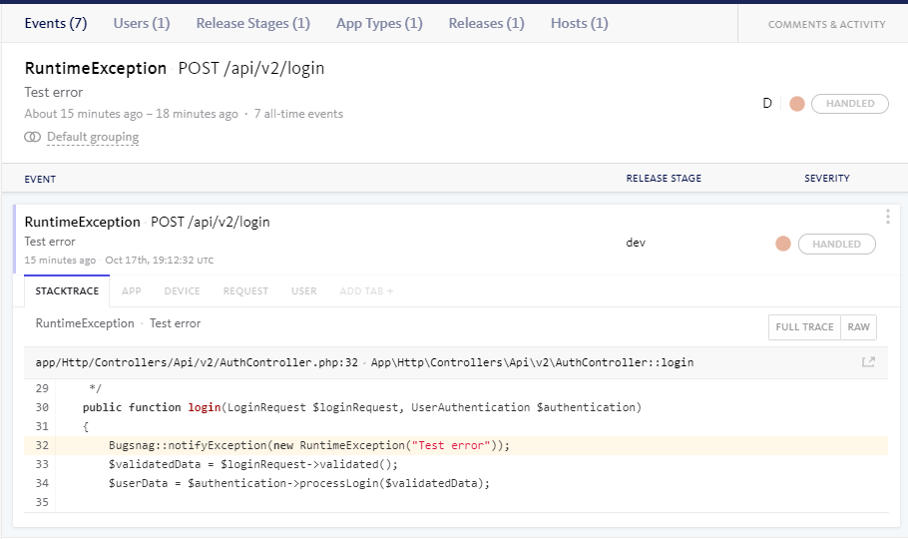
Example

Slide 15
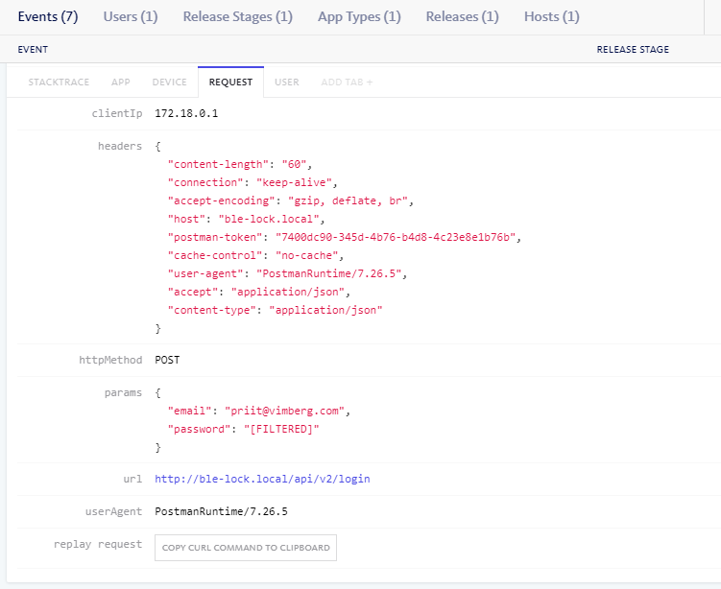
Example

Slide 16
Thanks!

