Slide 1
Chrome extensions for UI development
2020/10/25

Slide 2
Pesticide
This is the absolute easiest way to visualize box sizing in CSS. With pesticide, you see every element as a box with borders around them. See how the borders, margins, paddings and more affect the element. It is a pretty great extension.
https://chrome.google.com/webstore/detail/pesticide-for-chrome-with/neonnmencpneifkhlmhmfhfiklgjmloi

Slide 3
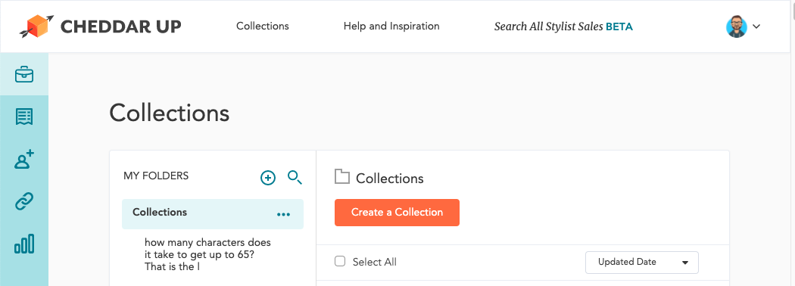
Before Analyze

Slide 4
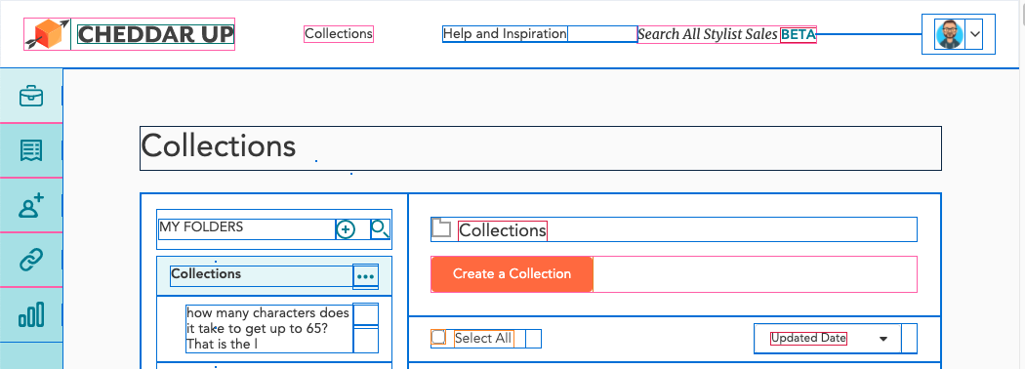
Analyze result

Slide 5
2. CSS Viewer
This browser extension makes it so simple to access the CSS properties of an element by simply hovering over on it.
https://chrome.google.com/webstore/detail/cssviewer/ggfgijbpiheegefliciemofobhmofgce?hl=en

Slide 6
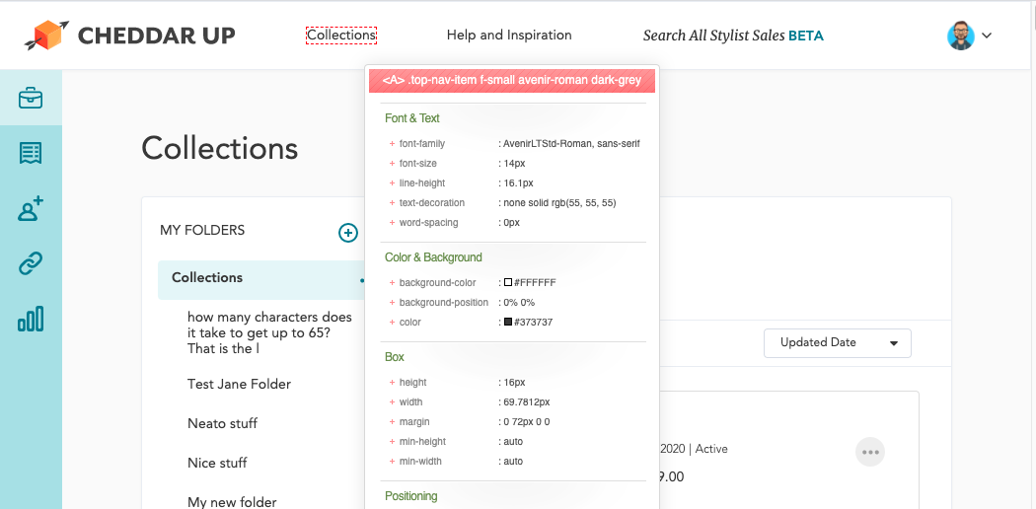
Analyze popup

Slide 7
3. Web Developer Checklist
This browser extension helps to analyze and check their websites or web applications for violations of best practices in web design.
https://chrome.google.com/webstore/detail/web-developer-checklist/iahamcpedabephpcgkeikbclmaljebjp?hl=en

Slide 8
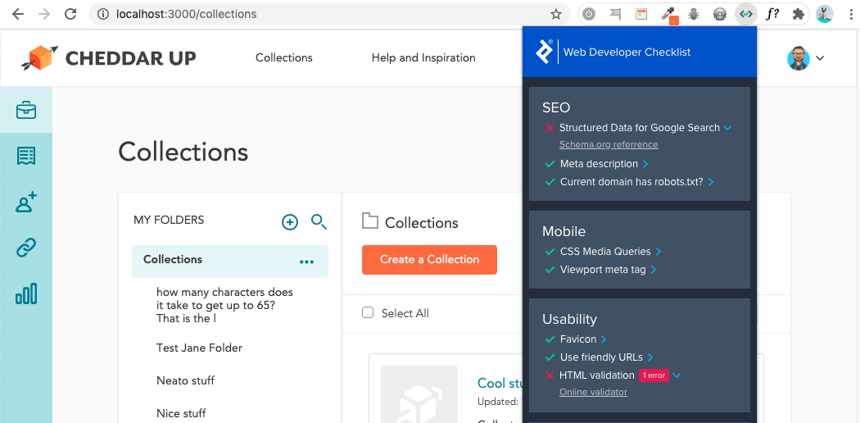
Full screenshot - web dev checklist popup (2)

Slide 9
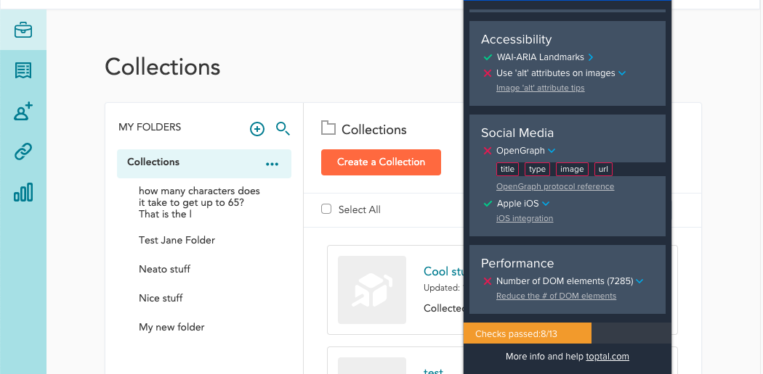
Full screenshot - web dev checklist popup (1)

Slide 10
4. ColorZilla
This is a browser extension that assists web developers and graphic designers with color related tasks. Simply hover over an element in a website or application to get all the information related to its color. It includes a Color Picker, Eye Dropper, Gradient Generator and much more....
https://chrome.google.com/webstore/detail/colorzilla/bhlhnicpbhignbdhedgjhgdocnmhomnp/details

Slide 11
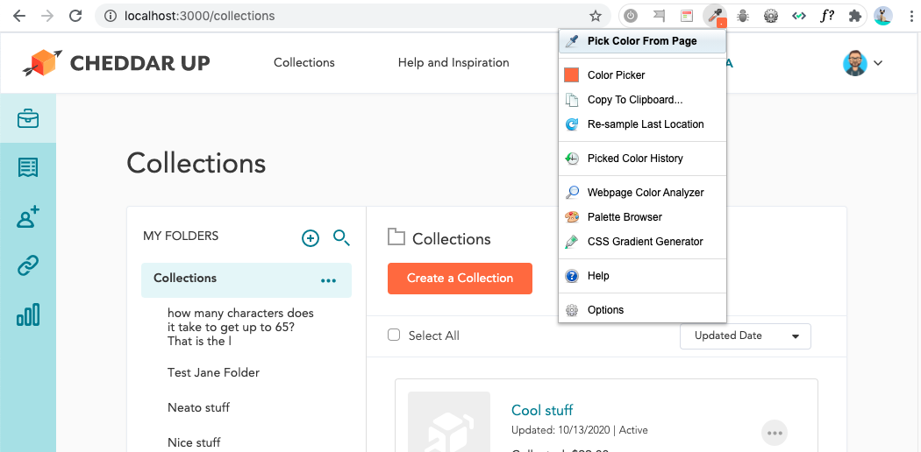

Slide 12
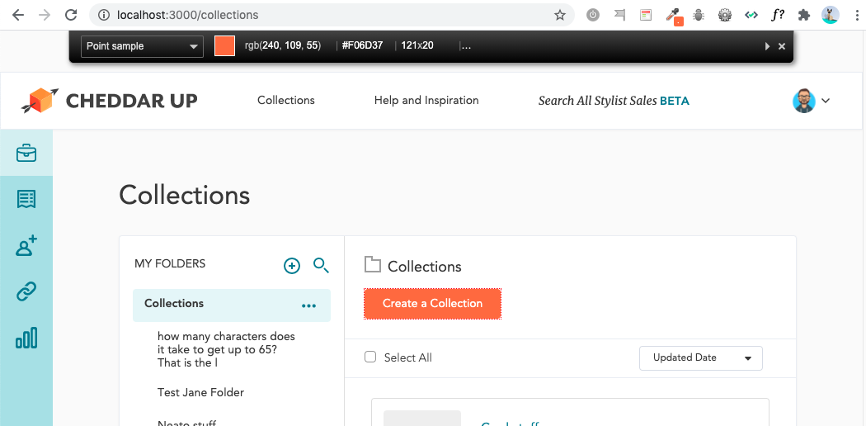

Slide 13
5. WhatFont
Knowing what typefaces are used on web applications and websites has never been easier. With this extension, you could inspect web fonts by just hovering on them.It also detects the services used for serving web fonts. Supports Typekit and Google Font API.
https://chrome.google.com/webstore/detail/whatfont/jabopobgcpjmedljpbcaablpmlmfcogm?hl=en

Slide 14
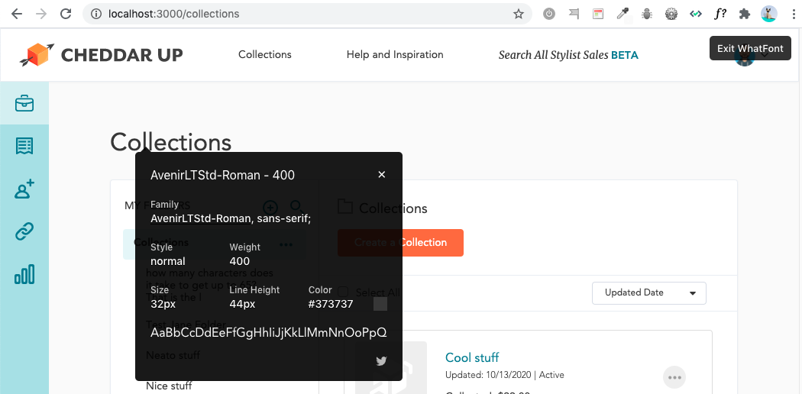

Slide 15
6. Web Developer
This browser extension adds a little toolbar button with various web developer tools pertaining to images, forms etc.
https://chrome.google.com/webstore/detail/web-developer/bfbameneiokkgbdmiekhjnmfkcnldhhm

Slide 16
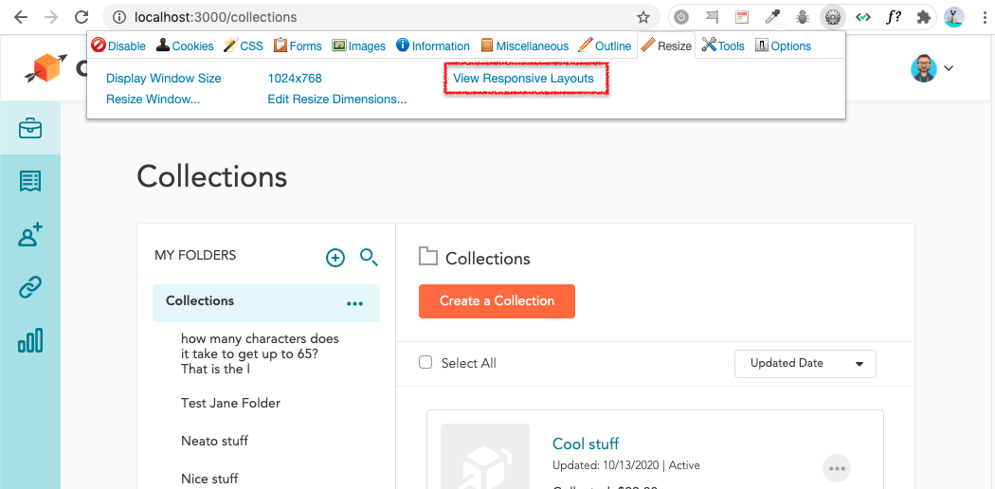

Slide 17
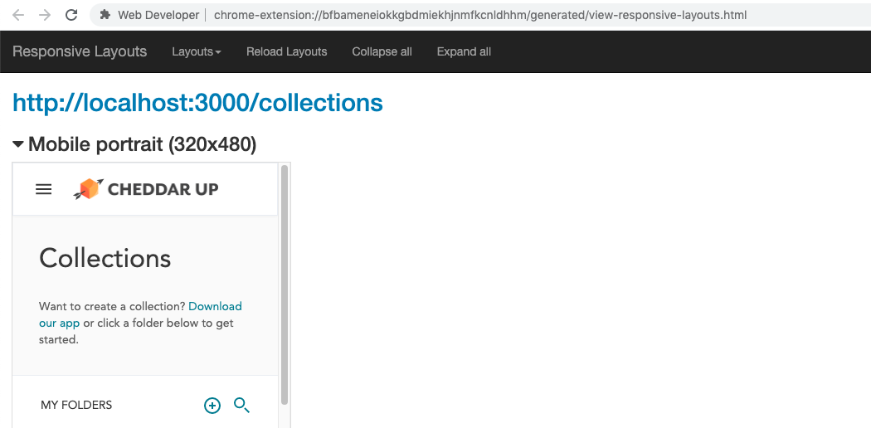

Slide 18
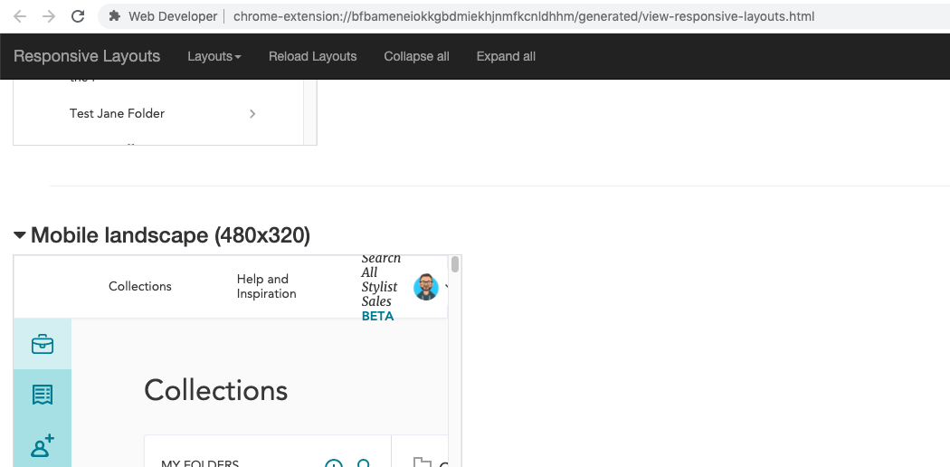

Slide 19
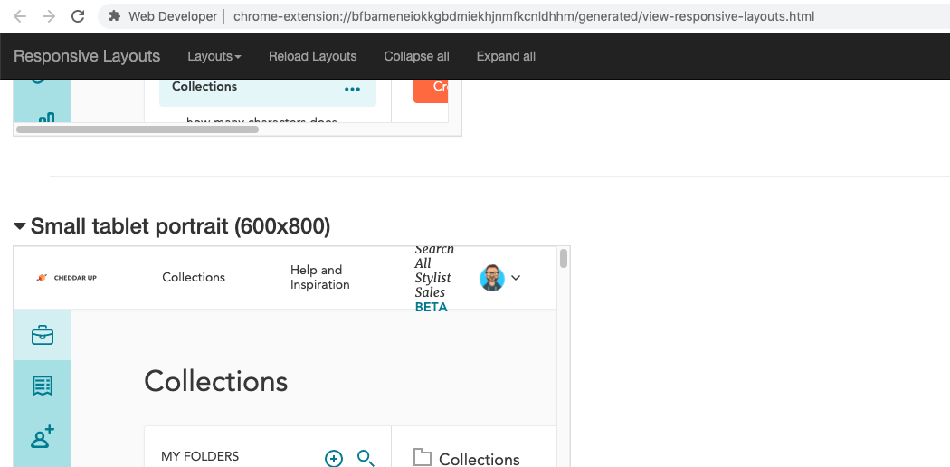

Slide 20
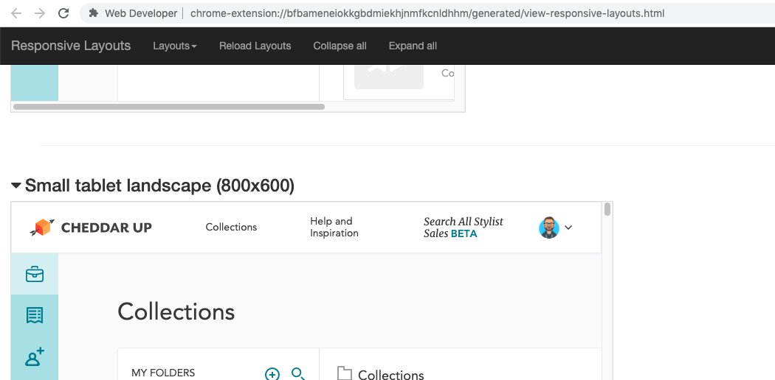

Slide 21
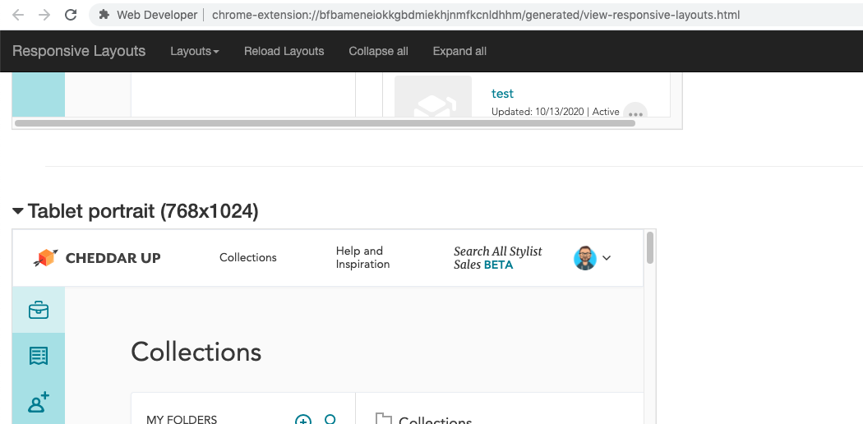

Slide 22
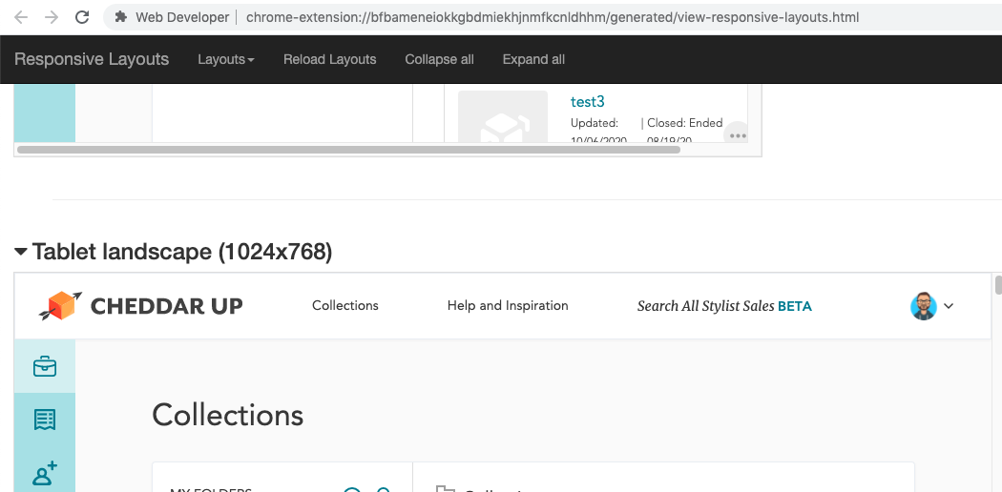

Slide 23
Reference
https://dev.to/developerkaren/chrome-extensions-every-developer-should-have-doh

Slide 24
Thank you!

