Slide 1
Dialogflow
Phurunbit Tech Ltd. 2020 copyright@kjh

Slide 2

Agenda
Conception
Configuration
Development
Related Jobs on Upwork

Slide 3




Conception
Dialogflow is a natural language understanding platform that makes it easy to design and integrate a conversational user interface into your mobile app, web application, device, bot, interactive voice response system, and so on.

Slide 4
Conception
Using Dialogflow, you can provide new and engaging ways for users to interact with your product.
Dialogflow can analyze multiple types of input from your customers, including text or audio inputs (like from a phone or voice recording).
It can also respond to your customers in a couple of ways, either through text or with synthetic speech.

Slide 5









Configuration

Slide 6
Agents
A Dialogflow agent is a virtual agent that handles conversations with your end-users.
It is a natural language understanding module that understands the nuances of human language.
Dialogflow translates end-user text or audio during a conversation to structured data that your apps and services can understand.
A Dialogflow agent is similar to a human call center agent.
You train them both to handle expected conversation scenarios, and your training does not need to be overly explicit.

Slide 7
Intents
An intent categorizes an end-user's intention for one conversation turn.
For each agent, you define many intents, where your combined intents can handle a complete conversation.
When an end-user writes or says something, referred to as an end-user expression, Dialogflow matches the end-user expression to the best intent in your agent.
Matching an intent is also known as intent classification.

Slide 8
Intents
1. Training phrases: These are example phrases for what end-users might say. When an end-user expression resembles one of these phrases, Dialogflow matches the intent. You don't have to define every possible example, because Dialogflow's built-in machine learning expands on your list with other, similar phrases.
2. Responses: You define text, speech, or visual responses to return to the end-user. These may provide the end-user with answers, ask the end-user for more information, or terminate the conversation.

Slide 9
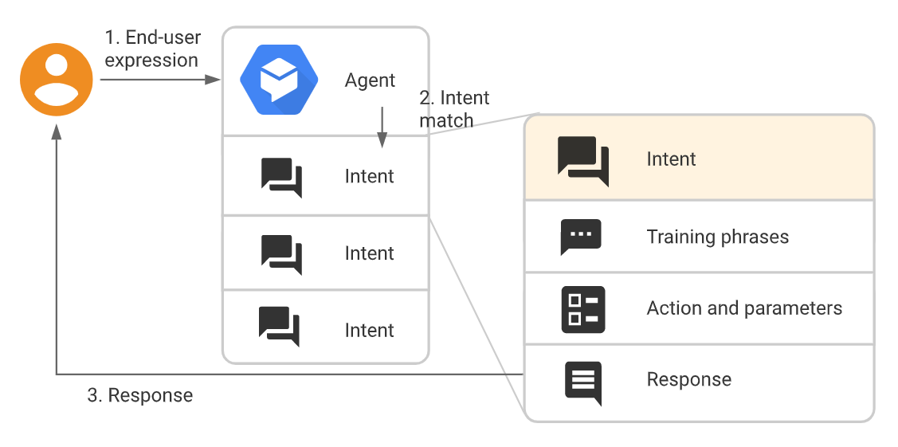
Intents

Slide 10
Entities
Each intent parameter has a type, called the entity type, which dictates exactly how data from an end-user expression is extracted.
Dialogflow provides predefined system entities that can match many common types of data. For example, there are system entities for matching dates, times, colors, email addresses, and so on.
You can also create your own custom entities for matching custom data. For example, you could define a vegetable entity that can match the types of vegetables available for purchase with a grocery store agent.

Slide 11
Contexts
Dialogflow contexts are similar to natural language context.
If a person says to you "they are orange", you need context in order to understand what "they" is referring to.
Similarly, for Dialogflow to handle an end-user expression like that, it needs to be provided with context in order to correctly match an intent.
Using contexts, you can control the flow of a conversation.

Slide 12
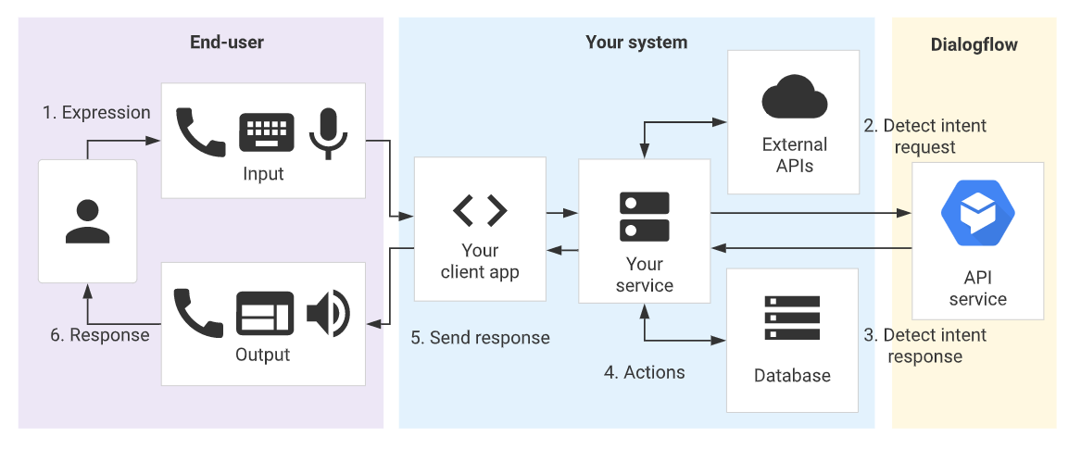
Fulfillment for integrations

Slide 13


Development

Slide 14
Set up authentication
If you plan to use the Dialogflow API, you need to set up authentication. Any client application that uses the API must be authenticated and granted access to the requested resources.
Install and initialize the Cloud SDK:
gcloud auth application-default print-access-token
Install the Dialogflow client library:
npm install dialogflow

Slide 15
Manage intents with the API
Create an agent
Import the example file to your agent
Create intent
List intents
Delete intents
Detect intent
Streaming detect intent

Slide 16
Related Jobs on Upwork

Slide 17
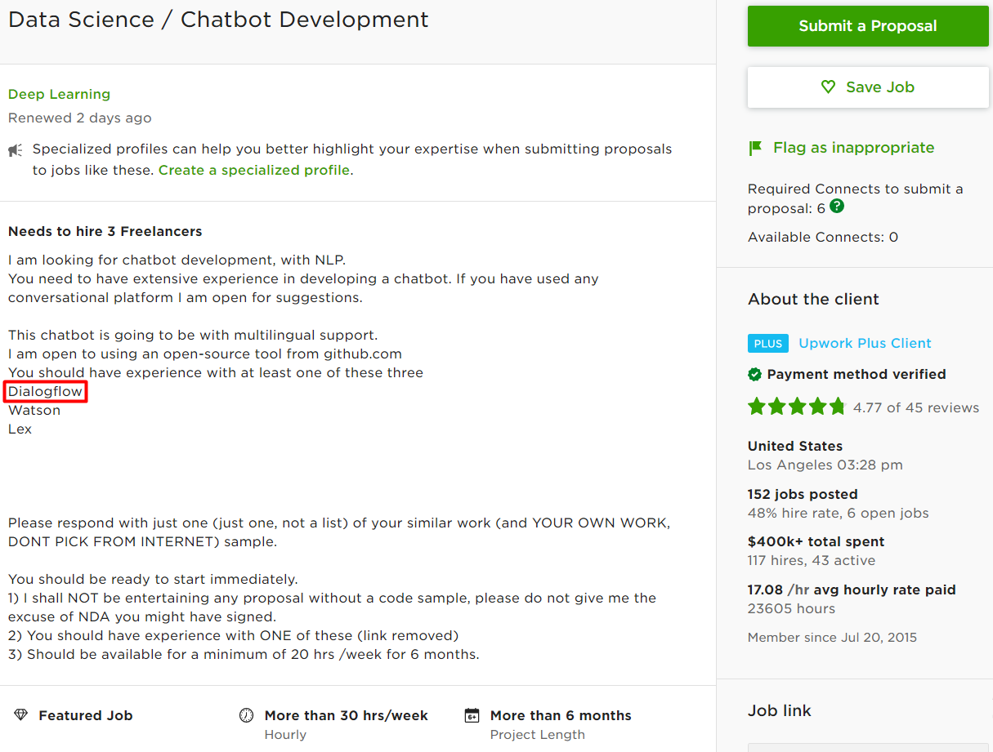

Slide 18
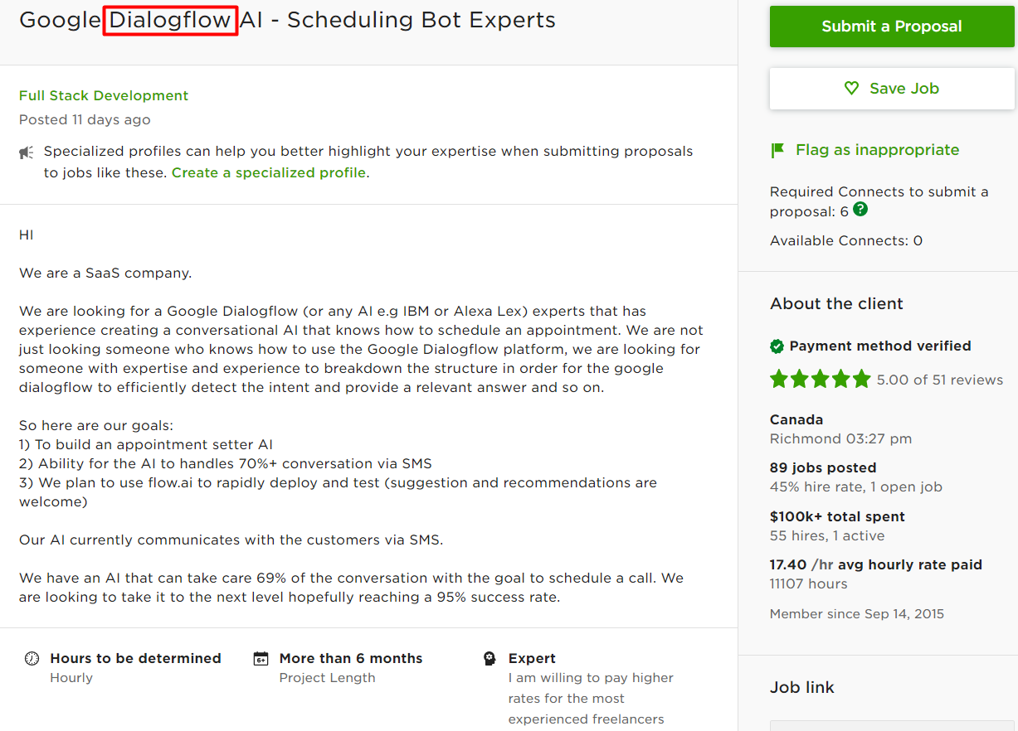

Slide 19
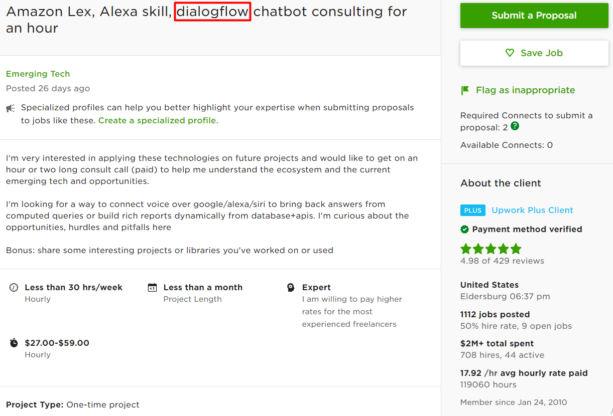

Slide 20
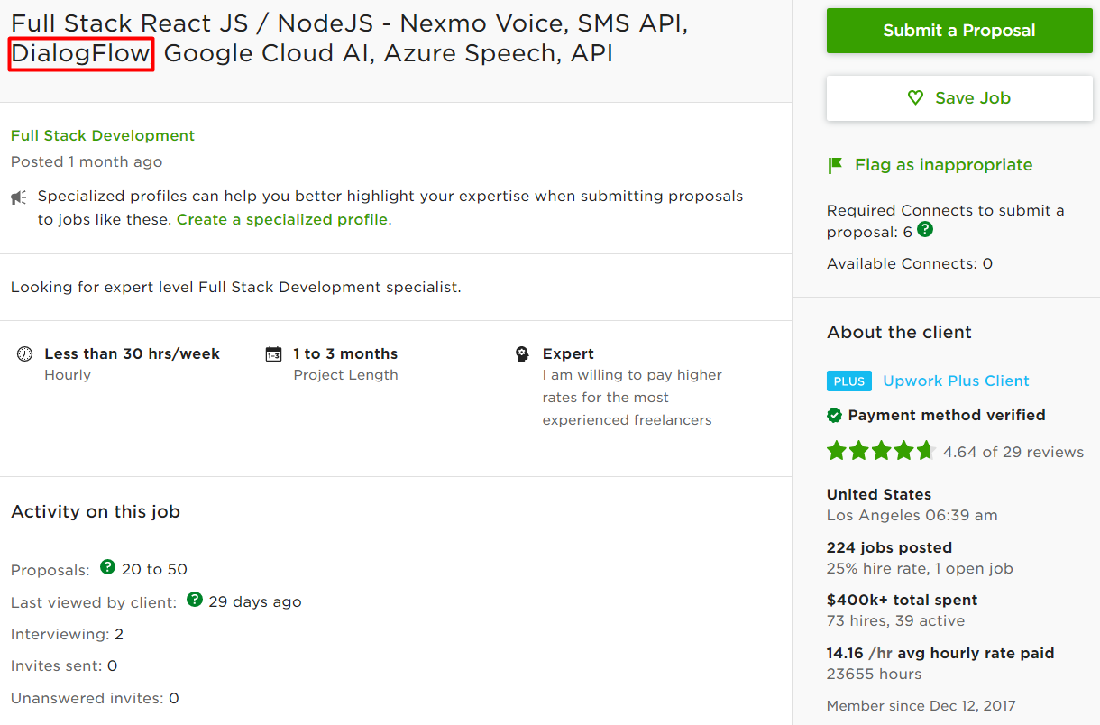

Slide 21
Thanks!
Any questions? You can find me at: kjh@mail.me

