Slide 1
Electron
@Phurunbit Tech Ltd, 2020

Slide 2
01
02
03
ABOUT ELECTRON
CREATE ELECTRON APP
Electron Features

Slide 3
01. ABOUT ELECTRON

Slide 4
WHAT IS ELECTRON
Electron
An open source library developed by GitHub for building cross-platform desktop applications with HTML, CSS, and JavaScript. Electron accomplishes this by combining Chromium and Node.js into a single runtime and apps can be packaged for Mac, Windows, and Linux.

Slide 5
CURRENT VERSION
2020
2013
2020
17 August Preview Release 10.0.0-beta.23
15 July
Initial Version
18 August
Stable Release
9.2.1

Slide 6
RECENT VERSIONS
 | Release date | Chromium version | Node.js version
v10.0.x | 2020-08-25 | 85 | 12.16
v9.0.x | 2020-05-18 | 83 | 12.14
v8.3.x | 2020-02-04 | 80 | 12.3
v7.3.x | 2019-10-22 | 78 | 12.8

Slide 7
Why Electron
Who Uses Electron?
To create desktop applications with pure JavaScript by providing a runtime with rich native (operating system) APIs.
Github developed for the text editor Atom - 2014.
Slack desktop
Wordpress desktop app
Visual Studio Code
Skype, Microsoft Teams
Zeplin, Rambox, Franz

Slide 8
How to Install
How Electron Works
npm install -g electron-prebuilt
electron --version
takes a main file defined in package.json file and executes it.
creates application windows which contain rendered web pages and interaction with the native GUI
as start an application, a main process is created.(GUI)
create by the main process in the main file by using the BrowserWindow module which runs its own renderer process.

Slide 9
02. CREATE ELECTRON APP

Slide 10
Example
const {app, BrowserWindow} = require('electron')
const url = require('url')
const path = require('path')
let win
function createWindow() {
win = new BrowserWindow({
width: 800,
height: 600
})
win.loadURL(url.format ({
pathname: path.join(__dirname, 'index.html'),
protocol: 'file:',
slashes: true
}))
}
app.on('ready', createWindow)
<!DOCTYPE html>
<html>
<head>
<meta charset = "UTF-8">
<title>Hello World!</title>
</head>
<body>
<h1>Hello World!</h1>
</body>
</html>

Slide 11
03. ELECTRON FEATURES

Slide 12
Native Node Libraries
Inter Process Communication
Building UIs
File Handling
System Dialogs
Menus
System Tray
Notifications
Defining Shortcuts
Environment Variables
Webview
Debugging

Slide 13
File Handling
let fs = require('fs')
function loadAndDisplayContacts() {
if(fs.existsSync(filename)) {
let data = fs.readFileSync(filename, 'utf8').split('\n')
data.forEach((contact, index) => {
let [ name, email ] = contact.split(',')
addEntry(name, email)
})
} else {
console.log("File Doesn\'t Exist. Creating new file.")
fs.writeFile(filename, '', (err) => {
if(err)
console.log(err)
})
}
}

Slide 14
Native Node Libraries
OS module:
Net module:
os.userInfo([options])
os.platform()
os.homedir()
os.arch()
os.EOL
net.createServer([options][, listener])
net.createConnection(options[, listener])
net.Server.listen(port[, host][, backlog][, callback])
net.Server.close([callback])
net.Socket.connect(port[, host][, connectListener])

Slide 15
Inter Process Communication(IPC)
ipcMain
ipcRenderer1
ipcRenderer2
ipcRenderer3
The ipcMain is used to communicate asynchronously from the main process to renderer processes.
The ipcRenderer module is used to communicate asynchronously from a renderer process to the main process.

Slide 16
Features
System Dialog
MENUS
const {dialog} = require('electron')
dialog.showOpenDialog()
dialog.showSaveDialog()
dialog.showMessageDialog()
dialog.showMessageDialog()
const {Menu, MenuItem} = require('electron')
const menu = Menu.buildFromTemplate(template)
// Main Menu
Menu.setApplicationMenu(menu)
// Popup Menu
window.addEventListener('contextmenu', (e) => {
e.preventDefault()
menu.popup(remote.getCurrentWindow())
}, false)

Slide 17
Features
System Tray
Defining Shortcuts
const {remote} = require('electron')
const {Tray, Menu} = remote
let trayIcon = new Tray('/path/images.png')
let trayMenu = Menu.buildFromTemplate(template)
trayIcon.setContextMenu(trayMenu)
const {ipcRenderer, remote} = require('electron')
const {globalShortcut} = remote
globalShortcut.register('CommandOrControl+O', () => {
ipcRenderer.send('openFile', () => {
console.log("Event sent.");
})
ipcRenderer.on('fileData', (event, data) => {
document.write(data)
})
})

Slide 18
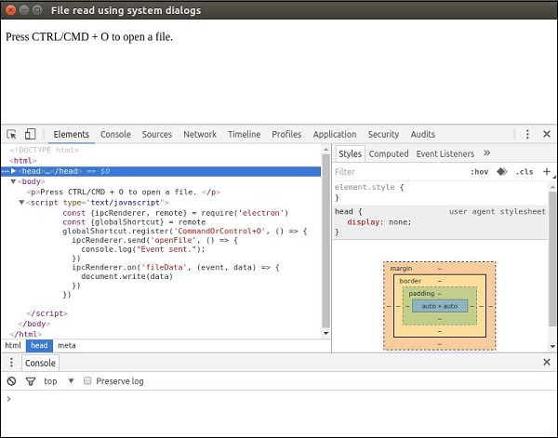
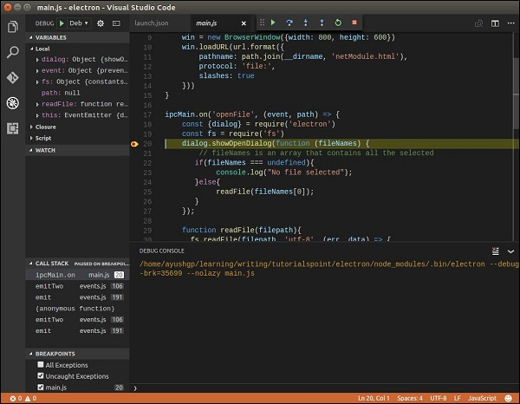
Debugging

Slide 19
Package Apps
npm install electron-packager
electron-packager <sourcedir>
<appname> --platform=<platform> --arch=<arch>
[optional flags...]

Slide 20
Supported Platforms
Windows
Mac OSX
Linux
Windows (also known as win32, for both 32/64 bit)
OS X (also known as darwin) / Mac App Store (also known as mas)
Linux (for x86, x86_64, and armv7l architectures)

Slide 21
THANKS!
2020-08-23

