Slide 1
How to build web pages on HubSpot (HubL)
2020.11.08 KIC

Slide 2
Content
Quick Start
Getting started with Modules / Themes
Getting started with local development

Slide 3
Quick Start
Before you begin
You’ll need to do a few things before you start building on the Hubspot CMS:
CMS sandbox account
Install Node.js, which enables Hubspot’s local development tools.
Versions 8.9.1 or higher are supported.
Install the Hubspot CMS CLI

Slide 4
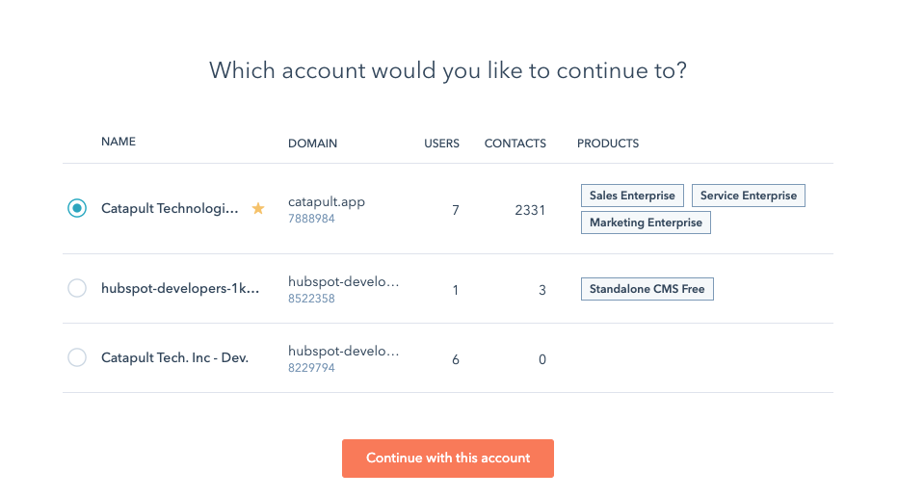
Configure the local development tools
Run hs init to connect the tools to your HubSpot account. This command will walk you through the following steps:
Create a personal CMS access key.
Copy your access key and paste it In the terminal.
Next, you’ll enter a name for the account.

Slide 5
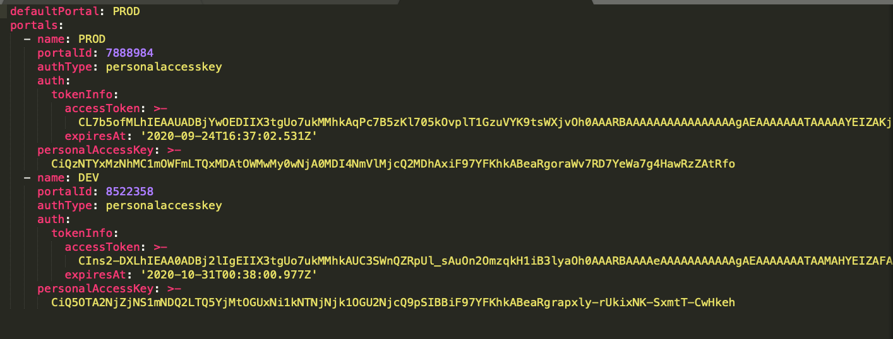
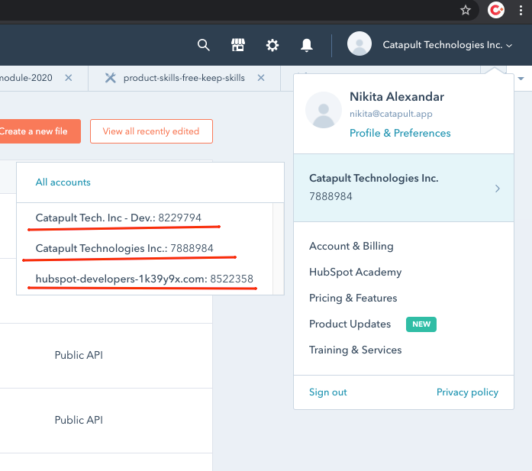
hubspot.config.yml file is generated

Slide 6
Create a project
hs create website-theme <theme_name>
This command will create a theme directory populated with files from the CMS theme boilerplate.
https://github.com/HubSpot/cms-theme-boilerplate
Upload your project to Hubspot
hs upload <local_theme_directory> <hubspot_theme_directory>
Watch project and sync with Hubspot
hs watch <local_theme_directory> <hubspot_theme_directory>

Slide 7
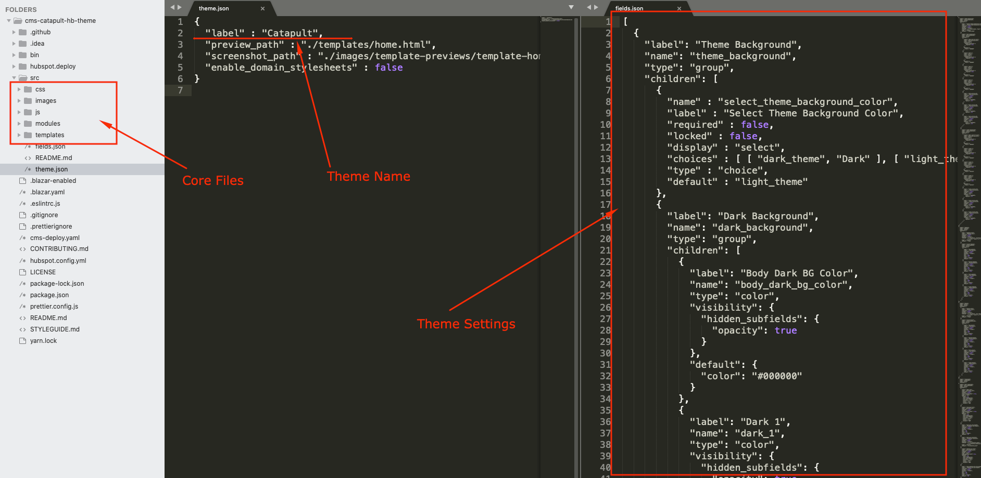
Project Structure

Slide 8
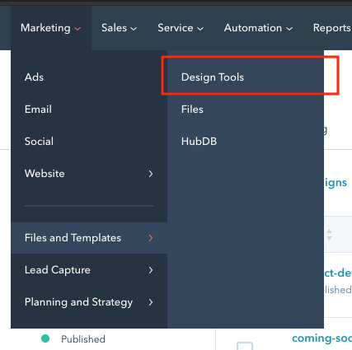
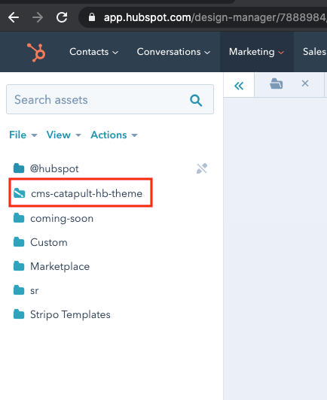
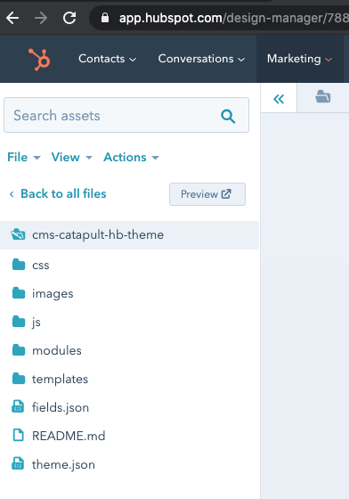
Getting started with modules / themes

Slide 9
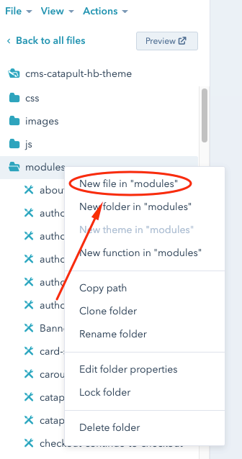
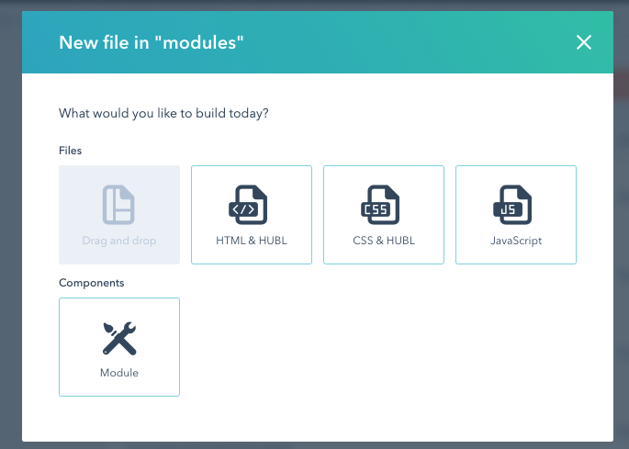
Create a Module

Slide 10
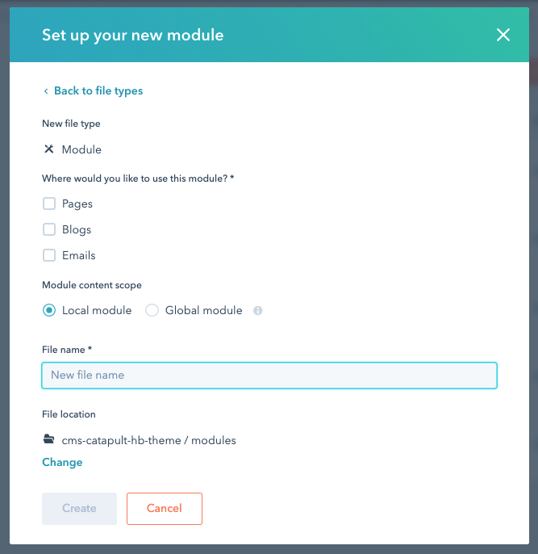
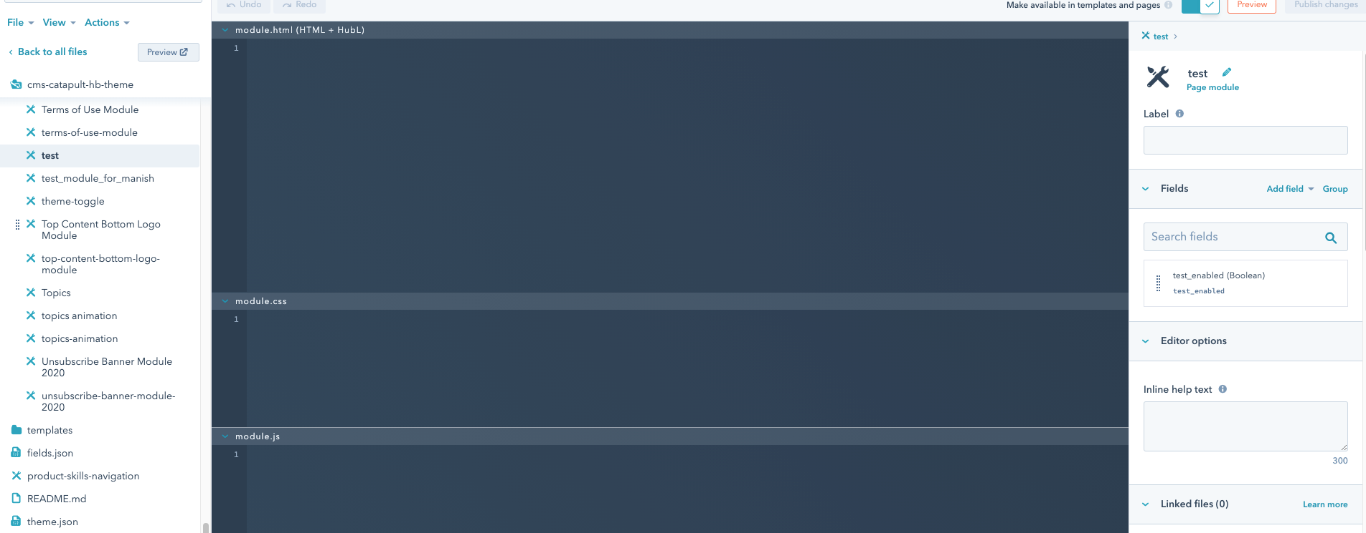

Slide 11
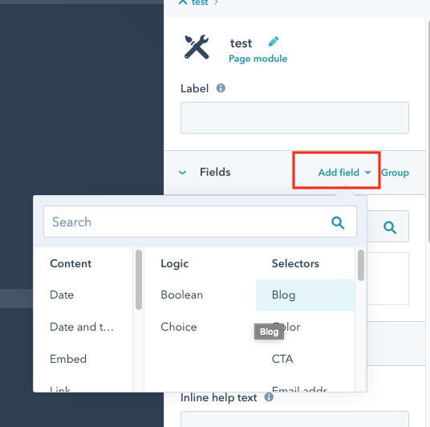
Add the fields
The module editor has three panes(module.html, module.js, module.css)
From the right sidebar menu, we click “Add field” to add field.
The field type is:
Text,
Image
Boolean,
Choose,
...

Slide 12
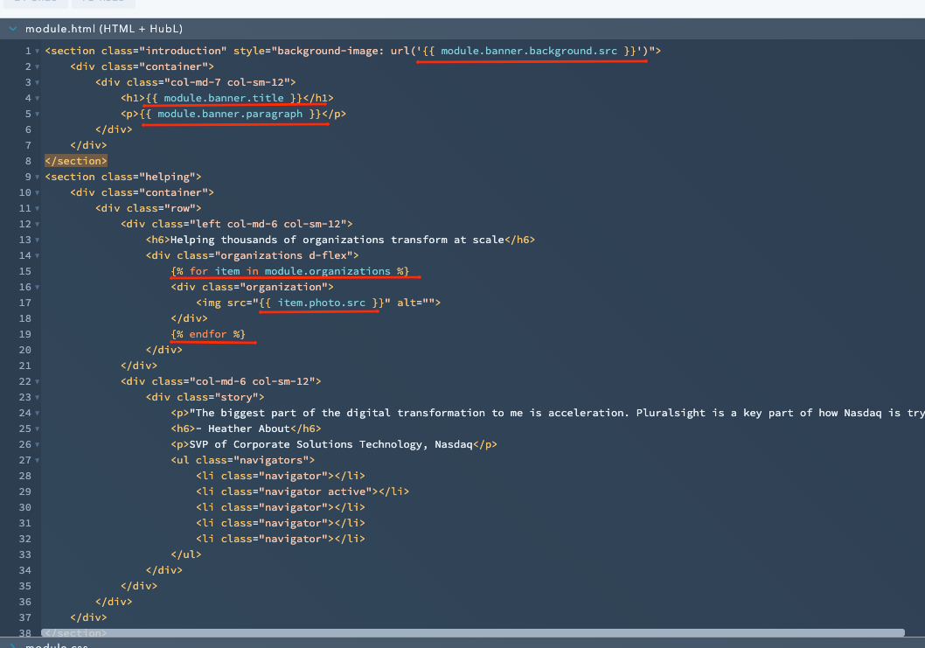
How to use field on the module

Slide 13
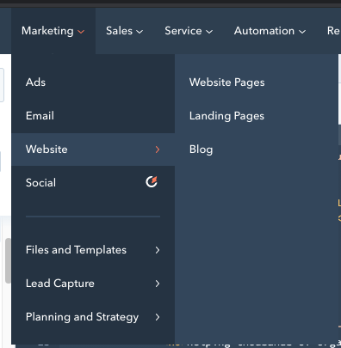
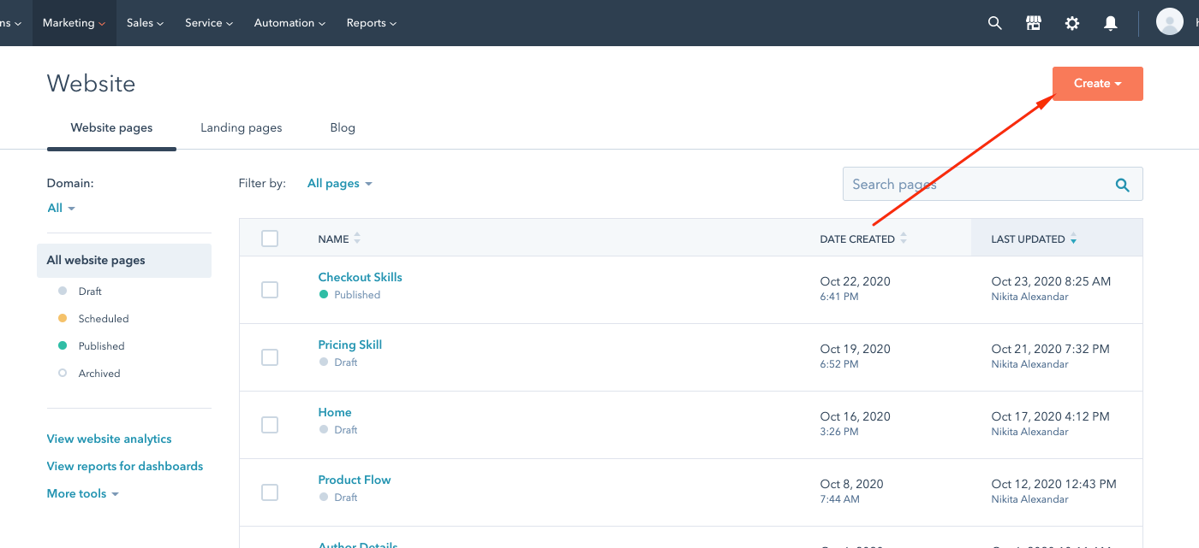
Create page and import module

Slide 14
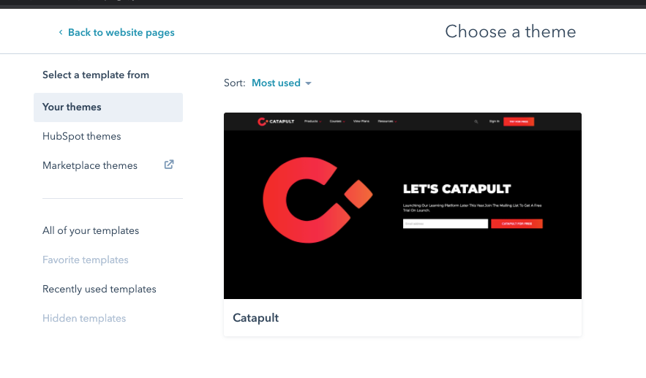
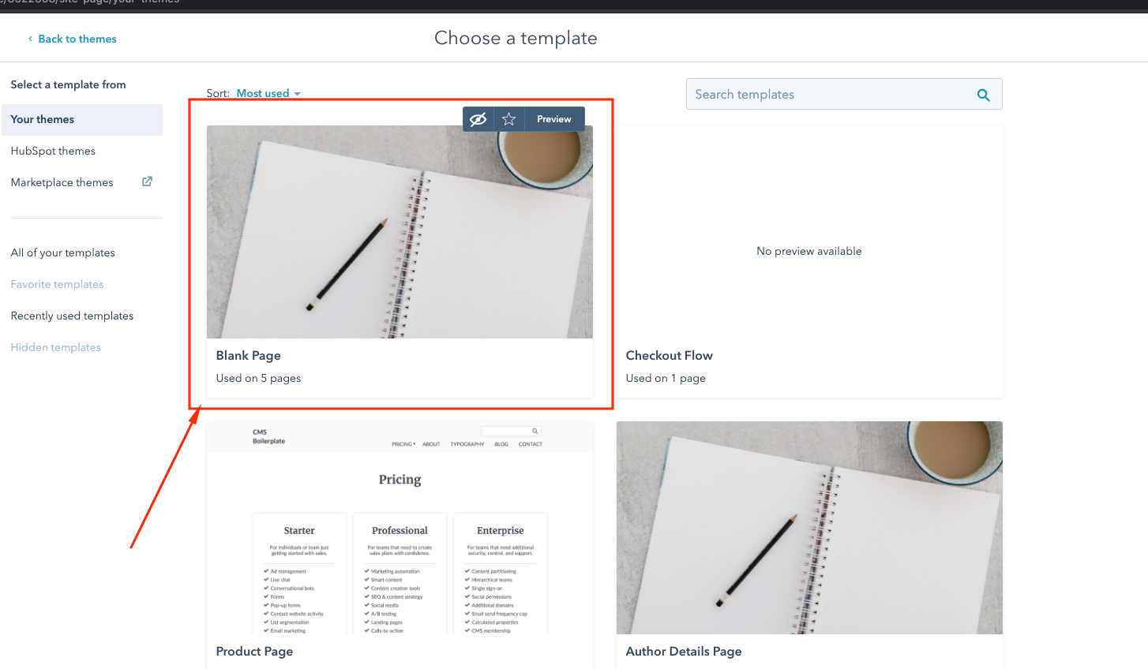
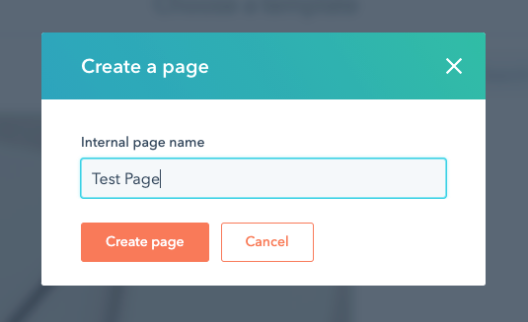

Slide 15
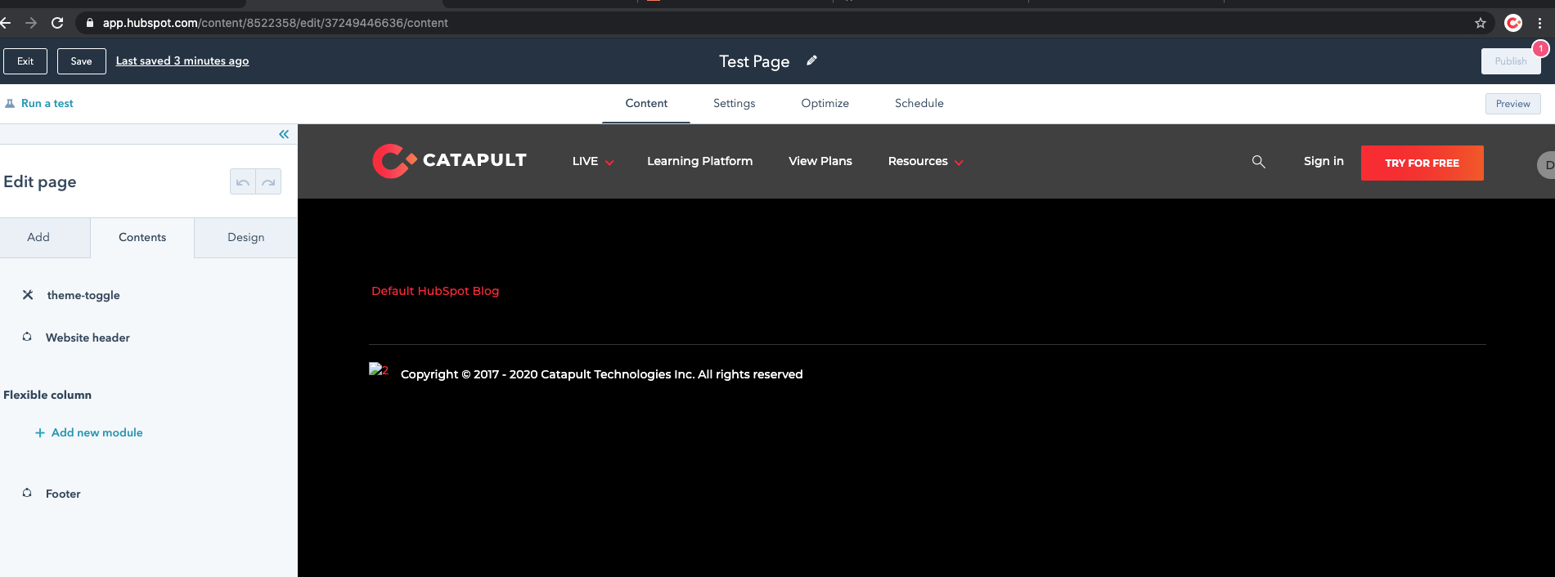
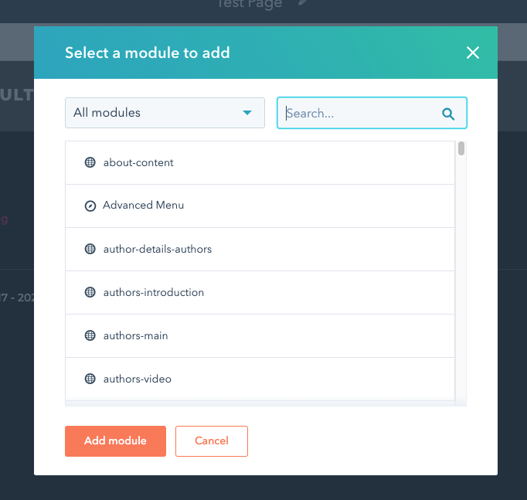
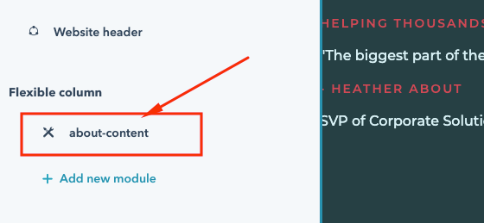

Slide 16
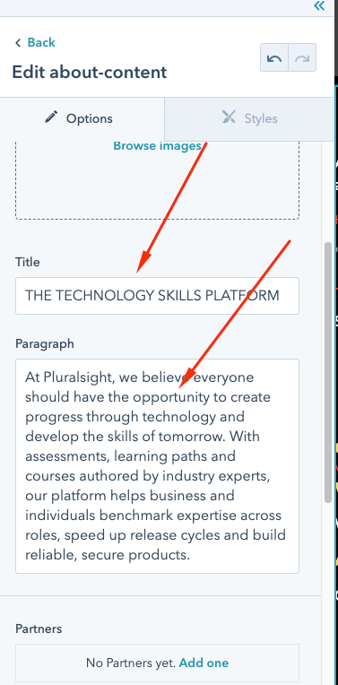
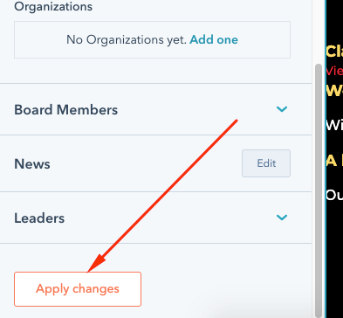

Slide 17
Getting started with local development
Pull the module down to your local environment
Now navigate to your terminal, and run the following command:
hs fetch --portal=<name> <src> [dest]
Here, the fetch command takes your module file from your HubSpot account and brings it into your local environment.
The <name> is the portal where you’ve stored your module. The name should match either your portal ID number or the name attribute you assigned to your portal in the ‚”hubspot.config.yml” file, when you configured your CLI.
The <src> is your module’s full path in the HubSpot Design Tools. In the Design Manager, you can right click on your module in the finder (sidebar menu). A context menu will appear, and you can select ‚”Copy path” to copy the full path to your clipboard.
The [dest] is the path to the local directory where you would like the module to be placed. If this is omitted, this argument will default to the current working directory.

Slide 18
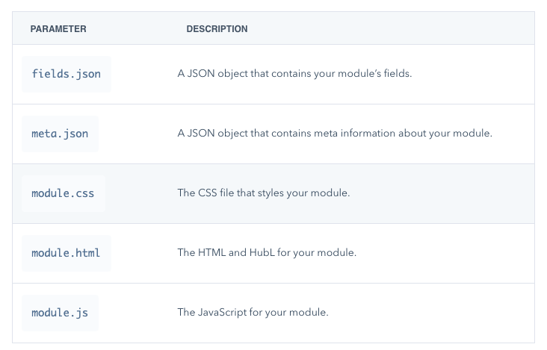

Slide 19
Push your local changes to your HubSpot account.
Now that we’ve made changes to our module in our local environment, we need to push them back to our HubSpot account.
Navigate to your terminal, making sure you are in the correct directory, and run the watch command once again:
hs watch --portal=<name> <src> <dest>
While the watch command runs, all your changes will be uploaded to your HubSpot account on file saves.
Leave this command running in the background, and your changes will immediately be live

Slide 20
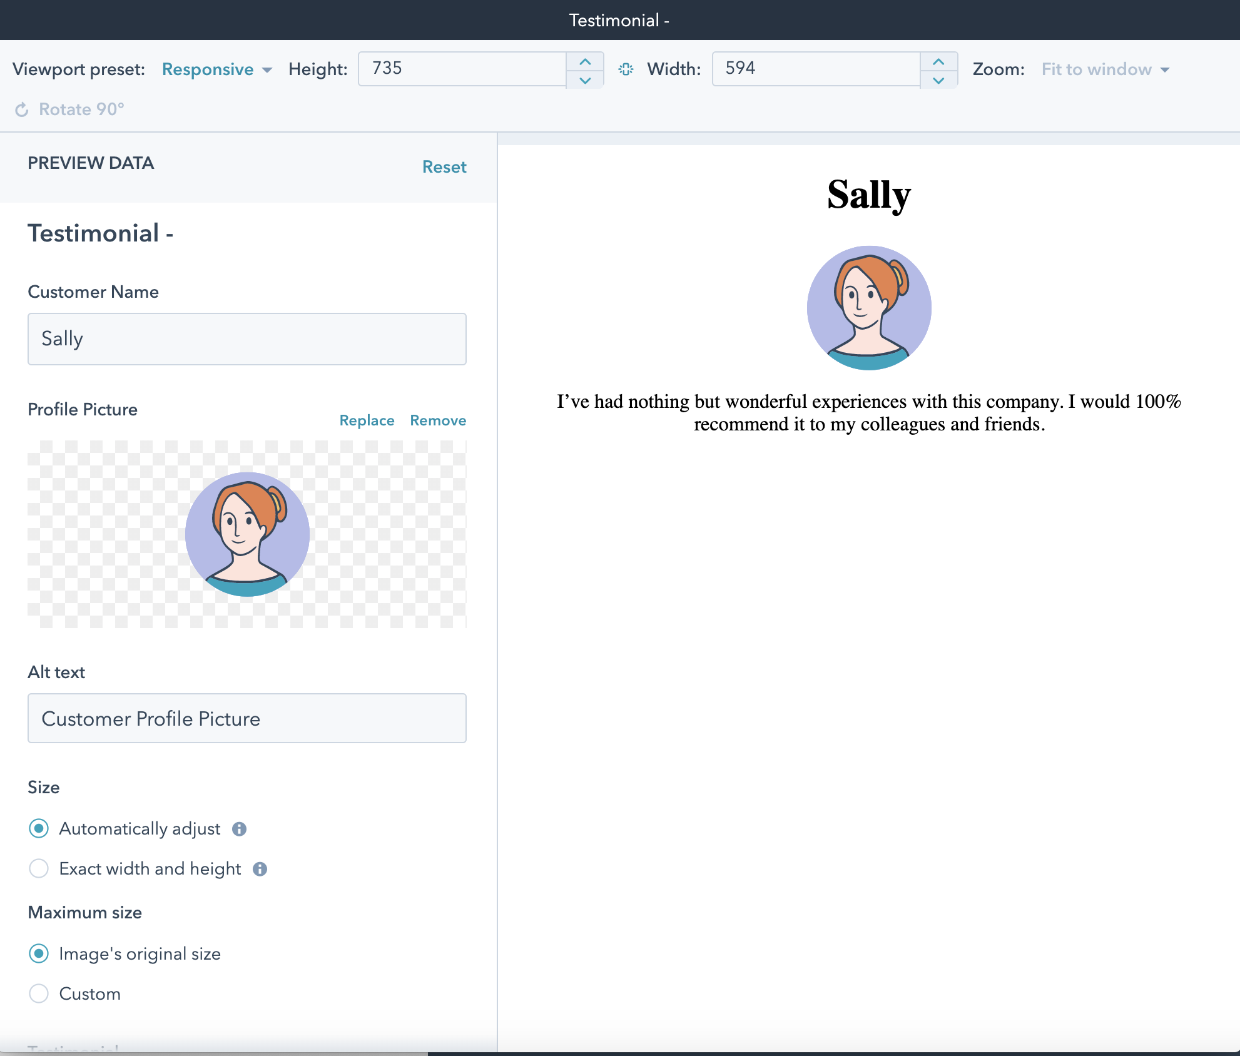
Preview your local changes in the Design Manager

Slide 21
Thank you...

