Slide 1
Introduction to Jitsi Meet
Phurunbit Tech Ltd. 2020 @Copyright

Slide 2
Agenda
What is Jitsi?
Architecture
How to use?
Pros & Cons

Slide 3
What is Jitsi?
More secure, more flexible, and completely free video conferencing.
Jitsi is a collection of Open Source projects which provide state-of-the-art video conferencing capabilities that are secure, easy to use and easy to self-host.
It supports for Web platform, Windows, Linux, macOS, iOS and Android.

Slide 4
Architecture
Jitsi Meet - WebRTC compatible JavaScript application that uses Jitsi Videobridge to provide high quality, scalable video conferences
Jitsi Videobridge (jvb) - WebRTC compatible server designed to route video streams amongst participants in a conference
Jitsi Conference Focus (jicofo) - server-side focus component used in Jitsi Meet conferences that manages media sessions between each of the participants and the videobridge
Jitsi Gateway to SIP (jigasi) - server-side application that allows regular SIP clients to join Jitsi Meet conferences
Jibri - set of tools for recording and/or streaming a Jitsi Meet conference that works by launching a Chrome instance rendered in a virtual framebuffer and capturing and encoding the output with ffmpeg

Slide 5
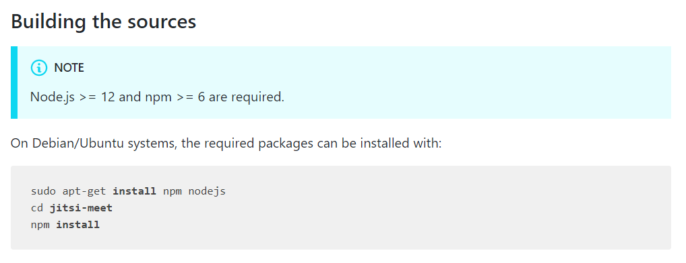
How to Use?
Web Installation

Slide 6
How to Use?
Web Integrations
Creating the Google API client for Google Calendar and YouTube integration
Creating the Microsoft app for Microsoft Outlook integration
Creating the Dropbox app for Dropbox recording integration

Slide 7
How to Use?
IFrame API

Slide 8
How to Use?
IFrame API

Slide 9
Pros & Cons
Pros
The ability to quickly create a meeting room, with a customized name and an easily accessible URL makes it perfect for everyday use.
I really liked the function of choosing the video quality, and the usability. You don't have to download it to be a part of the conference.
Free, Open Source

Slide 10
Pros & Cons
Cons
Stability and bandwidth issues, even on a self hosted server, seems to cause some issues with heavy usage unfortunately.

Slide 11
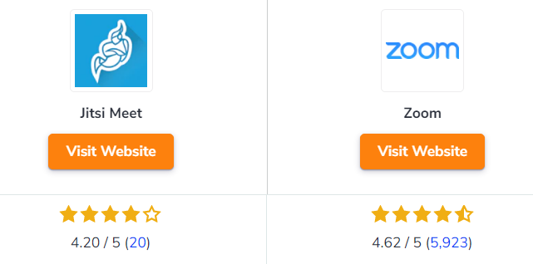
Jitsi vs Zoom

Slide 12
Thank You !

