Slide 1
Typo3
2020. 11.15 SMC

Slide 2
01
Overview
02
Features
03
Structure
04
Conclusion
Agenda

Slide 3
1. Overview
TYPO3 is an Open Source Content Management System (CMS) written in PHP.
TYPO3 is, along with WordPress, Joomla and Drupal, among the most popular content management systems worldwide, however it is more widespread in Europe than in other regions.

Slide 4
1. Overview
Version History
-First version: 1.0, 1997
-Latest version: Typo 10.4 LTS, 2020-04-21

Slide 5
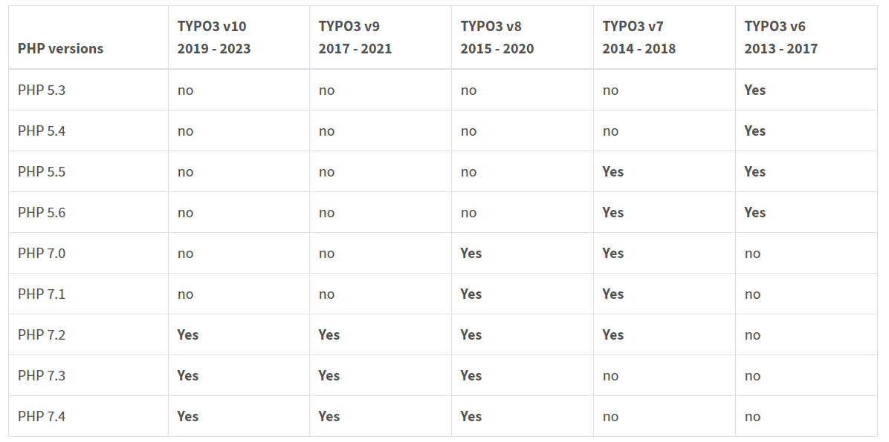
PHP Compatibility

Slide 6
01
02
03
04
05
06
2. Features
Free Open Source
Granular Frontend and Backend Access Rights
Publishing Content
Multi-Language
Your data - our strength
Runs everywhere

Slide 7
1) Free Open source
Access to the source code, with 15+ years experience
You can get the system customized to your wishes
Implementation, customization and maintenance will need to be done by professionals
2) Publishing Content
TYPO3 contains built-in versioning functionality that allows users to revert content to a previous version with ease. TYPO3 also features “workspaces,” which make it possible for users to edit content in one or more draft workspaces, and to confirm editorial approval before content is published.

Slide 8
3) Granular Frontend and Backend Access Rights
All frontend pages and content can be limited to specific user groups. Backend editors can easily be restricted to specific sections of the page tree, modules, and directories in the file system.
4) Multi-Language
For multiple languages are built-in to the TYPO3 core and are integrated at every level of the system’s architecture.

Slide 9
5) Your data - our strength
TYPO3 can be installed on any database based on MySQL/MariaDB, PostgreSQL, MSSQL or SQLite2 - due to the underlying database abstraction moving your data from one server to another with only little configuration changes.
6) Runs everywhere
You can install TYPO3 by downloading a zip-file or via composer. Putting it on a web server or on a cloud service like Microsoft Azure or Amazon AWS is simple - due to proper separation of content, configuration and other assets like caches and temporary files.

Slide 10
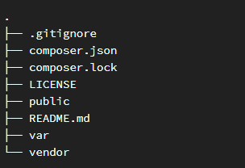
3. Installation
- Install TYPO3 via composer
folder structure

Slide 11
3. Installation
- Install TYPO3 without composer
Installing on a Unix Server
1. Get the Source Package and upload this package to your web server.
2. Unpack the file on your web server:

Slide 12
Installing on a Unix Server
3. Create these symlinks in your document root:
The final structure

Slide 13
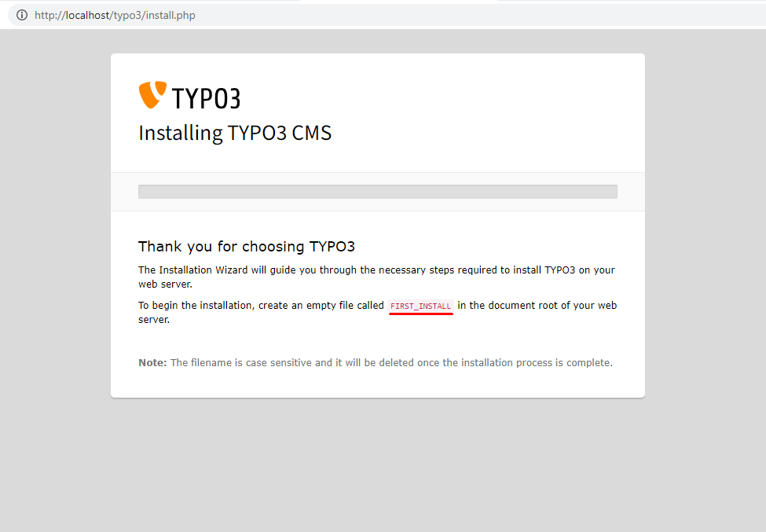
- Admin Tool
Start

Slide 14
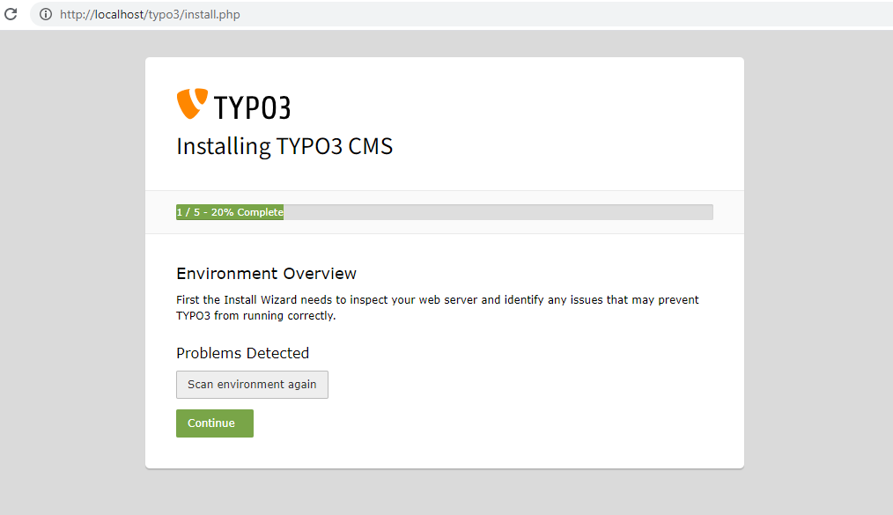
- Admin Tool
Step 1

Slide 15
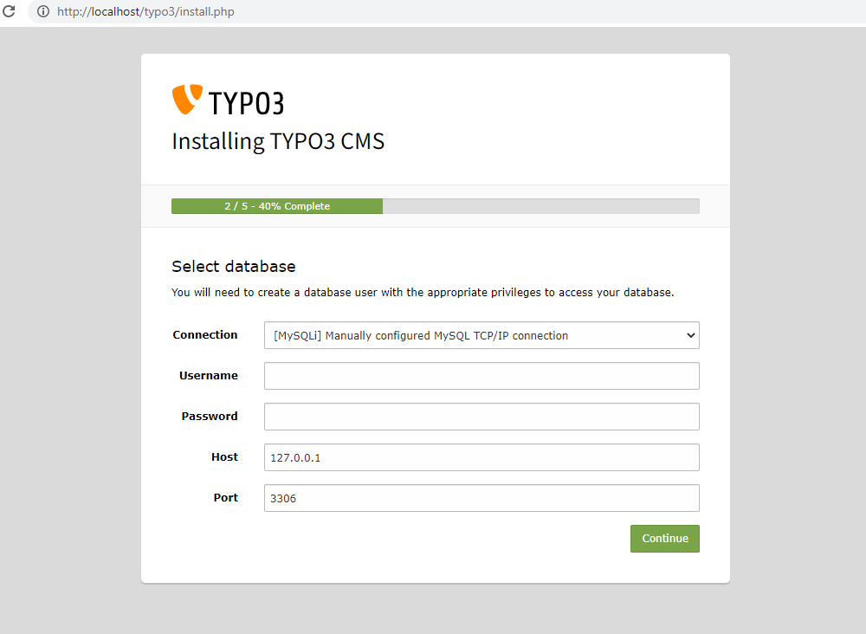
- Admin Tool
Step 2

Slide 16
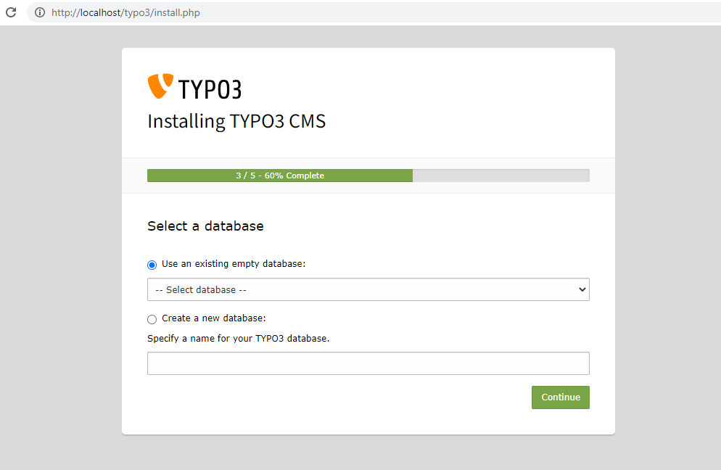
- Admin Tool
Step 3

Slide 17
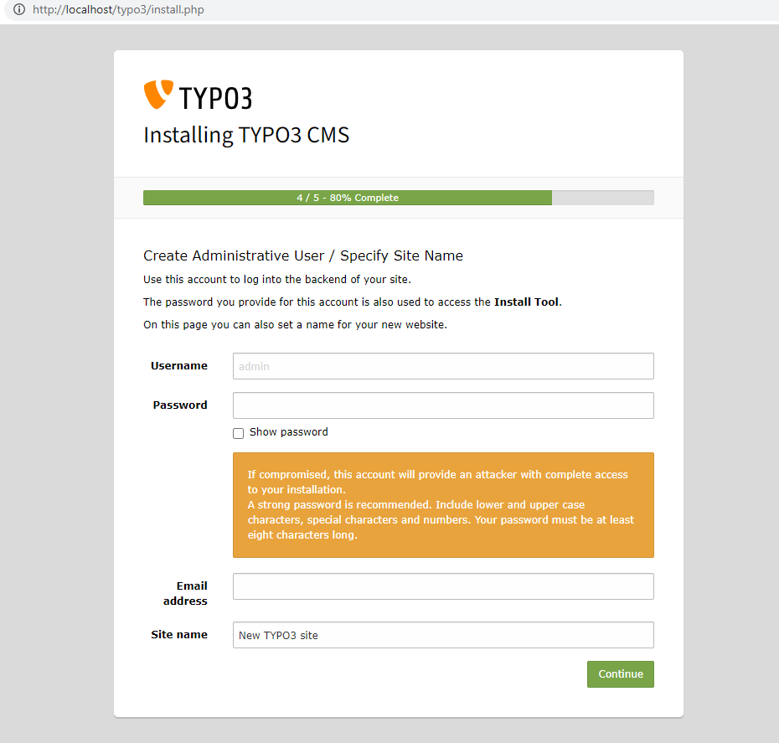
- Admin Tool
Step 4

Slide 18
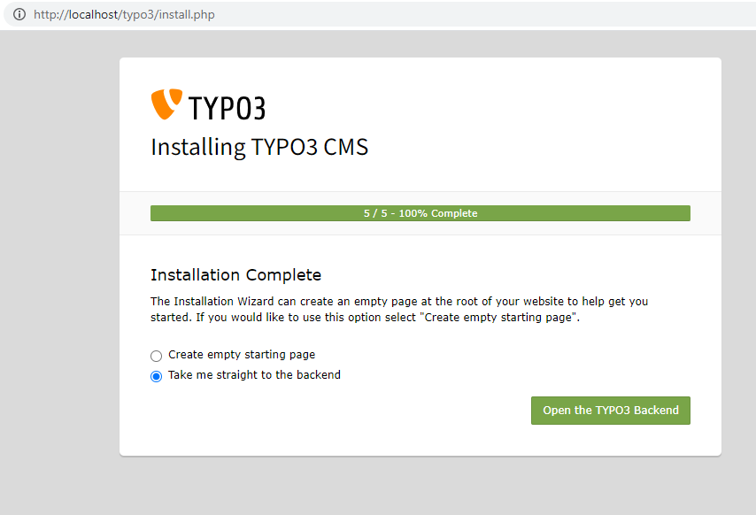
- Admin Tool
Step 5

Slide 19
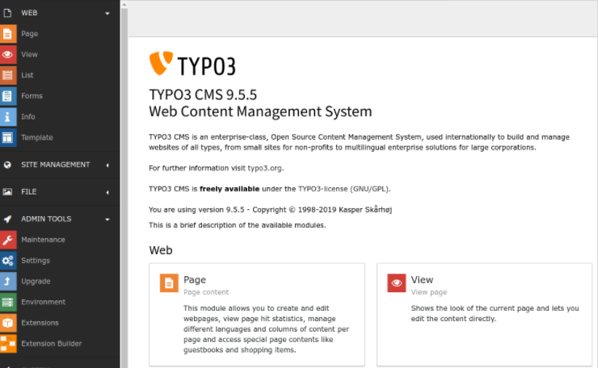

Slide 20
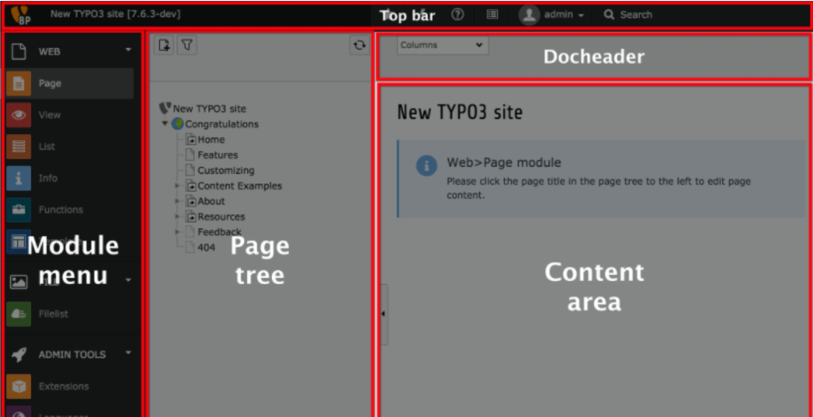
- Backend editing
* Administration of the website
* Elements can be enabled/disabled for given users or groups
* Rich Text Editor

Slide 21
- Frontend editing
* Editing content on directly on the web pages
( must be logged in )
- Templates
* The design of the website is defined by templates
* They are changable
* Own templates using Typoscript
* Templates can be setup and administered in multiple locations on the site.
- Extensions
* Extension manager
* Much extension available
* You can create your own extensions

Slide 22
4. Conclusion
 | Typo3 | WordPress
Trend | TYPO3 is the CMS used by 130, 000 websites. | WordPress is the CMS used by 27,000,000 websites.
purpose | Very suitable for large websites used for companies or businesses. | Very used in personal blogs, small websites, or business websites.
Security | Offers a set of built-in features for security. | Provides its optimal security when the system is updated on regular basis.
Layout structure | TYPO3 organizes the pages in a tree-structure, similar to the folders in a filesystem. | WordPress lists all under pages and blogs
Learning | Difficult to learn and get familiar for Tyopscript. | Don’t need to master any technological tool to add content in your website.

Slide 23
TYPO3 is the right CMS if:
- Your website is organized in a complex structure of pages and sub-pages.
- Your website will be the promotion of your business in many languages.
- There should be data integrated from other sources.
You better choose WordPress if :
- Your website is relatively simple, with some basic features.
- You have a small or a medium budget, and you prefer to manage yourself the website.
- Your website does not need to be in multiple languages.

Slide 24
Thanks

