Slide 1
Amazon S3
( 2020-06-14 )

Slide 2
Overview
Amazon S3
Policies
Settings
Backup DB

Slide 3
What is S3?
Amazon S3
store any amount of data
easy-to-use management features
Store your data in Amazon S3 and secure it from unauthorized access with encryption features and access management tools
stores data for millions of applications for companies all around the world.
Amazon Simple Storage Service (Amazon S3) is an object storage service that offers industry-leading scalability, data availability, security, and performance.

Slide 4
Policies
Policies
Policies
IAM
S3 Bucket

Slide 5
IAM Policies ?
Policies
IAM ( Identity and Access Management ) policies specify what actions are allowed or denied on what AWS resources
(e.g. allow ec2:TerminateInstance on the EC2 instance with instance_id=i-8b3620ec).
You attach IAM policies to IAM users, groups, or roles, which are then subject to the permissions you’ve defined. In other words, IAM policies define what a principal can do in your AWS environment.

Slide 6
Policies
IAM
{
"Version": "2012-10-17",
"Statement": [
{
"Effect": "Allow",
"Principal": {
"AWS": [
"arn:aws:iam::111122223333:user/Alice",
"arn:aws:iam::111122223333:root"
]
},
"Action": "s3:*",
"Resource": [
"arn:aws:s3:::my_bucket",
"arn:aws:s3:::my_bucket/*"
]
}
]
}

Slide 7
S3 Bucket Policies
Policies
S3 bucket policies are a type of access control list.
S3 bucket policies are attached only to S3 buckets.
S3 bucket policies specify what actions are allowed or denied for which principals on the bucket that the bucket policy is attached to (e.g. allow user Alice to PUT but not DELETE objects in the bucket).

Slide 8
Policies
S3 Bucket
{
"Version": "2012-10-17",
"Statement":[
{
"Effect": "Allow",
"Action": "s3:*",
"Resource":
[
"arn:aws:s3:::my_bucket",
"arn:aws:s3:::my_bucket/*"
]
}
]
}

Slide 9
Settings
Settings
Create S3 bucket
Set bucket Policy
...

Slide 10
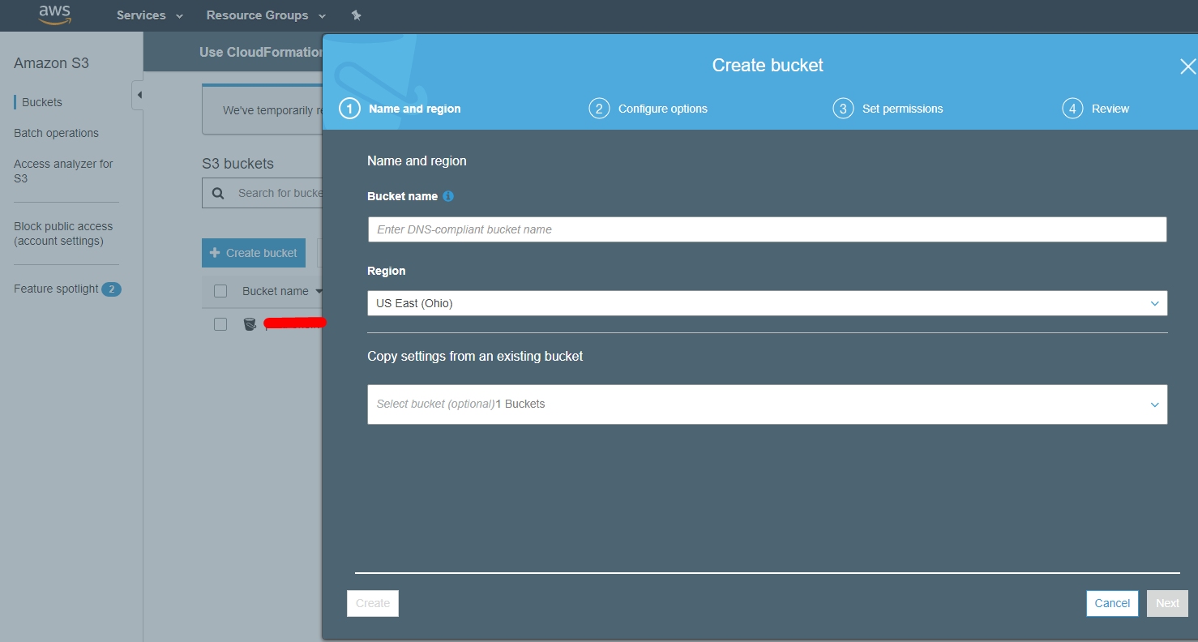
Settings
Policy

Slide 11
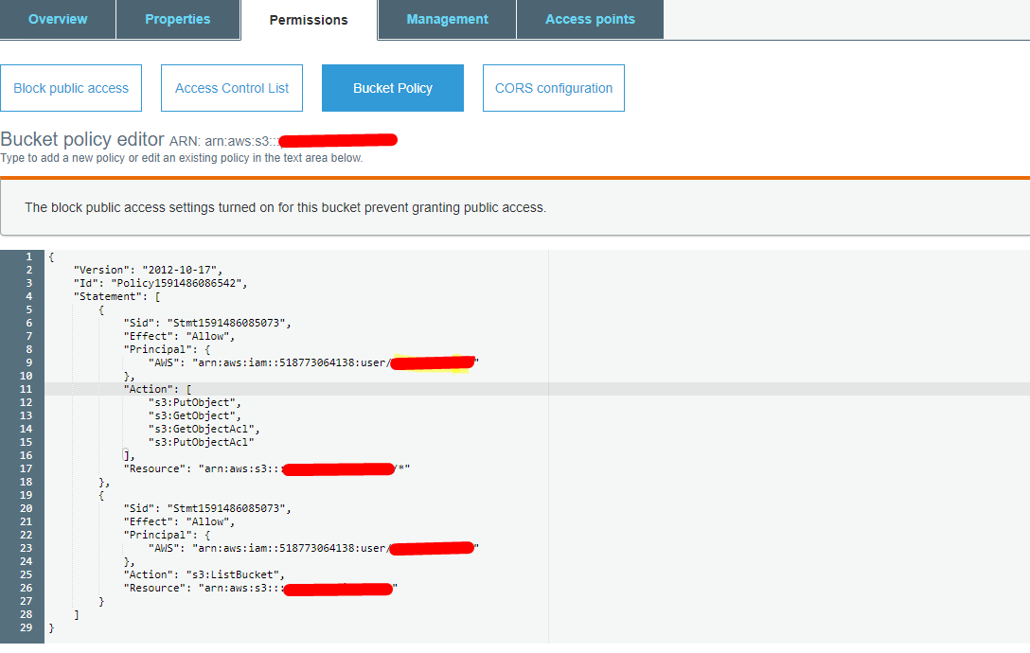
Settings
Policy

Slide 12
Backup DB
Backup DB
Backup DB
Cron Job
Restore DB

Slide 13
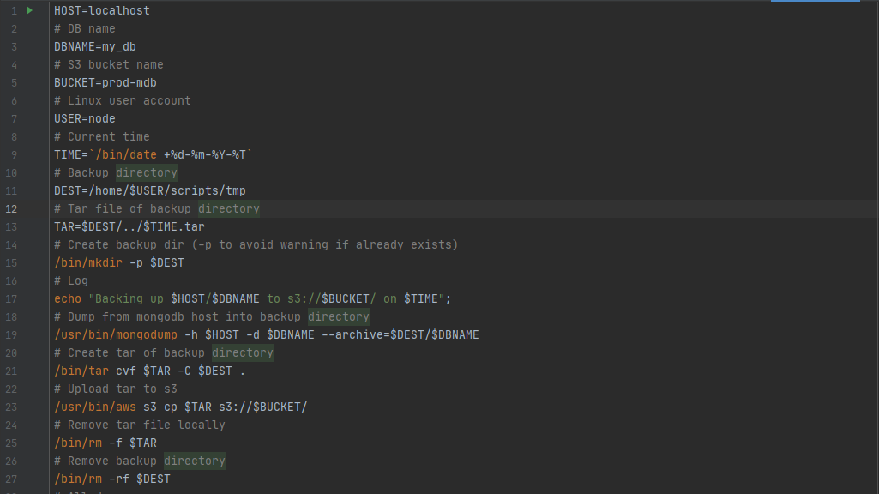
Backup DB
Backup

Slide 14
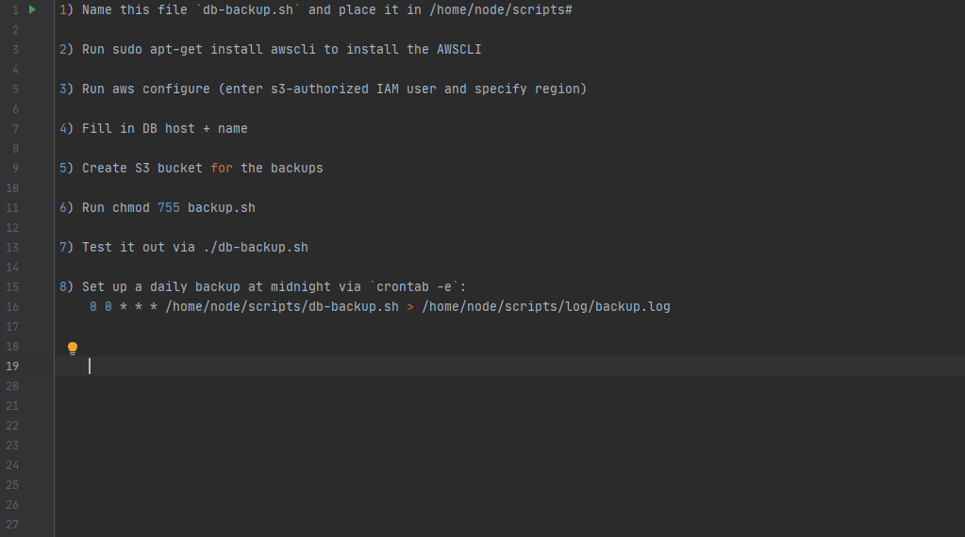
Backup DB
Cron Job

Slide 15
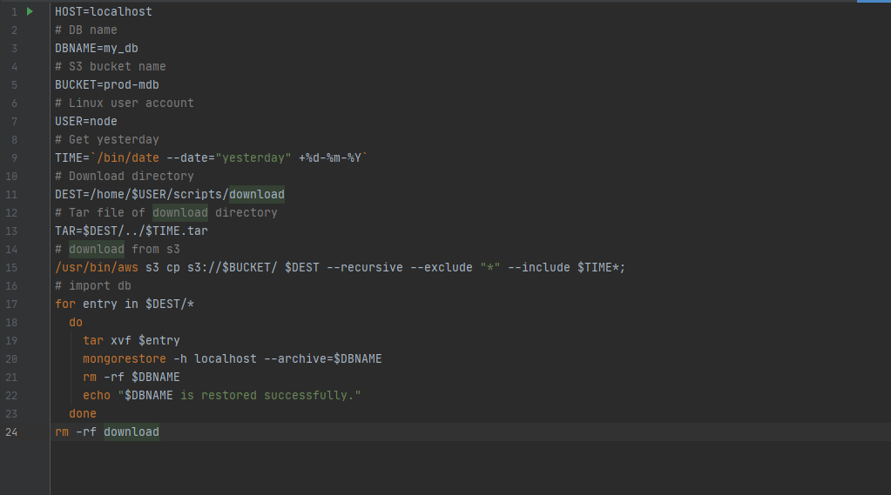
Backup DB
Restore

Slide 16
Thank You

