Slide 1
Cucumber
Development Cucumber-Based Test Automation
2020.09.05

Slide 2
Overview
Concept
Gherkin Syntax
Cucumber Development
Benefits
Test Automation

Slide 3
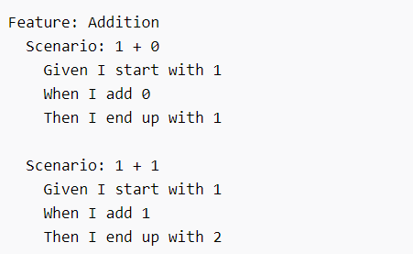
Concept - Cucumber
What is Cucumber?
Cucumber is a high-level testing framework that supports BDD (Behavior Driven Development)
Cucumber is a tool that executes plain-text functional descriptions as automated tests. Cucumber uses Gherkin language/rule.
Released stable version 3.1.2 on July 13, 2018

Slide 4
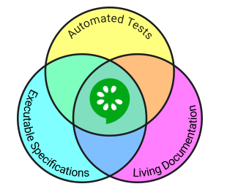
Concept - Gherkin
What is Gherkin?
Gherkin is a set of grammar rules that makes plain text structured enough for Cucumber to understand.
Purposes:
- Unambiguous executable specification
- Automated testing using Cucumber
- Document how the system actually behaves
Gherkin documents are stored in .feature text files

Slide 5
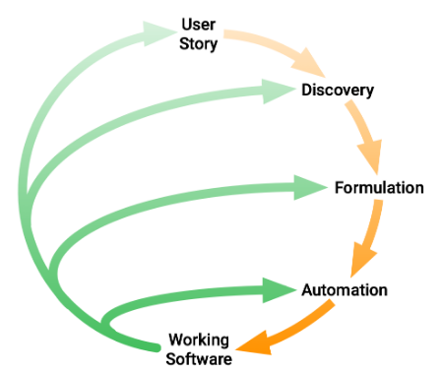
Concept - Behaviour-Driven Development (BDD)
What is BDD?
BDD is a way for software teams to work that closes the gap between business people and technical people
Essential process of BDD activity:
Explore, discover and agree functionalities on the details of what’s expected to be done.
Document those examples in a way that can be automated
Implement the behaviour described by each documented

Slide 6
Gherkin Syntax
Scenario
Scenario is a test case
Scenario many steps as you like, but we recommend you keep the number at 3-5 steps
Steps
Each step starts with Given, When, Then, And, or But
Given are used to describe the initial context of the system
When are used to describe an event or an action
Then are used to describe an expected outcome or result
And, But are used as additional test constructs
Background
Repeat steps in front of every scenarios

Slide 7
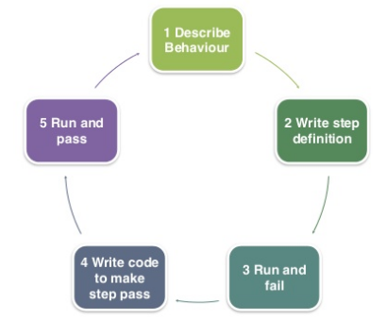
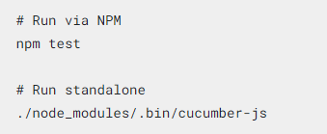
Cucumber Development
Installation
Development process
Run

Slide 8
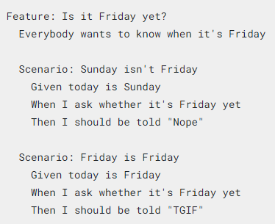
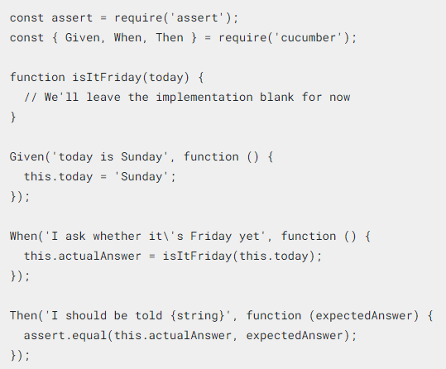
is_it_friday_yet.feature
step_definitions.js

Slide 9
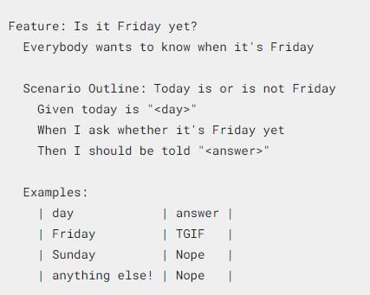
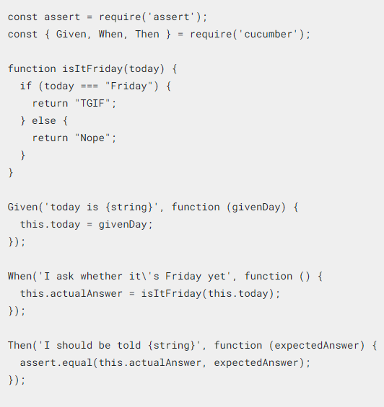
is_it_friday_yet.feature
step_definitions.js

Slide 10
What are the benefits?
Helpful to involve business team members who can’t easily read code
Cucumber focuses on end-user experience
Style of writing tests allow for easier reuse of code in the test
Write a human-readable user story, instead of writing your tests purely in code
Intuitive BDD implementation

Slide 11
Test Automation
Why automation?
Manual testing of all workflows, all fields and all negative scenarios is time and cost consuming
Automation does not require human intervention
Increases speed of test execution
Increate test coverage
Manual testing can become boring and hence error prone

Slide 12
Test automation with cucumber
Browser test automation with Selenium WebDriver
Selenium-WebDriver was developed to better support dynamic web pages where elements of a page may change without the page itself being reloaded.
WebDriver’s goal is to supply a well-designed object-oriented API that provides improved support for modern advanced web-app testing problems
WebDriver is designed as a simple and more concise programming interface.
It drives the browser effectively.

Slide 13
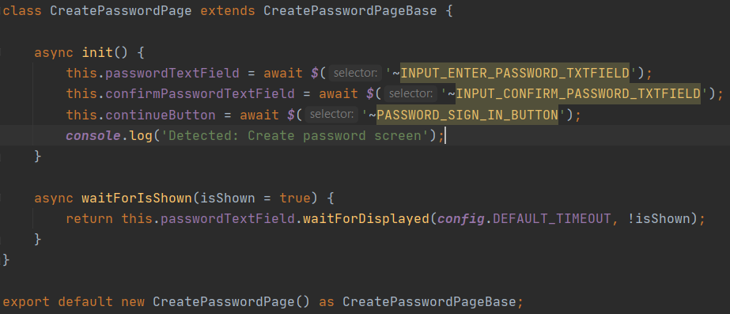
create_password_page.ts
step_definitions.ts

Slide 14
Thank You

