Slide 1
WSL (Windows Subsystem for Linux)
2021.03.28

Slide 2
What is WSL?
Why use WSL?
Compare WSL/WSL2
Installation

Slide 3
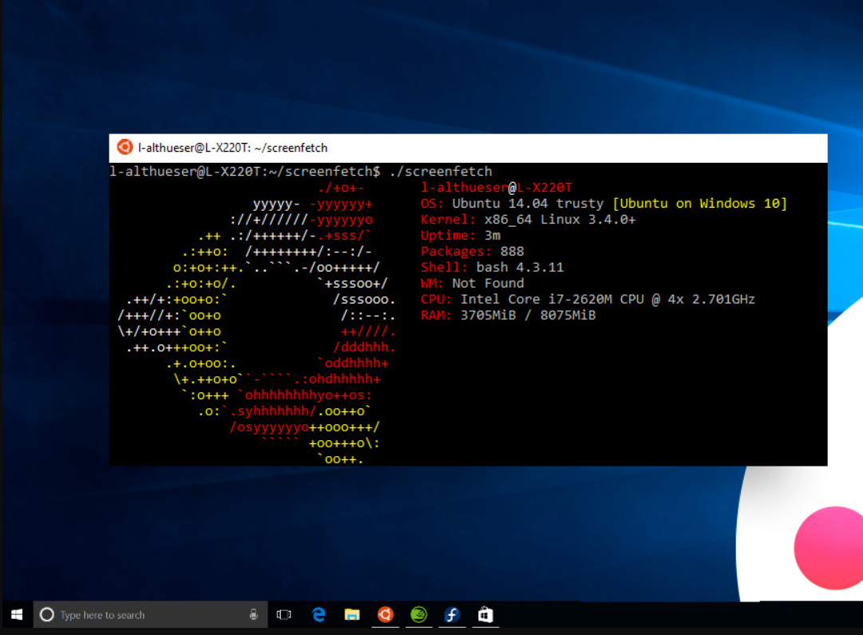
What is WSL?
- A feature of Windows 10 that enables you to run native Linux command-line tools directly on Windows.
WSL is a tool aimed at enabling users who need them to run Bash and core Linux command-line tools on Windows.
WSL does not yet support GUI desktops or applications (e.g. Gnome, KDE, etc.)
WSL supports x64 and ARM CPUs

Slide 4
Why would I use WSL rather than Linux in a VM?
Allows you to run Linux command-line tools and apps along side your Windows command-line, desktop and store apps, and to access your Windows files from within Linux.
Requires fewer resources (CPU, memory, and storage) than a full virtual machine.

Slide 5
Who is WSL for?
For developers, especially web developers, working on open source projects, or deploying to Linux server environments.
For anyone who likes using Bash, common Linux tools (sed, awk, etc.) and Linux-first frameworks (Ruby, Python, etc.) but also enjoys using Windows productivity tools

Slide 6
Compare WSL vs WSL 2
What is WSL 2?
New version of the WSL architecture that powers the Windows Subsystem for Linux to run ELF64(Executable and Linkable Format) Linux binaries on Windows
Its primary goals are to increase file system performance, as well as adding full system call compatibility
Uses an entirely new architecture
Work with VMware 15.5.5+ and VirtualBox 6+
Only available in Windows 10, Version 1903, Build 18362 or higher

Slide 7
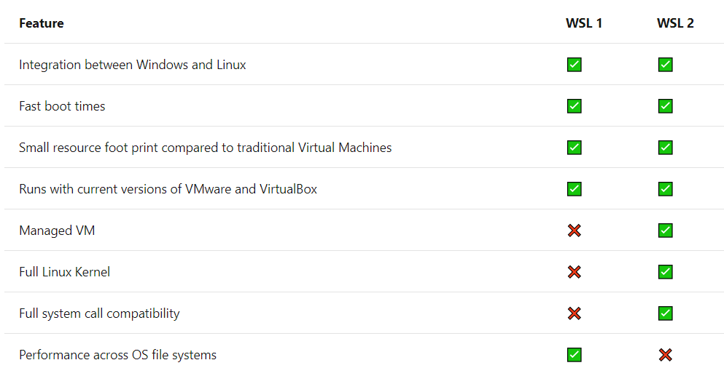
Compare WSL vs WSL 2

Slide 8
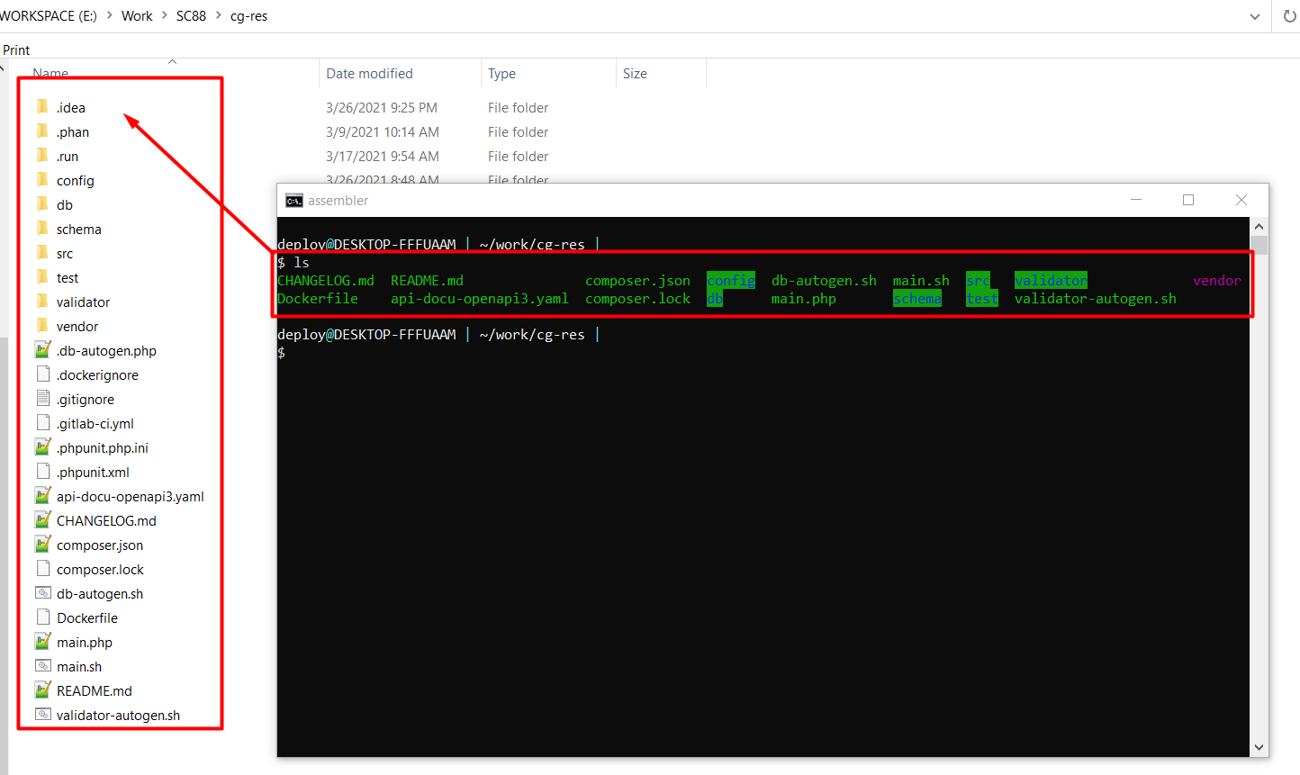
Exceptions for using WSL 1 rather than WSL 2
- Your project files must be stored in the Windows file system.
If you access project files on the Windows file system, and these files cannot be stored on the Linux file system

Slide 9
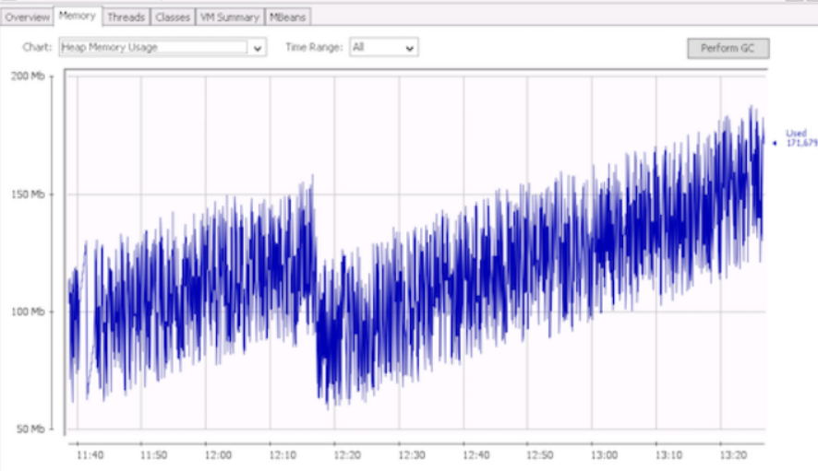
Exceptions for using WSL 1 rather than WSL 2
- You have strict memory requirements
WSL 2's memory usage grows and shrinks as you use it.
If you have long running WSL sessions, or access a very large amount of files, this cache can take up memory on Windows.

Slide 10
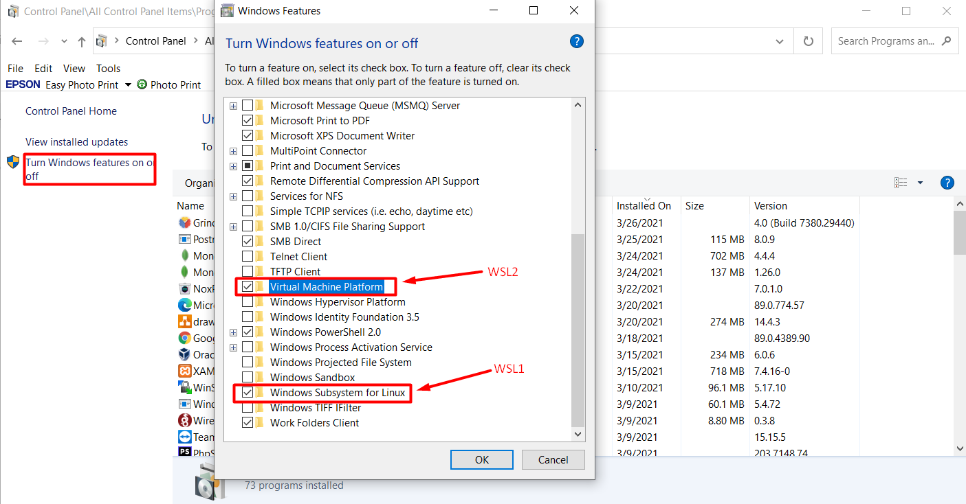
Set up WSL
Step 1 - Enable the Windows Subsystem for Linux
dism.exe /online /enable-feature /featurename:Microsoft-Windows-Subsystem-Linux /all /norestart

Slide 11
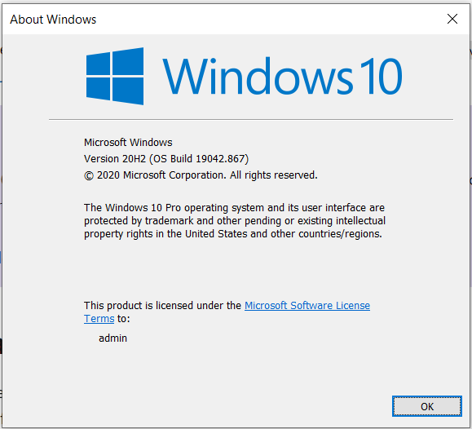
Set up WSL
Step 2 - Check requirements for running WSL 2
For x64 systems: Version 1903 or higher, with Build 18362 or higher.
For ARM64 systems: Version 2004 or higher, with Build 19041 or higher.
Builds lower than 18362 do not support WSL 2.

Slide 12
Set up WSL
Step 3 - Enable Virtual Machine feature
dism.exe /online /enable-feature /featurename:VirtualMachinePlatform /all /norestart

Slide 13
Set up WSL
Step 4 - Download the Linux kernel update package
Download and install the latest package:
https://wslstorestorage.blob.core.windows.net/wslblob/wsl_update_x64.msi
Step 5 - Set WSL 2 as your default version
wsl --set-default-version 2

Slide 14
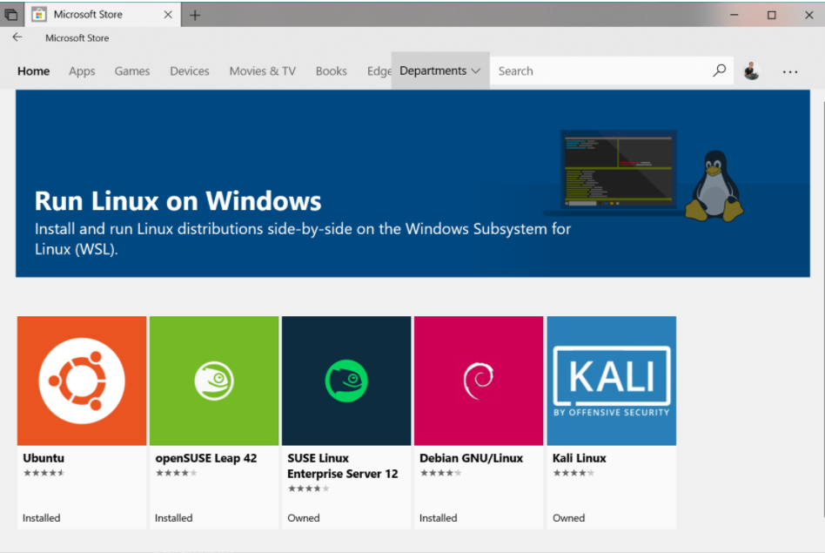
Set up WSL
Step 6 - Install your Linux distribution of choice
The first time you launch a newly installed Linux distribution, you will then need to create a user account and password for your new Linux distribution.

Slide 15
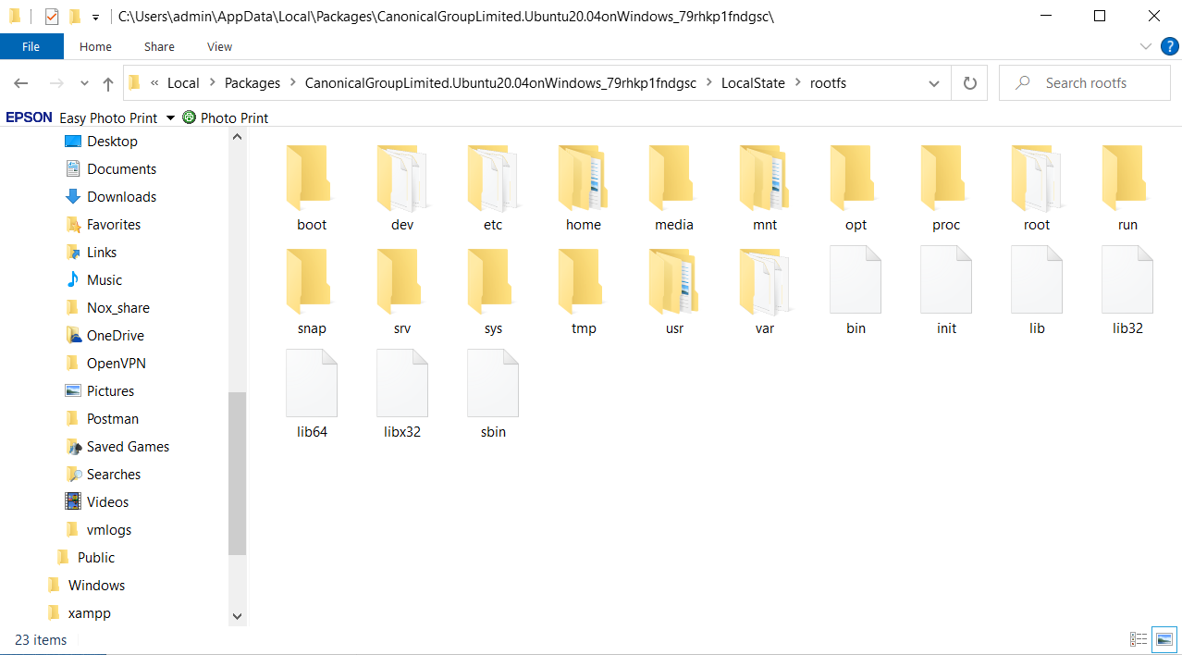
The real path of Linux OS

Slide 16
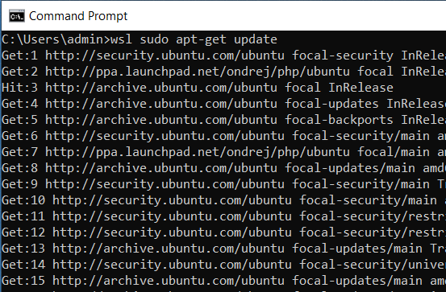
Simple Usage
> wsl ls –la
> wsl sudo apt-get update

Slide 17
Thanks!
ANY QUESTIONS?
You can find references:
https://docs.microsoft.com/en-us/windows/wsl
https://wiki.ubuntu.com/WSL

