Slide 1
Hasura - Instant GraphQL APIs for your data
2021.05.30

Slide 2
Overview
Basic Concepts
Development
Installation
Hasura Console UI
Available APIs
Actions
Pros & Cons

Slide 3
Concept
Hasura?
An open source GraphQL engine that deploys instant, realtime GraphQL APIs on any Postgres database
Hasura is a tool in the Platform as a Service
Released on Feb 2017
Built with Haskell
Work with PostgreSQL
GraphQL engine
CLI and Web UI

Slide 4
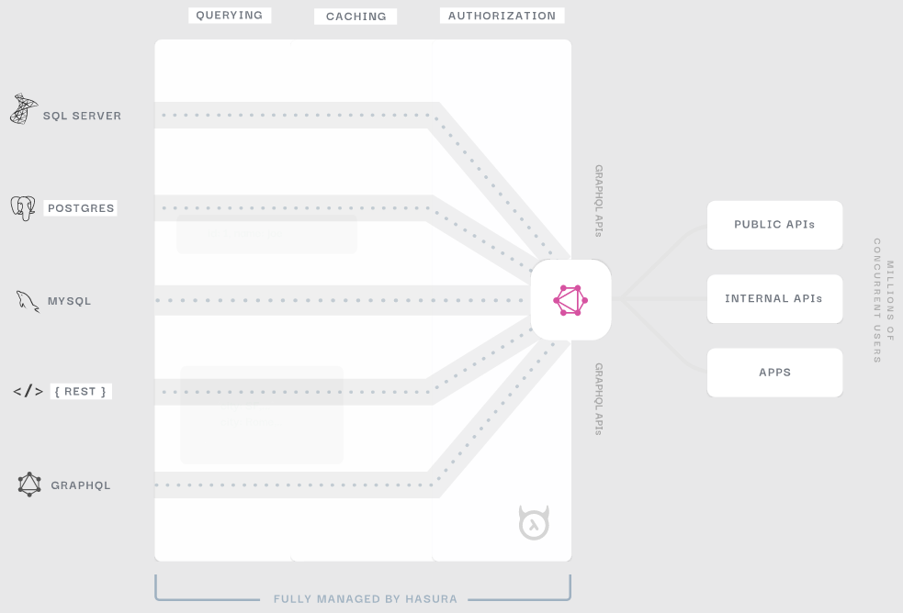
How it works

Slide 5
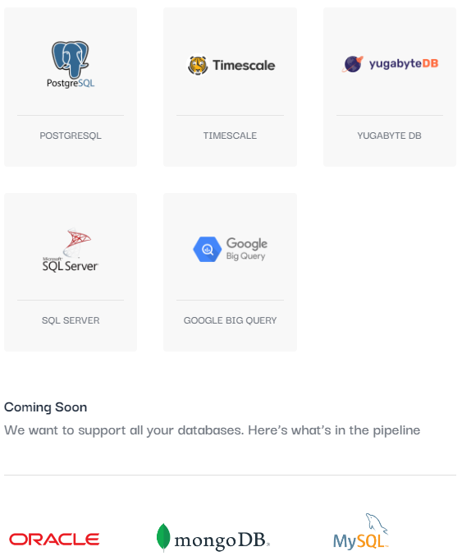
Auto-generate GraphQL and REST APIs for your data

Slide 6
Development

Slide 7
Installation (1)
Step 1: Get the docker-compose file
Download docker-run.sh file
$ wget https://raw.githubusercontent.com/hasura/graphql-engine/stable/install-manifests/docker-compose/docker-compose.yaml
Step 2: Run Hasura GraphQL engine & Postgres
Edit the docker-run.sh file
docker run -d -p 8080:8080 \
-e HASURA_GRAPHQL_DATABASE_URL=postgres://<username>:<password>@host.docker.internal:<port>/<dbname> \
-e HASURA_GRAPHQL_ENABLE_CONSOLE=true \
-e HASURA_GRAPHQL_ADMIN_SECRET=<myadminsecretkey> \
hasura/graphql-engine:latest

Slide 8
Installation (2)
Step 3: Run the Hasura Docker container
Execute docker-run.sh and check if everything is running well:
$ ./docker-run.sh
$ docker ps
CONTAINER ID IMAGE ... CREATED STATUS PORTS ...
097f58433a2b hasura/graphql-engine.. ... 1m ago Up 1m 8080->8080/tcp ...
Step 4: Open the Hasura console
Open this url in the browser
http://localhost:8080/console

Slide 9
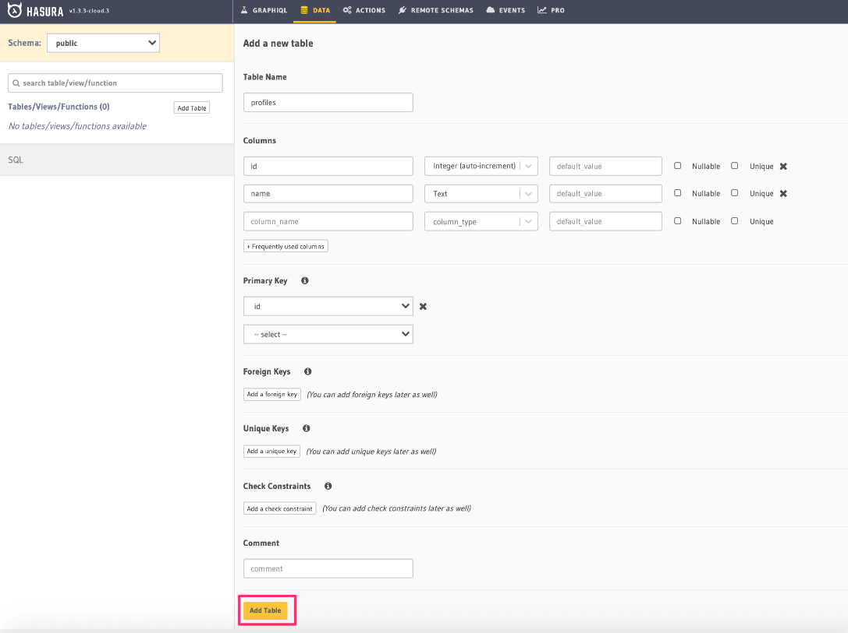
Hasura UI

Slide 10
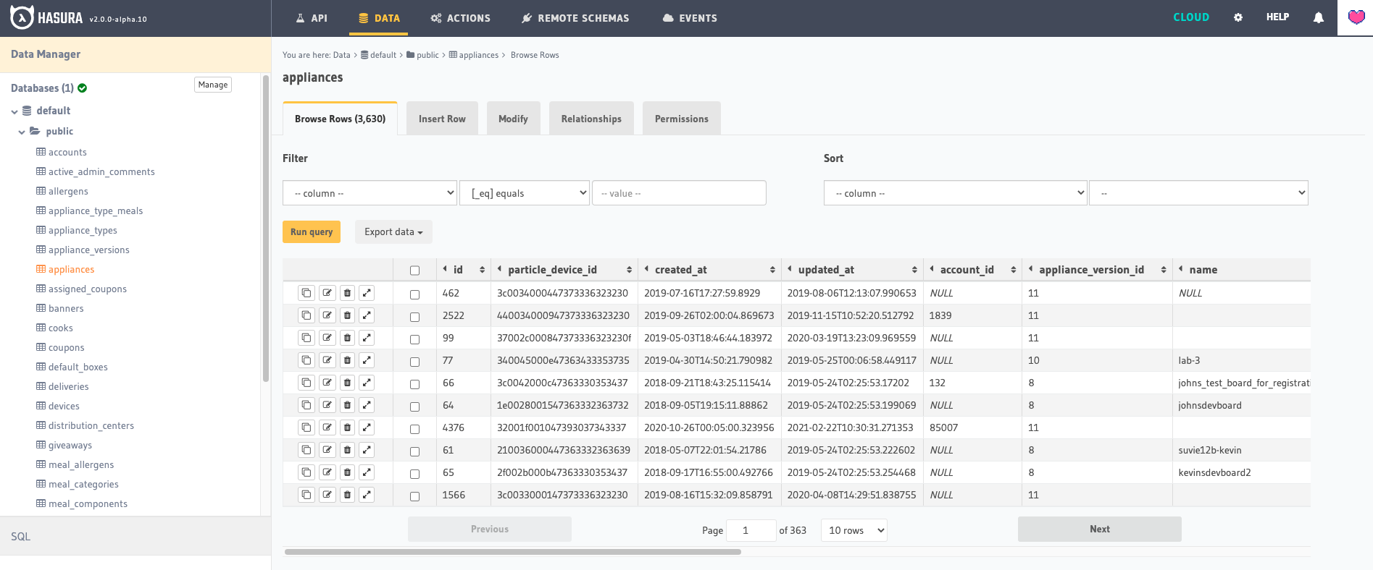
Hasura UI

Slide 11
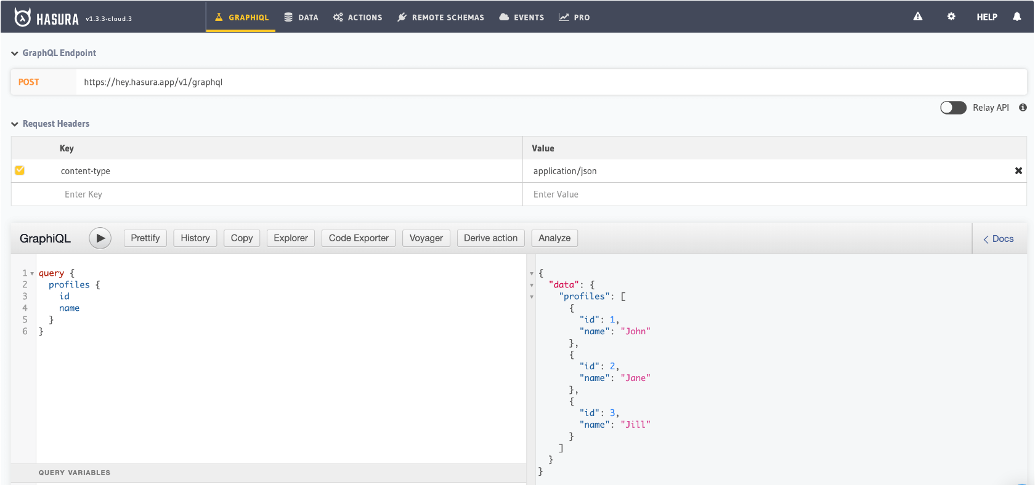
Hasura UI

Slide 12
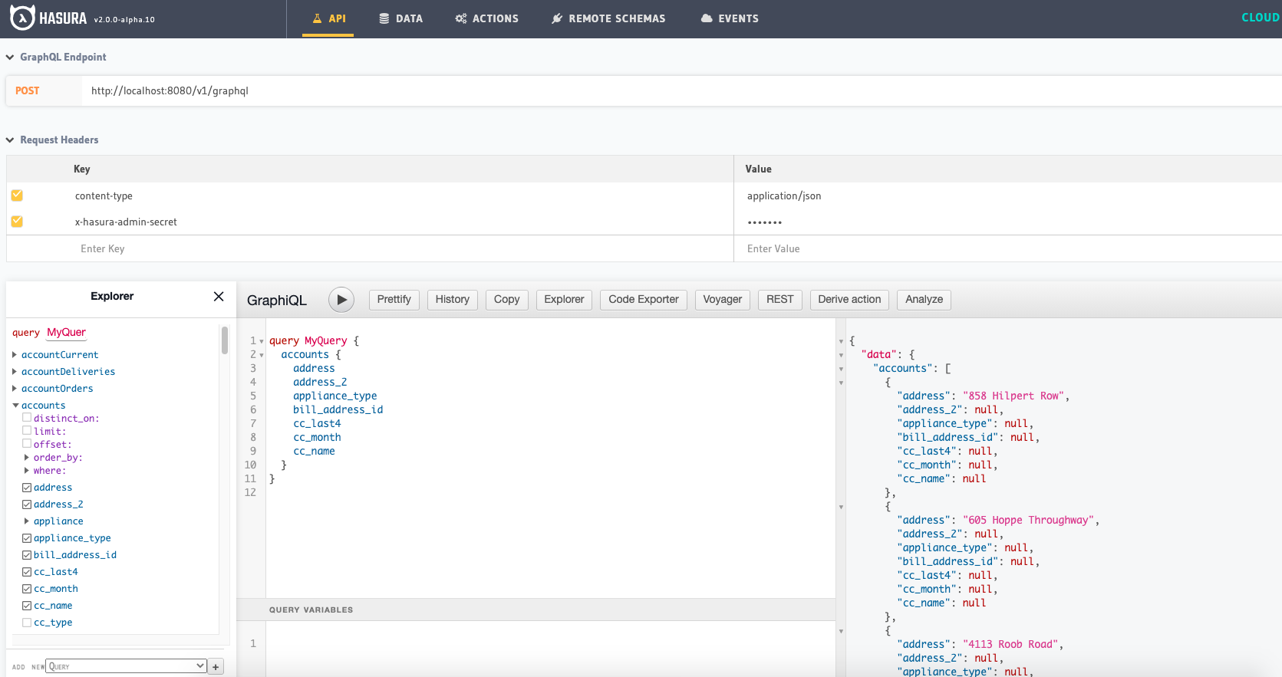
Hasura UI

Slide 13
APIs
API | Endpoint | Access
GraphQL | /v1/graphql | Permission rules
Relay | /v1beta1/relay | Permission rules
Legacy GraphQL | /v1alpha1/graphql | Permission rules
Schema (> v2.0) | /v2/query | Admin only
Metadata (> v2.0) | /v1/metadata | Admin only
Schema/Metadata (< v1.3) | /v1/query | Admin only
Restified GQL | /api/rest | GQL REST Routes
Version | /v1/version | Public
Health | /healthz | Public
PG Dump | /v1alpha1/pg_dump | Admin only
Config | /v1alpha1/config | Admin only
Explain | /v1/graphql/explain | Admin only

Slide 14
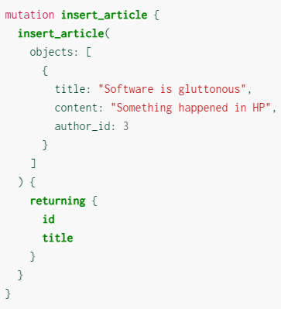
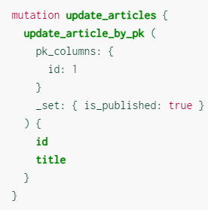
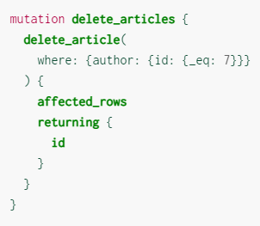
GraphQL API

Slide 15
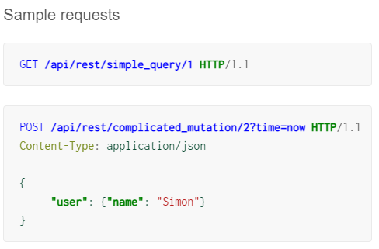
RESTified API
Requests are made to /api/rest/** endpoints.
By default these are:
- GET, POST requests for queries, and
- POST requests for mutations

Slide 16
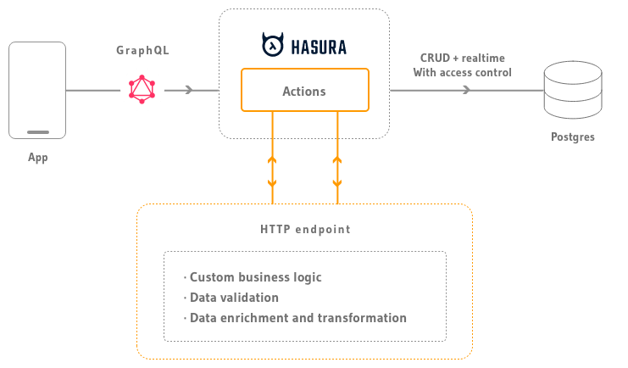
Actions
Actions are a way to:
- Extend custom business logic using custom queries and mutations
- Handle data validation, data enrichment from external sources

Slide 17
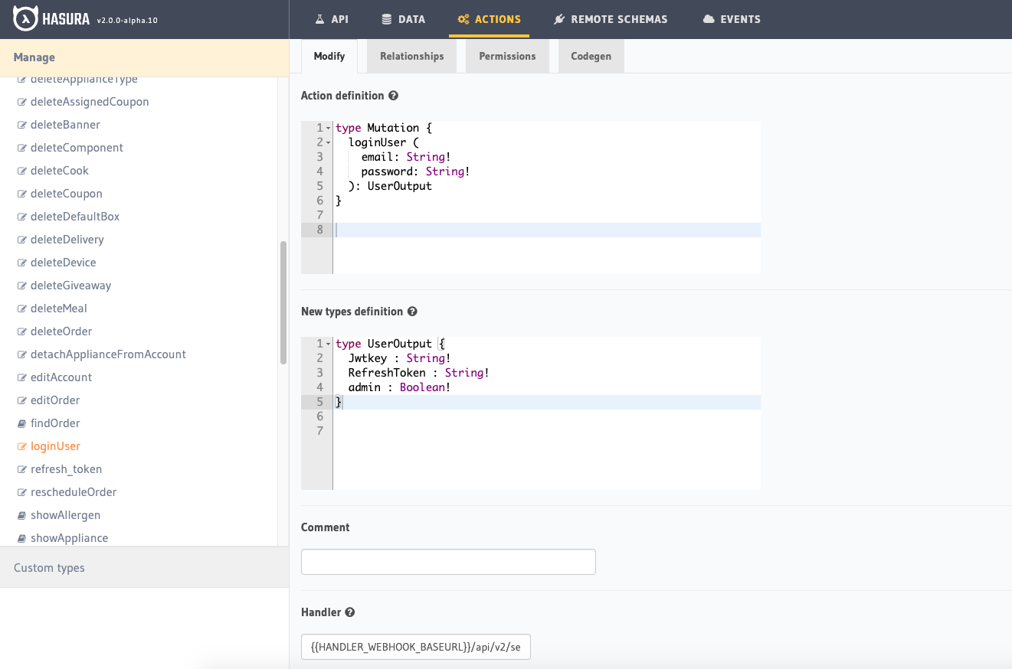
Actions

Slide 18
Pros & Cons

Slide 19
Pros
- Easy set up with docker-compose
- Basic + Advanced CRUD by GraphQL
- Benefit of Actions
- Websockets on table data
- Scheduled tasks and CRON

Slide 20
Cons
- Not an NPM library
- Only Postgres DB
- Relay is released as alpha
- Can’t insert related data as a transaction
- Doesn’t support group by

Slide 21
Thank you
References
- Official documentation:
https://hasura.io/docs/latest/graphql/core/index.html
- Github
https://github.com/hasura/graphql-engine/

